Slide 1
Polyglot Programming – How to do It right ? (Knowingly)
Praseed Pai KT
Sr. Solutions Architect
Gadgeon Smart Systems Pvt Limited
Kochi, India

Slide 2
About the Presenter
A Seasoned Software Engineering Professional with more than twenty five years of Exposure
Author of Two books on Computer Programming
Explorer in “Philosophical Tools for Software Engineering” ( Has Presented on it, Written one university accredited paper, Designed a Pattern based on Advaita Vedanta to transition from OOP to FRP)
An Expert level professional in Cross Cultural Encounters
A Critique of Digital Technology Fads ( Programmers will be better off , if they stick to Programming. Do not run after so called AI/ML, BlockChain etc ) - “Plumbing is preferred over Painting!”
Has Presented in more than three hundred sessions in the past twenty five years
I also help Programmers eliminate their “Math-Phobia”
Currently designated as “Sr. Solutions Architect @ Gadgeon”

Slide 3
Gist of the Presentation
Polyglot - The term and it’s meaning
Poly-this,Poly-that --- How do u make sense of it?
Programming – Formal Models/Paradigms/Compilation/Expressive Power/Intent specification ( How to view PL landscape?)
Encoding Architecture/Design/Models/Techniques in a Language Agnostic Manner.
How to Transfer Ontology/Idioms/Patterns/Style from One language to another?
Pragmatics of working as a Polyglot Professional
Anecdotes/Case Studies/Stories/Events which mandated Polyglot development.

Slide 4
Putting things into Context

Slide 5

Let us meet Kato Lomb!

Slide 6
Q&A with Kato Lomb
Question: Is it possible to know 16 languages?
Answer: No, it is not possible—at least not at
the same level of ability. I only have one mother
tongue: Hungarian. Russian, English, French,
and German live inside me simultaneously with
Hungarian. I can switch between any of these
languages with great ease, from one word to
another.
Translating texts in Italian, Spanish, Japanese,
Chinese, and Polish generally requires me to
spend about half a day brushing up on my
language skills and perusing the material
to be translated.
The other six languages [Bulgarian, Danish,
Latin, Romanian, Czech, Ukrainian] I know
only through translating literature and
technical material.
Question: Why haven’t you chosen a career in
foreign language teaching?
Answer: In order to teach, it is not enough
to have mastered a whole army of languages.
To look it at another way, surely there are
many unfortunate people who have needed to
undergo multiple stomach surgeries. Yet no
one would hand a scalpel over to them and ask
them to perform the same surgery they received
on another person, simply because they themselves
had undergone it so often.If those individuals
who conduct surveys and polls had a sense of
humor when asking us our occupations, my answer
would be “language learner.”
Question: Does one need an aptitude to learn
so many languages?
Answer: No, it is not necessary. Aside from mastery in the fine arts, success in learning anything is the result of genuine interest and amount of energy dedicated to it. In my own experience learning
languages, I have discovered many useful principles. This book outlines them for you.
I wish to acknowledge that my achievement in languages
is due to my collaborators over the years, known and unknown. This book is dedicated to them.

Slide 7
Why we (Indians) are natural Polyglots?
Before I move into the techniques , I would like to write a word of encouragement for Indians. We have got "polyglot" gene ( ala "math gene" ), embedded inside us because of the multilingual environment we are in. An average Indian , will master at least three languages A) Native Tongue (Malayalam,Tamil,Kannada,Oriya etc) B) English ( Lingua franca of the world ) C) Hindi ( being the national language ) Only exceptions are people in Hindi Heartland , where they might learn only two (Hindi/English)
In the case of Keralites, Tamil as an additional language by virtue of Tamil Film Industry. A person like me will have one more tongue as I speak Konkani at home. Additionally,I have studied Japanese ( Hiragana, Katakana and 150 words of Kanji ) Can an Indian afford to say that he will speak only one language ? So,becoming polyglot in natural languages is natural for us. Why cannot we extrapolate this instinct into Programming languages ? (

Slide 8
A Word of Caution!
“Most people consider spending time on learning
additional programming language is a waste of time.
In the name of focus, some headhunters do reject
people with skills in multiple languages and
technologies. Those are "political" problems which
this series do not consider. The topics are dealt
at a cognitive level over here”
- Praseed Pai (from the blog,”Analysis leads to Paralysis”)

Slide 9
Whet your appetite

Slide 10

Comparative Study of Programming Languages
In India, it is like this, I do not know how it is in Punjab?
- Punjabi House

Slide 11
Programming Languages – A Model Driven Reality
By Formal Models – Turing Machine/Lambda Calculus/Predicate Logic based Languages
By Typing – Static/Dynamic and Type annotation based languages
By Expressive Power – Turing Complete and Otherwise languages
By Compilation Strategy – Compiled/Semi-Compiled and Quasi Compiled ( Interpreted languages)
By Programming Paradigms – Procedure/Functional/Logic/Object Procedural/Object Functional
By Intent specification – Declarative vs Procedural

Slide 12
A Tactical Approach towards Learning Multiple Languages
Hello Script in Python/Java/Ruby
Maintain a Text File of Executable Code snippets
Pros
A Bootstrapping Strategy
A Handy Tool for “Assembling” Code very fast
Please your boss!
Cons
Too much Axiology driven
Cannot exploit deeper synergies between languages

Slide 13
Let’s Jump into the Water!
A Straight Line Program which accepts a list of numbers as command line arguments and sort them, to print to the Console
Implementation in Java/C#/Python/JS
Improving the above program by Data Parametrization
Implementation in Java/C#/Python/JS
Improving the above program by adding Type Parametrization
Implementation in Java/C#/Python/JS
Improving the above program by adding Behaviour Parametrization
Implementation in Java/C#/Python/JS

Slide 14
An Unusual story of JavaScript

Slide 15
A “Story” Of JavaScript
A Programmer was asked by his “boss” (in 1995) to design a language with following attributes
Simple
Modern
To be used by Casual Programmers
Embeddable inside a Browser
A Choice made by that programmer had deep consequences and resulted in “grotesque” language for those times.
Years later, when processing power improved, that language morphed into a “ubiquitous language”

Slide 16
Simple means “Dynamic Typing”
Bane of newbies is “Static Typing”
Brendon Eich chose Dynamic Typing

Slide 17
Modern means “OOP (in 1995)”
Three Kinds of OOP
Class based OOP
Actor based OOP (Event based)
Prototype OOP
Class based OOP is apt for Static Typing
Actor based OOP might result in “Event Cacophony”
The only choice available is “Prototype OOP”
Prototype treats Objects as dictionary
How to reduce a class to Key/Value dictionary?
What constitutes a class?
Static and Instance variables & Static and Instance methods

Slide 18
How to reduce a class into dictionary?
Variables can be mapped into key/value
Static variables can be mapped into key/value in prototype
Reference to Static Map is placed inside each Object
How to reduce Method to Key/Value?
We need a paradigm which treats Method/Function as value
Functional Programming fits the Bill
Support for functional programming was added to support prototype OOP

Slide 19
An Unusual story of JavaScript

Slide 20
Let us Discuss these Three Things
What is the primary difference between Stored Procedure and a Stored Function in the case of RDBMS Software?
Have u Come across a Declarative Language in an Imperative Language and Vice Versa ?
Please name a Reference Type which obeys value semantics in Java and C#?

Slide 21
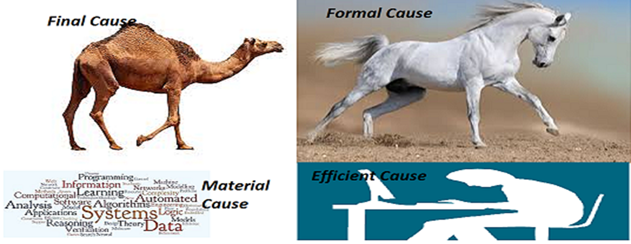
Perils of Polyglot Programming

Slide 22
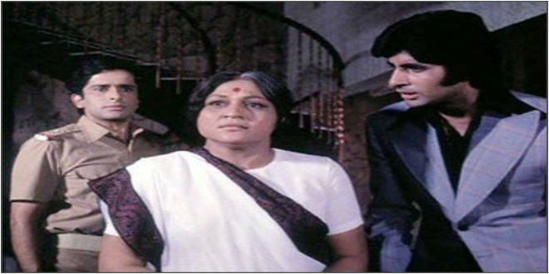
Which Language is important?
Aaj mere paas building(C++) hai, property(C#) hai ,
bank balance (Java) hai, bungla(Python) hai,gaadi hai(PHP)
Kya hai, Kya hai tumhare paas?
....Mere Paas Maa (JavaScript) hai

Slide 23
Programming Paradigms

Slide 24
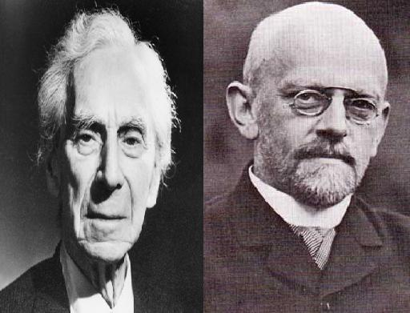
Who are they ?

Slide 25
A Tale of two mathematicians
Bertrand Russell and David Hilbert spear headed a plan to reduce entire mathematics to Logic.
Hilbert’s 23 problems
Bertrand Russell and Alfred north Whitehead’s Principia Mathematica.
Barber Paradox – The Quagmire

Slide 26
Entscheidungsproblem
Decision problem
The problem of algorithmically determining whether a First Order Logic statement is universally valid
First Order Logic – Propositional Calculus + Predicate Calculus

Slide 27
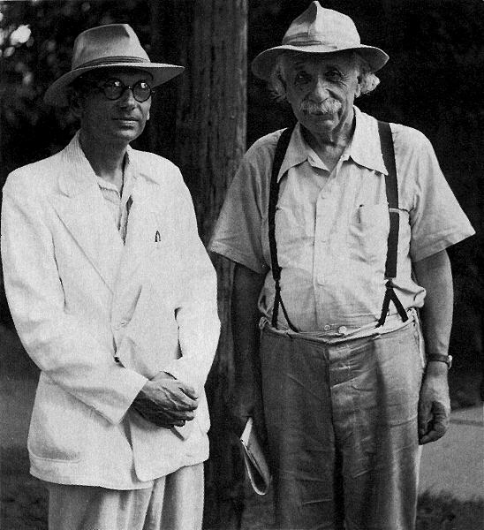
Who are they ?

Slide 28
KURT GODEL
Austrian Logician who proved the incompleteness theorem
Mathematics is not consistent ?
Demoralizing for the whole world
Return of the “GOD” ?

Slide 29
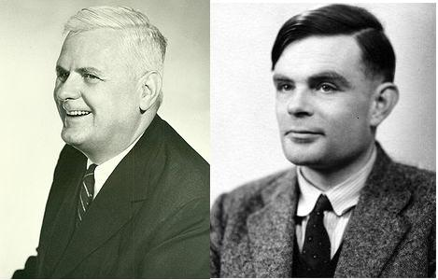
Hilbert's Scheme got broken

Slide 30
The BY-PRODUCT
Alonzo Church invented Lambda Calculus
Turing came up with the concept of Turing Machine
They were trying to solve the decision problem in the Predicate Calculus
Both Failed in finding an algorithmic procedure for the decision problem.
( Some stuff is not computable ! )‏

Slide 31
Why Should I care ?
Turing Machine , Lambda Calculus and Predicate Logic forms the basis of three widely used programming paradigms in the world.
All paradigms are getting converged in modern programming languages like C# and Java.

Slide 32
Three Programming Paradigms
Imperative Programming using C/C++,Java,C#,Perl and Visual Basic etc.
Turing Machine is the foundation.
Functional Programming using LISP,Scheme,ML,Haskell,Miranda etc.
Lambda Calculus is the foundation
Logic Programming using Prolog.
Based on Predicate Calculus

Slide 33
Imperative Programming
Command Oriented Programming.
Statement Oriented
Function is what u evaluate for it’s value and statement is what u execute for it’s effect.
X= X + 1 can give shiver to any person when he encounters it for the first time.

Slide 34
Functional Programming
Function as the unit of computation.
Functions can be composed arbitrarily
How can I write programs without Loop ?
Recursion is a good substitute.
Referential Transparency of the functions
Controlled manipulation of state is necessary for the real world.

Slide 35
Logic Programming
Declarative Model of computation
Logical Deduction is a medium for computation.
Has got good support for parallelism.
Heavy use of recursion and Depth first search.
Used in writing Huerisitics based programs.

Slide 36
Algorithms & it’s complexity!

Slide 37
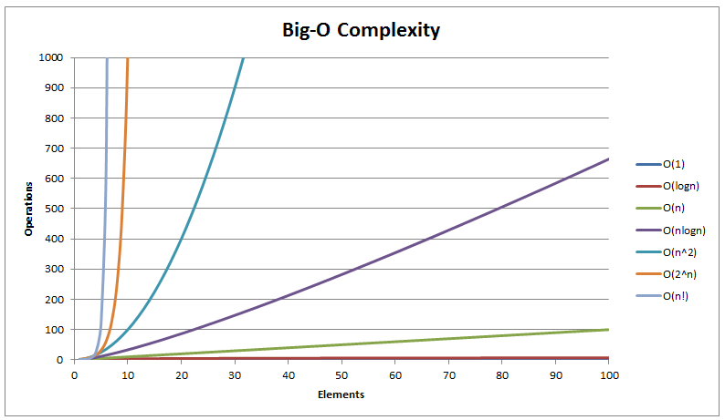
Algorithmic Complexity

Slide 38
Two Programs to demonstrate Intractibility
Permuation
SubSet
Data set generation

Slide 39
Algorithmic Landscape
After you have tried If/else/while/select/update programming Linear/Quadratic complexity algorithms Patented algorithms Heuristics based solutions Approximate Solutions Stochastic solutions All of the above are control path programming. When these fail you can opt for Machine learning based solutions which will reason based on data.

Slide 40
Linear Algebra through Programming

Slide 41
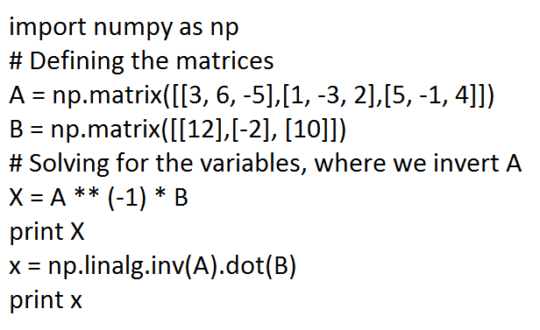
Learn Matrix Algebra through Python

Slide 42
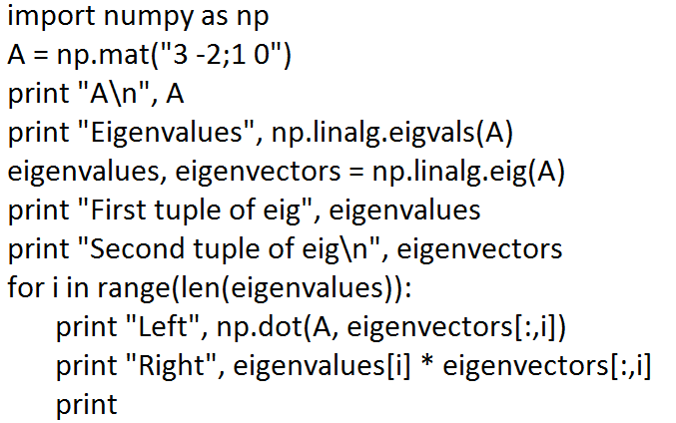
Eigen Value – Python Code

Slide 43
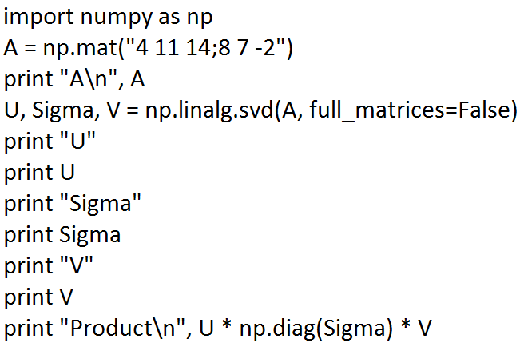
SVD

Slide 44
Going Native! & Interfacing with it!

Slide 45
Native Code Programming
Compile/Link/Load cycle under Windows and POSIX
Static Linking of libraries
How to Create DLLs and Shared Objects (.so) in Windows and GNU Linux ?
32 bit vs 64 bit DLLs
Three Ways to invoke DLLs/Sos in Windows and GNU Linux
Linking with import library ( Loaded at the Load time of the executable)
On the fly loading of the DLL

Slide 46
Mixed Language Programming
How to invoke native code libraries?
Invoking native libraries written in C/C++ from C#
Invoking native libraries written in C/C++ from Java
Invoking native libraries written in C/C++ from Python
Importance of Mixed Language Programming
Jython and Jruby – Two case studies

Slide 47
How to Exploit Synergy between JVM and CLR!

Slide 48
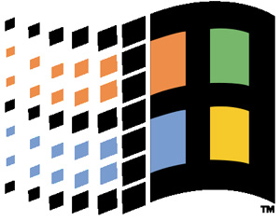
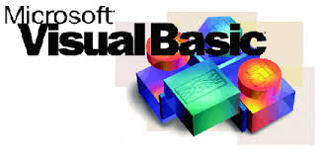
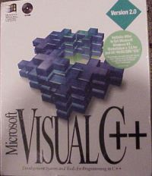
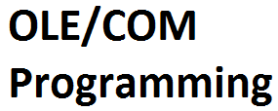
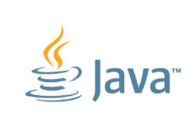
Circa 1995
Redmond, Seattle

Slide 49
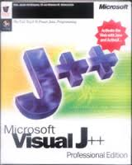
Circa 1997

Slide 50


Legal Battle
Visual J++ compiler became the fastest Java compiler. The compiler was written by a team headed by Anders Hejlsberg, who also Wrote Borland’s Object Pascal (Delphi) compilers
Microsoft brought J/Direct as a competitor to JNI for COM objects
Java had it’s own distributed Programming Model based on RMI, EJB ( RMI/IIOP) and support for CORBA
Microsoft did not comply to JCP process and JSR
Sun sued and won the battle against Microsoft.
VS

Slide 51
How Java upstaged Visual C++/VB/COM?
COM was a technology solution and was supposed to rectify the short comings of C++. Java achieved all the benefits at the Language level
Systems became powerful enough to run a Virtual Machine
A Language well suited for writing Internet centric web applications
Support for distributed Objects using RMI/IIOP & Corba
Enterprise Java Beans and JSP
The Java language became “Internet C++”
Lot of people deserted “Visual Basic”
Linux + Java became a formidable platform

Slide 52


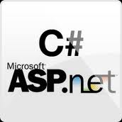

2000/2001- Back to the Basics for Microsoft
“Imitation is the sincerest form of flattery”

Slide 53
How to Kill “Visual Basic” ?
BASIC Programming Language and Microsoft
Visual Basic battled with Delphi, PowerBuilder and Visual C++
A Virtual Machine to run all languages ( CLR)
Visual Basic Programmers require VB.net ( OOP extension) and a Web programming model which mimics VB’s desktop model
ASP 3.0 became ASP+ and mutated to ASP.net Webforms
Created a new language (C#) for the new platform
VB.net was not actively promoted.
Despite Microsoft’s attempt to kill the language, it still survives.

Slide 54
“Emperor” Strikes Back
A new Virtual machine platform which adds features at the Platform level ( In Java, features are added at the Lexical level )
Projections of Platform features to Languages
Better constructs for Event handling, properties, Indexers, unchecked exceptions, Delegates etc.
Access to Windows API using P/Invoke ( Java uses JNI)
COM interoperability
A Web Programming model which mimics desktop
Attributed Programming and better Reflection Library

Slide 55
Stalemate!
Both Java and C# did add support for Generics
Java added support for Annotations to emulate Attributes
People began to mix and match ideas from both platforms
Better Concurrency primitives in Java to emulate .NET
.NET came up with Windows Communication Foundation to avoid Application server deficiency
Java people got rid of infamous EJB with the POJO based EJB because of pressure from “Spring Stack”
All was well with the both camps and C# was just a Java Clone.

Slide 56
How C# became “better” than Java?
Till 2005, both were going neck and neck
Language Integrated Query ( LINQ) was a watershed event in the battle. Microsoft did add lot of features to the language to support LINQ. Extension Methods, Lambda,Anonymous types,Type Intference got added to the platform
Sun got acquired by Oracle and community viewed that with suspicion. Lambda support got only added by Java 8
Microsoft did add Prototype OOP and Parallel programming framework to C#
Java + Scala + Groovy could emulate C# to a large degree.

Slide 57
How Java (JVM ) made a comeback?
Lambda Support in Java 8
Streams Support ( which can emulate LINQ )
Enhancement to VM to support Lambda
Prominence of Scala , Kotlin , Jython and JRuby
Big data offerings
Apache Spark/Flink , Kafka , Storm etc etc

Slide 58
Why should I care?
ENOUGH OF POLITICS & HISTORY – LET US GET INTO THE MEET OF THE STUFF

Slide 59
CLR/JVM Correspondence
ASP.net MVC
ASP.net Web Forms
WCF
ASP.net Web API
EF/Nhibernate
P/Invoke/COM-Interop
ADO.net
Unity
Spring MVC/Struts
JSF
JAX-WS
JAX-RS
JPA/Hibernate
JNI
JDBC
Spring DI/Java CDI

Slide 60
N* - Libraries
Spring
JUNIT
ANT
Hibernate
Jmock
Lucene
iText
Spring.NET (*)
NUNIT
NANT/MSBuild
Nhibernate
Nmock
Lucene.net
iText.net

Slide 61
Language Features
OOP
Functional Programming
Generics
Type Inference
Dynamic Typing
LINQ
Java
Java8/Scala/Groovy
Generics
Scala
Groovy
Limited form of Lambda Syntax supported by Java 8 Streams

Slide 62
X-Platform .Net!
The Mono Project
A Ground up implementation of .NET Platform
The powerhouse behind Xamarin
ASP.net support
IKVM.net – The “Mozart” of Enterprise World
Cross Platform .NET through .NET Core
“.NET classic” vs “.NET Core” vs “.NET Standard”

Slide 63
Why should .NET developers learn Java?
Most of the world’s high net worth corporations use Java for their front facing site.
Java people earn more respect and compensation than C# people
Escape from the comfort of Microsoft’s tools
Good Libraries are available ( Fine grained API as well)
Can program Google’s App Engine, Android and Amazon Beanstalk
Easy to learn for .NET developers

Slide 64
Why should Java developers learn .NET?
The Most advanced programming language in the world with support for Class based OOP, Prototype OOP(dynamic),Lambda Abstractions, LINQ, Generics, inline native code etc.
The C# eco system can help you to program Windows, Xbox, Windows CE, Kinect, .NET MF ( Netdiuno and Partial support for Rasberry Pi) and Xamarin etc.
It is easy for Java developers to cross skill
Understand the comfort of Visual studio editor (You are missing something)
Cross Platform support

Slide 65
Why should Java developers learn .NET?
Sun/Oracle Stack
Apache Stack
JBOSS Stack
IBM Stack
Spring Stack
Check the article, “Your Java is not my Java” @ http://www.technoparktoday.com/java-java-paradox-choice/ (writtem in 2014)

Slide 66
Conclusion

Slide 67
Questions
If any ?

