Slide 1
From SOLID (Principles) to LIQUID (Streams) – An Exploration of Programming Models
Praseed Pai K.T.
@ InApp,Trivandrum

Slide 2
About the Presenter
A Seasoned Software Engineering Professional with more than twenty five years of Exposure
Author of Two books on Computer Programming
Explorer in “Philosophical Tools for Software Engineering” ( Has Presented on it, Written one university accredited paper, Designed a Pattern based on Advaita Vedanta to transition from OOP to FRP)
An Expert level professional in Cross Cultural Encounters (How to deal with a Russian/Eastern European? , Working with Racial stereotypes like Jews / Chinese / Latin Americans )
A Critique of Digital Technology Fads ( Programmers will be better off , if they stick to Programming. Do not run after so called AI/ML, BlockChain etc ) - “Plumbing is preferred over Painting!”
I also help Programmers eliminate their “Math-Phobia”

Slide 3
Who is an Architect?
Architect (n) – Any person who has “fooled” around in the Software Industry for sizeable time (ever shrinking span) who is past his prime,as a Programmer Or Engineer, Systematically moved up in the hierarchy to obey “Peter Principle”.

Slide 4
The Goal of this Presentation
SOLID Principles as a Verification Tool
Better API design through Successive Refactoring for Procedural, Object/Component, Hierarchical, Iterative and Reactive model of Programming
Emphasis on Programming models like OOP, FP , Generic Programming (GP) and Rx Programming
Will help one to appreciate the work which has gone into creating the framework one uses (To become a Literate Consumer of it!)

Slide 5
Four Types of Parametrization and their associated LINGO
Data Parametrization (Transaction Script, Prcoedural)
Variable Parametrization (Class , OOP )
Type Parametrization (Generics, OOP/GP)
Behavior Parametrization (Lambda, GP/FP)
https://github.com/praseedpai/WhetYourApettite

Slide 6
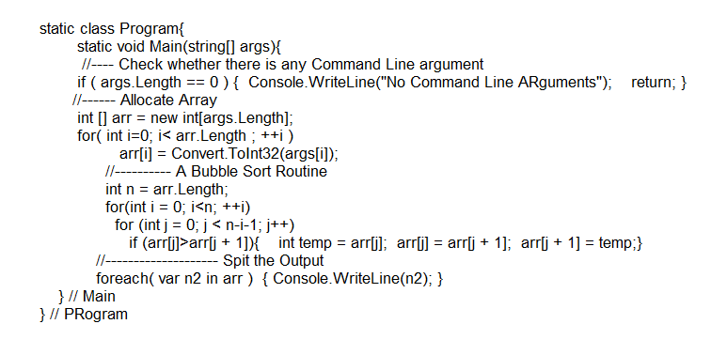
Data Parametrization (Step #1)

Slide 7
Variable Parametrization

Slide 8
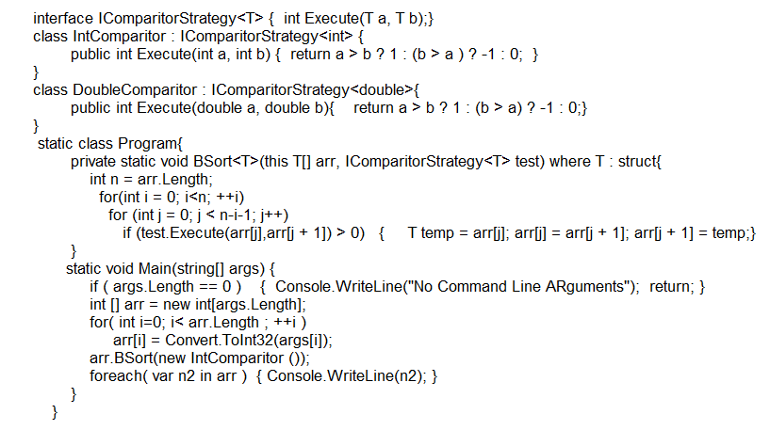
Type Parametrization

Slide 9
Behavior Parametrization

Slide 10
OOP – A quick introduction
A class has got a structure ( instance variable and class level variables and behaviors ( instance methods and class level methods ) to provide some functionality
For large programs , Structure and Behavior needs to be separated for SOC
Abstraction, Encapsulation , Polymorphism, Inheritance
Interface and abstract classes

Slide 11
SOLID Principles

Slide 12
The Design Pattern “Movement”
GOF Design Patterns
Structure , Behavioural and Creational Patterns
“POSA” Catalogue
Patterns of Software Architecture
DDD Pattern Catalogue
Domain Driven Design
“POEAA” Catalog
Patterns of Enterprise Application Architecture
Enterprise Architecture and the MDA
Archetype Pattern
Enterprise Integration Patterns
Apache CAML is based on this book
J2EE Design Patterns
A Pattern Catalogue for Web Application by Deepak Alur et al.

Slide 13
Command Pattern

Slide 14
Composite/Visitor (in a page!)

Slide 15
Generic Programming
Parametrized Types
Algorithms are the central citizen of GP
Highly useful for creating Type Safe Collections
In C/C++, Generics are called Templates
C#, Java and C++ instantiates templates differently
Type Erasure in Java/JVM
Dynamic Type Synthesis by CLR
Compile Time Code Factory by C++

Slide 16
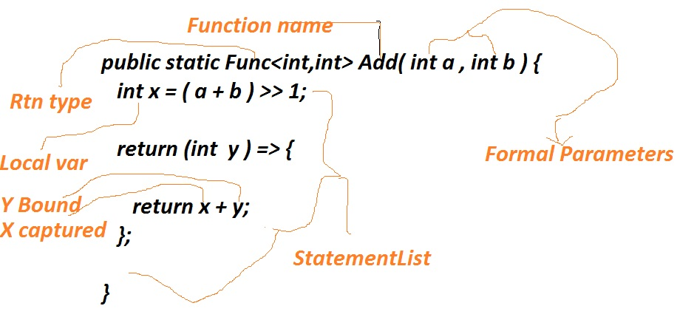
FP – Prologue

Slide 17
FP – A quick introduction
LISP is one of the oldest functional programming language
ML is the first typed functional programming language
The Lambda Calculus and FP
C# - an Object/Functional Programming language
FP is Programming with Pure Functions
Immutability , Side effects, Composition, Map/Reduce, Behavioral Parametrization , Variable Capture, Referential Transparency, Currying etc

Slide 18
Functional Composition

Slide 19
Currying – a Non Trivial Example

Slide 20
Rx Programming Model
FRP (Functional Reactive Programming) was pioneered by the Haskell Community
Microsoft released Rx.net and RxJs
NetFlix ported Rx.net to Java (RxJava)
Rx libraries are available for .NET, Java, JS, Python, C++ etc, to name a few

Slide 21
Rx – The Big Picture

Slide 22
Rx – What is happening?

Slide 23
Rx Simple Code Snippets

Slide 24
Case Study #1
A Directory Traversal Engine (Java)
A Procedural API for Directory Traversal
A OOP/Component Model for Directory Traversal
Directory Traversal using Composite/Visitor
Directory Traversal using Iterator
Directory Traversal using Streams
Directory Traversal using RxJava

Slide 25
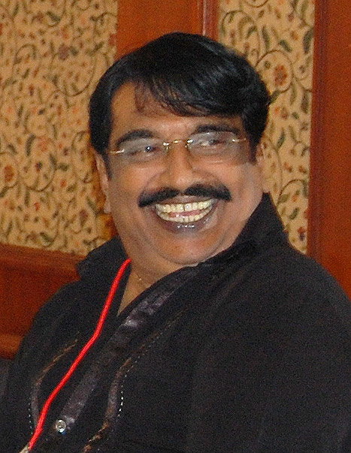
Comparitive Study of Programming Languages
In India, it is like this, I do not know how it is in Punjab?
- Punjabi House

Slide 26
OOP – What is the Essence?
Which is the canonical structure of a OOP program?
Hierarchical Structures
They are modelled using Gang of Four Composite Pattern
The Composite models Part/Whole Hierarchy
The Composite/Visitor duo

Slide 27

Patterns are Golden Hammers – at least for some

Slide 28
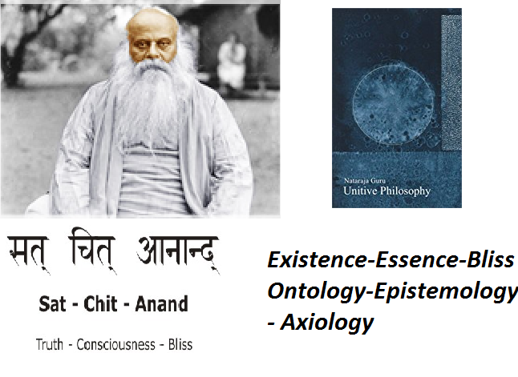
A Travel and Its aftermath
-

Slide 29
Why this session?
.
SAT | CHIT | ANANDA
Existence | Essence | Bliss
Ontology | Epistemology | Axiology
Who am I? | What Can I know? | What should I do?
Matter | Mind | Bliss
Structure | Behavior | Function

Slide 30
Three Pillars of any System
Structure,Behvior and Function are three pillars of the system
How these things appear in Economics?
How these things appear in Cognitive Psychology?
How these things appear in Computer Programming?

Slide 31
The Composite/Visitor Pair from OOP
The Hierarchies are modelled using Composites (Structural)
Processing Composites through Visitor ( Behavior)
Evaluation of Expression using AST (Structural ) and Visitor
Directory Traversal and Processing using Composite/Visitor
Problems with the Composite/Visitor

Slide 32
The Problem with Composite/Visitor and its Rectification
The Visitor needs to understand the structure of the Composites
Is there any Pattern which helps us to navigate the content in a Structure agnostic manner?
Flattening the Composite and navigation of the data using Iterator pattern
Demerits of Iterator Pattern

Slide 33
Reversing the Gaze through Observable/Observer
The Fire/Forget solution to the Blocking problem
Notification to people who have subscribed
Threads, Pools and Asyncrhony management
Scheduling Execution

Slide 34
In Short, the Reactive Programming model is
Modelling Hierarchical Structures using the Composite
Behavioral processing using the Visitor Pattern
Flattening the Hierarchy and navigating them through Iterator
Notification to the subscribers using Observable/Observer pattern
Functional Composition and Immutability
Schedulers and Asynchrony

Slide 35
Case Study #2
A Library for Evaluating Expressions (C#)
A Stack based Expression Evaluator
An AST based Expression Evaluator
An Expression Evaluator based on Composite/Visitor
An Expression Evaluator based on Iterator
An Expression Evaluator which uses Rx

Slide 36
Expression Evaluator – Part #1

Slide 37
Expression Evaluator – Part #1 (Contd…)

Slide 38
Expression Evaluator – Part #1 (Contd…)

Slide 39
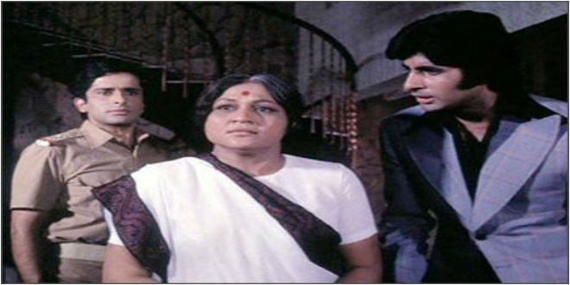
Who is more important?
Aaj mere paas building(C++) hai, property(C#) hai ,
bank balance (Java) hai, bungla(Python) hai,gaadi hai(PHP)
Kya hai, Kya hai tumhare paas?
....Mere Paas Maa (JavaScript) hai

Slide 40
Questions
If any ?

