Slide 1
Write Your Own .NET Compiler
January 30,2010
Community Tech Days
Kochi
  Praseed Pai K T
  praseedp@yahoo.com
  http://praseedp.blogspot.com
  http://slangfordotnet.codeplex.com

Slide 2
A Point to Ponder
“A Science is any discipline in which a fool of this generation can go far beyond the point reached by the genius of earlier generation.”
Max Gluckman , South African Anthropolgist

Slide 3
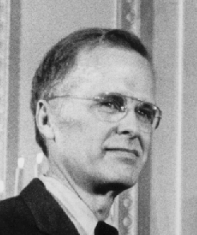
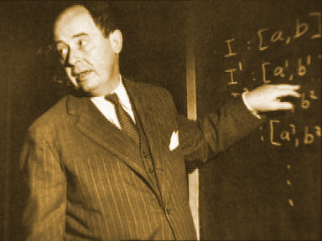
An interesting Tale

Slide 4
Compiler Construction
Just an exercise in Software Engineering
Now a days people can write compilers as fast as they can type !!!
Better Tools and Better People around
Compiler infrastructure software makes the task easier.

Slide 5
Why .net ?
.NET Reflection API
System.Reflection namespace
System.Reflection.Emit namespace
.NET contains facilities to compile user code into Assemblies ( Assemblies can be DLL or EXE )‏
C# contains 60 years of evolution of Programming models.

Slide 6
Computer Program – Can it be treated as data ?
Interpreter/compiler of a programming language is just another program !!!
One can create an Object Model for Programming Constructs
Programming constructs can be Organized as hierarchies
The Concept of Abstract Syntax Tree (AST)‏

Slide 7
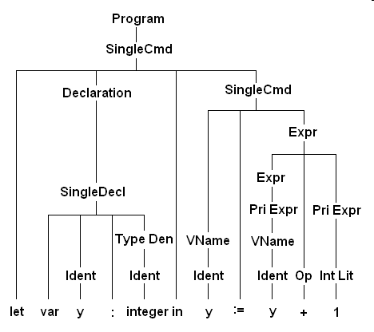
Abstract Syntax Tree (AST)‏

Slide 8
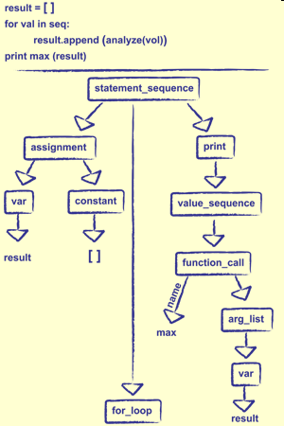
AST ( contd… )‏

Slide 9
ACTORS
FOUR ACTORS IN THE PROCESS

Slide 10
What is an Expression ?
Expression is something which one evaluates for it’s value

Slide 11
What is a Statement ?
Statement is what one executes for it’s effect. A statement mutates the STATE of variables.

Slide 12
What is a Procedure/Function ?
Procedure is a collection of Statements which will be executed. Procedures are referred as a single entity

Slide 13
What is a Module ? (Program )
Module or a Compilation unit is a collection of procedures which are interrelated ( most often in a single file ) and Execution will start from a known entry point ( MAIN in our case)‏

Slide 14
Object Model
Exp //---------- base class for expressions
NumericConstant //--- double constant
BinaryExp // + , / , - , *
UnaryExp // + , -
abstract class Exp
{
public abstract double Evaluate(RUNTIME_CONTEXT cont);
}

Slide 15
Object Specification
class BinaryExp : Exp {
private Exp _ex1, _ex2;
private OPERATOR _op;
}
class NumericConstant {
private double _value;
}
class UnaryExp : Exp {
private Exp _ex1;
private OPERATOR _op;
}

Slide 16
Operators
enum OPERATOR
{
ILLEGAL = -1,
PLUS,
MINUS,
DIV,
MUL
}

Slide 17
Interpretation of NumericConstant
public override double Evaluate(RUNTIME_CONTEXT cont)‏
{
return _value;
}

Slide 18
Interpretation of BinaryExpr
public override double Evaluate(RUNTIME_CONTEXT cont)‏
{
switch (_op)‏
{
case OPERATOR.PLUS:
return _ex1.Evaluate(cont) + _ex2.Evaluate(cont);
case OPERATOR.MINUS:
return _ex1.Evaluate(cont) - _ex2.Evaluate(cont);
case OPERATOR.DIV:
return _ex1.Evaluate(cont) / _ex2.Evaluate(cont);
case OPERATOR.MUL:
return _ex1.Evaluate(cont) * _ex2.Evaluate(cont);
}
return Double.NaN;
}

Slide 19
Interpretation of UnaryExpr
public override double Evaluate(RUNTIME_CONTEXT cont)‏
{
switch (_op)‏
{
case OPERATOR.PLUS:
return _ex1.Evaluate(cont);
case OPERATOR.MINUS:
return -_ex1.Evaluate(cont);
}
return Double.NaN;
}

Slide 20
Some Examples
A ) 10*5
Exp e = new BinaryExp(new NumericConstant(5),new NumericConstant(10), OPERATOR.MUL);
B) - (10 + (30 + 50 ) )‏
e = new UnaryExp( new BinaryExp(new NumericConstant(10), new BinaryExp(new NumericConstant(30), new NumericConstant(50),
OPERATOR.PLUS, OPERATOR.PLUS),
OPERATOR.MINUS);

Slide 21
Compiler Construction - stages
Lexical Analysis
Parsing
Creation of Abstract Syntax Tree (AST)‏
AST can be interpreted using a Recursive Walk
AST can be compiled into an instruction set to create executables

Slide 22
Representing Programs as Object is tedious
From the texual representation of the expression ( code ) , we need to generate the requisite objects to represent it as a Tree. (AST)‏
The idea of Recursive Descent Parsing
Parser and Lexical Analysis routine work side by side. ( Parser on the fly demands the next Token from the Lexical routine )‏
As the Parse Progresses we will create AST

Slide 23
Lexical Specifications
TOK_PLUS – ‘+’
TOK_MUL - ‘*’
TOK_SUB - ‘-’
TOK_DIV - '/'
TOK_OPAREN – ‘(‘
TOK_CPAREN – ‘)’
TOK_DOUBLE – [0-9]+

Slide 24
Lexical Analysis
while ( there is input ) {
switch(currentchar) {
case Operands:
advance input pointer
return TOK_XXXX;
case Number:
Extract the number( Advance the input )‏
return TOK_DOUBLE;
default:
error
}
}

Slide 25
BNF
<Expr> ::= <Term> | Term { + | - } <Expr>
<Term> ::= <Factor> | <Factor> {*|/} <Term>
<Factor>::= <number> | ( <expr> ) | {+|-} <factor>

Slide 26
Grammar ( BNF to psuedo code )‏
// <Expr> ::= <Term> { + | - } <Expr>
Exp Expr() {
Exp RetValue = Term();
if ( Token == TOK_PLUS || Token == TOK_SUB )‏
{
// -- Advance the input pointer and get the next token
Exp temp = Expr(); // recurse
RetValue = new BinaryExpr( RetValue,Temp );
}
}

Slide 27
Grammar ( BNF to psuedo code )‏
// <Term> ::= <Factor> { * | / } <Term>
Exp Term() {
Exp RetValue = Factor();
if ( Token == TOK_MUL || Token == TOK_DIV )‏
{
// Advance the input pointer
Exp temp = Term(); // recurse
RetValue = new BinaryExpr(RetValue,Temp);
}
return RetValue;
}

Slide 28
Grammar ( BNF to pseudo code )‏
// <Factor> ::= <TOK_DOUBLE> | ( <expr> ) |
// { + |- } <Factor>
Exp Factor() {
switch(Token)
case TOK_DOUBLE:
return new NumericConstant(#);
case TOK_OPAREN:
Exp p = Expr(); //recurse
// check for closing parenthesis and return
return p;
case UNARYOP:
return Factor(); //recurse
default:
//Error
}

Slide 29
Generation of Executable Code
.NET IL
Recursive Walk of the AST tree created
Refection.Emit package
Assembly , AppDomain , TypeBuilder , etc
APIs for creating Executables

Slide 30
Modelling Programming constructs using OOP
Class Exp
class NumericConstant
class StringLiteral,BooleanConstant
class Variable, BinaryPlus,BinaryMinus, class Div, Mul,UnaryPlus,UnaryMinus
class RelationExp,LogicalExp,LogicalNot
class CallExp

Slide 31
Modelling Statements…
Class Stmt
class VariableDeclarationStatement
class PrintStatement,PrintLineStatement
class AssignmentStatement
class WhileStatement
class IfStatement
class ReturnStatement

Slide 32
Modeling Procedure
abstract class PROC {
public abstract SYMBOL_INFO Execute(RUNTIME_CONTEXT cont,ArrayList actuals ) ;
public abstract bool Compile(DNET_COMPILATION_CONTEXT cont );
}
class Procedure : PROC {
public string m_name;
public ArrayList m_formals=null;
public SymbolTable m_locals=null;
public ArrayList statements=null;
public SYMBOL_INFO return_value = null;
public TYPE_INFO _type;
}

Slide 33
Modeling Modules
abstract class CompilationUnit {
public abstract SYMBOL_INFO Execute(RUNTIME_CONTEXT cont ,ArrayList actuals) ;
public abstract bool Compile(DNET_EXECUTABLE_GENERATION_CONTEXT cont );
}
class TModule : CompilationUnit {
private ArrayList m_procs;
private ArrayList compiled_procs = null;
private ExeGenerator _exe = null;
}

Slide 34
Programming Language Specification
get your
GRAMMAR right !

Slide 35
Grammar for the Module and Function
<Module> ::= {<Procedure>}+;
<Procedure>::= FUNCTION <type> func_name ‘(‘ arglist ‘)’
<stmts>
END
<type> := NUMERIC | STRING | BOOLEAN
arglist ::= '(' {} ')' | '(' <type> arg_name [, arglist ] ')'

Slide 36
Grammar for Statements…
<stmts> := { stmt }+
{stmt} := <vardeclstmt>|<printstmt>|<printlnstmt>|<assignmentstmt>|<callstmt>|<ifstmt>|<whilestmt> |<returnstmt>
<vardeclstmt> ::= <type> var_name;
<printstmt> := PRINT <expr>;
<assignmentstmt>:= <variable> = value;
<ifstmt>::= IF <expr> THEN <stmts> [ ELSE <stmts> ] ENDIF
<whilestmt>::= WHILE <expr> <stmts> WEND
<returnstmt>:= Return <expr>

Slide 37
Grammar for Expression
<expr> ::= <BExpr>
<BExpr> ::= <LExpr> LOGIC_OP <BExpr>
<LExpr> ::= <RExpr> REL_OP <LExpr>
<RExpr> ::= <Term> ADD_OP <RExpr>
<Term>::= <Factor> MUL_OP <Term>
<Factor> ::= <Numeric> | <String> | TRUE | FALSE | <variable> | ‘(‘ <expr> ‘)’ | {+|-|!}
<Factor> | <callexpr>
<callexpr> ::= funcname ‘(‘ actuals ‘)’
<LOGIC_OP> := '&&' | ‘||’
<REL_OP> := '>' |' < '|' >=' |' <=' |' <>' |' =='
<MUL_OP> := '*' |' /'
<ADD_OP> := '+' |' -'

Slide 38
Parsing Algorithm
Recursive Descent Parsing
Alternative is to use ANTLR or some other tool

Slide 39
Design Patterns
GOF book and the pattern movement
Use of Builder Pattern to create Procedures and Programs out of textual representation of program ( Code ).
ProcedureBuilder and ModuleBuilder co-ordinates with the parser to keep track of the state. At the end of the parse , we create Procedure and Program Objects.

Slide 40
Interpret or Compile ?
One can interpret the AST by recursive walk
One can compile the stuff into IL
Execute method is for Interpretation
Compile method will compile into IL

Slide 41
Execution/Compilation
BooleanConstant
NumericConstant
StringLiteral
Variable
BinaryPlus
UnaryMinus
CallExp ( Function Call )‏
WhileStatement ( While Loop )‏
IFStatement ( IF )‏
Procedure ( Function Defenition )‏
LogicalExp
RelationalExp

Slide 42
Recursive Procedures
Being a One Pass Compiler , one has to work around to support recursion
If a call to a function , which is not available in the list of parsed procedures , we make an assumption that call is a recursive one.
A strategy with holes at this point of time.
The call is resolved at the compilation/interpretation time.

Slide 43
Samples

Slide 44
Hello World Program
///////////////////////
// Helloworld.sl
// Hello World Program
//
FUNCTION BOOLEAN MAIN()‏
PRINT "Hello World";
END

Slide 45
Loop
//////////////////////////////
// onetohundred.sl
// Program to Print One To Hundred
// STEP 7 and above
//
FUNCTION BOOLEAN MAIN()‏
NUMERIC d;
d=0;
While ( d <= 100 )‏
PRINTLINE d;
d = d+1;
Wend
END

Slide 46
Recursive Fibonacci routine
/////////////////////////////////
//
// Recursive Fibonacci series routine
//
//
FUNCTION NUMERIC FIB( NUMERIC n )‏
IF ( n <= 1 ) then
return 1;
ELSE
RETURN FIB(n-1) + FIB(n-2);
ENDIF
END

Slide 47
Caller for Fibnacci series
/////////////////////////////////////////
//
//
// Main routine to call
//
FUNCTION BOOLEAN MAIN()‏
NUMERIC d;
d=0;
While ( d <= 10 )‏
PRINTLINE FIB(d);
d = d+1;
Wend
END

Slide 48
Conclusion
Extend the language to add call by reference , multiple modules
Adding Object Oriented Programming Constructs
Using a Compiler infrastructure like LLVM or MS common compiler infrastructure, to target native code and gain good optimization

Slide 49
Thank You
Q& A
VISIT http://slangfordotnet.codeplex.com

