Slide 1

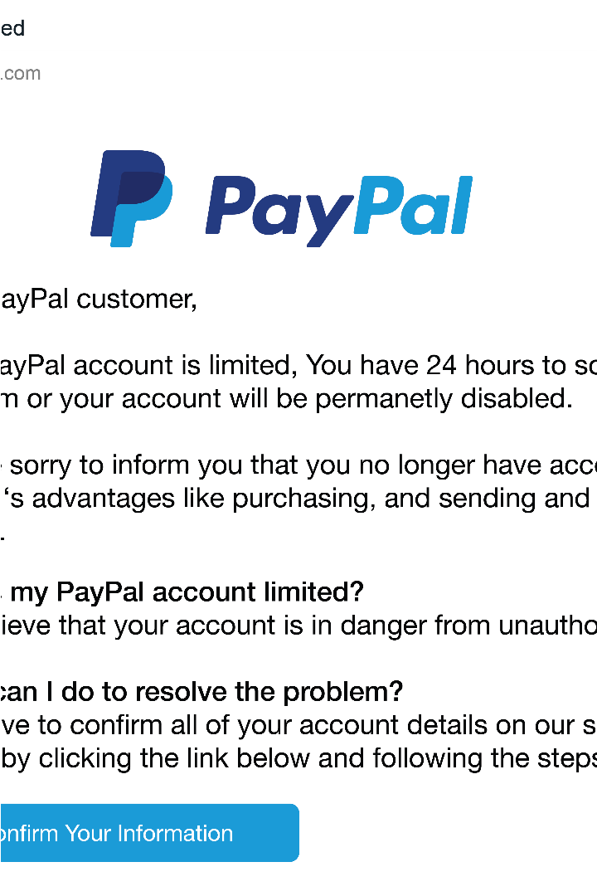

Phishing Awareness Training
Phishing is a form of cybercrime where attackers use deceptive emails, websites, and social engineering tactics to steal sensitive information like login credentials, financial data, and personal details. This training will help you recognize and avoid these sophisticated scams.
by Jatin Yadav

Slide 2
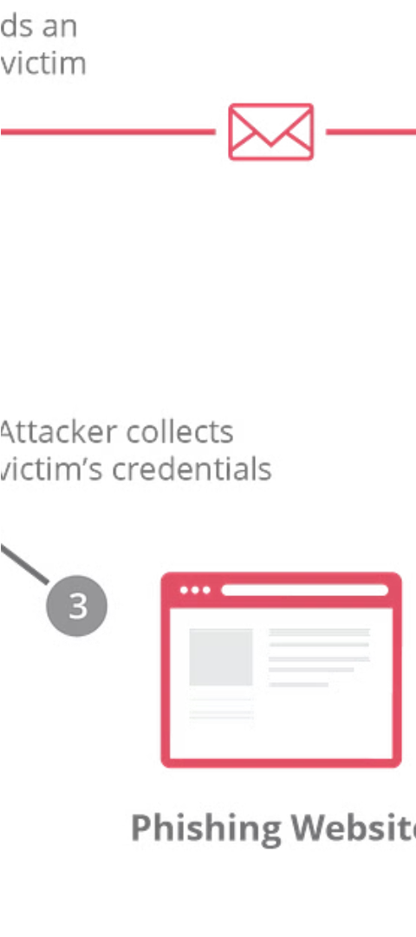
Understanding Phishing Attacks
1
Lure
The attacker crafts a tempting message or website to lure the victim.
2
Exploit
The victim is tricked into revealing sensitive information or downloading malware.
3
Monetize
The attacker uses the stolen data for financial gain or further attacks.

Slide 3

Recognizing Phishing Emails
1
Suspicious Sender
2
Urgent Tone
Check the email address - does it look legitimate?
Phishing emails often create a false sense of urgency.
3
Generic Greetings
4
Attachments/Links
Phishing emails often use generic salutations like "Dear Customer".
Be wary of unsolicited attachments or links that could contain malware.

Slide 4
Identifying Malicious Websites
URL Inspection
SSL Certificate
Visual Cues
Look for misspellings, unusual domains, or suspicious-looking URLs.
Verify the website has a valid SSL certificate and "https://" prefix.
Check for poor design, stock images, or other signs of a fake website.

Slide 5
Social Engineering Tactics
Pretexting
Baiting
Attackers create a plausible scenario to manipulate victims into sharing information.
Leaving behind infected physical media like USB drives to lure victims.
Tailgating
Phishing
Physically following someone into a restricted area by blending in.
Using deceptive emails, messages, or websites to steal sensitive data.

Slide 6




Best Practices for Avoiding Phishing
Verify
Inspect
Report
Educate
Confirm the source of any suspicious emails or messages.
Carefully examine URLs, attachments, and websites for signs of fraud.
Notify the appropriate authorities about any suspected phishing attempts.
Stay informed about the latest phishing tactics and share knowledge.

Slide 7
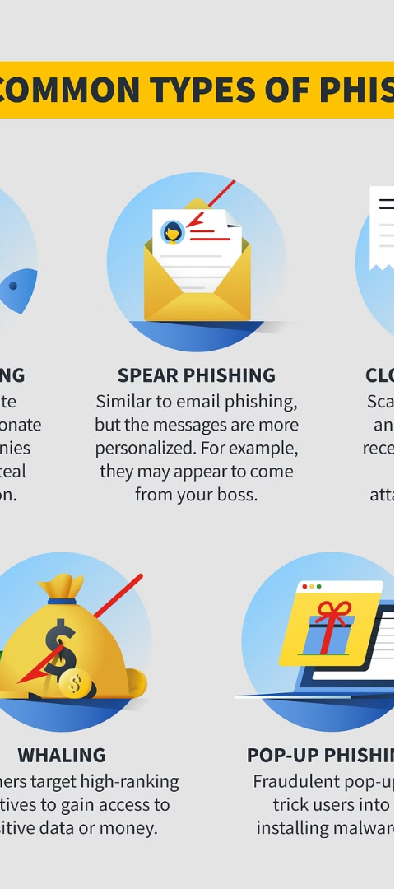



Reporting Suspected Phishing Attempts
Identify
Recognize the signs of a phishing attempt.
Document
Collect evidence like screenshots and email headers.
Report
Notify your organization's IT team or the appropriate authorities.

Slide 8
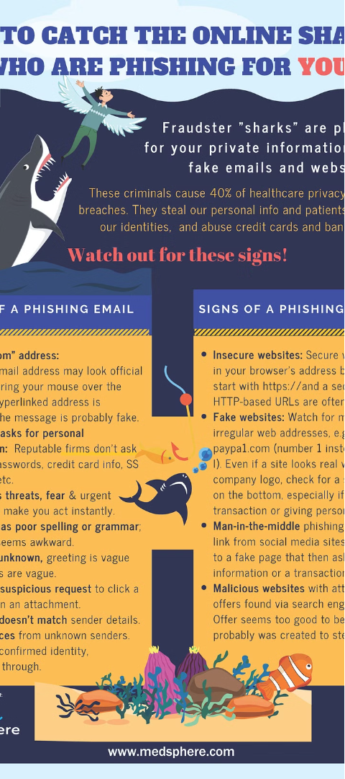
Conclusion and Resources
1
Stay Vigilant
2
Ongoing Education
Phishing attacks are constantly evolving, so remain cautious.
Regularly review phishing prevention best practices and resources.
3
Report and Respond
Notify the proper authorities if you suspect a phishing attempt.

