Slide 1

Git
An Distributed Version Control System

Slide 2
Outline
Git Overview
Features of Git
Pros & Cons of Git
Working of Git
Git v/s Github

Slide 3
Git Overview

Slide 4
Git Overview
Git is an Distributed Version Control System
Git was developed by Linus Torvalds, the same person who developed Linux
Git is mainly used for effectively maintaining different versions of a project.
As it is distributed, the project resources are shared & maintained between the team mates effectively.

Slide 5

Features of Git
Security
Performance
Flexibility

Slide 6
Security
Git has been designed with the integrity of managed source code as a top priority.
The content of the files as well as the true relationships between files and directories, versions, tags and commits, all of these objects in the Git repository are secured with a cryptographically secure hashing algorithm called SHA1.
This protects the code and the change history against both accidental and malicious change and ensures that the history is fully traceable.

Slide 7
Performance
The raw performance characteristics of Git are very strong when compared to many alternatives.
Committing new changes, branching, merging and comparing past versions are all optimized for performance.
The algorithms implemented inside Git take advantage of deep knowledge about common attributes of real source code file trees, how they are usually modified over time and what the access patterns are.

Slide 8
Flexibility
One of Git's key design objectives is flexibility.
Git is flexible in several respects: in support for various kinds of nonlinear development workflows, in its efficiency in both small and large projects and in its compatibility with many existing systems and protocols.

Slide 9

Pros & Con of Git

Slide 10
Pros
Git has the functionality, performance, security and flexibility that most teams and individual developers need.
Superior disk utilization and network performance
Collaboration friendly
Any sort of projects can use GIT
Git is a very well supported open source project with over a decade of solid stewardship.
Git enjoys great community support and a vast user base

Slide 11
Cons
Git can be difficult to learn
For those teams coming from a non-distributed VCS, having a central repository may seem like a good thing that they don't want to lose
GIT does not support ‘commits’ across multiple branches or tags
Git is less preferred for handling extremely large files or frequently changing binary files .
Max File Size: 100 MB
Max Repository Size: 1 GB

Slide 12
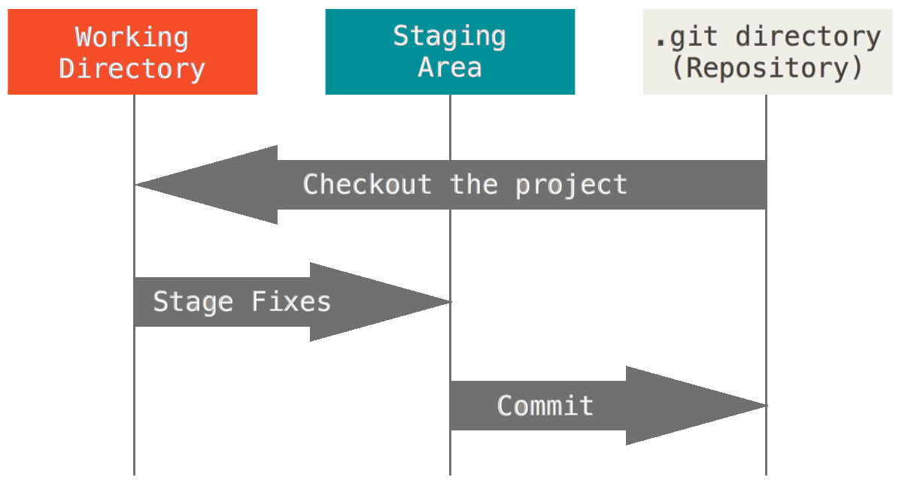
Working of Git

Slide 13
Basic overview of how Git works:
Create a "repository" (project) with a git hosting tool (like GitHub)
Copy (or clone) the repository to your local machine
Add a file to your local repo and "commit" (save) the changes
"Push" your changes to your master branch
Make a change to your file with a git hosting tool and commit
"Pull" the changes to your local machine
Create a "branch" (version), make a change, commit the change
Open a "pull request" (propose changes to the master branch)
"Merge" your branch to the master branch

Slide 14
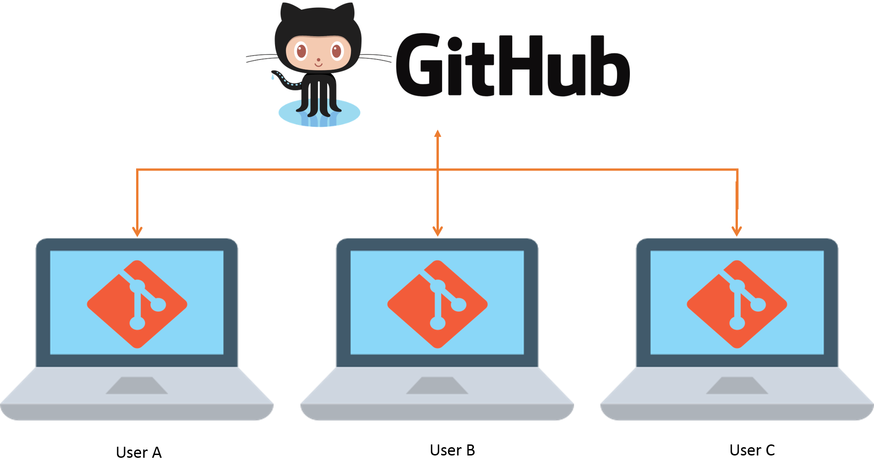
Git v/s Github

Slide 15
Git v/s Github
Git | GitHub
Git is a tool that allows creating a local repository | Allows hosting the central repository on a remote server
A version control system | A repository hosting service
Git is the tool, | GitHub is the service for projects that use Git.

Slide 16

Created By:
Prasenjeet Paul

