Slide 1
CSE 713-Advanced Syntactic Pattern Recognition
Spring 2022
Submission-02
Group-03
Paper Name: Nearest neighbour approaches for Emotion Detection in Tweets
Submitted by | Submitted to
Md. Sifat Ibn Awlad-21266012 Kazi Omar Faruk-21266024 Anika Rahman-21266028 Sanjida Ali Shusmita-21366018 Prasenjit Das-21366036 | Annajiat Alim Rasel Senior Lecturer Department of Computer Science and Engineering BRAC University Dhaka, Bangladesh

Slide 2
Introduction
SemEval-2018
Raw tweets
Labeled with scores
Four considered emojis(anger,sadness,joy and fear)
weighted k Nearest Neighbour(wkNN) algorithm
Tweet embeddings
Lexicons
NN-based methods

Slide 3
Related Work
SemEval-2018 task
The winning approach (Duppada et al., 2018)
XGBoost and Random Forest classification models
The runners-up (Gee and Wang, 2018)
Transfer learning with Long Short Term Memory (LSTM) neural networks
Gated-Recurrent-Units (GRU)
Convolution neural network (CNN)
Attention mechanism
BERT
RoBERT

Slide 4
Methodology
❖Data cleaning
➢General preprocessing
➢Preserving Emojis
➢Stop-word removal
❖Tweet embedding
➢Pre-trained Word2Vec from the Gensim package
➢DeepMoji
➢The Universal Sentence Encoder (USE)
➢Sentence-BERT (SBERT)
➢Twitter-roBERTa
❖Emotional lexicon vocabularies
➢Valence Arousal Dominance
➢Emotional Lexicon
➢Affect Intensity
❖Classification methods
➢weighted k Nearest Neighbors
❖Evaluation method
➢5-fold cross-validation
➢Pearson Correlation Coefficient (PCC)

Slide 5
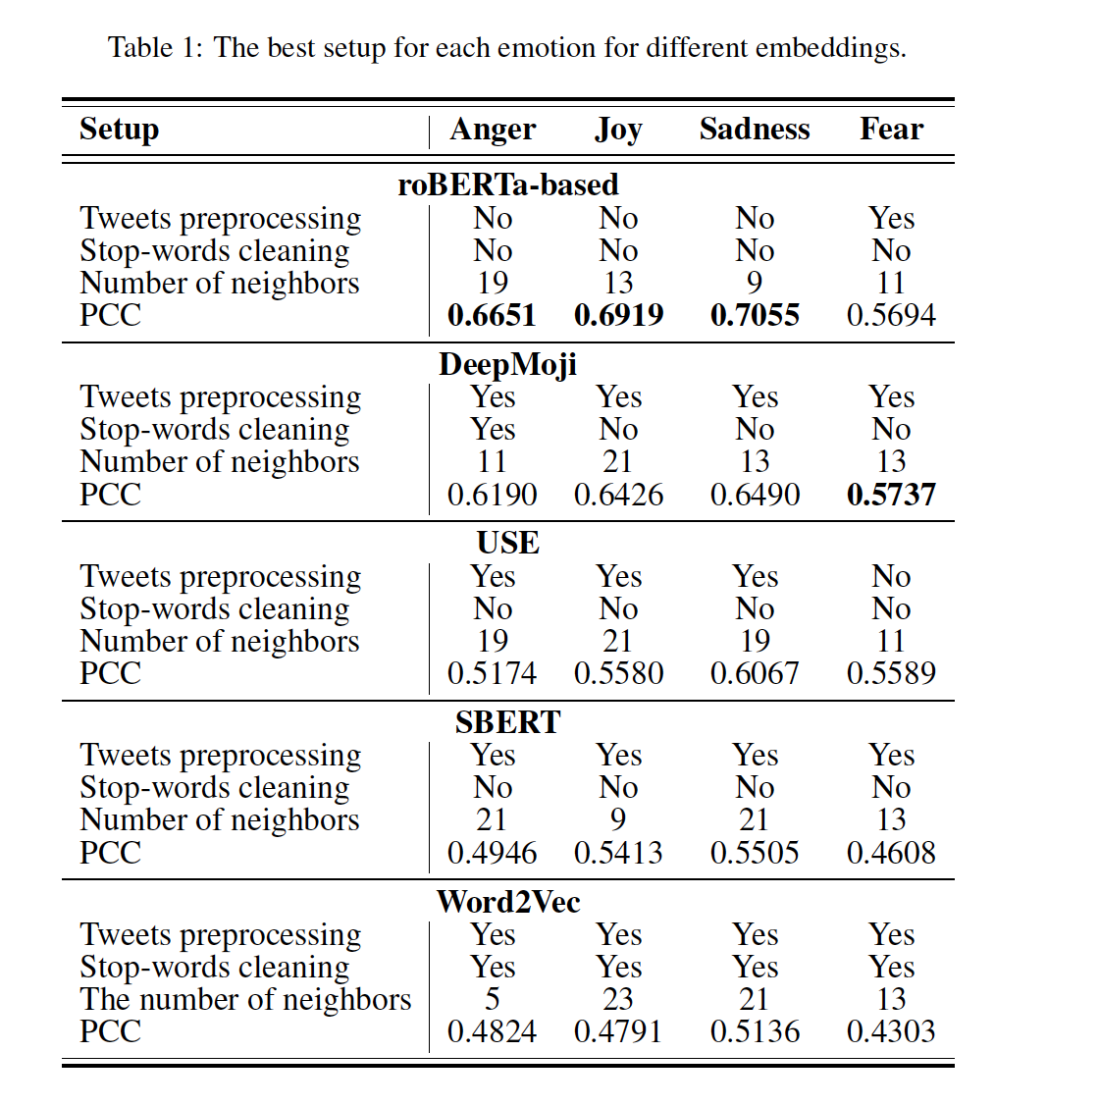
Experiment
❖ Experiments on the train and development are designed as follows
Firstly author compares the different tweet embedding methods to find which setup and embedding gives the best results
Then author evaluates the lexicon classifier independently and then apply embedding to them and finally evaluates the ensembles of classifiers.
❖ Detecting the best setup for embeddings:
Here the author describes the process of detecting the best data cleaning method and the best k parameter value for each emotion dataset and each embedding
Here in the table 1 we can see that roBERTa provides the best results on three out of four emotion datasets, while for Fear, DeepMoji performs the best.

Slide 6
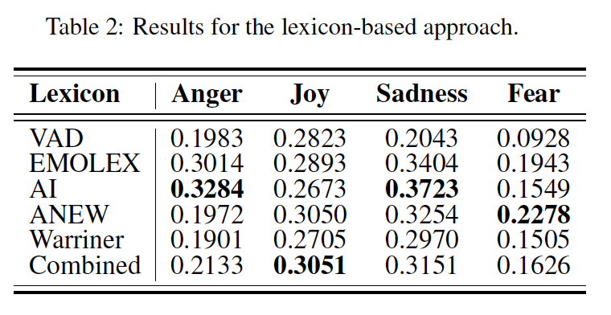
Experiment
❖ Model evaluation: After finding the best embedding and data preprocessing setup, the author evaluates the model in three ways.
1. Lexicon-only based models:
Here the author evaluates lexicon only classifier without using any kinds of embedding to check the classification strength of each lexicon only based models.
Lexicon based models are sentiment classifiers used to score a document by aggregating the sentiment scores of all the words in the document. It contains a word and sentiment score vector of that word. Author uses five lexicon based models which are VAD, EMOLEX, AI, ANEW, Warriner lexicon models.
In the table 2 we can see that the AI lexicon model is the best performing model, showing the highest results for two out of the four emotions datasets.

Slide 7
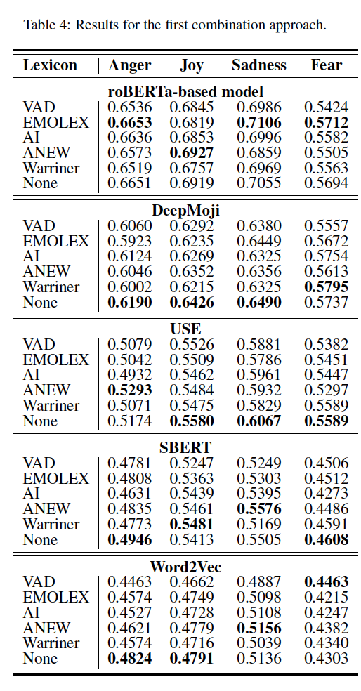
Experiment
2. Appending lexicon scores with word embeddings:
Here the author appended the lexicon scores with different word embeddings and evaluated all the lexicon models.
Here in table 4 we can see the roBERTa-based model is the only model which provides good result with lexicon information for the EMOLEX model on three out of four emotion datasets. And the other does not provide any benefit from lexical embedding.

Slide 8
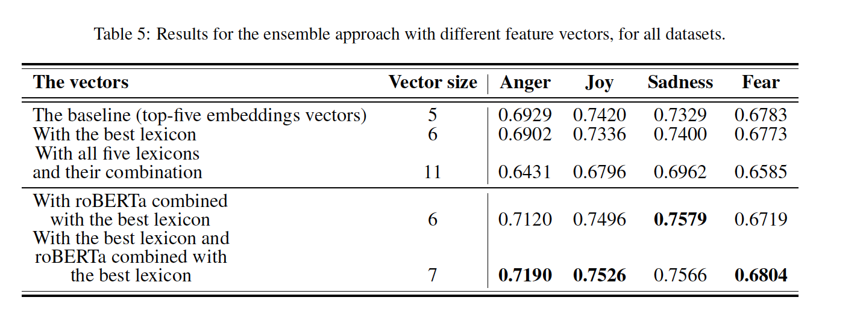
Experiment
3. Ensembles
The author performed different kinds of ensembles of the lexicon models and the embeddings.
Here in the table 5 we can see the ensemble of the best lexicon classifier and roBERTa combined with the best lexicon classifier was performing the best in three emotion datasets.
Also the roBERTa combined with the best lexicon classifier was also performing well compared to other ensembles.

Slide 9
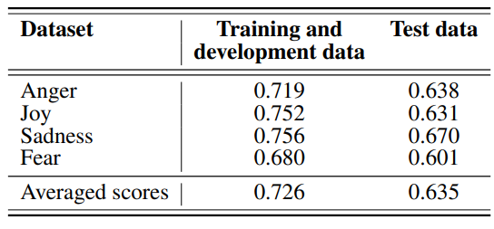
Results on the test data
Top 3 PCC scores obtained in the competition:
0.695
0.653
0.646
Table: PCC of the best approach on the cross-validation and test data for the four emotion datasets.
+1 (total positive linear correlation)
Evaluation Method:
Pearson Correlation Coefficient (PCC) Score
5-fold cross-validation
0 (no linear correlation)
-1 (total negative linear correlation)

Slide 10
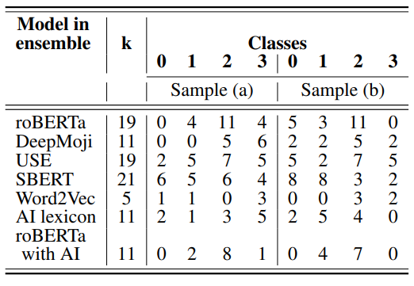
Discussion & Error Analysis
Sample 1: “I know you mean well, but I’m offended. Prick.”
Sample 2: “We’ve been broken up a while, both moved on, she’s got a kid, I don’t hold any animosity towards her anymore...”
Table 1: Predictions of models from the ensemble for some test tweets.

Slide 11
Conclusion & Future Work
We can say, using simple optimizations and the weighted kNN method can perform nearly on par with more complex state-of-the-art neural network-based approaches.
In future,
We plan to incorporate more elaborate nearest neighbour methodologies, which also take into account the inherently fuzzy nature of emotion data and it may show promising results.
As a possible further improvement, we may refine the voting function by assigning different weights to the different members of the ensemble, which can be based, for example, on the confidence scores.
Another important characteristic that influences the results is data imbalance. For further experiments with Fear, we consider the usage of imbalanced machine learning classification methods.

Slide 12
Thank You

