Slide 1

Basic Details of the Team and Problem Statement
Ministry/Organization Name/Student Innovation: Government of Gujarat
PS Code: 1365
Problem Statement Title: Online Blockchain based certificate generation and validation system for government organization
Team Name: Blockchain Innovators
Team Leader Name: Omraj Manoj Jadhav
Institute Code (AISHE): C-11018
Institute Name: Karmaveer Bhaurao Patil College of Engineering, Satara
Theme Name: Blockchain & Cybersecurity

Slide 2
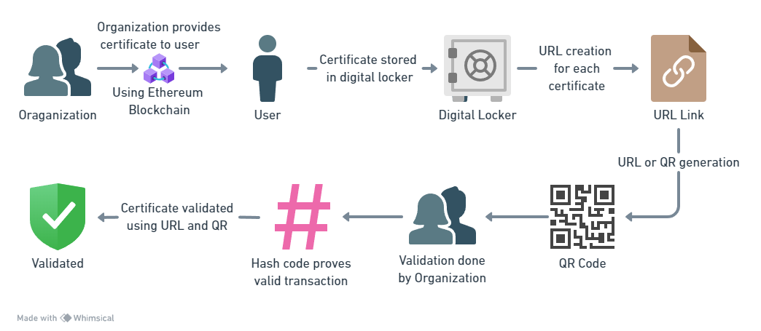
Idea/ Details
Flowchart:-
Solution:
Implementing Blockchain technology to create secure and immutable system for Certificate generation and Validation.
Tradition approach to validation creates introduces potential Risks such as Forgery, Tampering , Misplacement.
The Best Solution -
Ethereum : immutable Decentralized Blockchain Network for transaction of certificates between trainee and organization
Superior Smart contracts : To create impenetrable transactions and storage for assurance of Immutability
Cryptographic Hash Functions : An algorithm that ensures the security and integrity of the data on the blockchain by converting input data into a string of Letters
QR Code Generation : An unique QR code and URL link is generated and attached to the Certificate.
Chatbot (AI/ML) : To enable an user friendly interfaces which explains each step to the user.
Technology stack:
Ethereum – Immutable blockchain platform that Serves as a public distributed ledger
Solidity – Programming Language for blockchain
Ganache – provide fake ethers for testing on the test net
Truffle – Test environment
Metamask - Wallet
HTML and CSS – Programming Front End
Product Status :
Product built is 80% built, further
development in progress. Next steps
involve Front end building and more testing.

Slide 3
Idea/Approach Details
Use Cases:
Dependencies/ Showstopper:
The Product has only one dependency
Internet- Internet availability is essential because it's the backbone for data transmission, blockchain integration, user access, and security updates.
Advantages-
Seamless Process: A blockchain-based system streamlines processes by automating tasks like certificate issuance and validation, reducing manual intervention, and improving efficiency.
Scalability: Blockchain technology can be easily scaled to accommodate a growing number of certificates and users without compromising performance or security.
Immutability: Data recorded on a blockchain is immutable, meaning once information is added, it cannot be altered or deleted. This ensures the integrity and authenticity of certificates.
5. Easy User Interface- The Workflow has been meticulously designed so the user can understand and use the product with utmost ease.
Government offices - Blockchain can be used to hold different government licenses, permits, and certifications, confirming their legitimacy and eliminating counterfeiting.
Training and HR - Companies often conduct training sessions for which certificates are provided. Our solution can be used for secure validation process.
Institutions - Institutions need an efficient system to manage and validate their student’s certificates.
Companies- Companies while hiring need reliable and efficient methods to verify qualifications of potential employees. Our solution streamlines the validation process securely and seamlessly.
Medical Certifications- Certificates for medical training, specialization, and continuous education can be securely stored and validated. This ensures healthcare professionals' qualifications are legitimate.
Revenue Streams- Service based model

Slide 4
Team Member Details
Team Leader Name: Omraj Manoj Jadhav
Branch: Btech Stream: CSE Year: IV
Team Member 1 Name: Akhilesh Dange
Branch: Btech Stream: CSE Year: IV
Team Member 2 Name: Prasenjit Bhosale
Branch: Btech Stream: CSE Year: IV
Team Member 3 Name: Aniket Chavan
Branch: Btech Stream: CSE Year: IV
Team Member 4 Name: Ashay Vairat
Branch: Btech Stream: CSE Year: II
Team Member 5 Name: Sayali Nalawade
Branch: Btech Stream: CSE Year: IV
Team Mentor 1 Name: Dr. Shabina Modi-Sayyed
Category: CSE Expertise: CN Domain Experience: 21 Yrs
Team Mentor 2 Name: Prof. Vaibhav Bhosale
Category: CSE Expertise: Domain Experience:

