Slide 1
Nop Commerce Website Automation Testing
Under Guidance of Mrs. Vaishali Sonanis
Presented By : Prasenjit Bhosale

Slide 2
Introduction
nopCommerce is an online platform offering Computers, Electronics, Apparel, Books, Jewellery etc products
Goal: Test critical e-commerce functionalities (Register, Login, Cart, Search, Wishlist, Category navigation, my Account Details update).
Used Selenium WebDriver, TestNG Framework, Cucumber BDD, Chrome Browser, Java

Slide 3
Members of team
Prasenjit Bhosale

Slide 4
Responsibilities
Designed & executed automated test cases.
Performed functional testing on core modules.
Created defect report for failed scenarios.
Created test plan and test cases.

Slide 5
Overview
Application under test: www.https://demo.nopcommerce.com/
Tool Used :
IDE : Eclipse
Programming Language : Java, Gherkin
Automation Framework : Selenium (WebDriver)
BDD Framework : Cucumber BDD
Test Runner : Junit
Build Tool : Maven
CI/CD Integration : Jenkins
Version Control : GitHub

Slide 6
Modules
Module 1 : Register Page Checked registration functionalities including mandatory/optional fields, validations, and account creation.
Module 2 : Login Page Checked login functionalities including valid/invalid credentials.
Module 3 : Search Products Verified search functionality with multiple products (Laptop, Shoes, Books etc.)

Slide 7
Modules
Module 4 : Add to Cart & Remove from Cart Tested adding items to cart and removing items.
Module 5 : Change Personal Info Verified ability to update personal info such as Address details
Module 6 : Add to Wishlist & Remove from Wishlist Tested adding items to Wishlist and removing items from Wishlist.
Module 7 : Compare Multiple Products Tested adding multiple products to the comparison list, verifying product details side by side, and removing products from the comparison list

Slide 8
Modules
Module 8 : Checkout Tested after adding product to cart, proceeded through the checkout flow by entering correct user details and successfully placing an order.
Module 9 : Change Currency Tested after adding product to cart, proceeded through the checkout flow by entering correct user details and successfully placing an order.
Module 10 : Logout Tested user logout functionality to ensure session ends securely and the user is redirected to the homepage/login page.

Slide 9
Defects (From Defect Report)
Order status stuck in “Pending” after checkout
Expected: After successful payment, order status should update to Processing/Confirmed.
Actual: Order status remains stuck in Pending even after checkout is completed.
-------------------------------------------------------------------------------------------------------------------------------------
User should not be able to register with only numbers in name field
Expected: Registration form should validate name field and allow only alphabetic input.
Actual: System accepts numbers-only names and creates the account.

Slide 10
Defect ID | Def_003
Defect Summary | Order status stuck in “Pending” after checkout
Test Case ID | TC_NOP_CRT_Checkout_04
Test Case Name | Checkout Cart
Module Name | Checkout
reproducible | when user places an order successfully, order status remains Pending instead of updating to Processing/Confirmed. Update order workflow to change status
severity | High
priority | High
Raised by | Prasenjit Bhosale (Tester)
Assigned to | Development Team
Date of assignment | 05-09-2025
status | Open
Fixed by | FirstName Last Name (Developer)
Date of fixing=
Approvals=manager name | firstName LastName(Manager name)

Slide 11
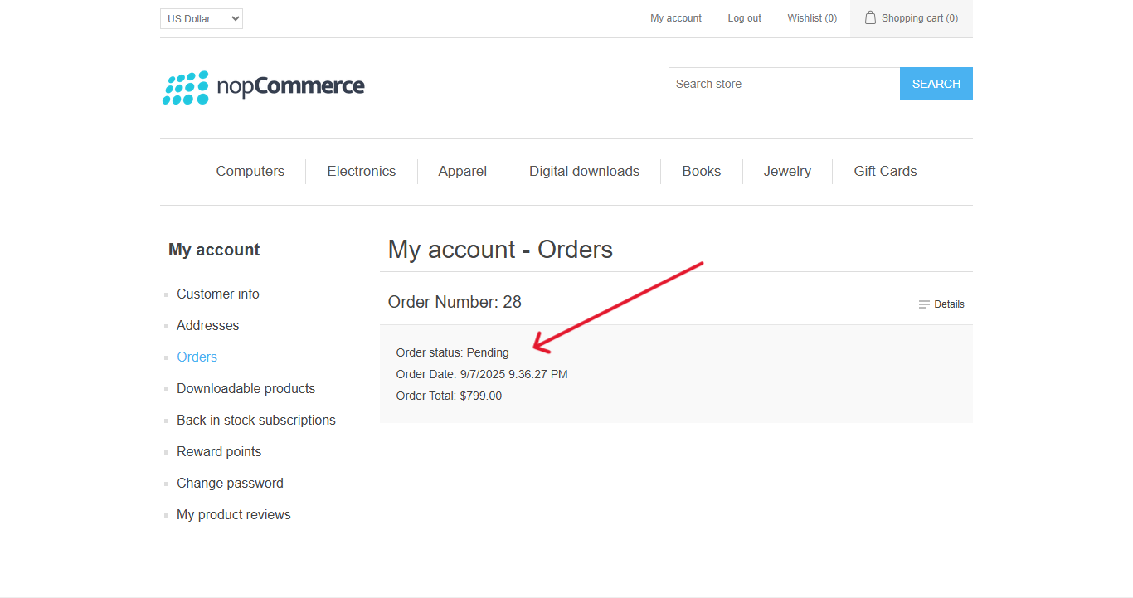
Order status stuck in “Pending” after checkout

Slide 12
Defect ID | Def_004
Defect Summary | User should not be able to register with only numbers in name field
Test Case ID | TC_NOP_REG_InvalidName_10
Test case name | Invalid Name format
Module Name | Register Page
reproducible | Add Validation Prompt user to enter only letters in Name Text fields
severity | Medium
priority | Medium
Raised by | Prasenjit Bhosale (Tester)
Assigned to | Development Team
Date of assignment | 05-09-2025
status | Open
Fixed by | FirstName Last Name (Developer)
Date of fixing=
Approvals=manager name | first Name LastName(Manager name)

Slide 13
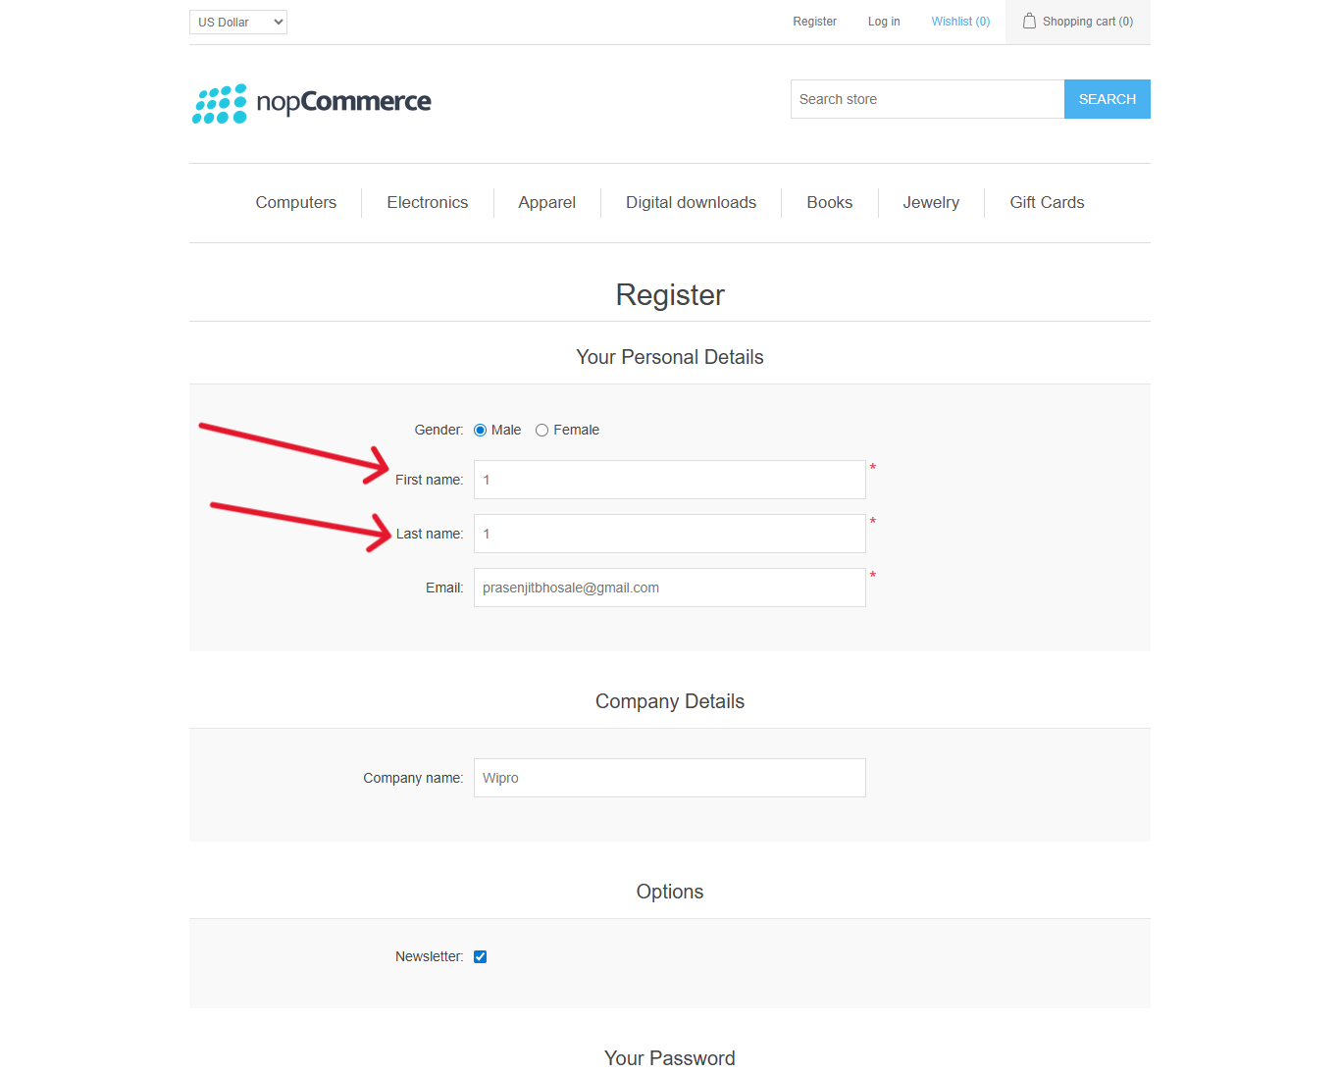
User should not be able to register with only numbers in name field

Slide 14
Challenges
Dynamic elements handling required Explicit Waits.
The Website Deletes User data after every 3 to 4 hours so it's really frustrating to create an account every time.
X-path doesn’t work sometimes.
Using Jenkins pipeline, I had to increase the Explicit Wait time up to 20 seconds. It was working fine on my laptop, but when test data came from GitHub (via Maven + Jenkins pipeline), shorter waits were causing test case failures.

Slide 15
Experience
Learned testing flow for an e-commerce site.
Gained hands-on experience in BDD with Cucumber, implementing feature files, step definitions, and scenarios for automated testing
Learned CI/CD integration using Jenkins, setting up pipelines to execute automated tests. Improved debugging skills while handling XPath & waits.
Developed an understanding of real-world challenges in combining manual and automated testing.

Slide 16
Thank You !
Vaishali Mam For Guiding Us through out the Project.

