Slide 1

A Project Defense on Lecture Archive
By:
Dina Manandhar (750312)
Niruta Baniya (750319)
Prashamsa Bakhrel (750323)
Sushma Karki (750347)
3 march,2022

Slide 2
Introduction
Web-based project ,purpose is to give instructors and students an interactive online platform for learning experience.
Students can have live class, materials of respective subjects .
Teacher can conduct classes, post related materials for the respective classes.
Provides necessary information on overall class activities.

Slide 3
Statement of problems
pandemic left students and colleges struggling which made physical learning difficult.

Slide 4
Objective
To develop a web portal for archiving lectures, tutorials and meetings.
To establish a central web archiving repository that could be equally shared among all parties.

Slide 5
Scope and application
is very useful in educational institutions.
to provide all necessary class activities in a systematic manner.
to make learning easier by staying in one place.

Slide 6
Literature Review
E-Pustakalaya is an education-focused digital library containing full-text documents, images, videos and audio files.
The University of Michigon and CERN with ATLAS collaboration journal paper, it focuses on lecture recording and large scale of conferences.
Richard I Arderson, Crystal Hoyer paper, it respects on classroom use of writing in one such system, in which instructor annotates projected slide using Tablet PC.
Craig Prince, Fred Videon paper, they make easier to interact with electronic material and extract information from them.
Edward C. Kaiser paper, recording, and uploading of the lecture archives are executed.

Slide 7
Algorithm
Step 1: Start.
Step 2: Go to Home page.
Step 3: Login as Student and Faculty separately by providing login username and password.
Step 4: View dashboard and use it to perform different classroom activities.
Step 5: Stop.

Slide 8
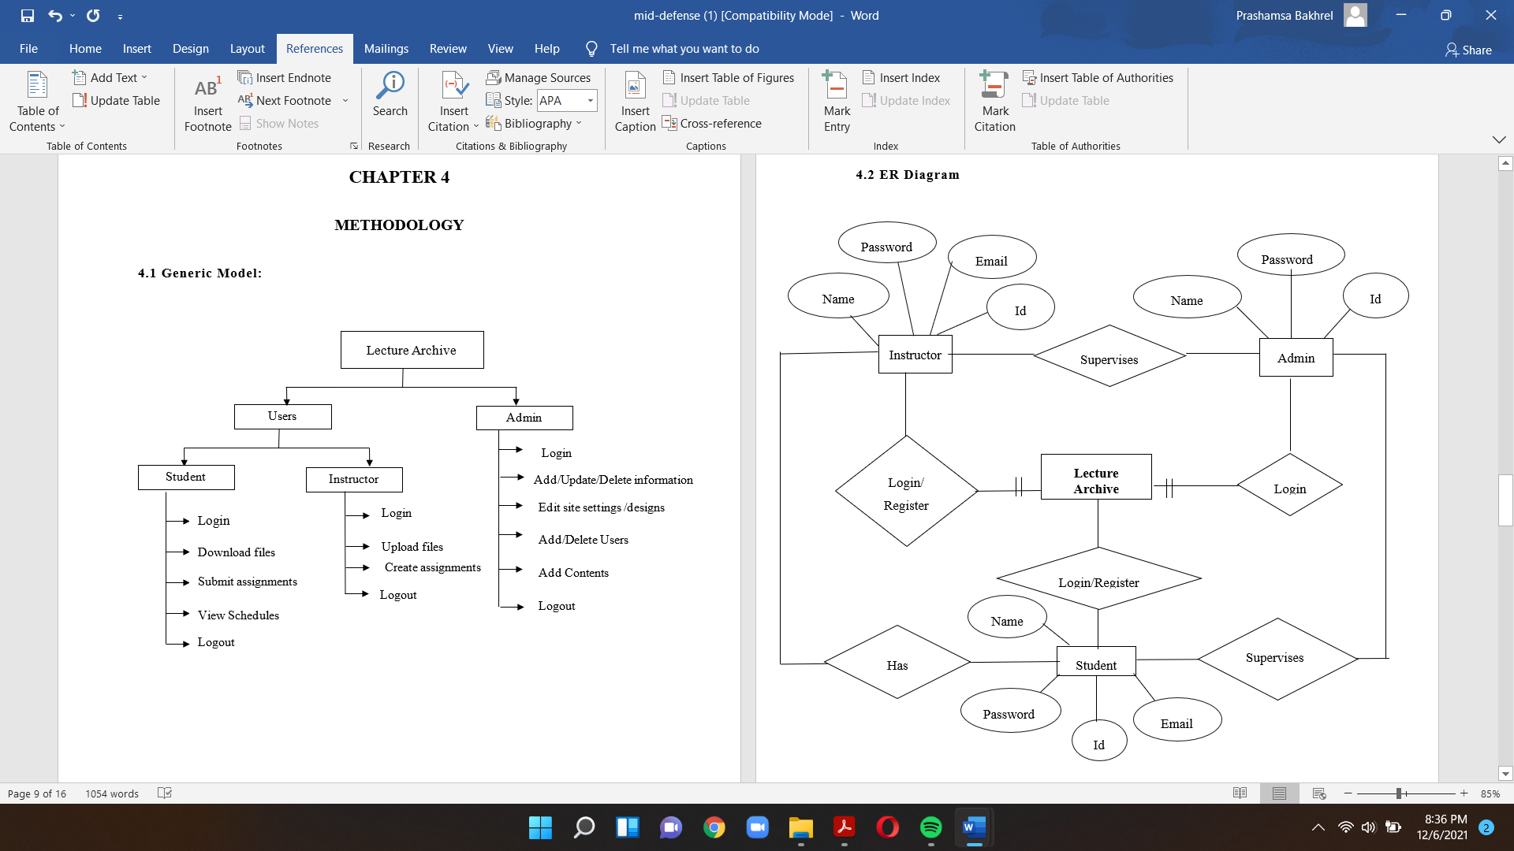
ER Diagram

Slide 9
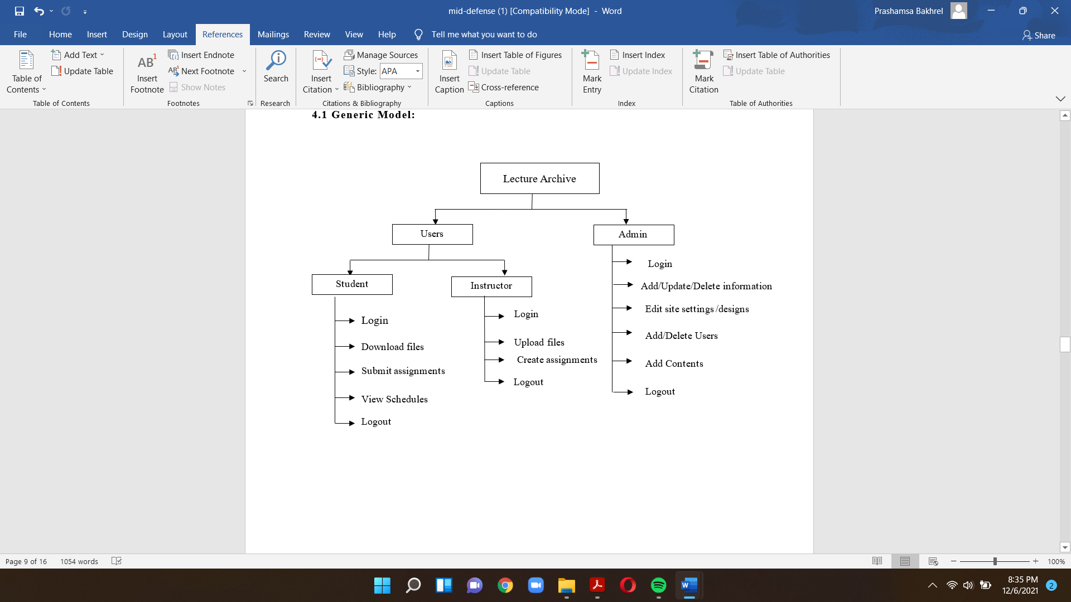
System Workflow

Slide 10
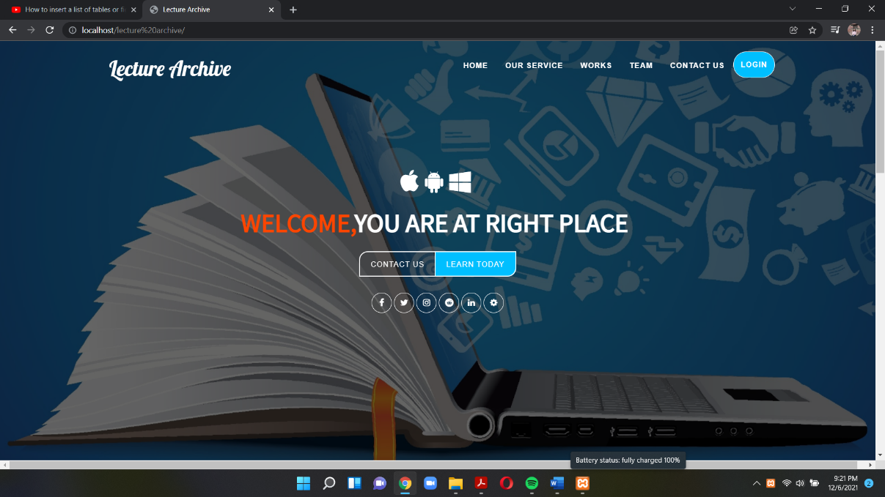
Appendix 1. Front Page

Slide 11
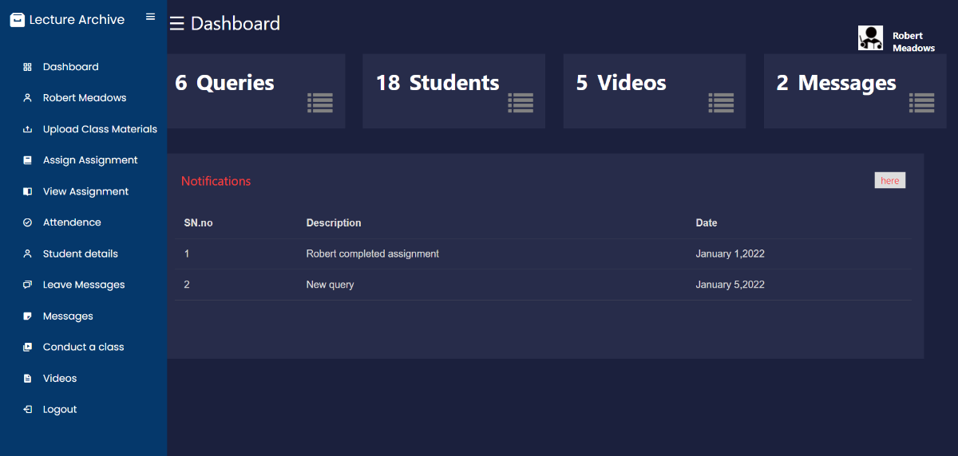
2. Faculty Dashboard

Slide 12
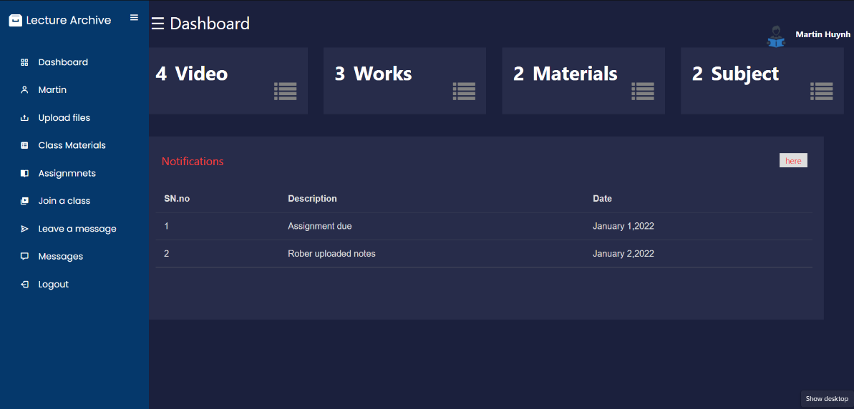
3. Student Dashboard

Slide 13
Result and Discussion
an effective environment for conducting an Online Classroom.
we introduced a user-friendly system
helped us to enhance more knowledge about different types of tools and software development life cycle in a practical way.

Slide 14
Limitations
Enhance the further website design.
To implement the notification systems.
To have materials of subjects in respective folders.

Slide 15
Conclusions
this project has been a good learning experience for us.
help for archiving lectures, tutorials.

Slide 16
Thank YOU!

