Slide 1
Category review: Chips
June 2020
Retail Analytics
Brand note: If client logo is not required, use alternate title page layout right click slide thumbnail > Layout > Title

Slide 2
Notes:
To view Privacy video explaining how important data privacy is to Quantium, please click here: https://www.youtube.com/watch?v=Zq1QDAkoRzU
or here Q:\Company Reference\Brand & Design\Brand videos\Q Privacy.mp4
At Quantium, we believe that data is the behavioural footprint of humanity and that it has to be treated with the utmost care and responsibility.
Histories, attitudes, indeed lives are stored within it in ways that aren’t always apparent – and that’s what makes its potential so powerful.
To work with it responsibly, sensitively, we set ourselves the highest data privacy protection and governance standards.
We have spent 17 years perfecting privacy-by-design and secure-by-design principles. Central to this is not holding any personally identifiable information about people –
we neither receive it, and put the necessary protections in place to be unable to decipher it.
Every aspect of handling data is safeguarded: from its de-identification, to its encryption – data security is paramount and of the highest grade.
We pride ourselves on gaining the trust of iconic organisations around the world through years of securely working with their data,
and in turn the trust that builds with their stakeholders.

Slide 3
Executive summary
Analyzed the Chips category to understand overall sales performance, customer purchasing behaviour, and key customer segments. Identified the customer groups contributing the highest sales and examined the impact of life stage and premium customer segments on purchasing patterns. These insights help identify the most valuable customer segments for future marketing and business strategies.
01
Task 1
Evaluated the effectiveness of the in-store trial by selecting suitable control stores and comparing their performance with the trial stores. The analysis measured changes in sales, customer numbers, and transaction behaviour during the trial period. Results showed that Store 77 (Trial) delivered the strongest positive impact, while Store 86 (Trial) showed moderate improvement and Store 88 (Trial) demonstrated limited impact.
02
Task 2

Slide 4
01
Category

Slide 5
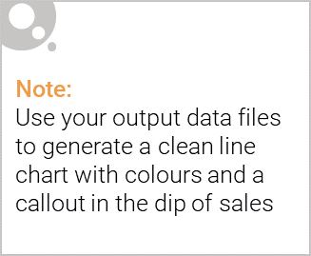
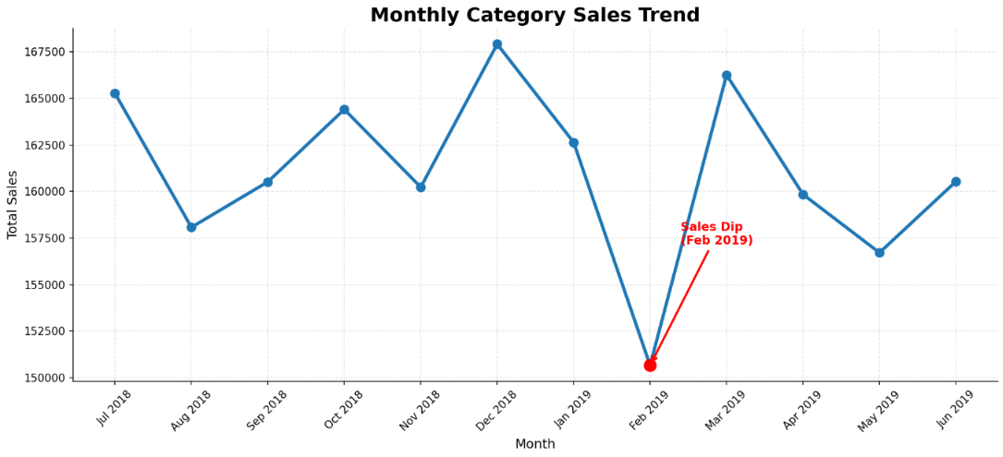
Category Overview:
The chips category demonstrated stable sales throughout the year, with only a temporary decline in February 2019.
Key Insights:
• Monthly chip sales remained relatively stable throughout the analysis period, indicating consistent customer demand.
• Category sales peaked in December 2018, while a temporary sales dip was observed in February 2019, before recovering in March 2019.
• The overall sales trend suggests short-term seasonal fluctuations rather than a sustained decline in category performance.

Slide 6

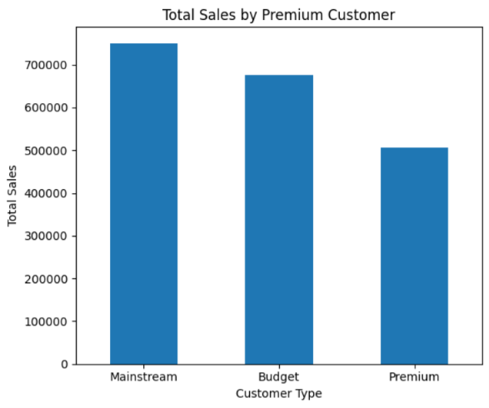
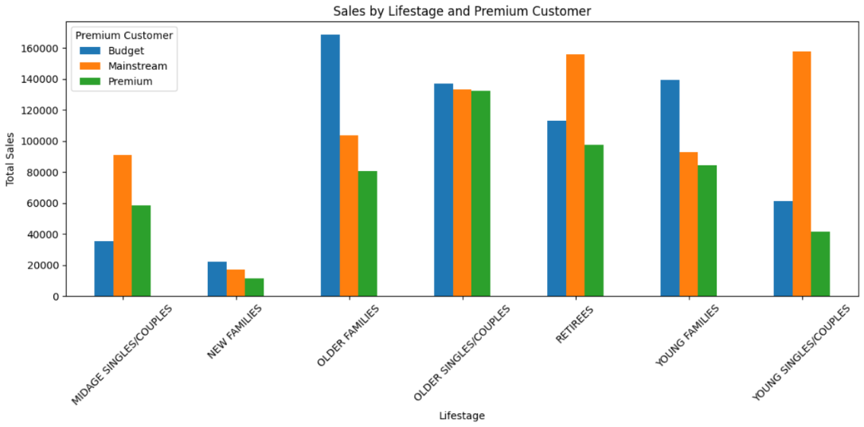
Affluence and Consumer Buying behaviour
Mainstream customers consistently generate the highest chip sales across most customer groups.
Mainstream customers contributed the highest overall chip sales across all affluence segments
Purchasing behaviour varies across life stages, with different affluence segments contributing more strongly depending on the customer group
Older Families and Young Families generated strong sales across affluence segments, highlighting them as important customer groups for the chips category

Slide 7
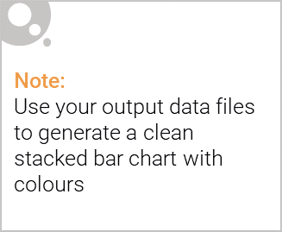
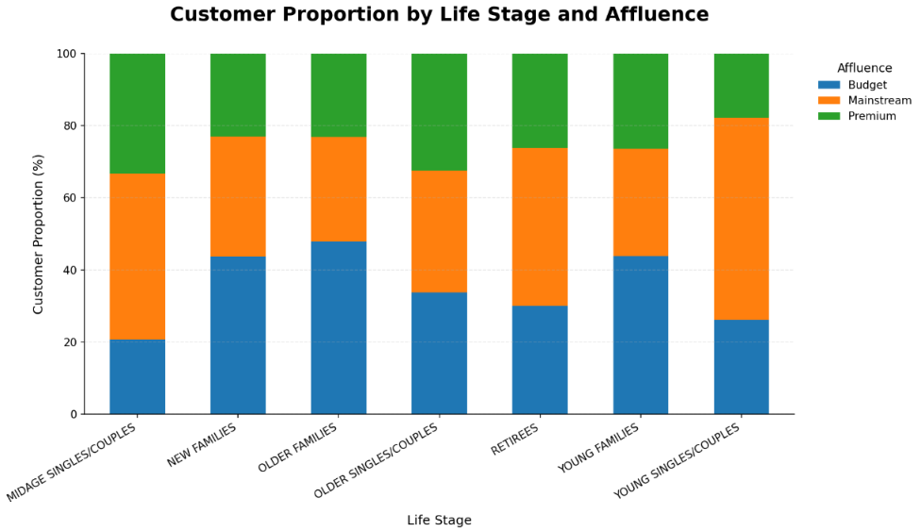
Editable (delete this)
Customer Composition by Life Stage and Affluence
Customer composition differs across life stages, highlighting distinct Budget and Mainstream customer segments.
Key Insights:
Mainstream customers dominate Young Singles/Couples, Midage Singles/Couples and Retirees.
Budget customers represent the largest proportion in New, Young and Older Families.
Older Singles/Couples are almost evenly distributed across Budget, Mainstream and Premium segments

Slide 8
02
Trial store performance

Slide 9
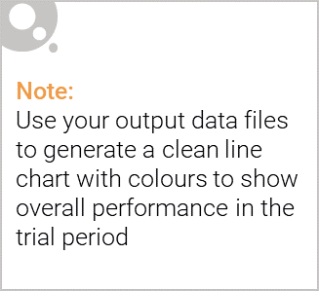
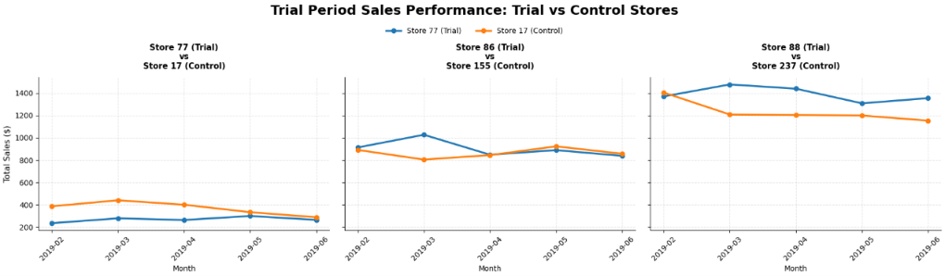
Trial Sales Comparison
(February 2019 – June 2019)

Slide 10
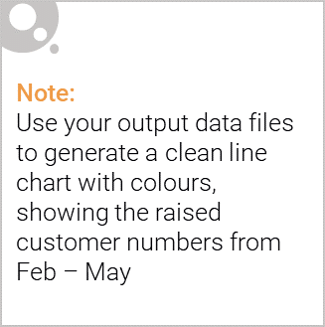
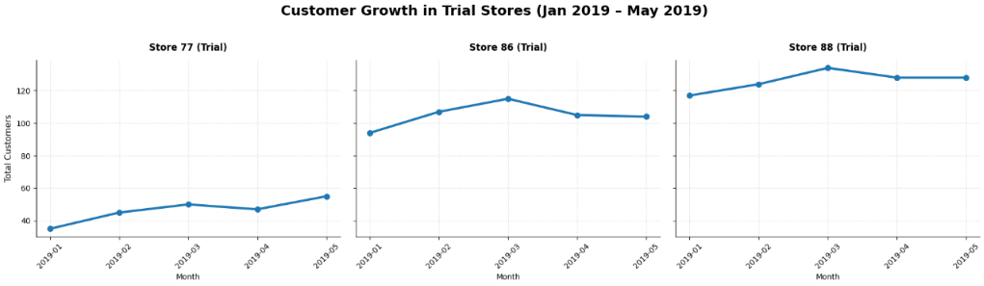
Call out of the performance in the trial store, determining if it was successful

