Slide 1

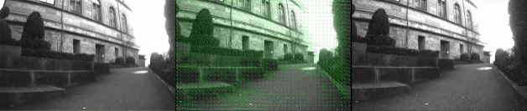
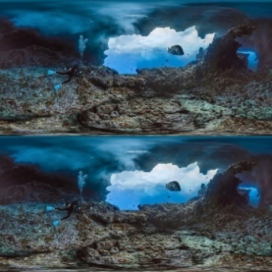
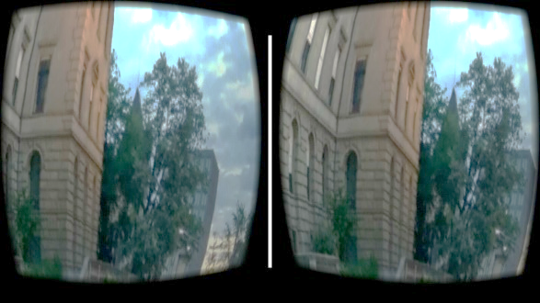
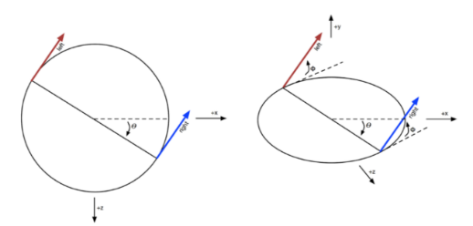
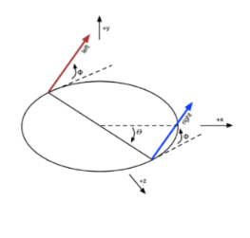
Omni-directional stereo for 360° 3D virtual reality video
Sasha Pagani¹, Julia Giger¹, Prashanth Chandran¹ supervised by Johannes Schönberger ²
¹Master Students, ETH Zurich; ²Computer Vision and Geometry Group, ETH Zürich
1 Motivation
3 Results and discussion
4 Technical details
Recently, Google introduced Jump¹, a hardware and software framework for the offline rendering of omni-directional stereo (ODS) videos for virtual reality(VR). Since Jump is designed as a complete solution, the vision algorithms it employs are optimized for a specific camera rig: the GoPro Odyssey. The goal of this project is to implement their ODS capture and composting algorithm and analyze its ability to render stereo images and videos captured through other means. At the end of the project, we hope to be able to render ODS content that can be viewed on the Google Cardboard; a cost effective head mounted display (HMD) for VR.
Results
One intermediate result is the per pixel optical flow computation.
The final results of the described method are omni-directional stereo images (see figure 4), which can be viewed in the Google Cardboard.
Discussion
We were not able to produce panoramas with the same high quality as Anderson et al.¹. One main reason for the lower visual quality of our panoramas is that we used a much simpler and therefore more inaccurate method for estimating the optical flow. Because our method is not based on a coarse-to-fine approach like the procedure presented by Anderson et al.¹, we adapted the standard per-pixel optical flow method of the OpenCV libary. Additionally, this approach does not take into account the borders of an object and is therefore not edge preserving in contrast to the bilateral-solver used by Anderson et al.¹, which also respects the edges in the image. Furthermore, we used a much simpler exposure correction based on a classic linear interpolation and we simplified the stitching procedure. Moreover, our results have of course the same drawbacks as the implementation of Anderson et al.¹. Namely, straight lines may appear slightly curved in the constructed panorama. Additionally, there is a small vertical distortion because the camera rig is larger than the actual viewing circle.
In addition, we were only able to construct omni-directional stereo images, but not videos.
We implemented the solution using Python 2.7. For generating an output usable on an Android smartphone, we used Unity 5.6 with the Google VR SDK provided by Google. A Google Cardboard is necessary for a better VR feeling. During the testing part we used different datasets. The one provided from our supervisor is obtained from 10 cameras mounted on a robot. The calibration information of every camera was also made available to us. Furthermore, we also produced some simple datasets by ourselves with our smartphone cameras.
Fig. 3. This image shows the optical flow between two images.
2 Method overview
5 Conclusion
We implemented a similar method as described in [3]. The following method is applied twice, once for the left and once for the right eye. Therefore, the final results are two different panoramas. For meeting the required image format for the Google Cardboard, the panorama of the left eye is stacked on top of the right. The main idea of the stitching procedure is to compute for each pixel the horizontal angle ϴ (fig. 1) and vertical angle Φ (fig. 2) of the corresponding camera ray with respect to the camera center.
Based on the computed flow values of the neighboring camera, the new position (ϴ’, Φ’) of the same pixel is calculated. The values of the pixels in between the original and the shifted pixel are obtained by a simple interpolation. All the RGB- values of the pixels are stored in the new panorama image at the corresponding position: (ϴ, Φ), (ϴ’, Φ’) or at one of the interpolated positions.
We were able to implement a similar system like the Jump from Google for viewing omni-directional stereo images on the Google Cardboard. However, we did not use such sophisticated methods for the different subproblems, like for example the optical flow computation, the exposure correction and the compositing step. Therefore, we only achieved a much lower visual quality with some artefacts. Moreover, the quality of our produced panoramas is lower because our dataset only contained images from 10 different cameras, which additionally were not equally distributed onto the rig. Whereas Anderson et al.¹ used a camera rig with 16 equally-distant GoPro cameras with a larger vertical field of view.
Fig. 4. An example of an omnidirectional stereo image, produced by Google³.
Fig. 5. An example of an omni-directional stereo image, viewed in the Google Cardboard.
6 References
Fig. 1 This figure shows the horizontal angle ϴ
Fig. 2: This figure shows the vertical angle Φ
Robert Anderson, David Gallup, Jonathan T. Barron, Janne Kontkanen, Noah Snavely, Carlos Hernandez Esteban, Sameer Agarwal, and Steven M. Seitz. Jump: Virtual reality video. 2016.
Google Inc. Rendering Omni-directional Stereo Content
https://developers.google.com/vr/concepts/vrview

