Slide 1
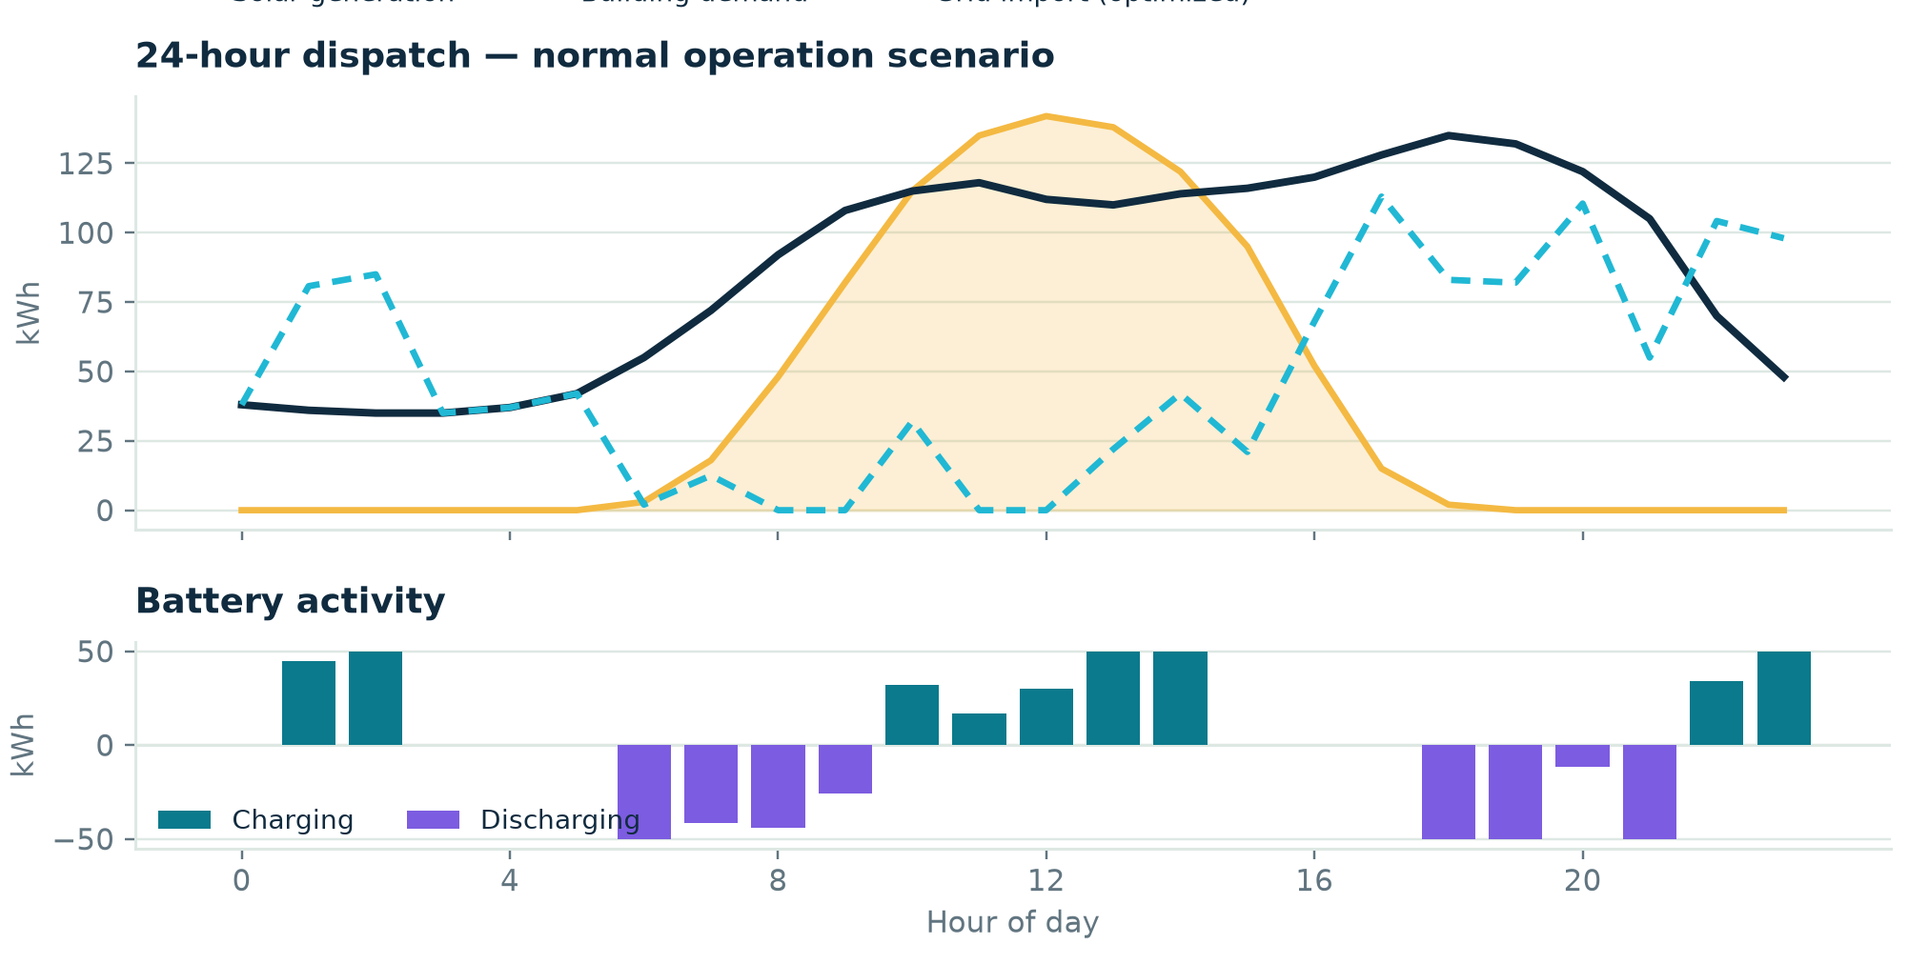
01 / PROBLEM
Solar peaks at noon. Bills peak in the evening.
C&I buildings with solar + battery: offices, hotels, hospitals, factories.
Assets run independently — no system decides hour-by-hour whether to store, use, or buy power.
Result: wasted midday solar, expensive grid import at the 6–10 PM peak.
40%
of China's solar is now distributed — with grid congestion in 11 provinces (IEA, 2024). India just opened its own VPP policy path.
Actual synthetic-day output from the GridPilot AI model — solar (orange) vs. demand (navy).
IMPACT TANK '26 / FINAL PITCH DAY
01

Slide 2
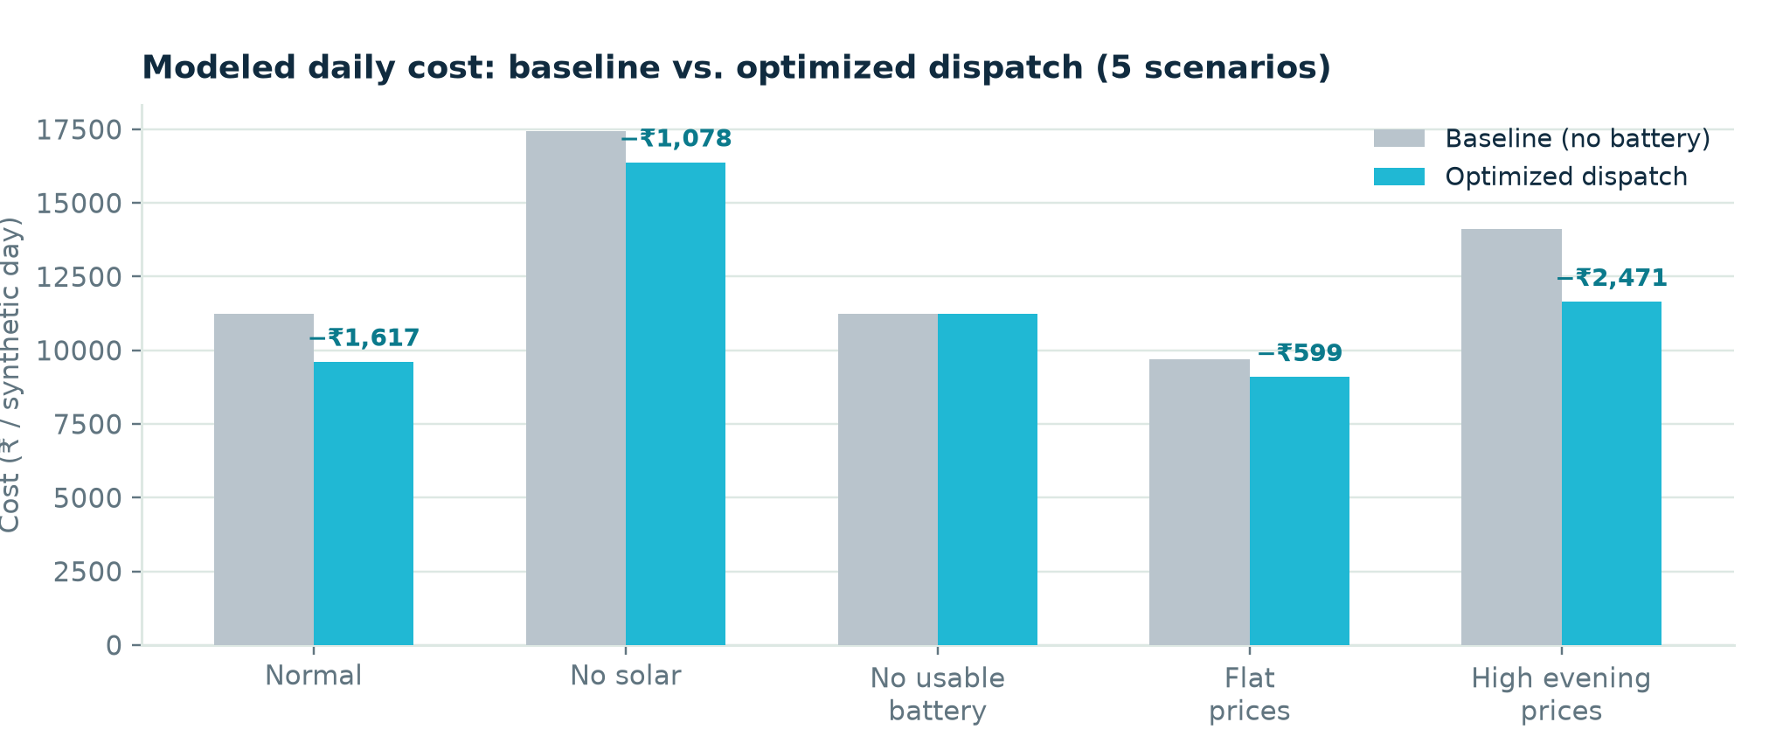
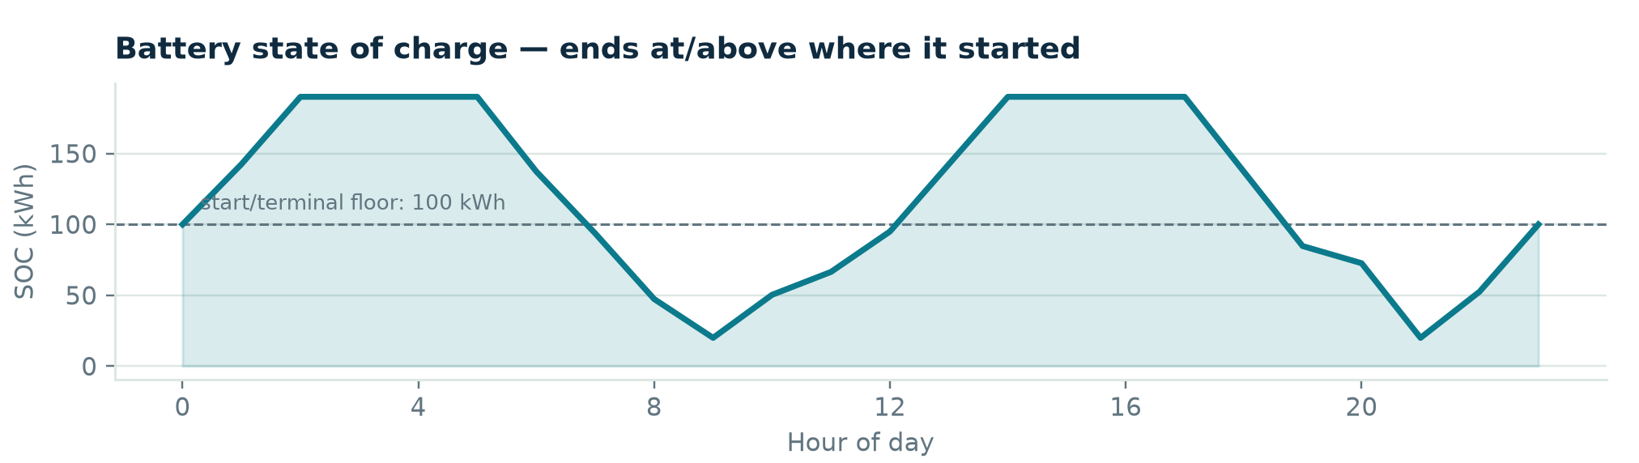
02 / SOLUTION
GridPilot AI decides, hour by hour, what the battery should do.
Reads a building's hourly demand, solar, and electricity tariff.
Solves a linear program to pick grid import vs. battery charge/discharge for every hour — minimizing cost under real battery physics.
Works with any Indian DISCOM ToU tariff, not fixed presets.
Modeled savings across all 5 standard test scenarios.
Why it matters
Level 1 of a 4-level path: solar+battery → EVs/appliances → grid flexibility → virtual power plant.
IMPACT TANK '26 / FINAL PITCH DAY
02

Slide 3
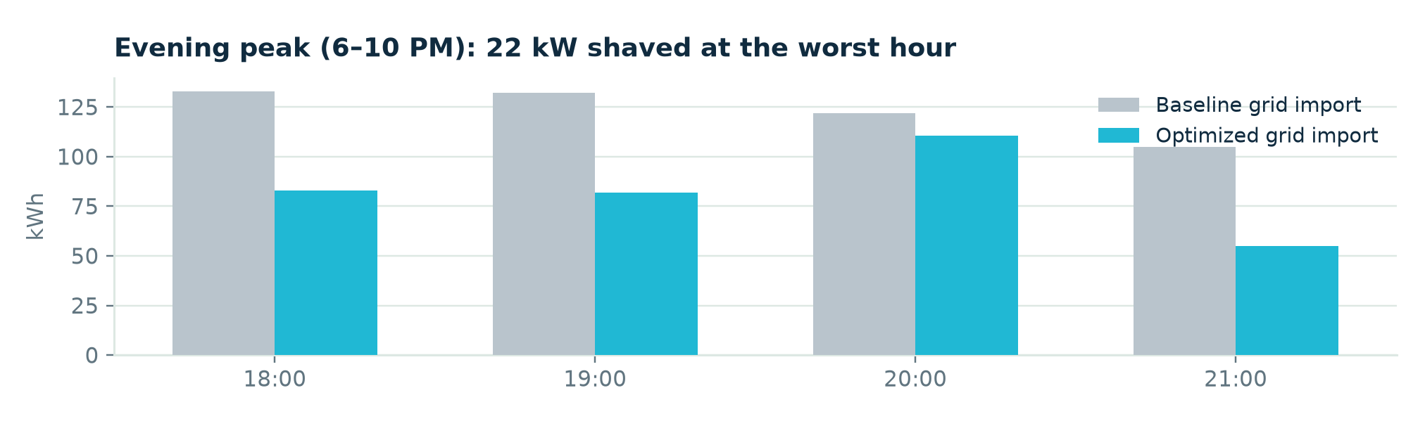
03 / HOW IT WORKS
Four inspectable stages, start to finish.
INPUTS
CONSTRAINTS
SOLVER
OUTPUT
Hourly demand
Solar generation
Electricity tariff
Power limits
SOC bounds
Terminal SOC rule
SciPy linprog
(HiGHS)
Minimize cost
Grid import
Charge / discharge
SOC + ₹ savings
Every output is re-checked independently
validate_physical_schedule() re-verifies energy balance, SOC bounds and the terminal-SOC rule before any number reaches the dashboard.
IMPACT TANK '26 / FINAL PITCH DAY
03

Slide 4
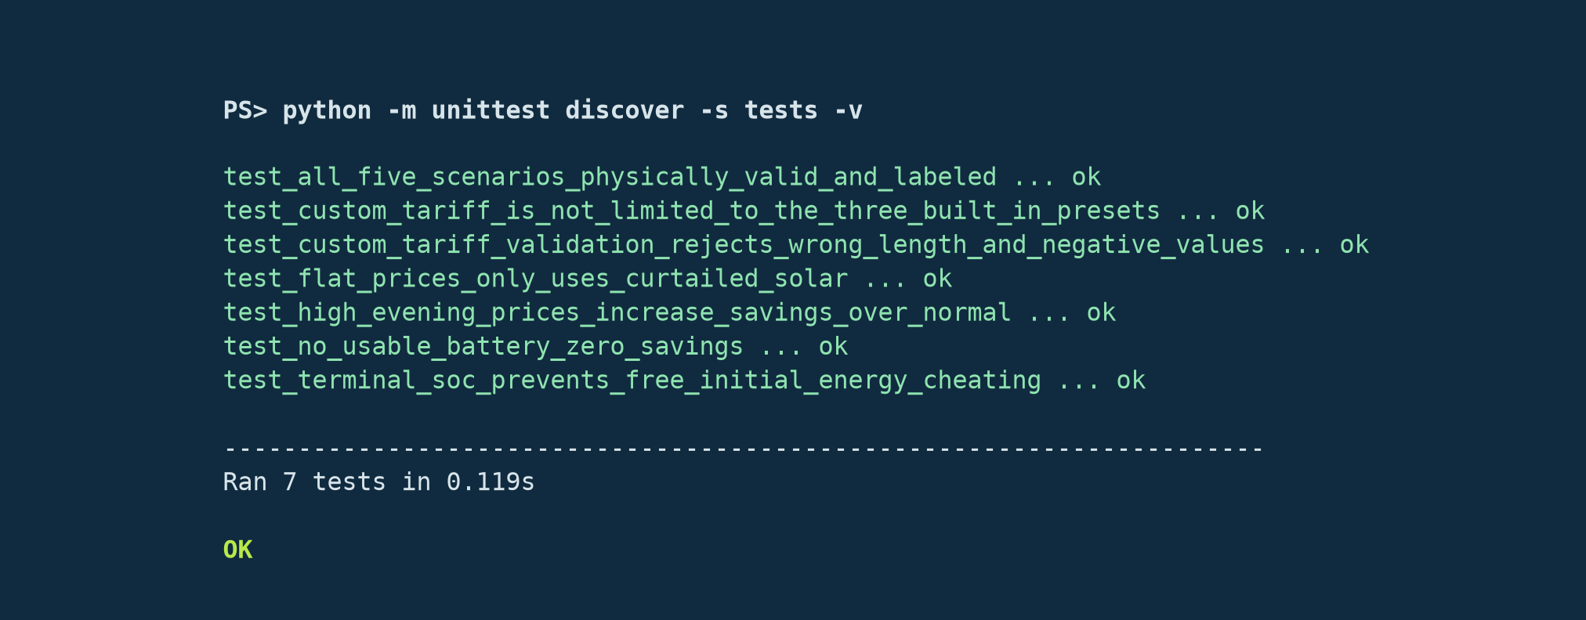
04 / LIVE PROTOTYPE
Runnable today — not a mockup.
poetry run streamlit run app.py
Pick any of 5 scenarios or set a custom battery + tariff.
See the optimized 24h schedule, Sankey energy flow, and savings waterfall instantly.
Download the hourly schedule as CSV.
Actual terminal output, this session: 7/7 tests pass.
Stated up front
All inputs are SYNTHETIC — nothing is wired to a live meter, tariff feed, or real battery yet. Single building, single day horizon; no demand charges or degradation modeled.
IMPACT TANK '26 / FINAL PITCH DAY
04

Slide 5
05 / VALIDATION
Software correctness: proven. Field validation: next.
✓
All 5 scenarios pass physical validation
✓
Flat prices → no fake arbitrage (round-trip losses respected)
✓
High evening tariff beats normal tariff, as it should
✓
Zero battery → exactly ₹0 savings (sanity check)
✓
Terminal-SOC rule blocks fake “free energy” savings
✓
Custom DISCOM tariffs flow through unmodified
7 / 7
automated tests pass, re-run live this session
Not yet validated: real customer data, a live pilot, or facility-manager interviews. That's the next slide, not a claim made here.
IMPACT TANK '26 / FINAL PITCH DAY
05

Slide 6
06 / COMPETITORS
Every alternative is siloed, foreign-market, or supply-side only.
APPROACH
EXAMPLES
LIMITATION
Vendor ecosystems
Tesla Autobidder, Huawei, sonnen
Locked to their own hardware
VPP / DERMS platforms
EnergyHub, Leap, Kraken, Sunrun
Built for US/EU markets, not Indian ToU
Device-level controls
Inverter / battery / EV defaults
Each device only sees itself
India grid-side
Transmission, BESS, pumped hydro
Supply-side, doesn't reach behind-the-meter
India DR + 2025 VPP policy
Early pilots, new framework
No simple coordination layer yet
Our edge: transparent, auditable, built for Indian C&I ToU tariffs — hardware-agnostic.
IMPACT TANK '26 / FINAL PITCH DAY
06

Slide 7
07 / IMPACT
Measured honestly: observed this round vs. projected.
17.5%
20 kW
7 / 7
₹0
peak modeled savings
(high evening tariff)
evening-peak grid
import shaved
automated tests
passing today
fake savings — blocked
by terminal-SOC rule
Observed this round
5 synthetic scenarios, physics-validated. Savings ₹599–₹2,471/day.
Projected, pending pilot
Real bill savings and kW/kWh impact on a live site, measured in the GTM pilot.
IMPACT TANK '26 / FINAL PITCH DAY
07

Slide 8
08 / NEXT STEPS
From tested MVP to a validated pilot.
1
2
3
4
Submit
1 shadow pilot
Reconcile
Extend model
Demo video + this deck as PDF.
Real tariff + data, 1–2 weeks, no hardware control.
Compare vs. the site's actual utility bill.
Demand charges, degradation, peak trade-off.
RISKS
SUPPORT NEEDED
No pilot partner secured yet.
DISCOM tariff edge cases untested.
Cost-min doesn't guarantee peak reduction.
Intro to a willing C&I facility manager.
Real interval meter data for one building.
Mentorship on DISCOM tariff nuances.
GridPilot AI
Priyam Pandey · Kirthi Priya M · Prashanth R — pilot outreach, model extensions, and dashboard/demo respectively.
IMPACT TANK '26 / FINAL PITCH DAY
08

