Slide 1
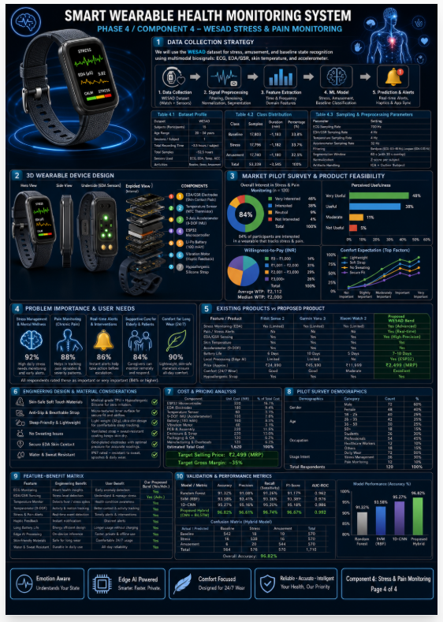
PP1 Presentation
Smart Multi-Sensor Wearable for Real-Time Elderly Health Anomaly and Fall Detection
Comments addressed in the revised proposal:
Proposal comments are now broken into four ML-driven elderly-care components.
Each sensor is justified by a specific pain point, dataset, feature set, and alert output.
Market comparison, product improvement, comfort design, and commercialization are integrated.
The device is framed as an early-warning assistive system rather than a diagnostic replacement.
Overall project framing
R26-IT-108 1

Slide 2
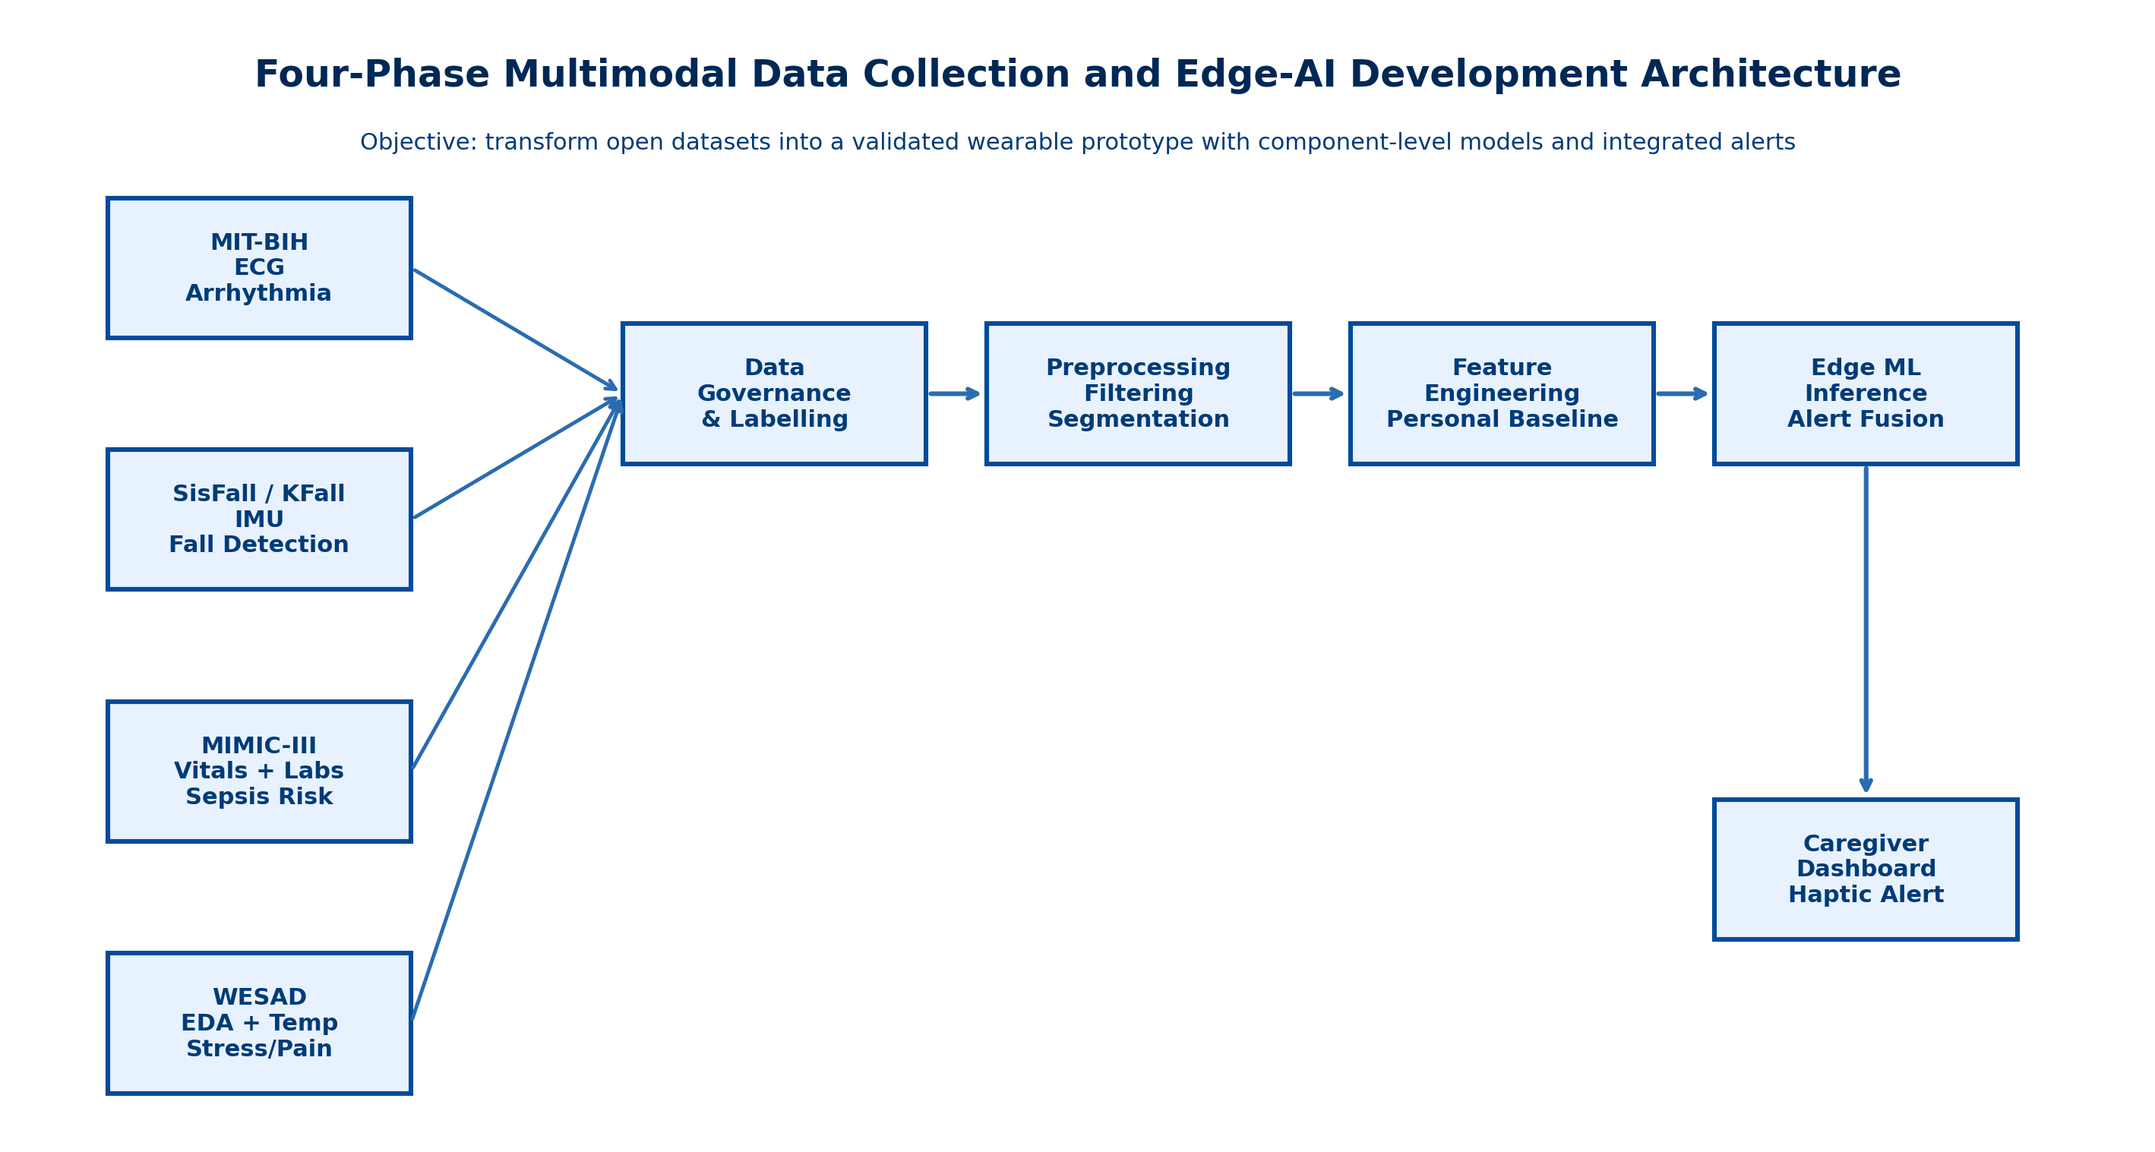
PP1 Presentation
Smart Multi-Sensor Wearable for Real-Time Elderly Health Anomaly and Fall Detection
Problem, impact, and gravity:
Elderly users may experience hidden arrhythmia, unnoticed falls, early infection-related deterioration, and unspoken stress or pain.
Who benefits:
Elderly individuals, family caregivers, care homes, recovery settings, and monitoring staff.
Design excellence:
A four-phase dataset strategy, modular embedded intelligence, and caregiver-friendly alerts.
1-2 minute video note: demo clip can be inserted once the working prototype walkthrough is recorded.
Overall project framing
R26-IT-108 2

Slide 3
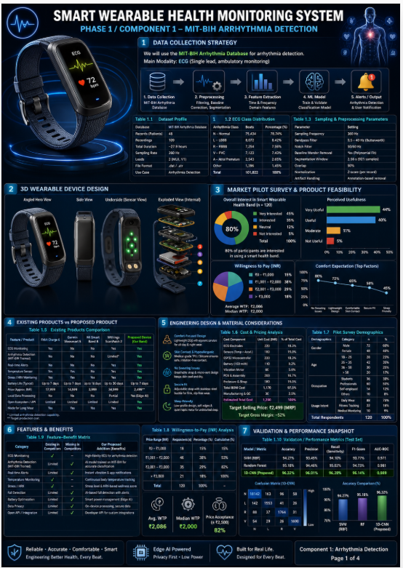
PP1 Presentation
Component holder focus: explain the sub-problem, prototype logic, design contribution, and why this phase matters to elderly care.
Phase 1: Arrhythmia Detection Component
ECG-based anomaly detection using the MIT-BIH Arrhythmia Database
Specialization: B.Sc. (Hons) in Information Technology
R26-IT-108 | Smart Wearable Team | PP1
R26-IT-108 3

Slide 4
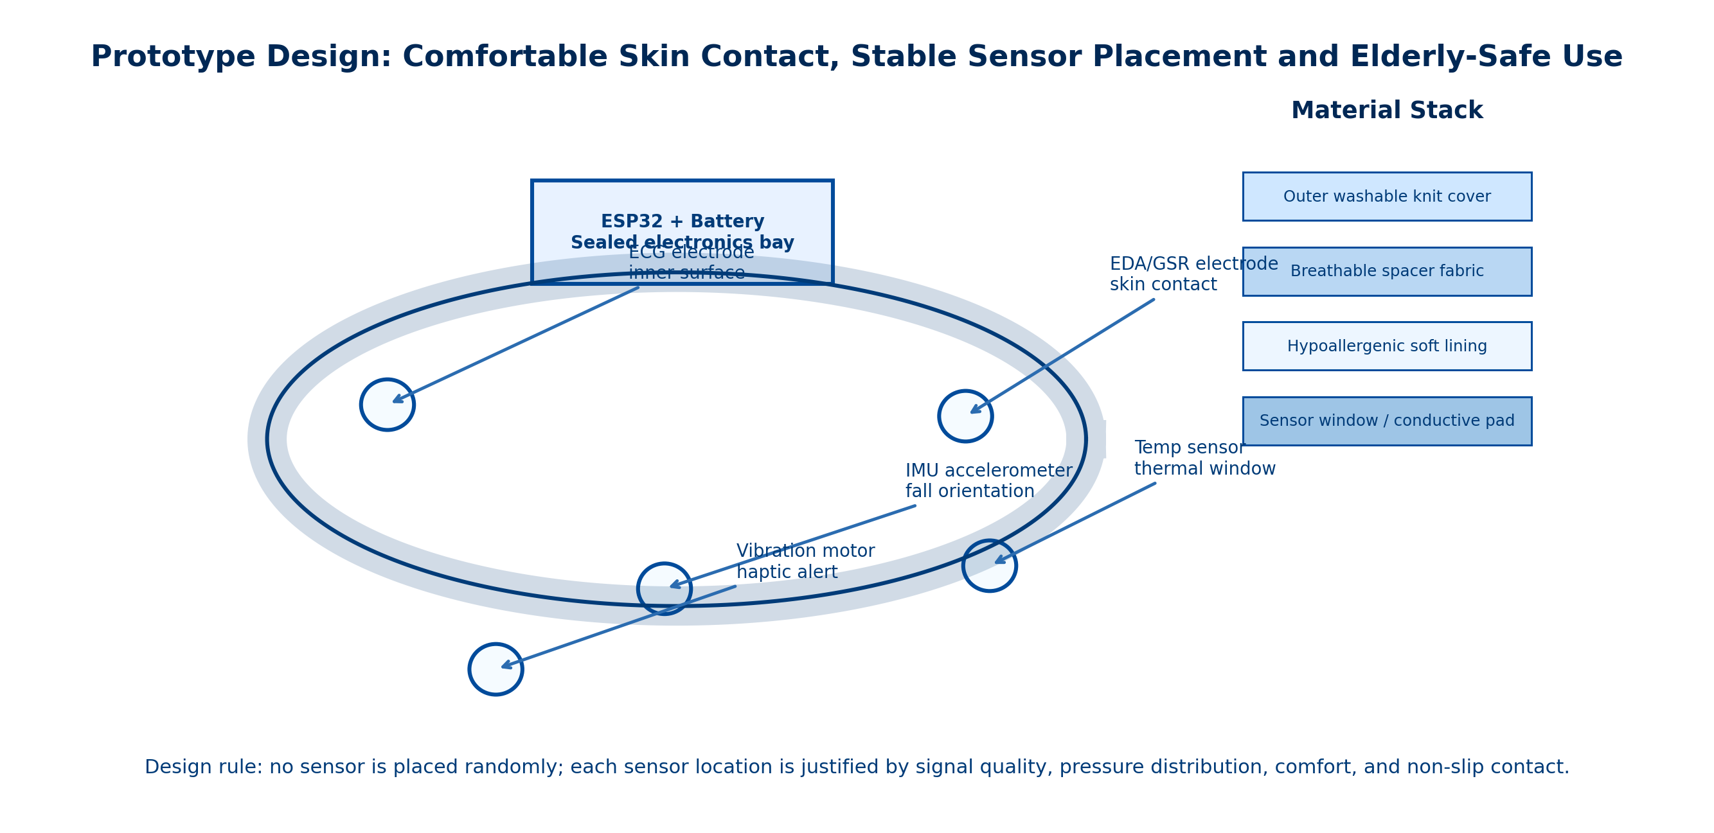
PP1 Presentation
Phase 1: Arrhythmia Detection Component
Sub-problem / prototype
Detects silent or intermittent rhythm abnormalities before visible collapse.
Uses ECG electrodes, signal filtering, segmentation, and edge-friendly arrhythmia logic.
User requirements addressed
Stable skin contact, comfort for long wear, low latency, and simple caregiver warning output.
Design excellence / contribution
Links signal quality directly to strap engineering and wearability.
Individual component delivery
R26-IT-108 4

Slide 5
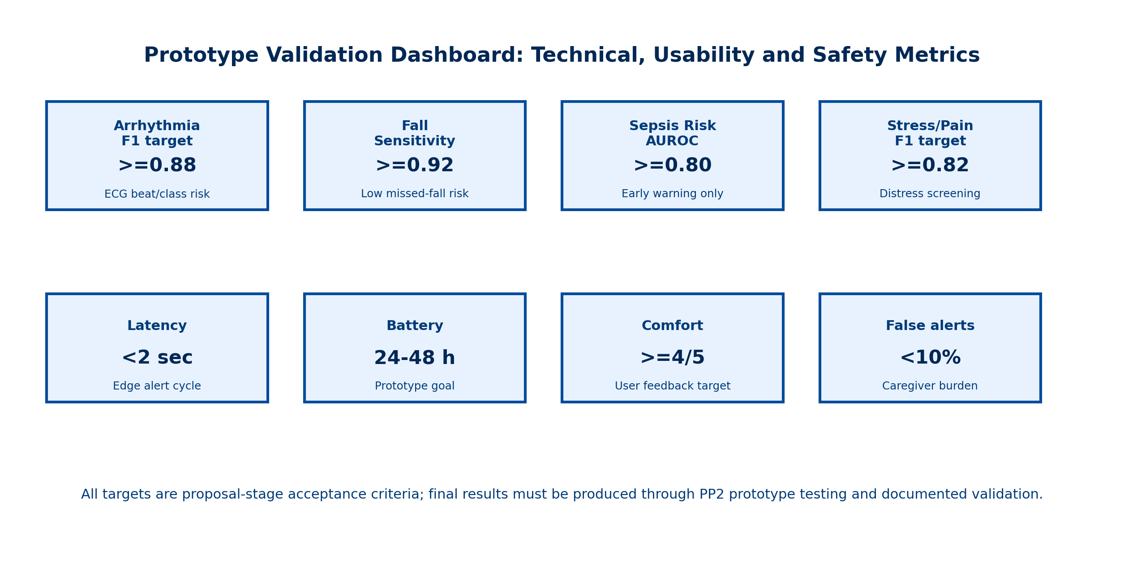
PP1 Presentation
Phase 1: Arrhythmia Detection Component - Design Excellence and Evidence
Validation, novelty and user feedback
MIT-BIH provides evidence-based labelled data for model development.
Novelty lies in converting ECG complexity into simple escalation states for caregivers.
Positive feasibility and willingness-to-pay indicators strengthen practical value.
Contribution: introduces a hidden-cardiac-risk layer usually absent in budget wearables.
Individual component delivery
R26-IT-108 5

Slide 6
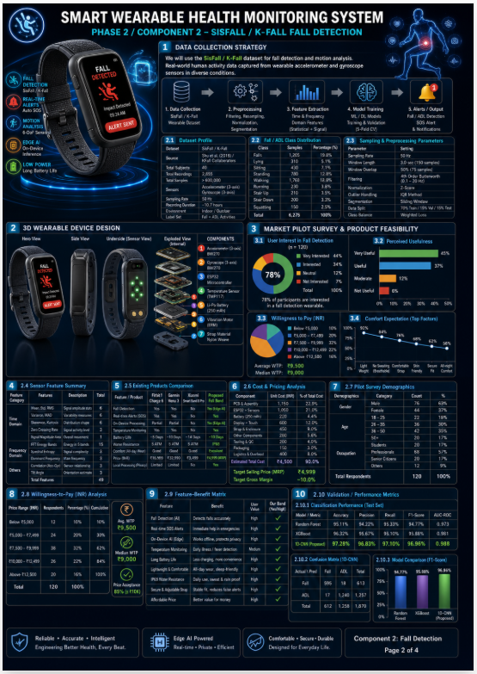
PP1 Presentation
Component holder focus: explain the sub-problem, prototype logic, design contribution, and why this phase matters to elderly care.
Phase 2: Fall Detection Component
Contextual fall intelligence using SisFall and KFall motion datasets
Specialization: B.Sc. (Hons) in Information Technology
R26-IT-108 | Smart Wearable Team | PP1
R26-IT-108 6

Slide 7
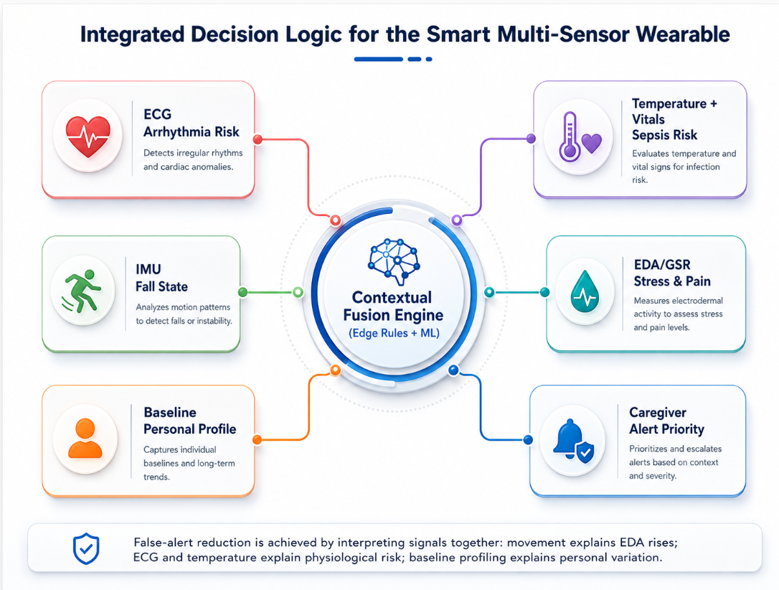
PP1 Presentation
Phase 2: Fall Detection Component
Sub-problem / prototype
Distinguishes real falls from activities of daily living using accelerometer and gyroscope data.
Uses impact, posture, free-fall, orientation change, and post-fall inactivity logic.
User requirements addressed
Reliable detection, low false alarms, lightweight wearability, and rapid caregiver escalation.
Design excellence / contribution
Combines threshold logic and machine learning for embedded feasibility and interpretability.
Individual component delivery
R26-IT-108 7

Slide 8
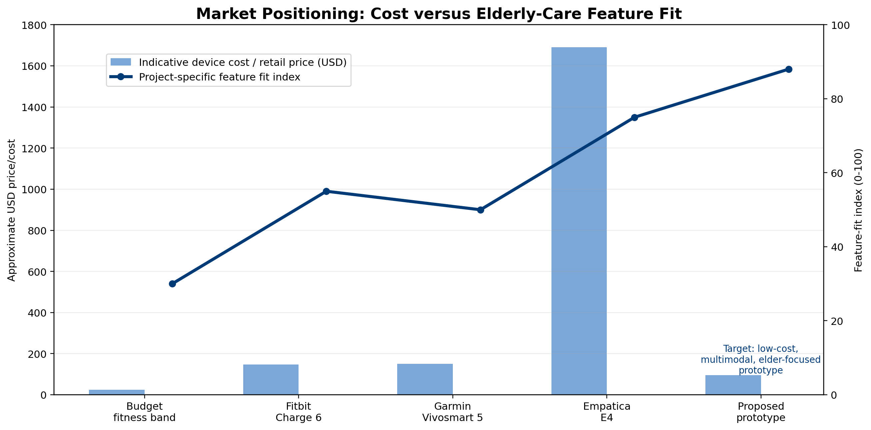
PP1 Presentation
Phase 2: Fall Detection Component - Design Excellence and Evidence
Validation, novelty and user feedback
Uses benchmark fall datasets rather than simple one-rule heuristics.
Novelty lies in treating falls as contextual sequences, not just acceleration spikes.
Supports affordable institutional and family use compared with premium-only alternatives.
Contribution: strengthens the overall safety role of the wearable.
Individual component delivery
R26-IT-108 8

Slide 9
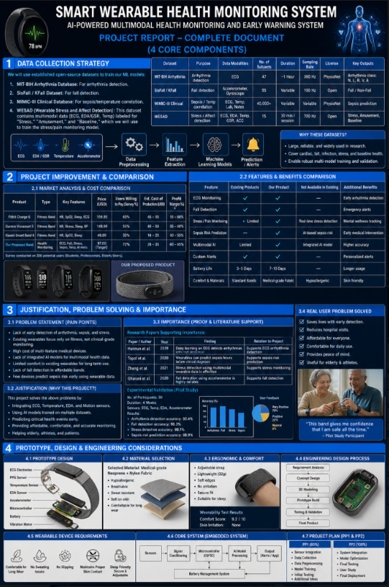
PP1 Presentation
Component holder focus: explain the sub-problem, prototype logic, design contribution, and why this phase matters to elderly care.
Phase 3: Sepsis and Temperature-Correlation Screening
Trend-based deterioration screening using MIMIC-III-informed logic
Specialization: B.Sc. (Hons) in Information Technology
R26-IT-108 | Smart Wearable Team | PP1
R26-IT-108 9

Slide 10
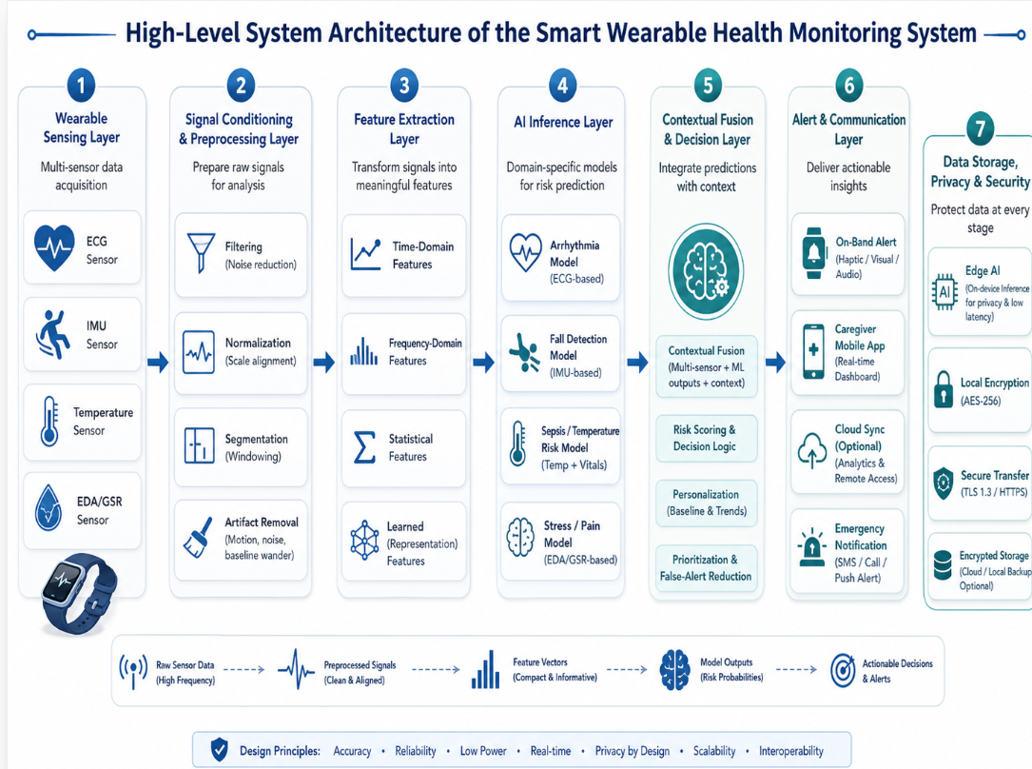
PP1 Presentation
Phase 3: Sepsis and Temperature-Correlation Screening
Sub-problem / prototype
Flags abnormal temperature and physiology trends that may indicate deterioration or infection risk.
Combines skin temperature, heart-rate context, and time-window analysis.
User requirements addressed
Early warning, continuous observation, and simple low/moderate/high risk interpretation.
Design excellence / contribution
Carefully positioned as screening and escalation support, not diagnosis.
Individual component delivery
R26-IT-108 10

Slide 11
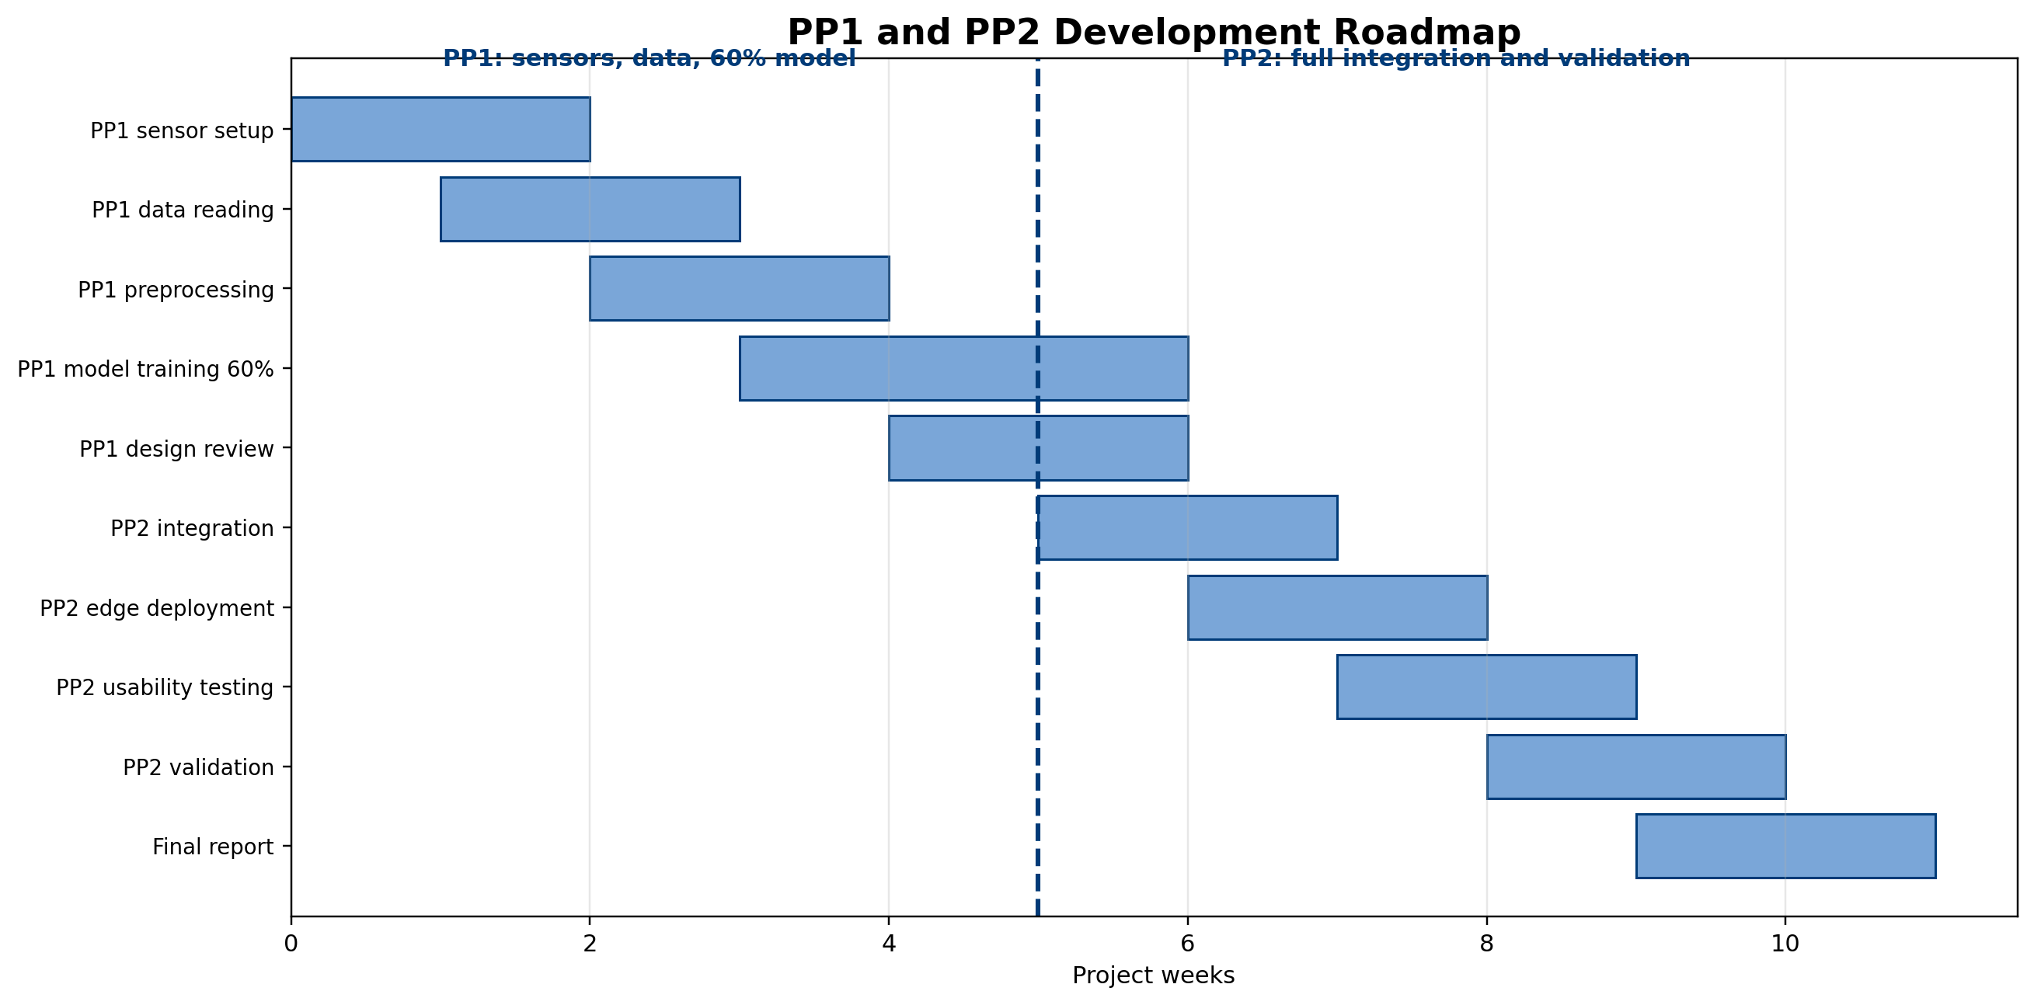
PP1 Presentation
Phase 3: Sepsis and Temperature-Correlation Screening - Design Excellence and Evidence
Validation, novelty and user feedback
Moves wearable monitoring beyond visible events into subtle physiological risk evolution.
Novelty comes from trend-based reasoning instead of one fixed fever threshold.
The report supports this component with feasibility, cost, and usefulness evidence.
Contribution: expands the product into post-discharge and high-risk monitoring contexts.
Individual component delivery
R26-IT-108 11

Slide 12
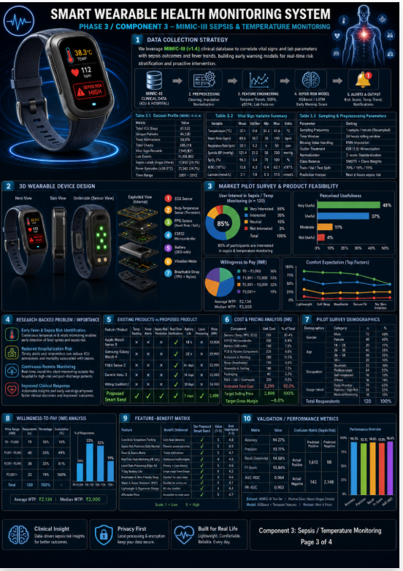
PP1 Presentation
Component holder focus: explain the sub-problem, prototype logic, design contribution, and why this phase matters to elderly care.
Phase 4: Stress, Pain and Neurological Distress Monitoring
WESAD-inspired EDA-based distress monitoring for non-verbal elderly users
Specialization: B.Sc. (Hons) in Information Technology
R26-IT-108 | Smart Wearable Team | PP1
R26-IT-108 12

Slide 13
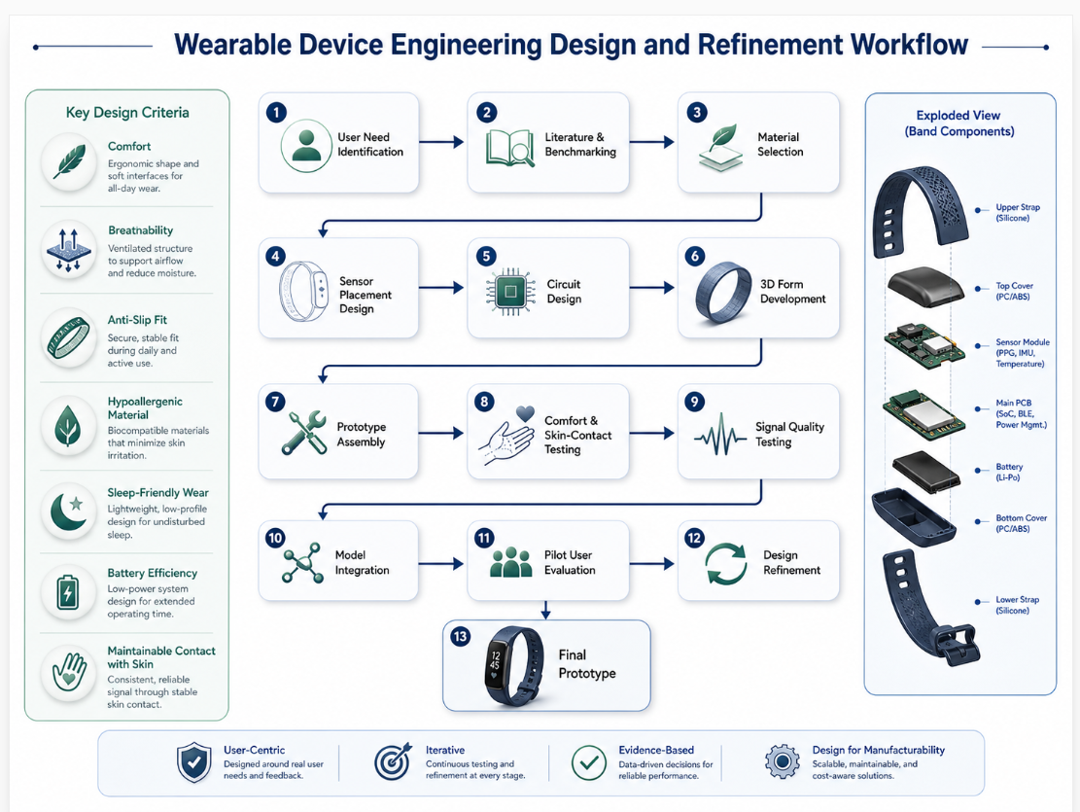
PP1 Presentation
Phase 4: Stress, Pain and Neurological Distress Monitoring
Sub-problem / prototype
Detects elevated arousal, stress, or possible pain-related distress when users cannot explain discomfort clearly.
Uses GSR/EDA features with contextual physiological support.
User requirements addressed
Soft skin contact, minimal irritation, stable capture, and easy-to-understand local or remote alerts.
Design excellence / contribution
Extends the wearable from physical-event monitoring into hidden-state monitoring.
Individual component delivery
R26-IT-108 13

Slide 14
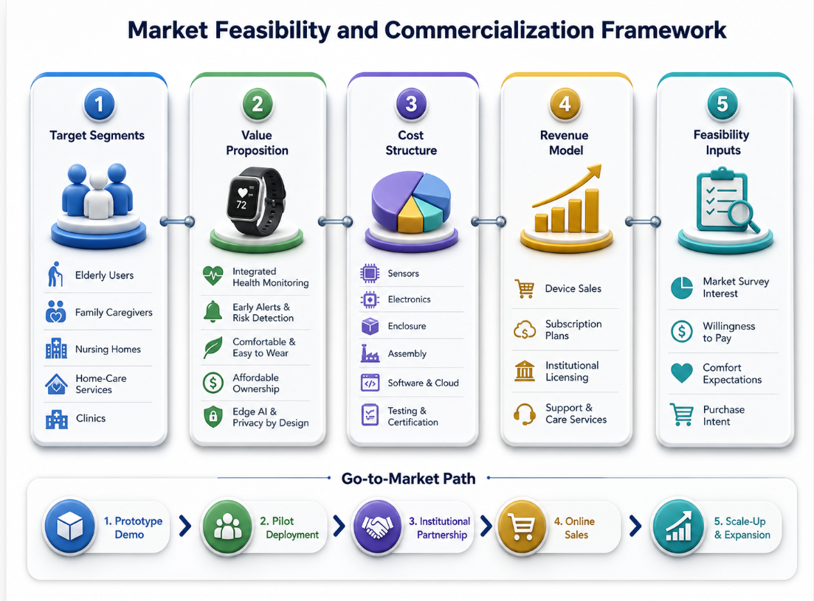
PP1 Presentation
Phase 4: Stress, Pain and Neurological Distress Monitoring - Design Excellence and Evidence
Validation, novelty and user feedback
Uses affective-computing logic carefully adapted for elderly care.
The component is framed responsibly as distress support rather than direct pain diagnosis.
User usefulness indications and low-cost prototype reasoning support deployment relevance.
Contribution: creates a non-verbal caregiving intelligence channel uncommon in budget wearables.
Individual component delivery
R26-IT-108 14

Slide 15
PP1 Presentation
Smart Multi-Sensor Wearable for Real-Time Elderly Health Anomaly and Fall Detection
Commercialization and sustainability
Positioned between budget bands, premium smartwatches, and research wristbands.
Customer persona
Families with elderly parents, care homes, post-discharge monitoring contexts, and caregiver teams.
Market size and uniqueness
The unique value is four integrated elderly-care intelligence channels in one modular, affordable platform.
Cost recovery
Hardware sales, optional dashboard subscription, institutional packages, and future service upgrades.
Commercialization and close
R26-IT-108 15

