Slide 1


Stock Market Analysis
Data Analysis &Visualization
Raj Shah , Prasham Parekh

Slide 2

Table of Contents :
Understanding the data and source
Data Key Features
Research Questions
Research Questions Analysis
Overall Dashboard
Introduction
Conclusion
Notes:
The authors of this paper defined data integration as the use of common field definitions and codes across different parts of the organization.

Slide 3
Introduction about Mid Cap 100
This data is the historical index data of the equities from 17th October 2021 to 14th October 2022. With the help of this data, one can analyse the trend of the Mid Cap 100 for about a year
NIFTY Midcap 100 is a stock market index designed and managed by India Index Services and Products Limited. It comprises 100 diversified companies and is meant to monitor the behaviour of the midcap segment of the Indian market.
Data Source - NSE India
Notes:
The authors of this paper defined data integration as the use of common field definitions and codes across different parts of the organization.

Slide 4
Basic Demography of the Dataset
Basic Description and Demographic of the dataset:-
52-Week high and low – The 52-week high/low is the highest and lowest price at which a security, such as a stock, has traded during the time period that equates to one year
Open – This is the opening price of a particular stock for that particular day
High – This is the highest price the stock has attained for that particular day
Low – This is the lowest price the stock has attained for that particular day
Previous Close – The previous close almost always refers to the prior day's final price of a stock when the market officially closes for the day.
Volume - Volume is an indicator that means the total number of shares that have been bought or sold in a specific period of time or during the trading day. It will also involve the buying and selling of every share during a specific time period.
365D and 30D %change – Refers to the percentage change, the stock suffers during a year or 30-day period.
Notes:
The authors of this paper defined data integration as the use of common field definitions and codes across different parts of the organization.

Slide 5
Research Questions (Solved using Tableau)
Volatility Analysis: Calculate and compare these mid-cap stocks' volatility (using standard deviation or other measures) based on the daily price movement.
Volume vs %change relation: This analysis depicts the change in %change concerning its volume. The graph mainly focuses on the fact that %change and Volume are not directly dependent.
Notes:
The authors of this paper defined data integration as the use of common field definitions and codes across different parts of the organization.

Slide 6
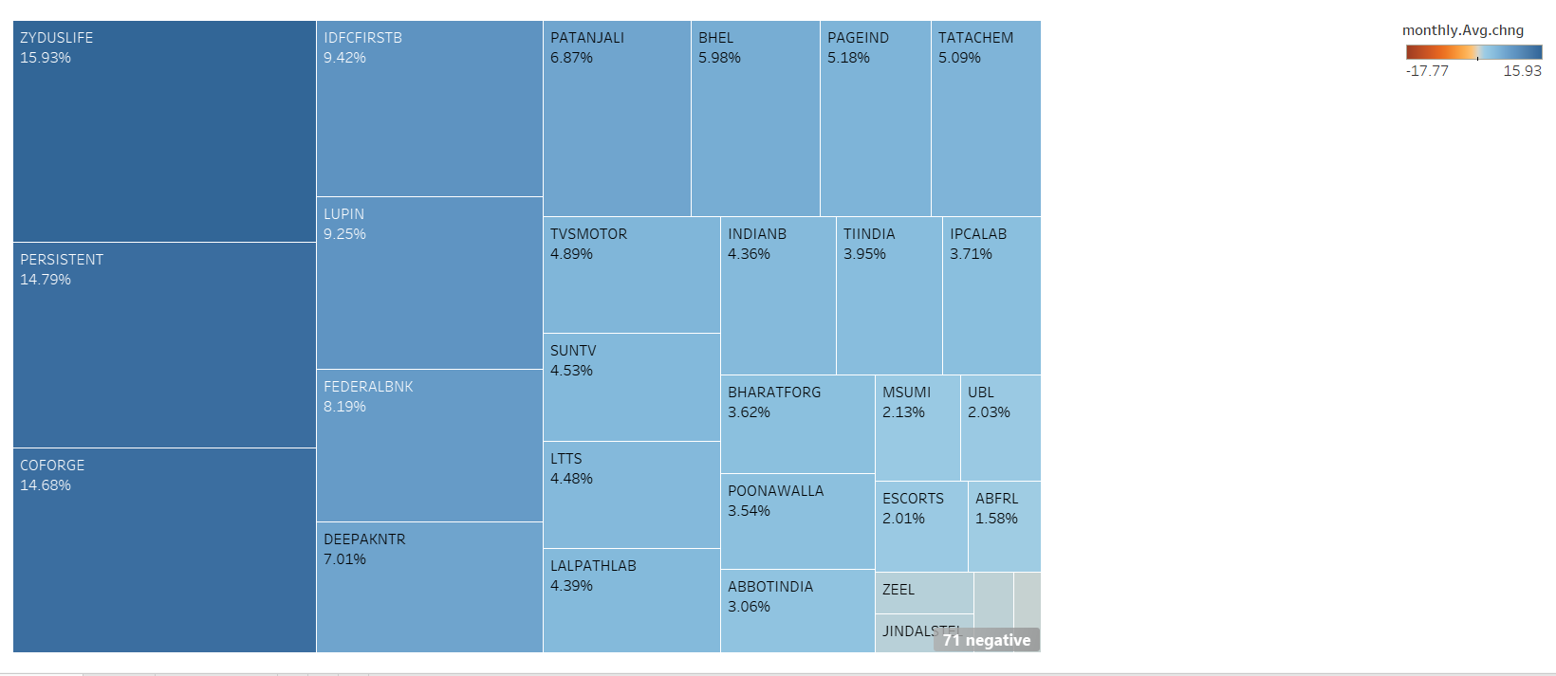
Bullish Volatility on Monthly Basis

Slide 7
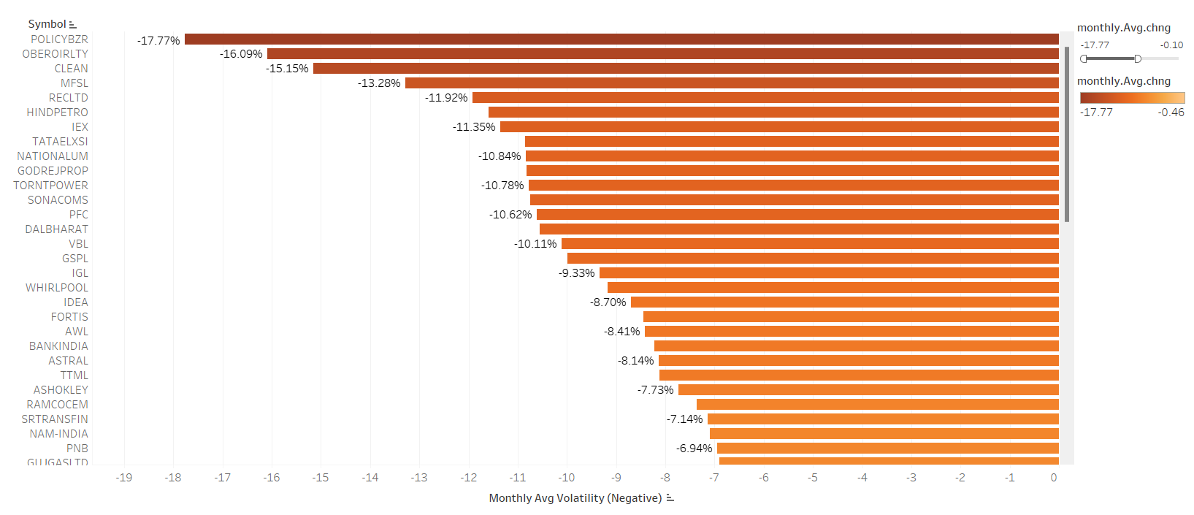
Bullish Volatility on Monthly Basis
Bearish Volatility on Monthly Basis
This chart depicts all the stocks of MidCap100 which are Bullish Volatility on a monthly time frame. This analysis concludes that Zydus Life had the highest volatility on the bullish side.

Slide 8
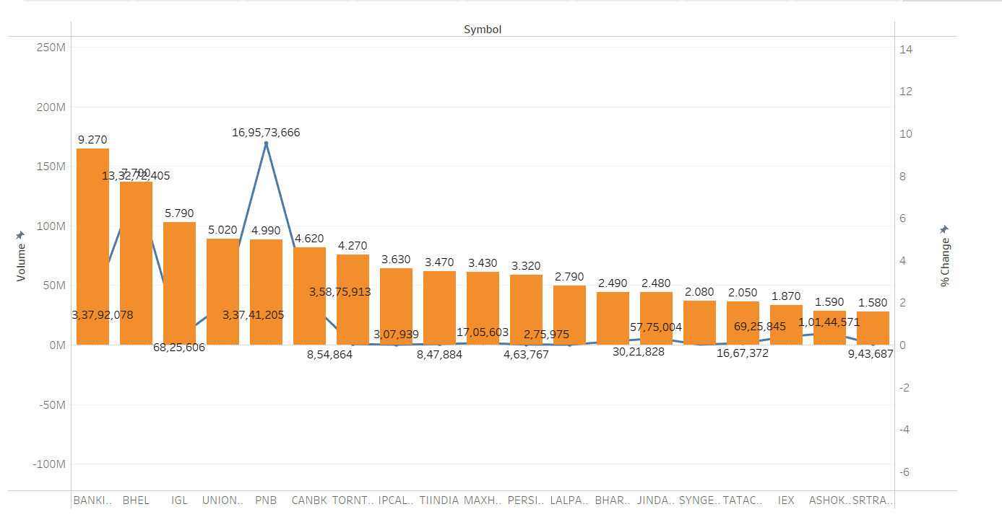
%Change VS Volume Analysis (selected a few random stock)
I've chosen a selection of diverse stocks to enhance clarity. This combined line and bar graph illustrates both the traded volume and the percentage change for each specific stock. The primary focus is to showcase that the percentage change doesn't consistently correlate with the trading volume.

Slide 9
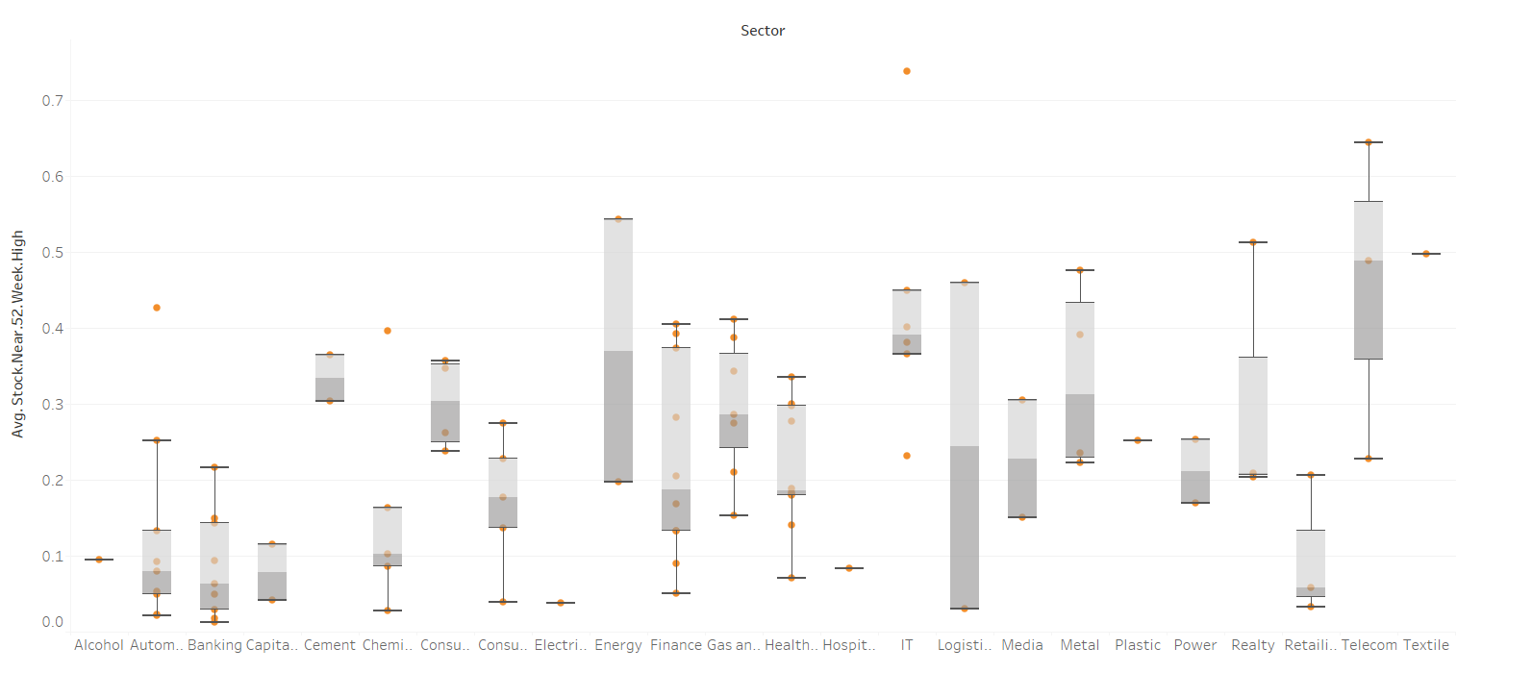
Box Plot – Stock Nearing 52 wk High
This box plot chart highlights the spectrum of stock performances within a specific sector, illustrating the stock near to its 52 week high and indicating the upper and lower whiskers. It also provides insight into the average performance, showcasing the mean of stocks within that sector.

Slide 10
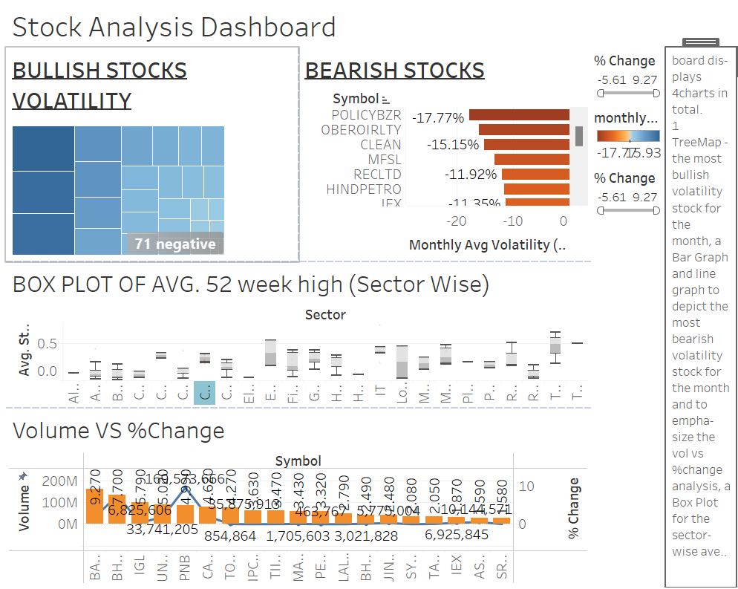

Slide 11
Conclusion
1. TreeMap for Bullish Volatility Stock: This chart displays the most bullish volatility stock for the month. A TreeMap visualizes hierarchical data using nested rectangles, where the size of each rectangle represents the stock's volatility. The larger the rectangle, the higher the bullish volatility of the stock. Users can easily identify the stock with the most significant positive volatility.
2. Bar Graph and Line Graph for Bearish Volatility Stock: These graph highlight the most bearish volatility stock for the month. The Bar Graph illustrates the volatility, likely displaying the stock's negative volatility or decline.
3. Volatility vs. % Change Analysis (Line Graph & Bar Graph): This graph contrasts volatility with the percentage change in stock prices. It aims to illustrate that volume and percentage change are not always directly correlated. For instance, high volume might not necessarily result in a significant percentage change in stock price and vice versa. This analysis helps understand the relationship between volume and price movement.
4. Box Plot for Sector-wise stock nearing 52 Week High: This visualization provides a comprehensive view of the distribution and how near the stock is to it’s 52-week high across different sectors. It helps in understanding the variation of stocks concerning it’s bullishness among sectors and identifying outliers.

Slide 12
Conclusion
Each chart serves a distinct purpose, collectively providing a comprehensive overview of bullish and bearish volatility, the relationship between volume and percentage change, sector-wise closing prices, and the relative weightage of sectors in the market. This dashboard empowers users to make informed decisions based on a holistic understanding of market dynamics and stock behaviors.
In conclusion, the dashboard provides a robust toolkit for market participants to understand the behavior of the NIFTY Midcap 100 index during the specified time frame. It empowers users with valuable data to make informed investment decisions, react to daily market fluctuations, and strategically allocate their resources based on sectorial performance. The insights gained from this dashboard are instrumental for investors looking to navigate the dynamic landscape of the Indian midcap market.

