Slide 1

PEER TO PEER DISTRIBUTED COMPUTING FRAMEWORK
Group id: 16-023

Slide 2
Team
Supervisor
Dr. Darshana Kasthurirathna
Group Members
Prashan Dharmapala (L) IT13037116
Sri Darshanun S. IT13002466
Lumeshkantha Koneshvaran IT13071608
Imtizam Ismail IT13029364

Slide 3

Introduction
Introduction

Slide 4
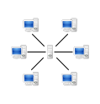
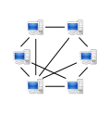
Background
What is Peer-to-Peer Computing?
Peer-to-peer (P2P) computing or networking is a distributed application architecture that partitions tasks or work loads between peers [1].
Peers are equally privileged, equipotent participants in the application.
Client-Server model
Peer-to-Peer model

Slide 5
Existing Systems
BOINC
Berkeley Open Infrastructure for Network Computing
Volunteer computing
Centralized
Fault tolerance
Security
Server
Homogeneous redundancy
Workunit trickling
Locality scheduling
Work distribution based on host parameters

Slide 6
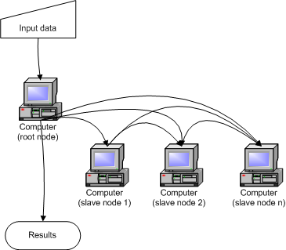
Existing Systems
Distributed.net
1st general purpose distributed computing project
Centralized
Fault tolerance
Result Validation

Slide 7
Existing Systems
BitTorrent
Introduced by Bram Cohen in 2001
Decentralized
Client
Examples : uTorrent, Xunlei, qBitTorrent
Determines the order to download pieces
Creates & manages a list of peers
Reassembles the file once all pieces have arrived
Tracker
Assists in communication between peers
Informs the swarm of a new client
Informs the new client of the swarm
Less bandwidth

Slide 8
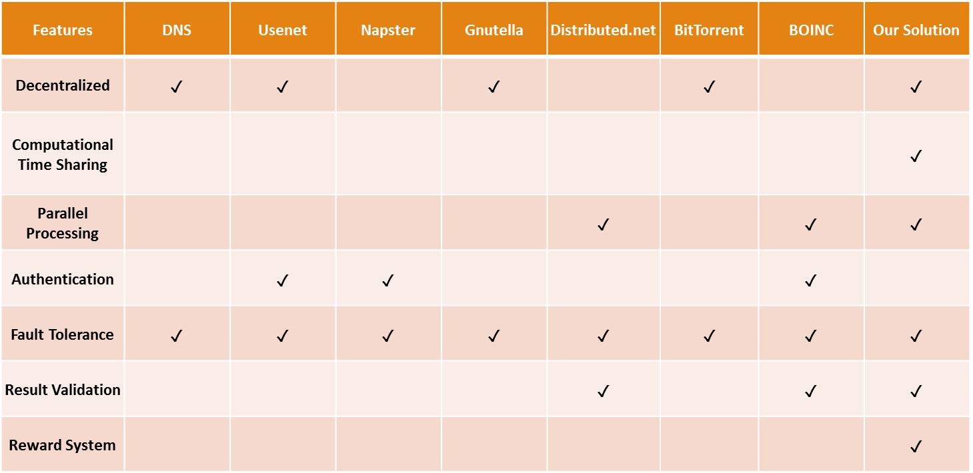
Existing Systems
Comparison of existing systems vs. proposed system

Slide 9
Research Problem
Personal computers have extensive computational capacity which is heavily under utilized
Idle processing power of these machines can be used to solve computational problems if,
they can be connected together and coordinated through the internet
Such a system should ideally be distributed, without a central coordinating server and capable of generic problem solving

Slide 10
Objectives

Slide 11
Objectives
Research and design a distributed peer-to-peer computing framework.
2. Develop a user agent software to demonstrate the functionality of the framework.
>>the four components
Design a distributed, peer-to-peer, server-less network that can manage arbitrary arrivals and departures of random nodes
Research and develop a method to break down a generic computational task into smaller independent units of work.
Develop a distributed computing algorithm to share the workload among many computational nodes, execute and aggregate the results.
Develop the network and distributed computing modules to be fault tolerant

Slide 12
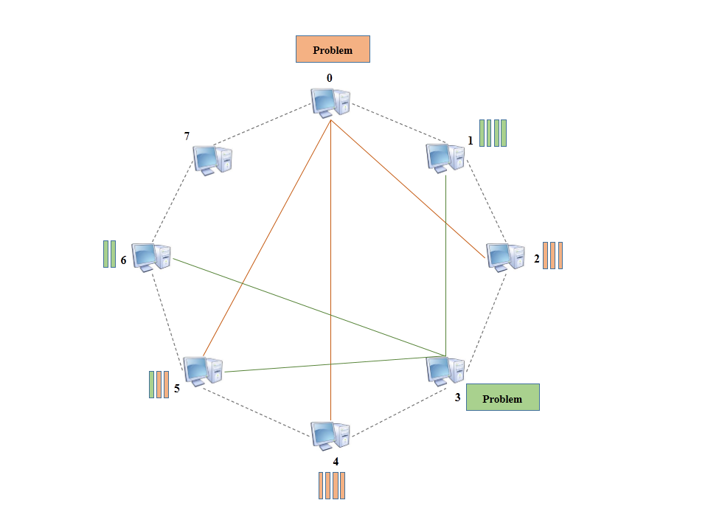
System Diagram

Slide 13
Research Methodology
Distributed P2P network
Breaking down parallel problems in to small units
Distributed computing algorithm

Slide 14
Research Methodology
Distributed P2P network
No central server
Peer discovery
Boot the network
Join/Leave network

Slide 15
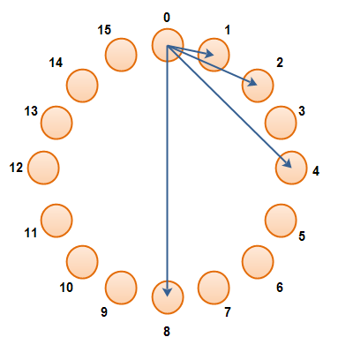
Research Methodology
DHT Peer discovery
Peer referencing
Each peer has a GUID
Peers are organized to a virtual link
Each peer reference to a subset of peers
Cell Index | Referenced GUID | GUID Distance
0 | 1 | 1 (2⁰)
1 | 2 | 2 (2¹)
2 | 4 | 4 (2²)
3 | 8 | 8 (2³)
Peer routing table
Peer referencing

Slide 16
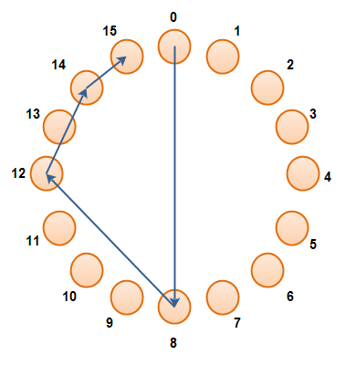
Research Methodology
DHT Peer discovery
Peer discovery
A peer uses its GUID to identify other peers in network
Peer with nearest GUID is found
Route to destination peer is questioned from this peer
Peer discovery

Slide 17
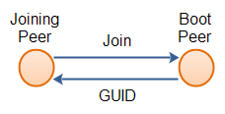
Research Methodology
DHT Peer discovery
Booting a P2P network

Slide 18
Research Methodology
DHT Peer discovery
Peer leaving
Leaving peer sends leaving message to all referenced peers

Slide 19
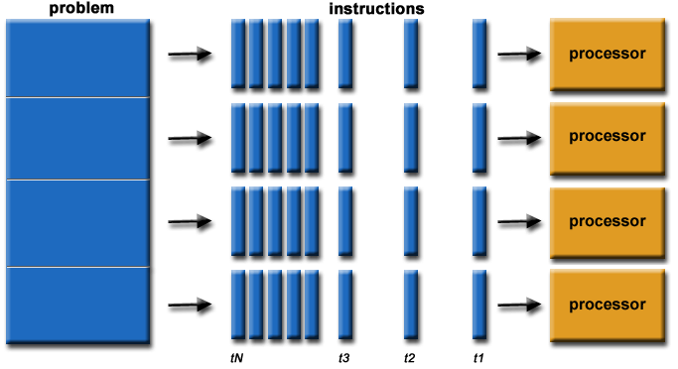
Research Methodology
Breaking down parallel problems in to small units
Embarrassingly parallel problems
Rendering of computer graphics
Brute-force searches in cryptography
facial recognition systems
Node
Node
Node
Node

Slide 20
Research Methodology
Distributed computing algorithm
Any peer can be a workload allocator
Any peer can be a workload executor
The results are validated by redundant calculations
Results aggregated by the allocator

Slide 21
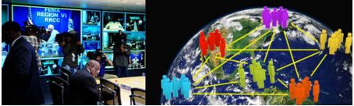

Users & Benefits
Benefits
Solve larger or more complex problems
Save time and money
Provide concurrency
Take advantage of non-local resources
Make use of underlying parallel hardware

Slide 22
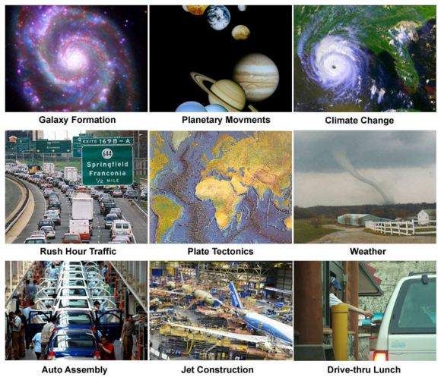
Users & Benefits
Users
Science and Engineering
Industrial and Commercial
Global Applications
Space and Astronomy
[2]

Slide 23
Outcome to be expected
Build a framework to share CPU time of personal computers over a P2P network
Utilize the idle processing power of personal computers to solve complex problems
Reduce the need to produce more high performance computers
Environmental benefits
Provide the average user with access to high performance computers on-demand.

Slide 24
Reference
[1] Wikipedia: Peer-to-peer [Online]. Available: https://en.wikipedia.org/wiki/Peer-to-peer
[2] Introduction to Parallel Computing [Online]. Available: https://computing.llnl.gov/tutorials/parallel_comp/
[3]

Slide 25

Questions

