Slide 1
DISEASE PREDICTION SYSTEM
[ Based on User Symptoms ]

Slide 2
Table of contents
01
02
03
Topics
Introduction to AI concept used
Research Evidences
Reasons for Selected Topic
Solution
Explanation of Application
Achieved Results
How it solves real world problems?
Synthesis of
Information
Pseudo code for the Solution
Flowchart

Slide 3
Project Description
Nowadays, people are always looking online for any kind of challenges people are facing. In the medical section as well, people are researching through the web before for medical issues or to gather any heath related information. So, this system build is to reduce the time consumption of people trying to figure out about the health issues they are facing. If a system can predict what disease might be the reason for the user to face certain symptoms then this will help people to learn about their health issue immediately before consulting a medical expert. Hospitals can also analyze well on the disease more quickly and save some precious time.
.

Slide 4
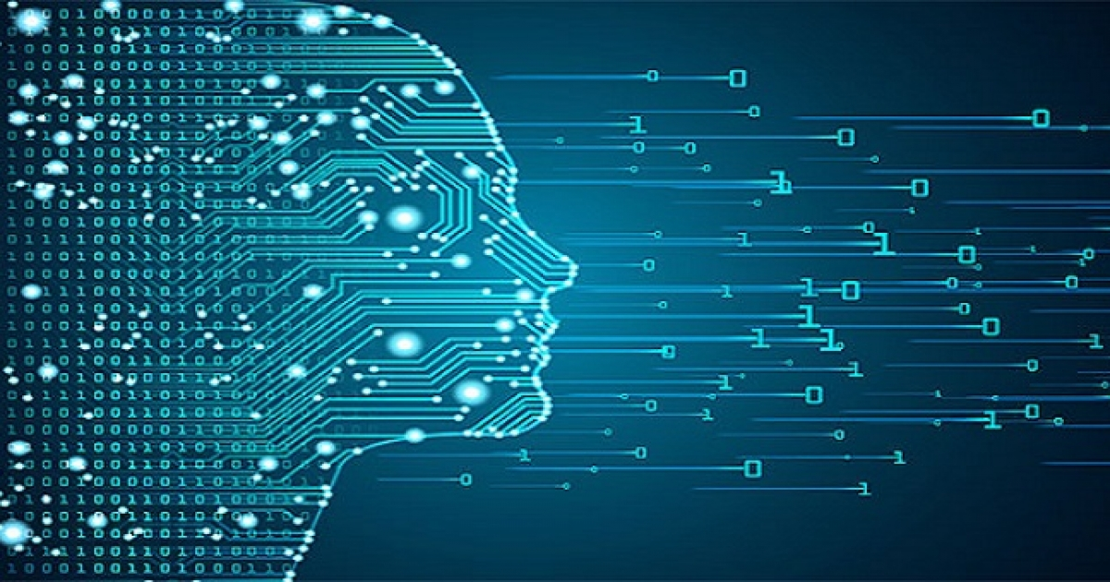
Introduction to Artificial Intelligence
Artificial intelligence(AI) is the basis for mimicking human intelligence processes through the creation and application of algorithms built into a dynamic computing environment.
Using AI, computers can be trained to process large amounts of data and recognizing patterns in the data.
AI adapts through progressive learning algorithms.
AI analyzes more and deeper data to achieve incredible accuracy.

Slide 5
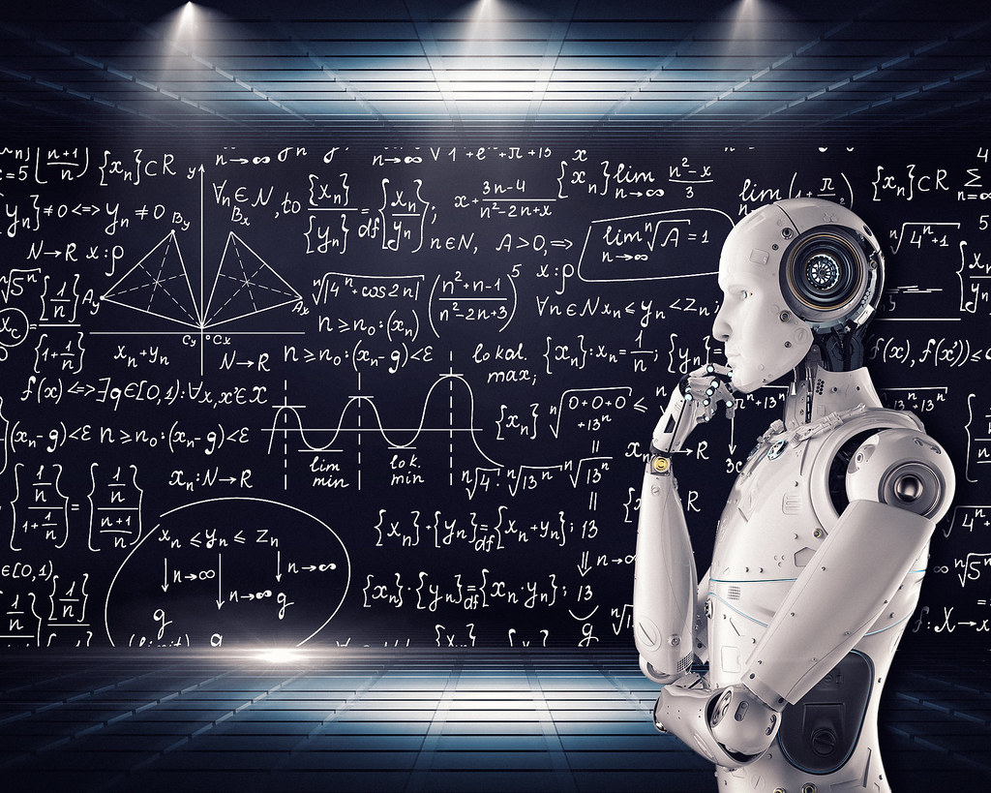
Introduction to Machine Learning
Machine Learning is a branch of computer science and artificial intelligence where the study of algorithms and data trains a computer without being explicitly programmed.
It provides the machine with an ability to learn from the experience of its own program.
The process involves various quality datasets and correct choice of algorithm during the training phase of computer machine but later the learning phase of the machine is automated depending on the system.

Slide 6
Why Supervised Learning?
Because it makes the ML model to collect labeled data points which helps to train the system in a way that it gathers input and learns itself from its previous ML deployment and generates an output.
Because it provides both input and output data to the ML model which are later identified as mapping function by the supervised learning algorithm.
Because it directly deals with either structured or semi structured data and doesn't need to stimulate human behavior in solving complexity.

Slide 7
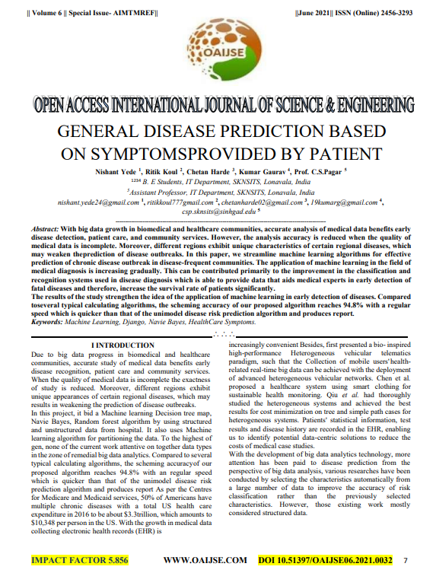
Research Evidences
General Disease Prediction Based on Symptoms (Provided by Patient)
This research paper includes research on general disease prediction based on symptoms. This research helped me to study about the application of machine learning algorithms in prediction and early detection of diseases. The ML model built according to several typical calculating algorithms, the scheming accuracy of this algorithm in this research was 94.8%. with an regular speed which is quicker than that of the uni-modal disease risk prediction algorithm and produces report.

Slide 8
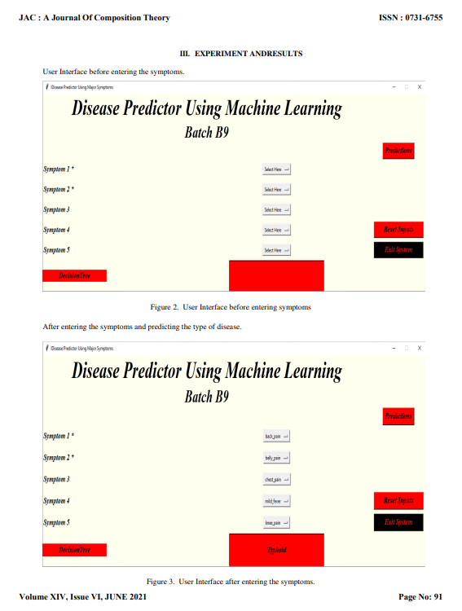
Research Evidences
Identification of Disease Prediction Based on Symptoms Using Machine Learning
From this research paper, I studied about the development of application with the techniques of machine learning for disease prediction. A sample data of 4920 patients was collected and 41 diseases were collected for the prediction. I learned about the various visual representation of data collected and results achieved. Since, this datasets had less number of data for training the model so the supervised learning of ML was implemented in this project.

Slide 9
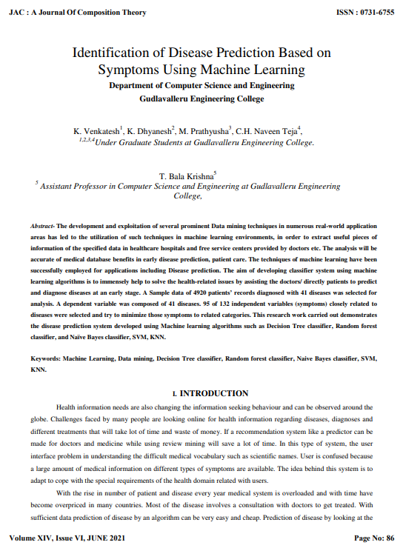
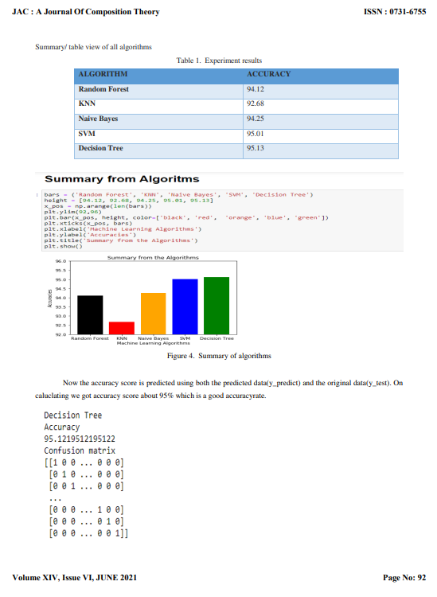
Research Evidences (Some Screenshots)

Slide 10
Reasons for the Topic Selection
This concept of ML model can be used in decision makings for different kind of treatments and supporting professional medical procedures in multiple health sectors.
an individual can use the AI-powered tools to research and get to know about the disease based on symptoms.
This system can decrease rush at OPDs at hospitals.
This system can reduced workloads on medical staffs.

Slide 11
Explanation of Solution
In this coursework, I have created a machine learning model which is able to identify the disease of the patient based on the symptoms provided as the input by the user. KNN algorithm is used for in ML model. The training and testing datasets are provided in the KNN algorithm to test and train the model. After the training, testing process is completed the output should be the closest prediction of the disease. The working process includes prediction based on the K values which is like the training the model. All the available classes are stored and are the new data are classified on similarity measures. The algorithm implementation finds that if a new point of the class is comparable to the neighboring points. For this project, I have categorized and research datasets for the disease prediction system based on symptoms. The records found in the datasets here are qualitative records which has also been used and approved by expertise users. The datasets include multiple rows and columns of data that has the required information on symptoms for various diseases.

Slide 12
How the Application works?
This system is developed to predict the disease based on five symptoms provided by the user as input. With the help of JupyterLab from Anaconda platform the interface prototype is constructed. For the construction libraries Numpy, Pandas and Matplotlib.pyplot were used. At the very beginning after importing the required libraries, the dataset loaded and analyzed for developing the model. After much research on datasets, I was able to find this appropriate datasets for my model and the datasets was which splitted and separated testing and training my ML model. The separate independent and dependent variables was recognized, and the remaining portion like converting the variables in a numpy array and encoding the array was done in my ML model.

Slide 13

Importing Libraries
The Matplotlib.pyplot library was used for the visualization of histogram/bar graphs of column data and for the scattering of matrix inversion of kernel density plots.
The Numpy library was used for the mathematical calculation in the ML model.
The Pandas library was used for the analysis of datsets.
The sklearn library was used importing necessary elements like KNeighborsClassifiers, classification_report,confusion_matrix, and accuracy_score.

Slide 14
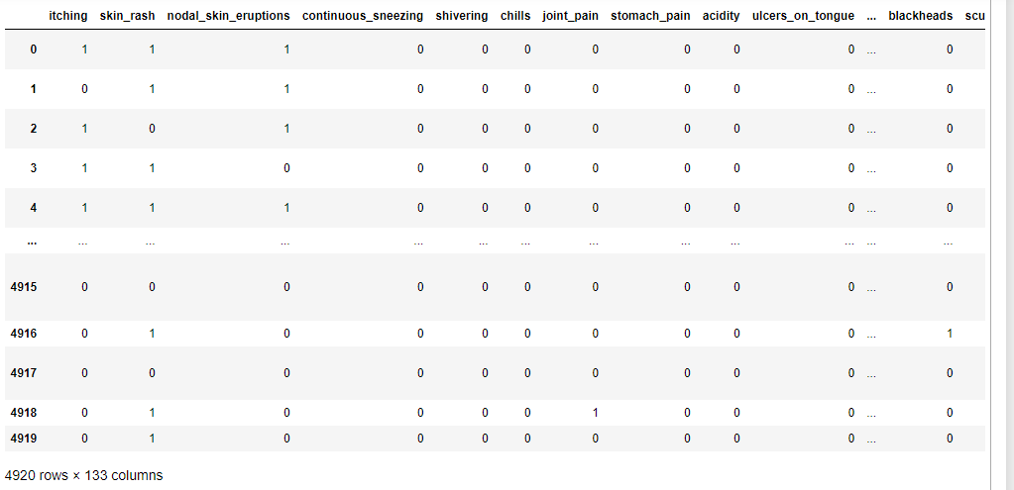
Reading and Displaying Datasets
By the help of pandas library and its inbuilt read_csv() funtion, the datasets was imported and loaded. The main dataset used in this model which is training.csv dataset includes two columns “Disease” and “Symptoms”. The dataset was processed to help classify the data and the model was trained with this data.

Slide 15
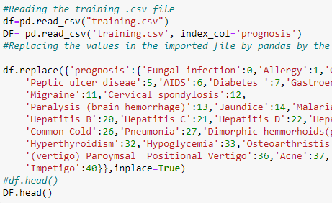
Replacing the Training data
The training datasets which contains the diseases and symptoms is utilized for the ML model. The read_csv() function is used to analysis the datasets and initialized to store the values in a dataframe df. And, after the training datasets was read and loaded. The values obtained from importing the training.csv datasets was replaced in pandas by using an inbuilt function called replace(). Then, the head() function is used to display the five top rows of the dataframe df.

Slide 16
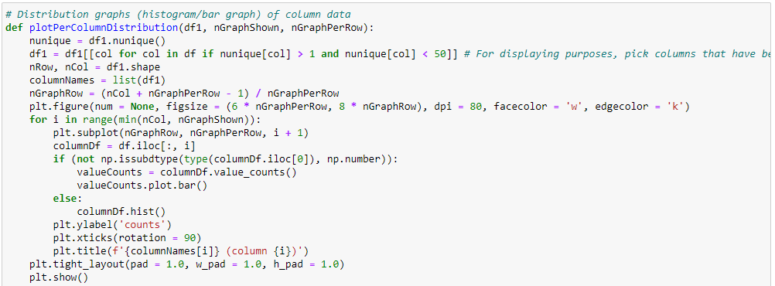
Distribution graph Output
In this plotPerColumnDistribution() function, the codes to create and display the histogram/bar graph of column data is done. The Matplotlib.pyplot library is imported to use this function for the visualization of distribution graph of the columns of the training.csv file.

Slide 17
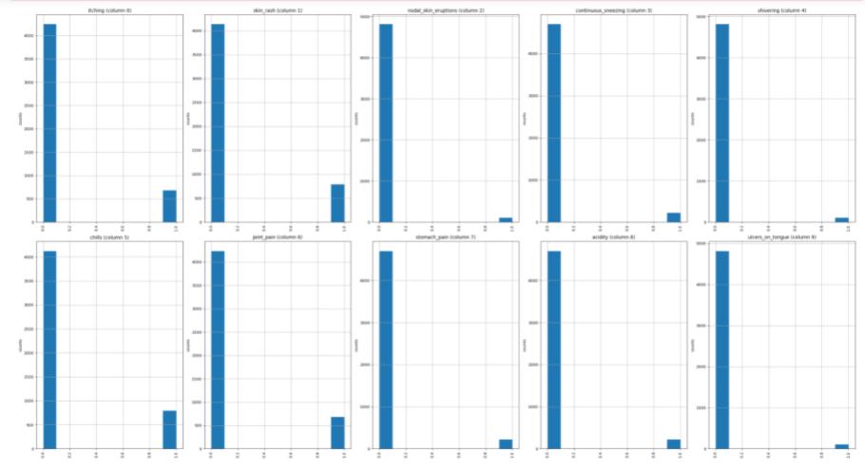
Distribution graph
The output of the histogram/bar graph is given below:

Slide 18
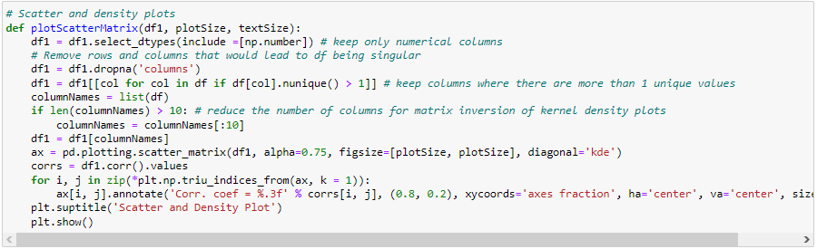
Scattering the Matrix
Using the plotScatterMatrix, the scattering of the matrix and density plots of the column of the training.csv file is done.

Slide 19
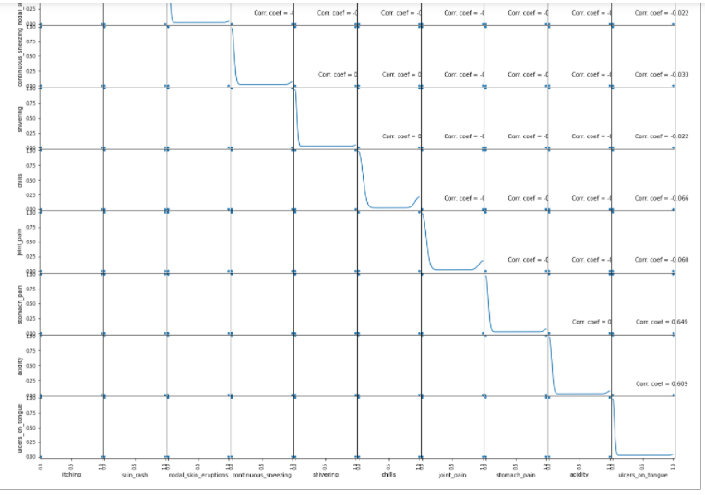
Scattering the Matrix
The output after the scattering is given below:

Slide 20
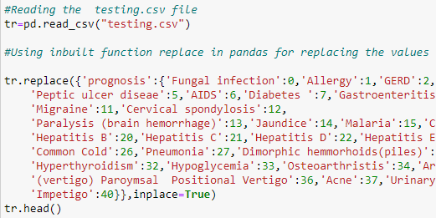
Replacing the Testing data
The testing datasets which contains the diseases and symptoms is utilized for the ML model. The read_csv() function is to analysis the testing datasets and initialized to store the values in a dataframe tr. And, after the testing datasets was read and loaded. The values obtained from importing the testing.csv datasets was replaced in pandas by using an inbuilt function called replace().

Slide 21
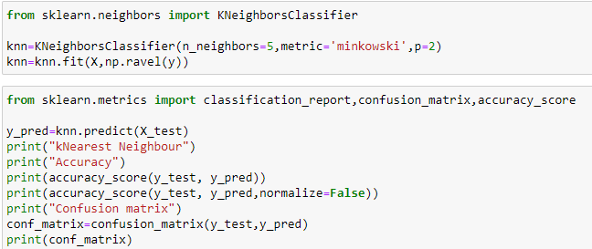
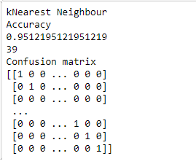
Implementation of KNN algorithm
Output:
For training the model KNN algorithm is used and the prediction of the nearest disease based on the symptoms is done. The accuracy as per the KNN algorithm is gained 96% accuracy. Along with accuracy the total number of correctly classified accuracy_score and the confusion matrix is displayed as output.

Slide 22
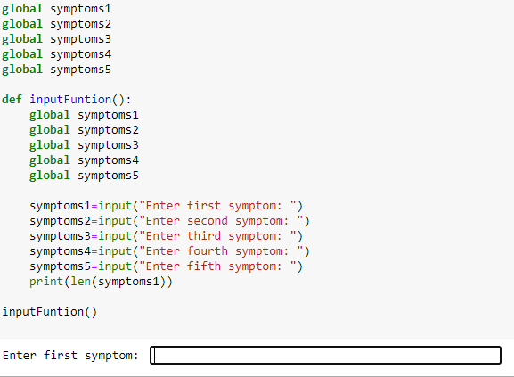
Achieved Results [ User Input Fields ]
Here, five global variable was given in which each of the input provided by the user as symptoms is stored. And a inputFunction() created and called which provides the input field for the user to provide the symptoms.

Slide 23
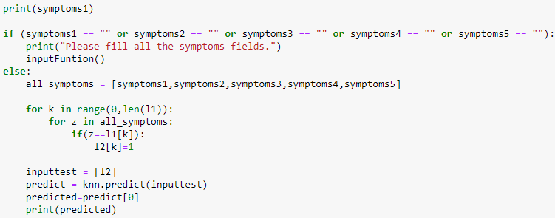
Achieved Results [ Prediction Step ]
In this step the validation, prediction and displaying the predicted disease is shown. All the five symptoms provided by the user is stored in a list named all_symptoms, and with the use of KNN algorithm provided above the prediction is done for the disease. The user must enter five symptoms for the prediction of the disease. So, if any of the input field is left empty then an error message instructing the user to fill all the symptoms field is displayed.

Slide 24
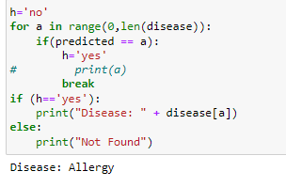
Achieved Results [Output ]
In this step the validation, prediction and displaying the predicted disease is shown. All the five symptoms provided by the user is stored in a list named all_symptoms, and with the use of KNN algorithm provided above the prediction is done for the disease. The user must enter five symptoms for the prediction of the disease. So, if any of the input field is left empty then an error message instructing the user to fill all the symptoms field is displayed.

Slide 25
How does it solve real world problems?
Normally, people don’t pay much attention on simple symptoms and choses to ignore the problem. Any kind of simple symptoms like headache, coughing etc. may lead to major health problem later. People are not even aware about what diseases they can have. Any people who neglect the simple symptoms might be needing an urgent health care under the expertise supervision. Depending on the severity of the symptoms, the medical procedures should not be skipped.
To help detect the disease without consulting a doctor directly, this ML model developed can be used efficiently. Determining simple symptoms to figure out the disease urgently, whether the disease is critically or not this model can be handy. Such system can decrease the rush at OPDs of hospitals and also decrease the workload on medical staffs. People don’t need to rush in busy hours to consult the medical expertise. By tracking vital signs of the patient symptoms, the medical procedures can be continued. Even before consulting doctors and visiting hospitals directly, the details of the disease can be known which will help to take preventions and ease the patient discomfort. Lack of medical care or even delayed medical care can lead a human body in serious disadvantage so this machine learning model developed with the use of KNN algorithm can be used in real world scenario to decrease risk factors of patients.

Slide 26
Pseudo Code
IMPORT libraries
IMPORT dataset
LOAD dataset
REPLACE the values of training datasets in pandas dataframe
VISUALIZATION distance between query and current data
PLOT distribution graph(histogram/bar)
PLOT scattering of matrix
REPLACE the values of testing datasets in pandas dataframe
IMPLEMENTATION of KNN algorithm
RUN input function to collected user symptoms
VALIDATION for the program
PREDICT the disease when five symptoms entered
OUPUT of the program

Slide 27
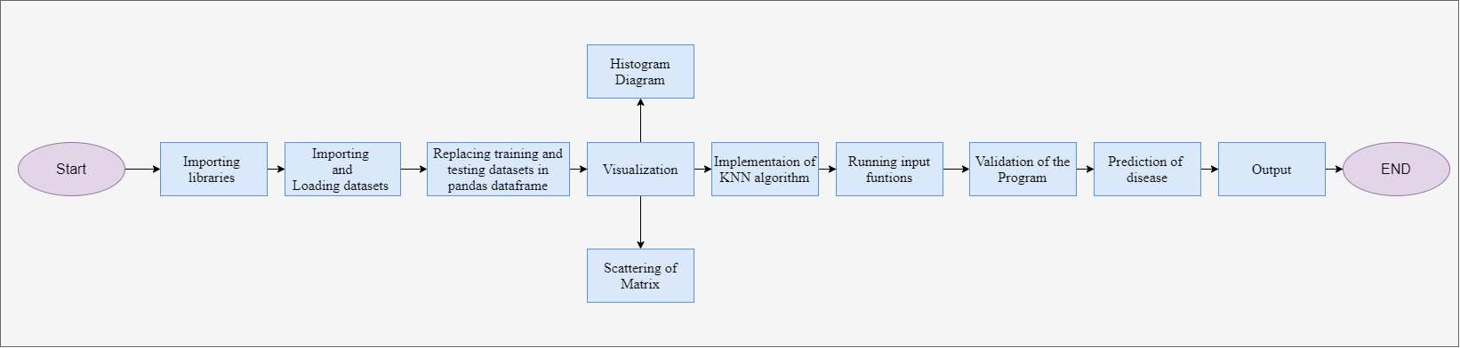
Flow Chart

Slide 28
Conclusions
This presentation was all about how an ML model was developed using Jupyter Notebook. We were provided with list of material via Google Classroom app to learn and understand about Artificial Intelligence and the algorithms to use in the model. So, based on the knowledge of algorithms from lecture and workshop sessions, this AI application was developed. The topic was about an ML model which should be able to detect diseases based on the symptoms provided by the users as input. This presentation includes the prototype of the machine leaning model application. An AI application to predict the disease of the user based on the symptoms has many advantages in the field of medical sections. Also, this presentation includes the details of the algorithms and how these algorithms are implemented in a machine learning model.

Slide 29

Thank You
Do you have any questions?
prashannagc00@gmail.com
+977 9840308399
END OF THE SLIDES

