Slide 1
Salary Contributors

Slide 2
Our Company
We approached our project as if we work for a staffing company who wants to be up to date on current salaries in order to be able to educate both companies knowing how much to offer new hires and how much applicant can negotiate for a job based on specific criteria.
We believe that this is of the utmost importance in order to be competitive with salaries offered. We want our clients to be fully equipped and prepared to negotiate salaries that are fair.

Slide 3
Business Understanding
Problem
What factors highly influence salary of a person?
How much should an employee expect to be paid based on different variables?
Data Analytics Problem
The data analytics will address the business problems by identifying factors that are highly correlated with salary, and how large their positive (increase in) or negative (decrease in) effect on salary is.
Notes:
We want to be able to know which factors are important for our customers to emphasis in salary negotiations as well as it being applicable to the real world situation - calculate their personal salary range
We found which were significant for salary and what that impact those significant variables had on it

Slide 4
Our Data
Kaggle Dataset
1 million instances: needed to sample our data in order to run our tests
Variables: Job Type, Years of Experience, Job Title, Company ID, Degree, Major, Miles from Metropolis, and Salary
Example instance:
In order to proceed, we created dummy variables of our categorical variables to run tests that would give us numerical outcomes for our continuous target variable, Salary

Slide 5
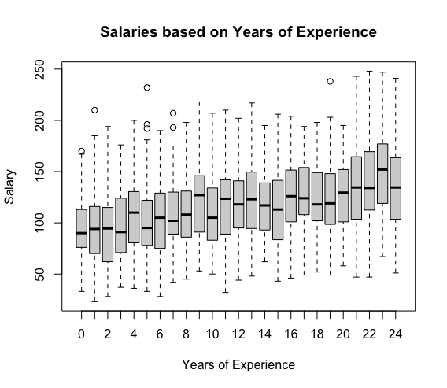
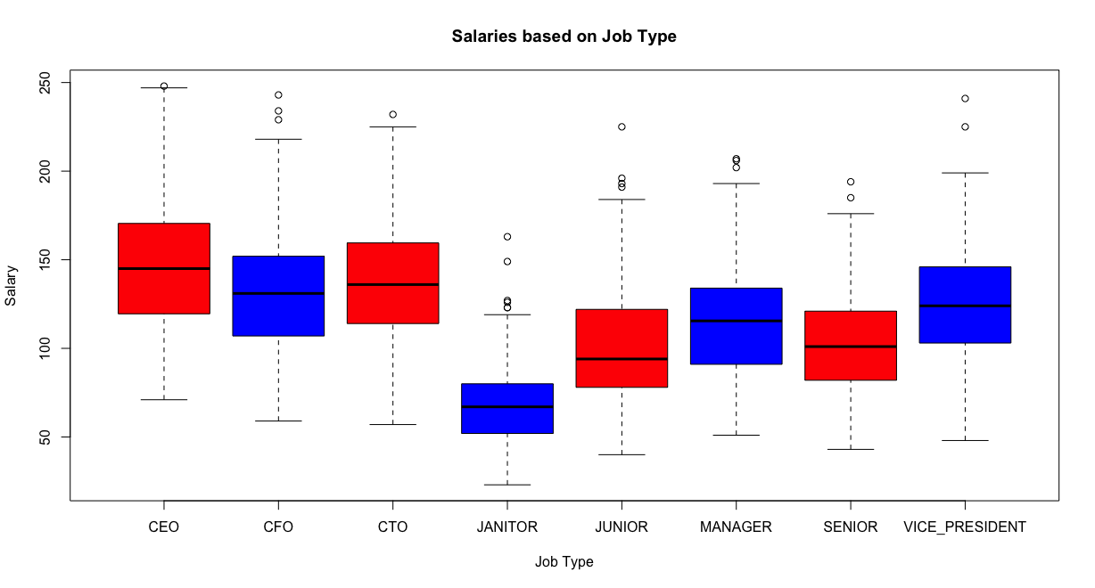
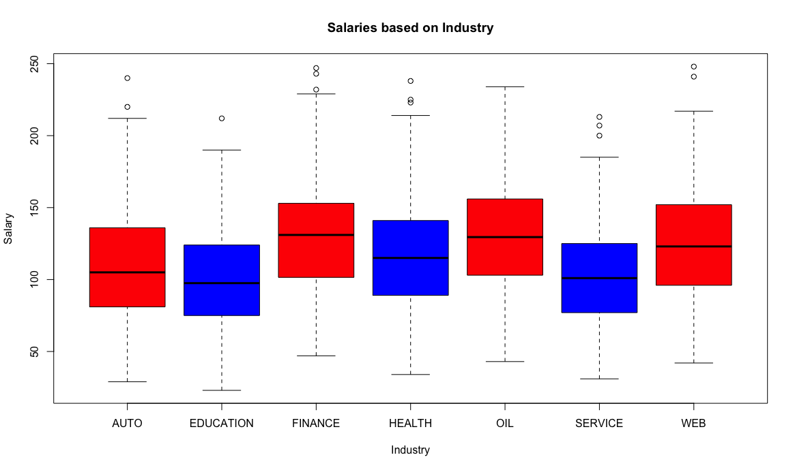
Variable Selection
Our first step was to determine the important features.
Job Type, Years of Experience, and Industry

Slide 6
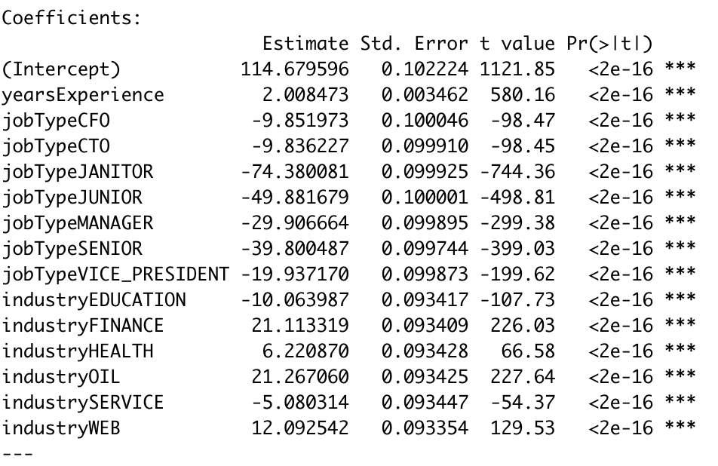
Linear Regression
We were able to interpret our coefficient outcomes of our linear regression:
The intercept was a person with 0 years experience, a CEO, and in the Auto Industry
As years of experience increase the pay will increase by about $2,000
The change in pay amongst industries is dramatic in some instances
As job titles change they go down with the largest difference being between CEO to Janitor

Slide 7
Linear Regression Cont.
Conclusion:
After running our initial linear regression we test it on a training and testing set from our data
The end result was a MSE: 623.7277

Slide 8
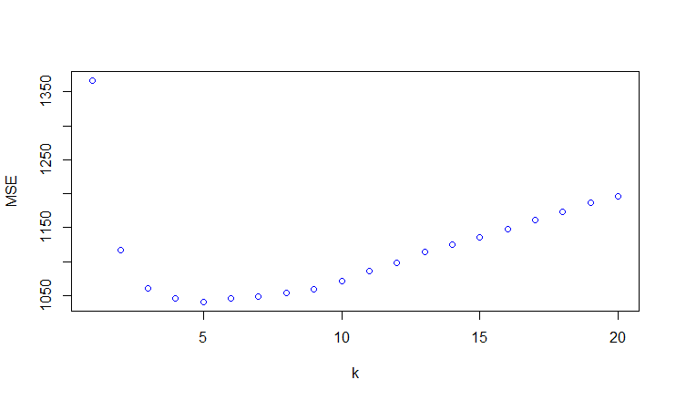
K-Nearest Neighbors
Features Included:
Years of Experience
Job Title
Industry
20 iterations ran
Performance peaked when comparing to 5 neighbors
MSE: 1040.66
R-squared: 0.3099
MAE: 25.71

Slide 9
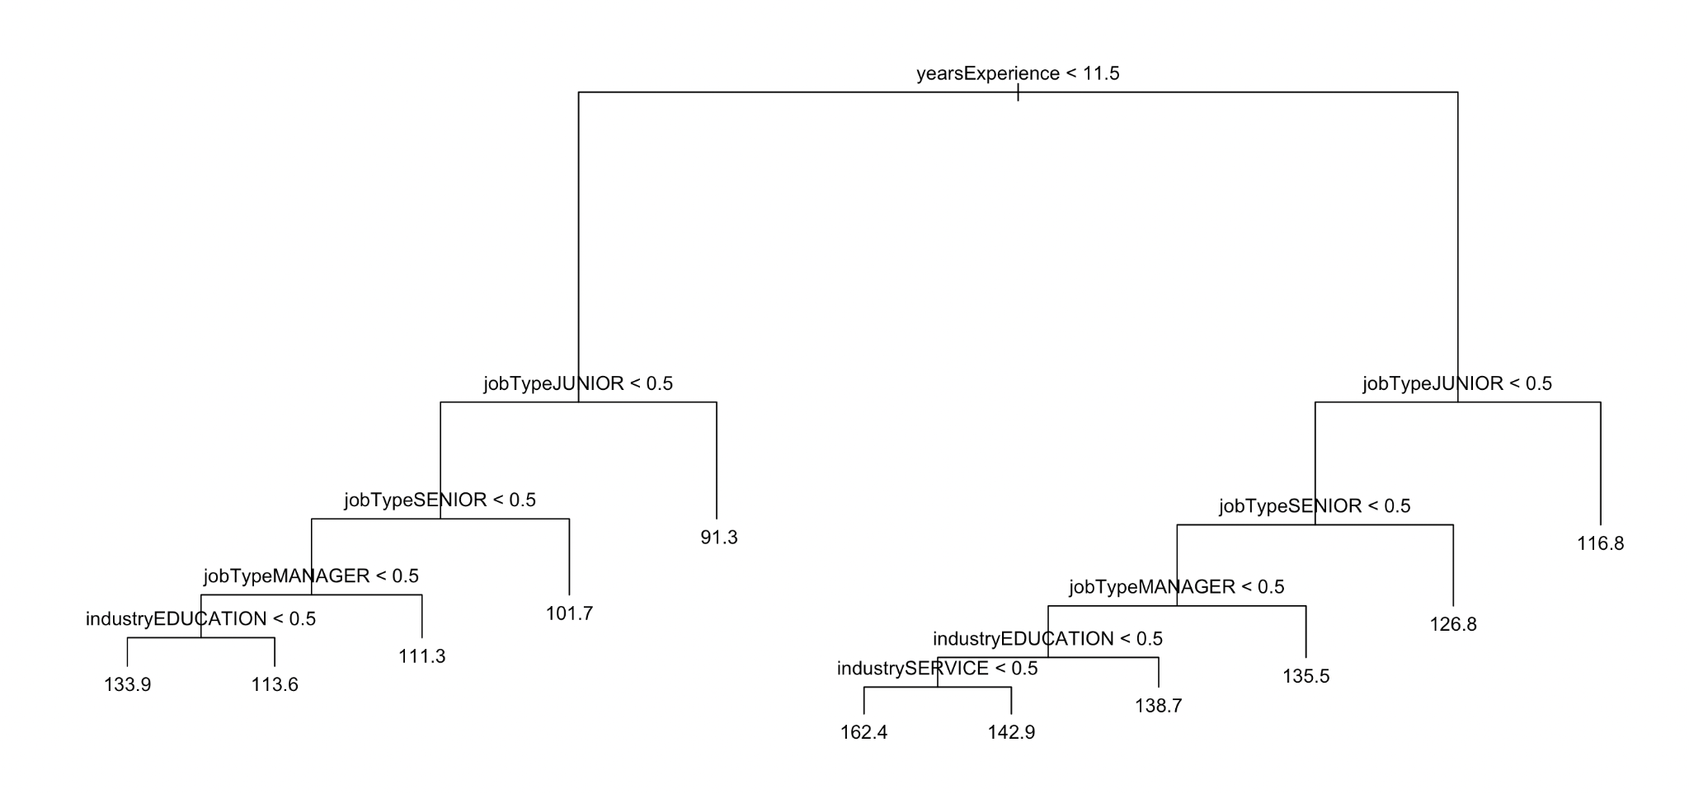
Decision Trees
Ran the Decision Tree
The MSE was 839.0077

Slide 10
Decision Trees
Built a larger Decision Tree using the Validation set approach
MSE for the tree was 715.442
Ran the Random Forest to check if the MSE could further be reduced
The MSE was 629.0503

Slide 11
Implementation
Algorithm | MSE
Linear Regression | 623.7277
5-Nearest Neighbors | 1040.66
Decision Tree | 839.0077
Larger Decision Tree | 715.4429
Random Forest | 629.0503
The lowest MSE was Linear Regression
We recommend that our staffing agency use the linear equation you can get from our outcomes to calculate salary suggestions based on the individuals
Preparation for salary negotiations
Disclaimer: these salaries are estimates not guarantees

