Slide 1
Unified AI Optimization for Animal Shelters and Fitness Clubs
PAW PETROL - CSCN8030
Nilkumar Patel, Prashansa Rathod, Harsh Joshi, Jaiv Burman, Nidhi Ahir

Slide 2
Agenda
Project Overview
GoodLife Fitness – Problem A & B
Paw Petrol Shelter – Problem A & B
ML Pipeline & Results
Ethical AI & DSS Strategy
Final Thoughts

Slide 3
Project Overview
Goal: Use ML to optimize operations in two domains:
GoodLife: Optimize class/gym usage
Paw Patrol: Improve adoptions and resource use

Slide 4
GoodLife Fitness – Problem A
Predict Class Attendance
Model: Random Forest Classifier
Accuracy: 75%
Precision (No-Show): 80%
Precision (Attended): 61%
Key Features: months_as_member, days_before
Impact: Smarter overbooking

Slide 5
GoodLife Fitness – Problem B
Gym Crowd Forecasting
Model: Random Forest Regressor
R²: 0.92
MAE: 4.35
Top Features: hour, day_of_week, temperature
Impact: Optimize HVAC, staffing, app nudges

Slide 6
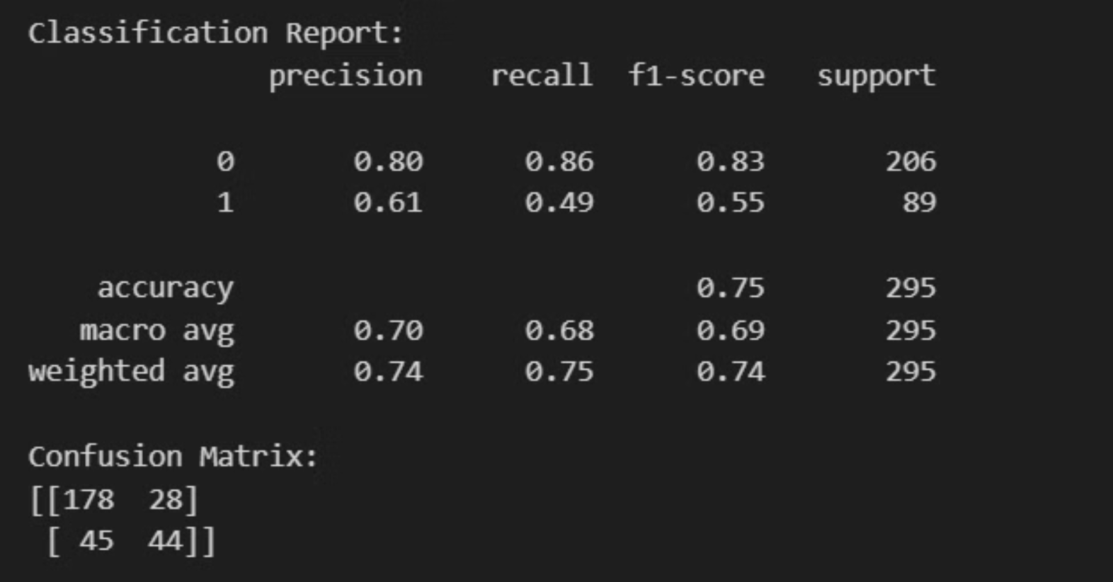
Confusion Matrix – Class Attendance (Problem A)

Slide 7
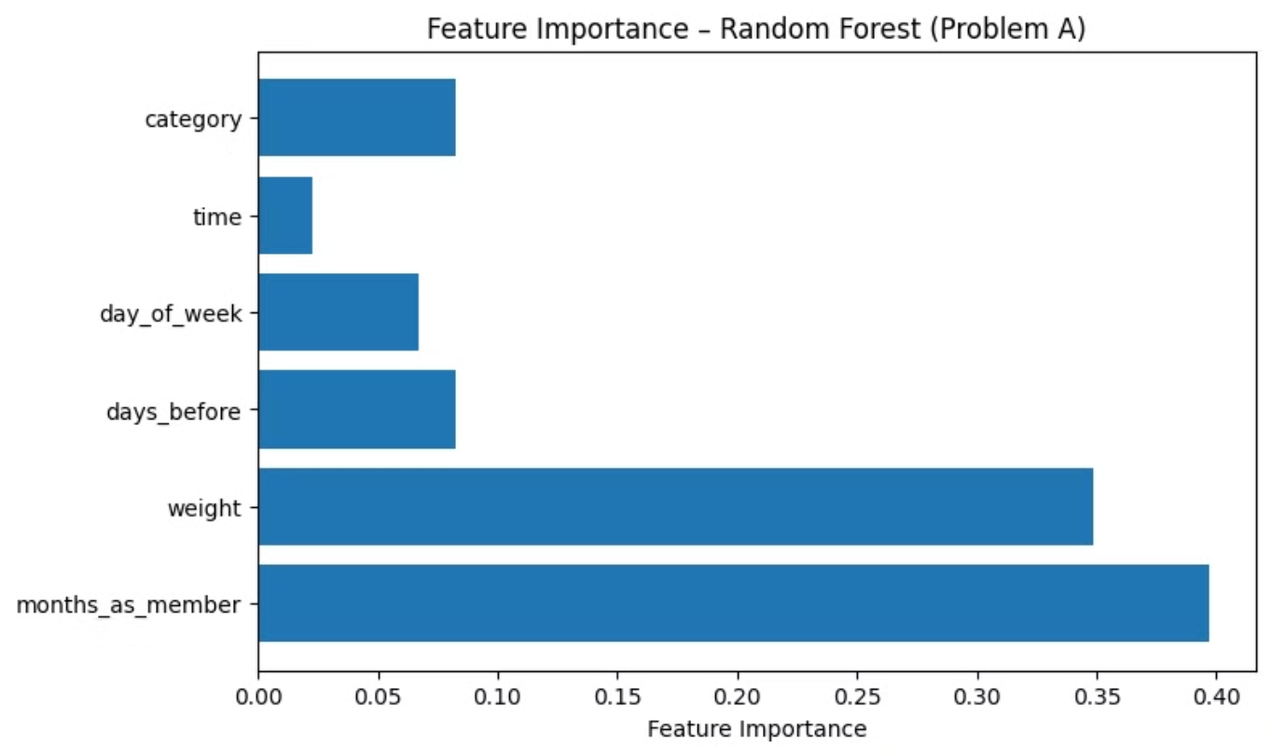
Feature Importance – Class Attendance (Problem A)

Slide 8

Regression Metrics – Gym Crowd Forecasting (Problem B)

Slide 9
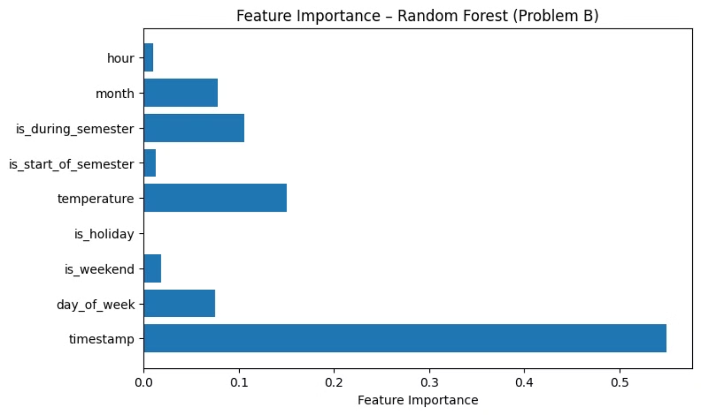
Feature Importance – Gym Crowd Forecasting (Problem B)

Slide 10
Paw Patrol – Problem A
Predict Animal Outcomes
Model: Random Forest Classifier
Predict adoption, transfer, euthanasia
Features: age, breed, health
Impact: Promote at-risk animals

Slide 11
Paw Petrol – Problem B
Seasonal Intake/Outcome Trends
Approach: Time-Series Analysis
Spikes during holidays
More adoptions in spring
Impact: Plan staffing, campaigns

Slide 12
Ethical AI & DSS Strategy
Fairness - Balanced data
Explainability - Feature importance, SHAP ready
Privacy - No PII used
Deployment - Cloud-ready REST APIs
Sustainability - Energy/resource optimized

Slide 13
Final Thoughts
Unified approach across different domains
Accurate, transparent, ethical AI
Ready for deployment and scaling

Slide 14
Thank You
Questions?
Let's make smarter, kinder decisions — with AI.

