Slide 1
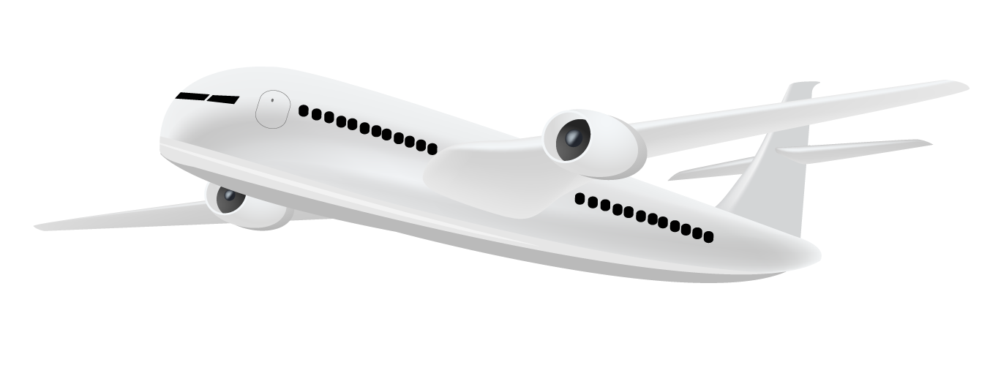

Analyzing Top Airlines Reviews
Presented by:
Prashansa Thapa
Bikin Ghimire

Slide 2
Analyzing Top Airlines Reviews
Presented by:
Prashansa Thapa
Bikin Ghimire

Slide 3

Improving People’s experience

Slide 4
Improving People’s experience

Slide 5

Objectives
To help airlines understand their customer’s needs better
Identify customer’s rating based on class
Identify customer’s rating based on airlines on lowest rated class
Identify areas of improvement for the lowest rated class
Find the most popular words used in negative reviews
Calculate the likelihood of people recommending the airlines to others

Slide 6
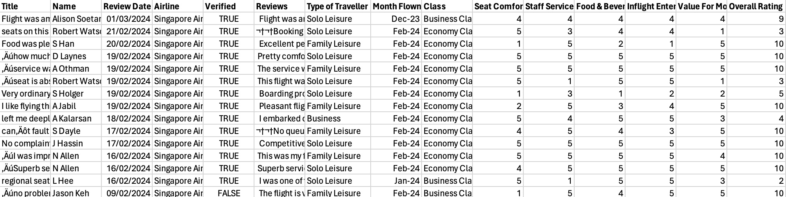
Data Identification and Acquisition
Data Source
Dataset Source
Dataset Scope
Review Count
Airlinequality.com
Thesujalsuthar’s GitHub profile
Top 10 rated airlines in 2024
8100

Slide 7

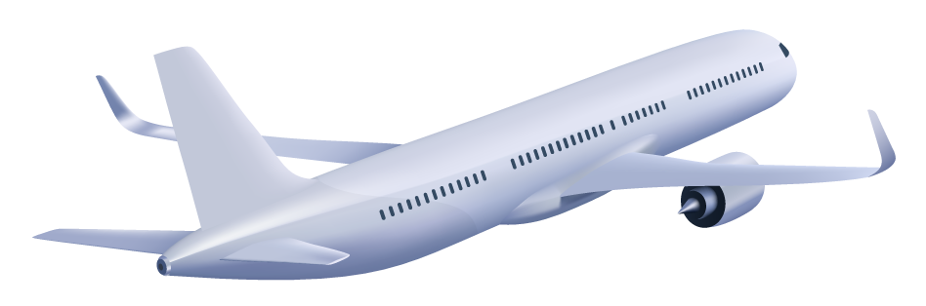
Data Extraction and Transformation
 | What | How
1 | Data Schema | Pyspark datetime
2 | Removed Special Characters | Regex_replace
3 | Converted overall rating to 5 | withColumn
4 | Added Review ID | monotonically_increasing_id()

Slide 8
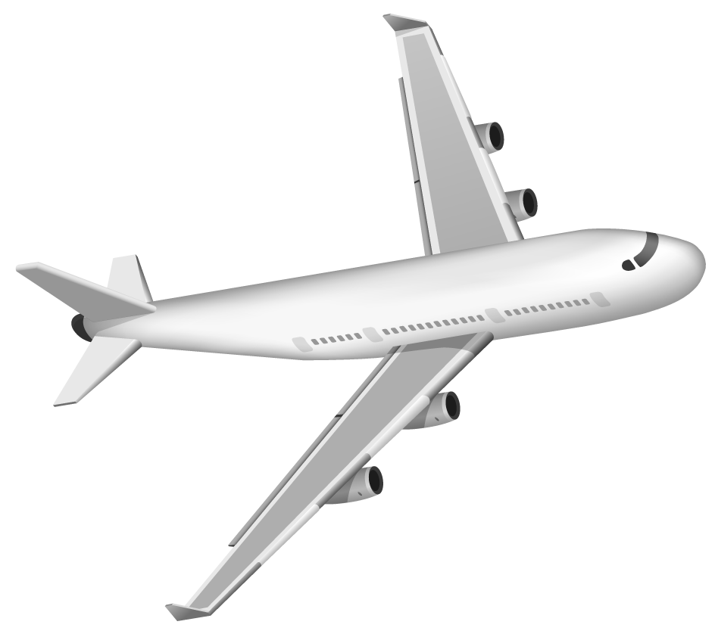
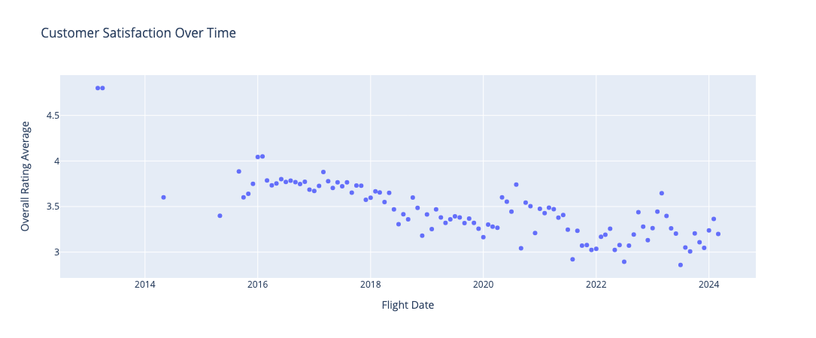
Data Analysis

Slide 9
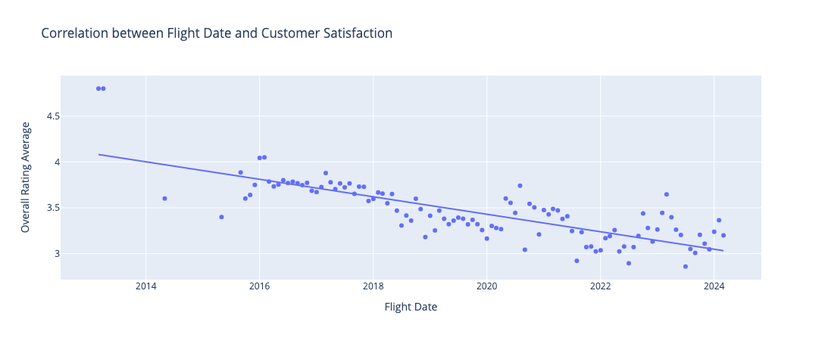
Data Analysis
Customer Satisfaction in Airline’s services has (almost) linearly decreased over time.

Slide 10
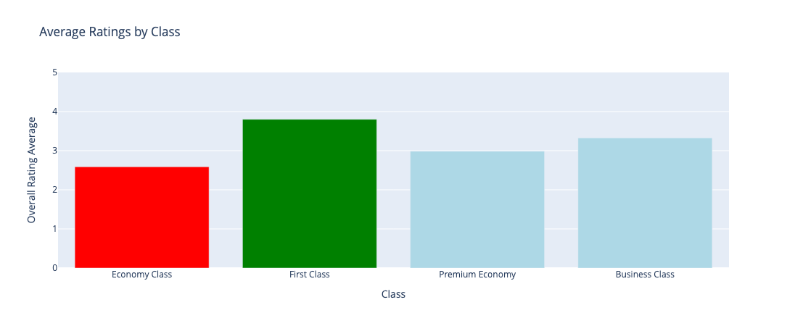
Data Analysis
Passengers flying in economy class are the ones that give the poorest review for their flights

Slide 11
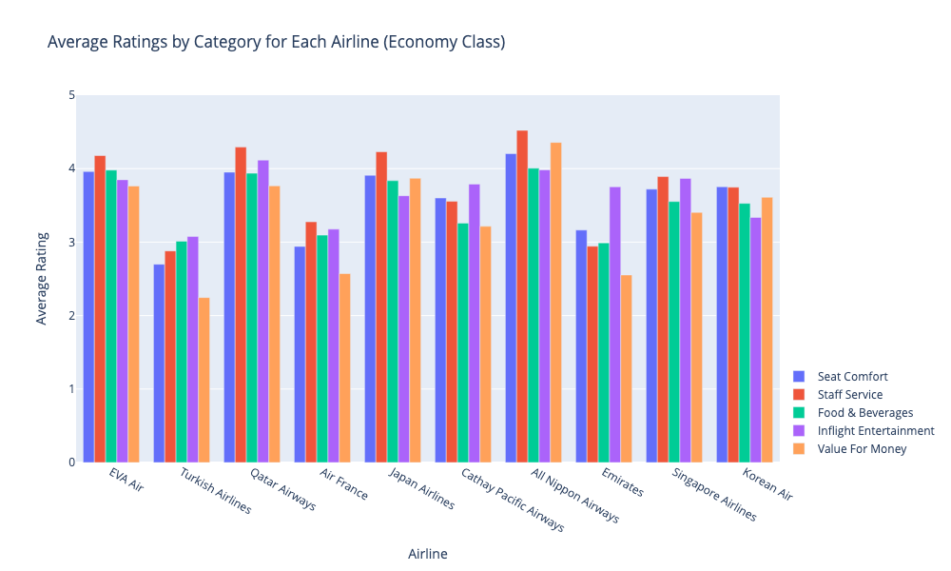
Data Analysis
For all the lower rated airlines, Value for Money is the least rated category.

Slide 12
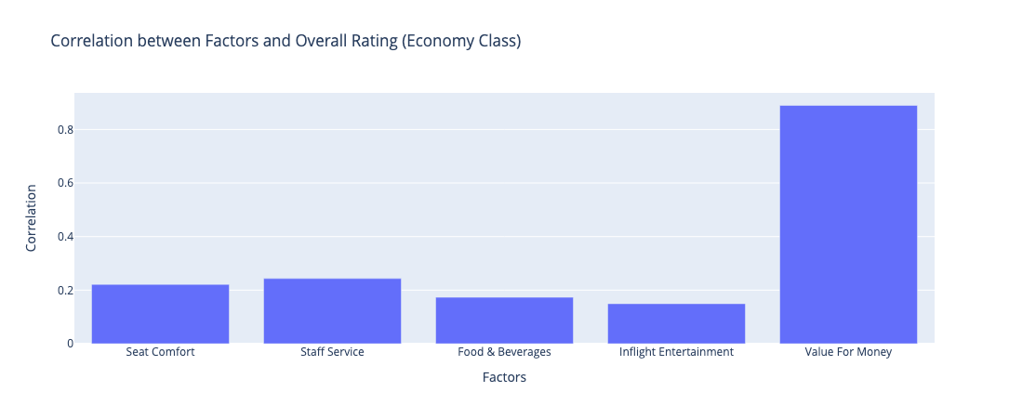
Data Analysis
People’s satisfaction in the services received compared to the price of the flights is the factor that impact’s their overall rating of the flights the most.

Slide 13
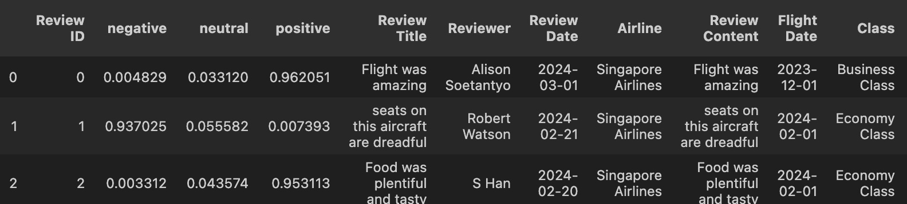
Sentiment Analysis
Using RoBERTa model
Step 1: Load the tokenizer from the pre-trained model
Step 2: Load the model
Step 3: Pass the input and get the scores (negative, neutral, positive)
Step 4: Apply softmax to convert the scores to probability
Step 5: Store the scores in the dataframe

Slide 14
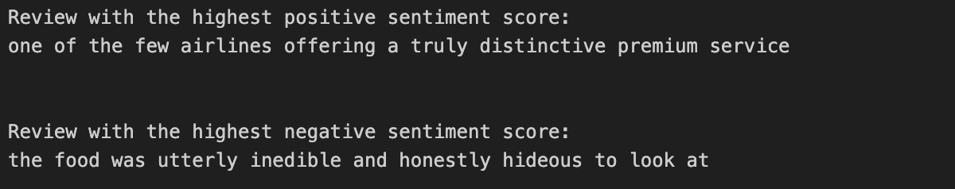
Sentiment Analysis
Using RoBERTa model
Step 1: Load the tokenizer from the pre-trained model
Step 2: Load the model
Step 3: Pass the input and get the scores (negative, neutral, positive)
Step 4: Apply softmax to convert the scores to probability
Step 5: Store the scores in the dataframe

Slide 15
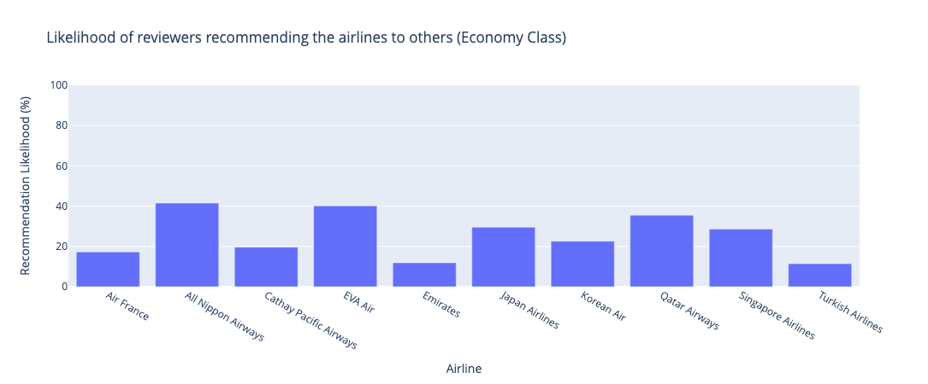
Sentiment Analysis
The reviewers of Turkish Airlines, Emirates, Air France, and Korean Air are very unlikely to recommend the airlines to others.

Slide 16
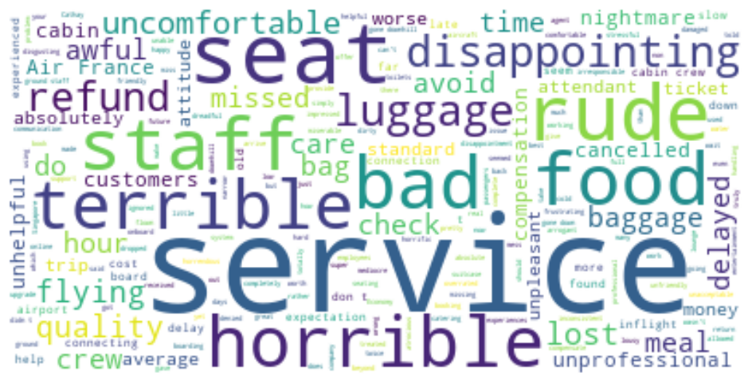
Sentiment Analysis
Most used words in negative reviews (Economy Class)
The words represent the areas where reviewers are most disappointed in and suggests areas for improvement for the airlines.

Slide 17
Conclusion
Customer satisfaction in airline services have steadily declined over the years, and the airlines need to improve their services.
1 | Airlines need to focus on improving services for Economy Passengers to improve their overall rating.
2 | Turkish Airlines, Air France, and Emirates need to up their game the most and improve their services for customers.
3 | Airlines should balance the services provided compared to the price of the flights, because that is the factor that impact’s their overall rating the most (Economy Class).
4 | The reviewers of Turkish Airlines, Emirates, Air France, and Korean Air are very unlikely to recommend the airlines to others (Economy Class).
5 | Airlines need to improve their quality of food, luggage, seat, staff, comfort, and helpfulness among others in their negative reviews (Wordcloud result).

Slide 18
Tools and Technologies Used
Code Editor and IDE | VSCode, Jupyter Notebook, Python
Data Extraction and Transformation | PySpark
Data Analysis | Numpy, PySpark, Pandas
Sentiment Analysis | AutoTokenizer, Softmax, RoBERTa model
Visualization | Plotly, MatPlotLib, Wordcloud

Slide 19
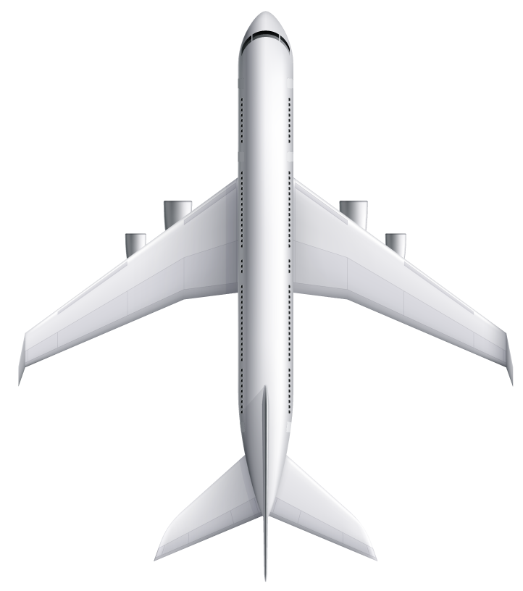
Thanks!
Do you have any questions?

Slide 20
Thanks!
Do you have any questions?

Slide 21
Thanks!
Do you have any questions?

Slide 22
Thanks!
Do you have any questions?

