Slide 1
Events

Slide 2
Events
What is JavaScript Events? JavaScript's interaction with HTML is handled through events that occur when the user or the browser manipulates a page.
When the page loads, it is called an event. When the user clicks a button, that click too is an event. Other examples include events like pressing any key, closing a window, resizing a window, etc..
Events list – Body or frame level - onLoad, onunload
Form level events - onchange, onsubmit, onreset, onselect, onblur, onfocus
Key board events - onkeydown, onkeypress, onkeyup
Others events - onclick, ondblclick, onmousedown, onmousemove, onmouseout, onmouseover, onmouseup
2

Slide 3
Events
What is events handlers?
A piece of code executed when an event occurs.
Browser assign a default handler for few events. Eg. Link
There are a lot of different types of events that can occur, for example:
The user clicking the mouse over a certain element or hovering the cursor over a certain element.
The user pressing a key on the keyboard.
The user resizing or closing the browser window.
A web page finishing loading.A form being submitted.
A video being played, or paused, or finishing play.An error occurring.
3

Slide 4
Events
How to define handlers? 1. Classic method. <button id="myButton" onclick="alert(1);"> My Button</button>
2. Registering event handlers using addEventListener method window.document.querySelector("#myButton").addEventListener("click", function(){
alert("clicked");
}, false);
3. Cancelling Default Handler window.document.querySelector("a").onclick = function(){
alert("Welcome to QNimate");
return false;
}
4

Slide 5
Events
What is Event Propagation? When you click on an HTML element then all of its parent elements along with it receive a action event. Understand this and event.target using example. event.target – is the “target” element that initiated the event, it doesn’t change through the bubbling process.this – is the “current” element, the one that has a currently running handler on it.
5

Slide 6
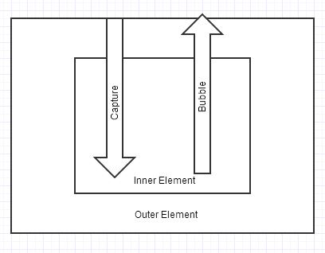
Events
What event handlers as bubbling And captureing? When we register handlers using addEventListener(), we have the choice to choose whether a handler comes under bubble or capture phase. If the last parameter is true then it comes under capturing and if its false then bubbling.
6

Slide 7
Events
What is Stopping Propagation? Event propagation can be stopped using two ways: returning false in classic method or using stopPropagation() in addEventListener() method. As soon as one of this is called the propagation stop there.
7

