Slide 1
Final Presentation- Philip Morris International
Case Study #3 Supervised Learning Problem(Regression task) Name :Prashant Bansod Github : https://github.com/prashant-bansod/usecase_3

Slide 2

Problem Statement: Identifying the attributes in the surrounding that affect the sale
Situation
Every company wants to succeed and gain an edge on the competition. Achieving the revenue goals translates into maximizing sales. Many companies distribute their goods at a physical Point Of Sales (POSs). For all of them the challenge is to devise a strategy that will drive the sales at POSs.
Solution
Designing a Machine learning model which will identity the important attributes in the surrounding that impact the sales

Slide 3
Steps to develop a Machine Learning model
Exploratory Data Analysis
Deciding the Target Variable
Data Pre-processing
Preparing Data for the Machine Learning Model
Applying the Machine Learning Model
Deciding the most important features

Slide 4
Deciding the Target Variable
As we want to know the impact of the surroundings on the total sales, the target feature is going to be the total sale.
We are going to decide the effect of the Surrounding attributes on the total sale
As the target variable is continuous, we are going to apply regression algorithmm for this problem

Slide 5
Data Preparation Method
1 .The dataset was prepared using the both sales_granular.csv and Surroundings.json file.
2. Extraction of the features is done using Surroudings.json where we have all the attributes related to
the surroundings
3. The total sale is being calculated by adding all the sales for a particular store.
4. As the scales of the features is not same, the feature scaling step is important

Slide 6
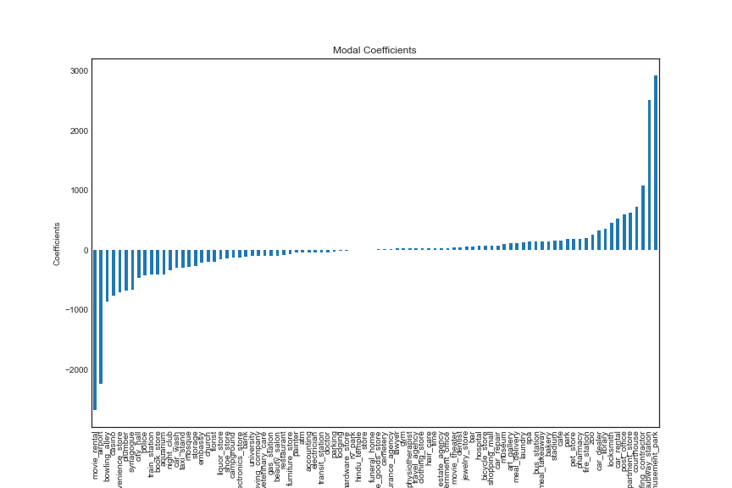
Applying Machine Learning Model
After preprocessing the data, Lasso Model was used to understand the features in the data

Slide 7

Why Random Forest Machine Learning Algorithm
It can handle categorical features, numerical features without any need for scaling and also provide a pretty good indicator of feature importance. It overcomes the problem of overfitting as well.
Random Forest Steps :
1) Take different subset of training samples
2) Build decision trees on each sample
3) For regression task, the process follows the same as described
above except the final predicted value would be the average of all
the values predicted by individual decision trees.
Final Accuracy of the model :
R ² score=0.87

Slide 8
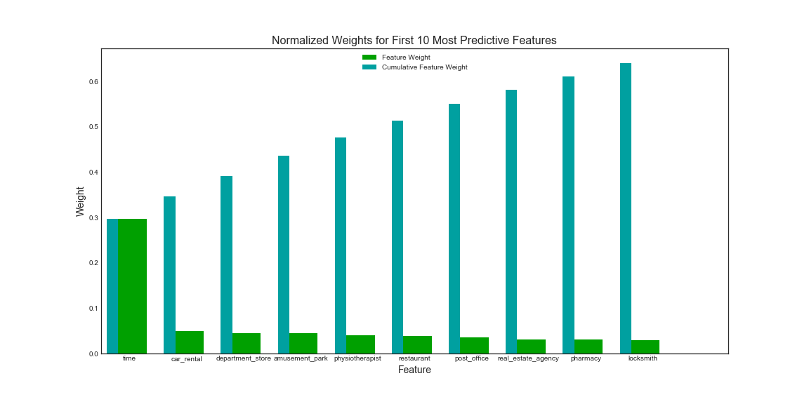
Feature Importance
By using using the Gradient Boosting Regressor we can get the understanding of the important features in the data. To drive the sales at the point of sale (POS), top 5 attributes are
Time ( Hourly sales)
Car rental service
Department store
Amusement park
Physiotherapist

Slide 9
Challenges & Lessons Learned
-Understanding and extracting the features
-Invested considerable time in data preparation
Challenges
- Enhanced my knowledge of the data preparation process
- Got hands on a real life project with the complex data
Learnings
-Application of XGBoost algorithm to improve the accuracy further
- Better Hyperparameter tuning
Future
implementations

