Slide 1

Builder
An Object Creational Pattern
Tim Rice
CSPP51023
March 2, 2010

Slide 2
Intent / Applicability
Separate the construction of a complex object from its representation so that the same construction process can create different representations
Use the Builder pattern when:
  the algorithm for creating a complex object should be independent of the parts that make up the object and how they are assembled
  the construction process must allow different representations for the object that is constructed
Reference: Design Patterns, Gamma, et. al., Addison Wesley, 1995, pp 97-98

Slide 3
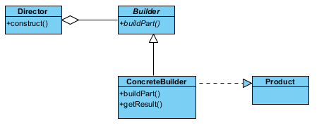
UML Structure

Slide 4
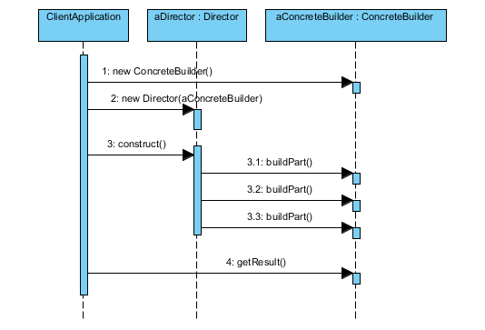
Collaborations

Slide 5

Example: building different types of airplanes
AerospaceEngineer: director
AirplaneBuilder: abstract builder
Airplane: product
Sample concrete builders:
  CropDuster
  FighterJet
  Glider
  Airliner

Slide 6
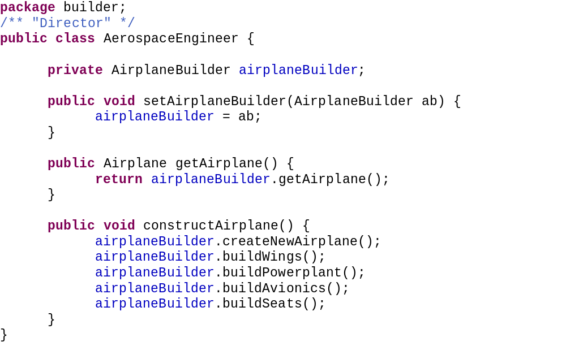
Director

Slide 7
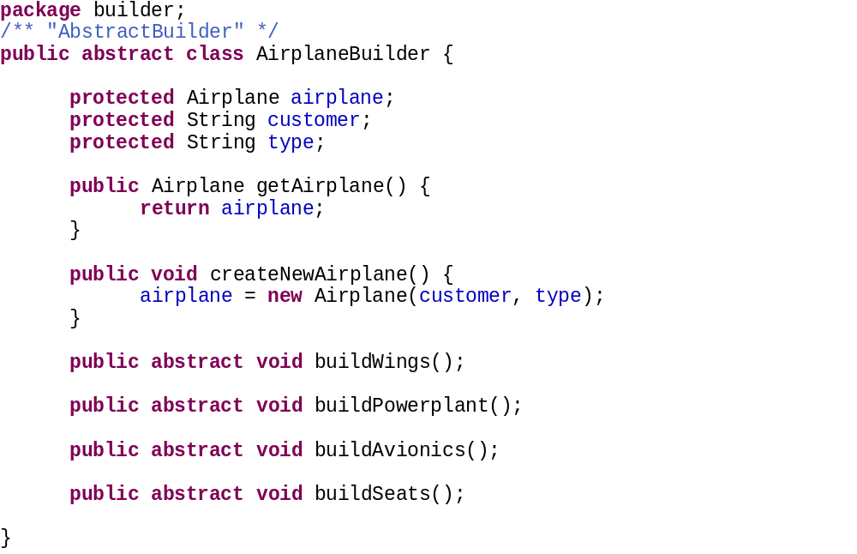
AbstractBuilder

Slide 8
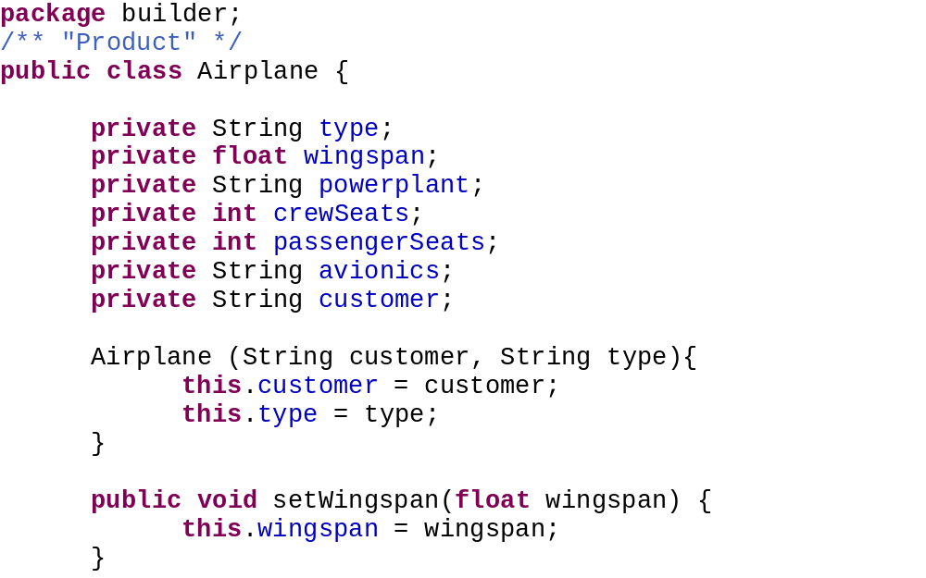
Product

Slide 9
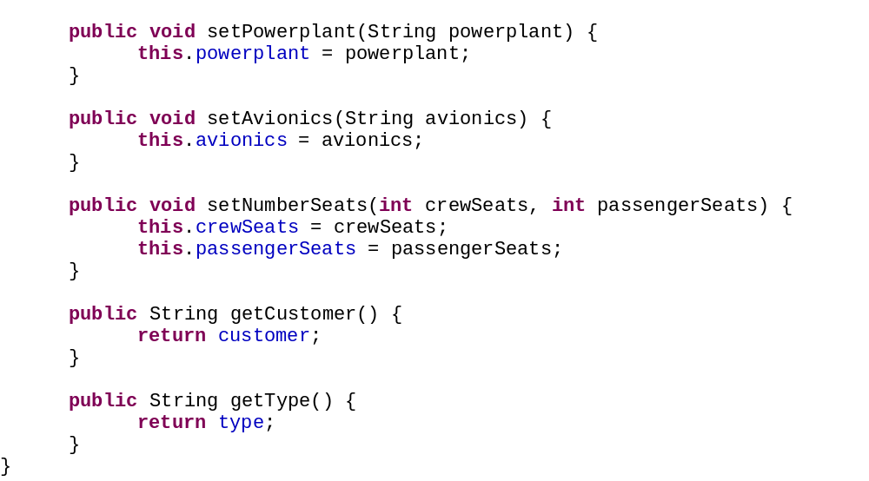
Product (continued)

Slide 10
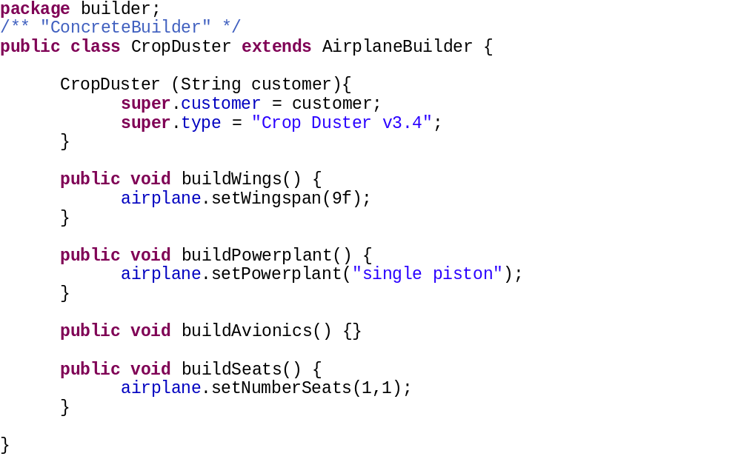
ConcreteBuilder 1

Slide 11
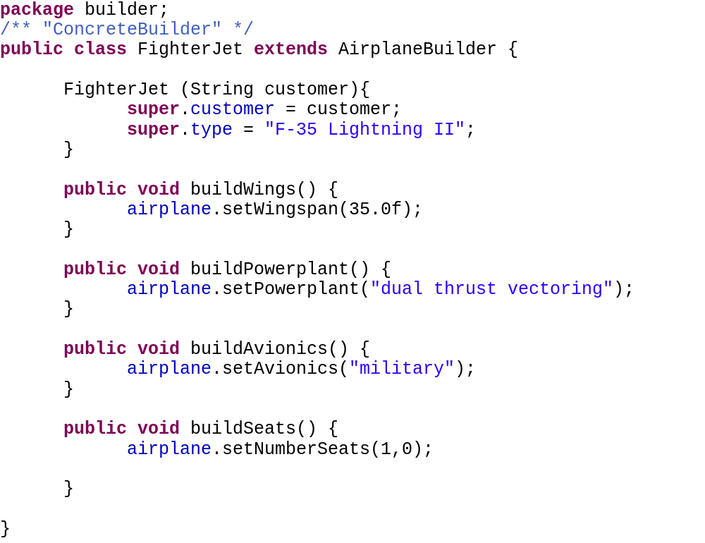
ConcreteBuilder 2

Slide 12
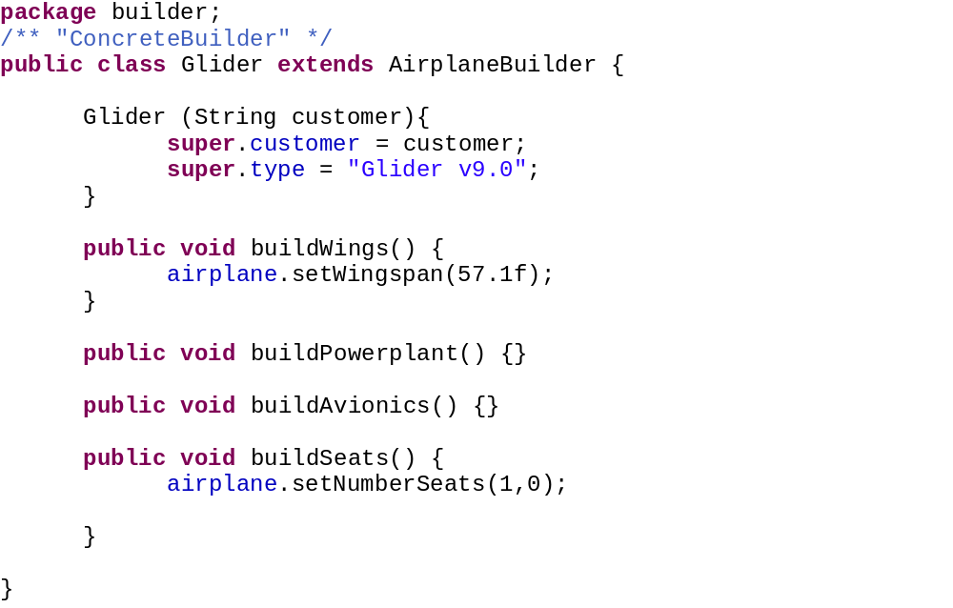
ConcreteBuilder 3

Slide 13
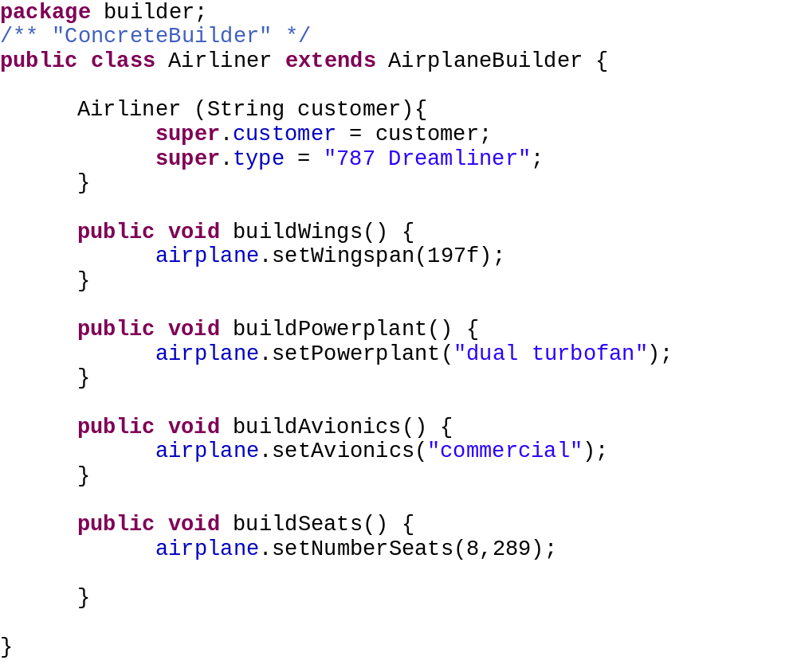
ConcreteBuilder 4

Slide 14
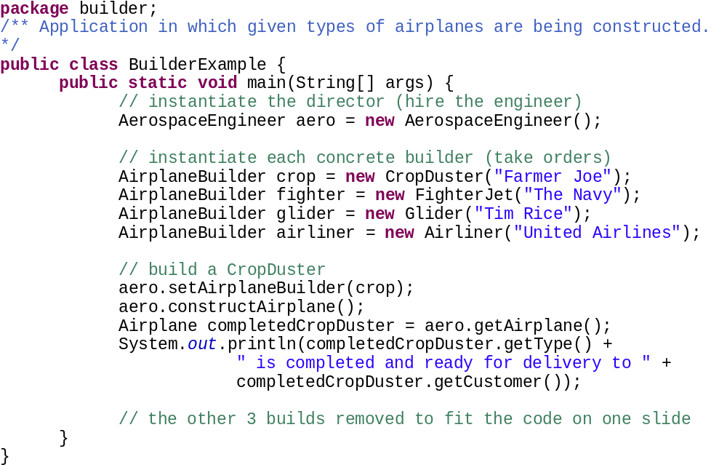
Client Application

Slide 15
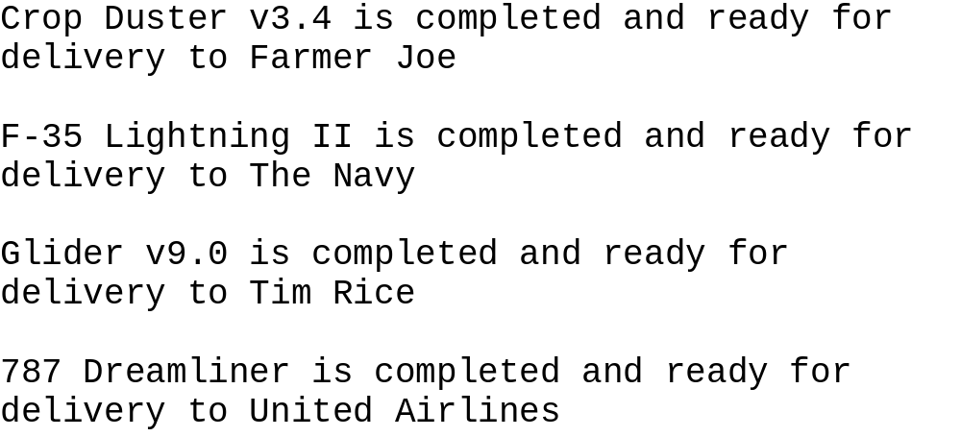
Client Application output

Slide 16
Builder: Advantages / Disadvantages
Advantages:
  Allows you to vary a product’s internal representation
  Encapsulates code for construction and representation
  Provides control over steps of construction process
Disadvantages:
  Requires creating a separate ConcreteBuilder for each different type of Product

Slide 17
Related Patterns
Factory Method: “class creational” pattern
  Provides interface for constructing objects, allowing subclasses decide which creation class to use
Prototype: an “object creational” pattern
  Separates system from object creation and representation, using a prototypical instance
Abstract Factory: another “object creational” pattern
  Also separates system from product creation and representation, but does not have an abstract builder – application calls the factory methods directly

