Slide 1


Breast Cancer Detection
PCET’s Pimpri Chinchwad University, Pune
Department of Computer Science and Engineering
SY B Tech (B)
Using Machine Learning
Presented by
Prashant Gupta (B-17)
SOE23201010438
Guided by
Dr. Sachin Jadhav

Slide 2
Introduction
Breast Cancer Overview:
Breast cancer is one of the most common cancers affecting mens and womens worldwide.
Early detection is crucial for improving survival rates and treatment outcomes.
Challenges in Detection:
Traditional diagnostic methods, such as mammography, have limitations, including false positives and negatives.
Manual analysis of medical images is time-consuming and subject to human error.

Slide 3
Data Utilized:
Medical data, including 29 features of tumor for identification of cancer .
Breast Cancer Wisconsin data from biopsy samples (Kaggle).
Objectives of ML Model:
Classify tumors as benign or malignant.
Assist radiologists in interpreting medical reports.
Benefits:
Improved diagnostic accuracy and reduced human error.
Ability to process and analyze large volumes of data efficiently.
Support personalized treatment plans based on predictive analytics.

Slide 4
LITERATURE REVIEW
Overview:
Breast cancer is a significant global health concern.
Mammograms are widely used but have limitations (false positives/negatives).
Machine Learning (ML) improves accuracy in detection.
ML Techniques Used:
Logistic Regression
Decision Trees
Random Forest
Identified Gaps:
Heavy reliance on imaging datasets.
Lack of accessible, user-friendly detection systems.

Slide 5
METHODOLOGY
MODEL DEVELOPMENT:
Developed a breast cancer detection model using python and trained it on the dataset.
The model was serialized into a .pkl file to save its state.
Integrated this model into the backend of a Flask based web app for easy interaction.
Flask Based Web Application:
The web app allows for manual entry of 29 features or the upload of a PDF file to extract these features.
Based on the 29 features, the model predicts whether the cancer is malignant or benign.

Slide 6
DESIGN & IMPLEMENTATION
ML Algorithms Implemented:
Logistic Regression (98% accuracy)
Decision Tree Classifier (100% accuracy, risk of overfitting)
Random Forest Classifier (99% accuracy)
Data Processing:
Exploratory Data Analysis (EDA)
Encoding & Scaling (StandardScaler applied)
Train-Test Split (80-20% division)
System Implementation:
Flask-based web application for interactive use.
Supports manual feature input and PDF upload for automated processing.

Slide 7
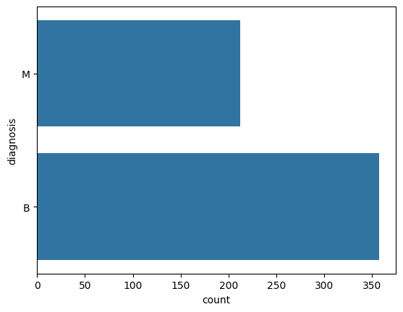
RESULT & PERFORMANCE
ALGORITHMS & ACCURACY:
Logistic Regression: 98.90%
Decision Tree: 100%
Random Forest: 99.78%

Slide 8
IMPACT, BENEFITS & CHALLENGES
Impact & Benefits:
Enhanced Accuracy: ML reduces human error in cancer diagnosis.
Timely Interventions: Faster and more reliable screening process.
Resource Optimization: Helps medical professionals focus on complex cases.
Challenges:
Data Extraction Issues: Variability in PDF formats can lead to misinterpretation.
Overfitting Concerns: High training accuracy may not generalize well.
Integration Complexity: Seamless backend-frontend communication needs optimization.

Slide 9
Conclusion
Machine Learning significantly improves breast cancer detection.
Implementation of a web-based ML tool enhances accessibility.
User friendly web application for early detection of cancer.
Addressing existing challenges can further refine model effectiveness.
Future work:
Plan to introduce an image upload feature for automatic cancer detection from images (eg. mammogram images).
References:
Udemy: Breast Cancer Detection Using Machine Learning.
Research works from Research Gate, IEEE Xplore, SciHub.
Various online resources and datasets.

Slide 10
THANK YOU
PCET’s Pimpri Chinchwad University, Pune
A Breast Cancer Detection model and web application using ML
Presented by
Prashant Gupta
CSSB017
Guided by
Dr. Sachin Jadhav

