Slide 1

GODRIVE Self Drive car rental
Project By:
Prashant Kumar Mishra 1719210187
Abhay Raj Singh 1719210004
Shahid Khan 1719210233
Project Guide:
Ms. Sheetu

Slide 2

Purpose:
This software, called ‘Online Car Rental System’, will allow for the company to access their database securely and safely in a user-friendly online environment. Allowing them to change car information with ease. The software will be in sync with the both the Web App, allowing for real-time up-to-date services for their customers.

Slide 3
scope
Online Rental business is a hefty industry in the world. Car rental businesses hold more share in the rental business world. Due to the development and fast moving work culture and rotational shifts, it’s not preferable to use own transport for safety travel. To comfort those people’s car rental business owners took these issues and came up with the concept called “Online Car Rental System”.

Slide 4
motivation
Our Aim is to design and create a data management System for a Online car rental system. This enables admin to rent a vehicle that can be used by a customer. By paying the money for a specified period of time. This system increases customer retention and simplifies vehicle and staff Management in an efficient way. This software, Online car Rental System has a very user friendly interface. Thus the users will feel very easy to work on it.

Slide 5
Description of project:
CAR REGISTRATION
MANAGE CUSTOMER
USER DATA
BILLS AND DISCOUNT
MANAGE CAR
CAR RENTAL STATUS

Slide 6
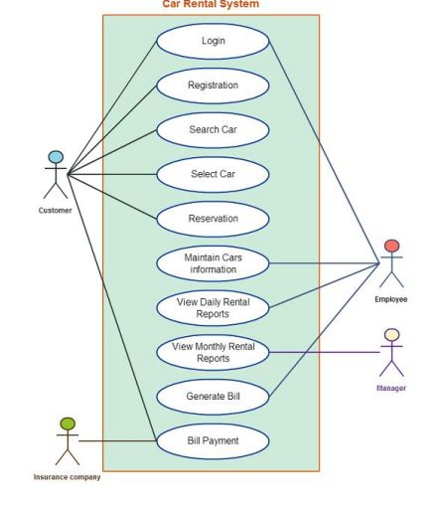
Usecase diagram

Slide 7
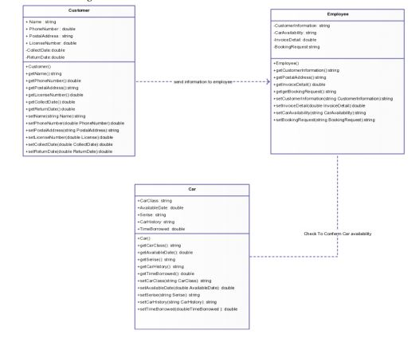
Class diagram

Slide 8
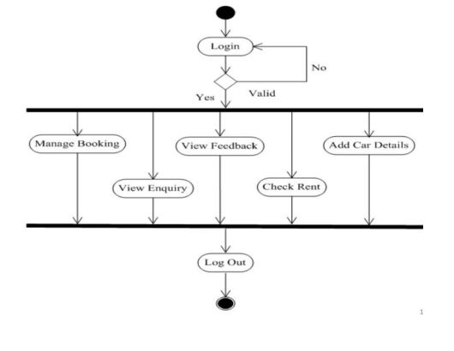
Activity diagram

Slide 9
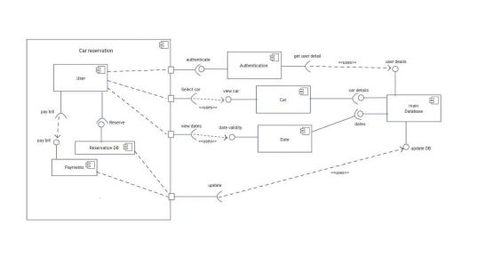
Component diagram

Slide 10
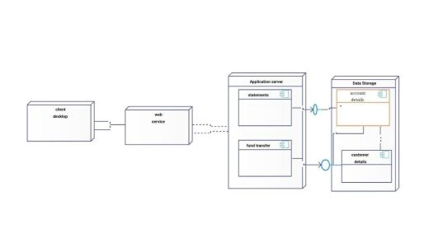
Deployment diagram

Slide 11
solution
There should be a Web App version for the software to connect with for those who wish for a quick car rental servicer. The Web App will be responsive to any device using it. This allows for consumers to access the service from any sort of hardware device: tablet, computer, mobile devices, and so on. The software itself will be available on all computer platforms that are running any aspect of Linux, Windows 7, Windows 8, and Mac operating systems.

Slide 12
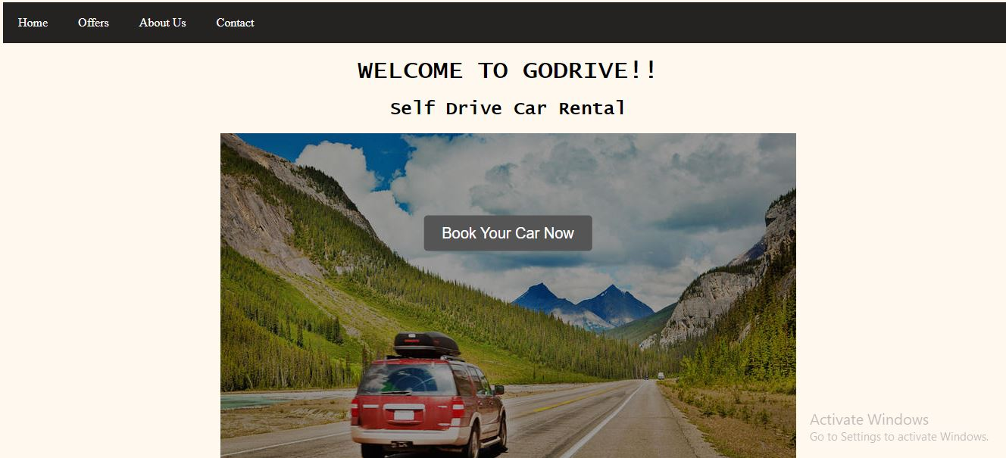
Screenshots of result

Slide 13
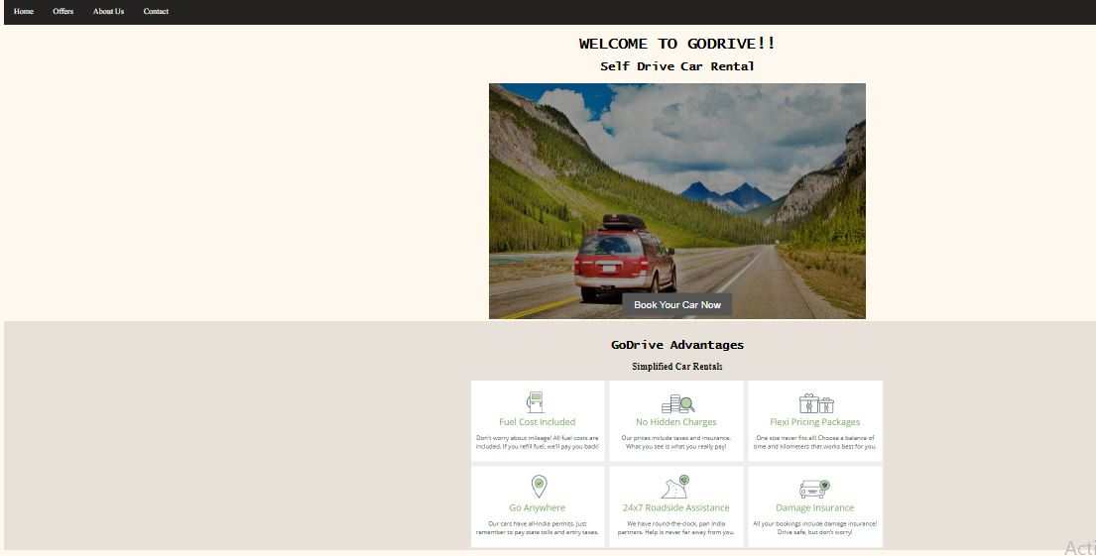
Screenshot of result

Slide 14
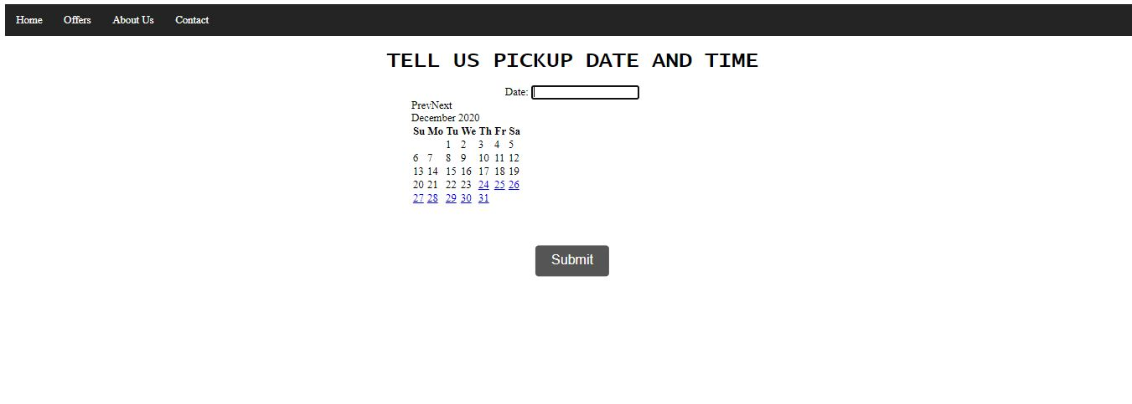

Slide 15
references
W3Schools - https://www.w3schools.com/
Devdocs - https://devdocs.io/
Freecodecamp - https://www.freecodecamp.org/
Stackoverflow - https://stackoverflow.com/

