Slide 1

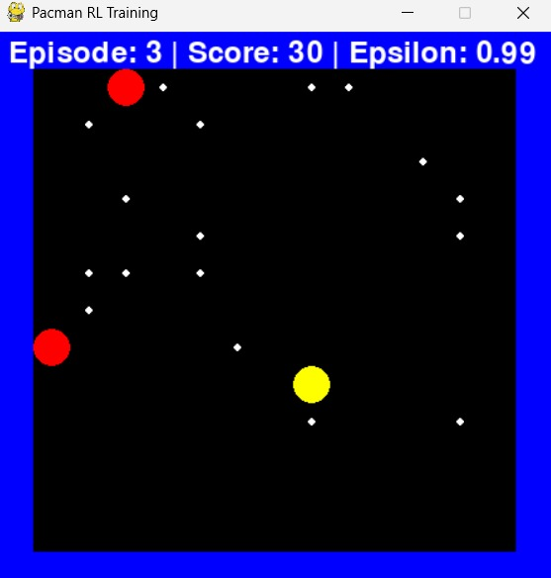
Game playing Agent
Team Members:
- Prashant Kumar Mishra (2447021)
- Rishi Kumar (2447031)
- Satyam Bhardwaj (2447051)
Subject :Artificial Intelligence
Course: 3rd semester MCA (AI & IoT) NIT Patna

Slide 2
PROJECT OBJECTIVES
implemented multi-agent Pac-Man Game environnent
Develop RL agent learning from visual inputs
Use Deep Q-Networks (DQN) for decision making
Real-time training visualization
No handcrafted features - pure image-based learning

Slide 3

KEY FEATURES:
  Pacman vs Adversarial Ghosts
  CNN + DQN Architecture
  PyGame Visualization
  Experience Replay
TECH STACK
Python
PyTorch
PyGame
NumPy

Slide 4
SYSTEM ARCHITECTURE
1. Environment - Custom Pacman game
2. State Representation - RGB image grids
3. CNN Model - Feature extraction
4. DQN Agent - Q-value approximation
5. Training Loop - Experience replay + Target networks

Slide 5
“
REINFORCEMENT LEARNING APPROACH
State: 15×15×3 RGB game grid
Actions:
Reward System:
- Food: +10
- Ghost collision: -50
- Step penalty: -0.1
- Win: +100
Up
Down
Left
Right
Stop
”

Slide 6
“
CNN with 3 convolutional layers
• Experience replay (10,000 capacity)
• ε-greedy exploration (1.0 → 0.01)
• Target network updates
”

Slide 7
“
TRAINING PROGRESS:
• Episode 0: Score = -52(Random)
• Episode 100: Score = 32 (620% improvement)
• Episode 400: Consistent scores 58-60
”

Slide 8
References
https://cs221stanford.edu/
https://cs221stanford.edu/
https://cs224nstanford.edu/
https://cs229.stanford.edu/
https://cs230.stanford.edu/
Artificial intelligence and intelligent systems by N. P. Padhy, Published 2005 by Oxford University press
Artificial Intelligence: A Modern Approach, 3rd Edition, by Stuart Russell and Peter Norvig.
Artificial Intelligence, 3rd Edition, by Elaine Rich, Kevin Knight, Shivashankar B Nair

