Slide 1







TTN Proposal | Client
Date : 17 Sep 2026
Ref : fbd194c7-6658-4976-9fe9-850206906b58
Proudly recognised by
Notes:
ChatBot Development - Sales & After Sales ( Text to sequel problem)

Slide 2
Agenda
Executive Summary and Our Understanding of Project Requirements
Proposed Technical Solution Approach
Project Plan and Key Deliverables
Commercial Summary
Success Stories

Slide 3
Executive Summary
The proposed solution aims to deliver a comprehensive and user-friendly website that meets all the mandatory functional and technical requirements outlined in the RFP. The solution will ensure that all pages are developed with the necessary input controls, forms, and content displays as specified. The website will be designed to provide a seamless user experience while maintaining the integrity and functionality required for the platform.

Slide 4
Why TTN?
Proven UX & Mobile Expertise
We specialize in building intuitive, high-performance mobile applications with seamless user journeys - critical for customer engagement and retention.
Domain-Focused Delivery
Our extensive experience in iGaming with real-time data integration, media streaming, and interactive user features aligns perfectly with your racing platform requirements.
End-to-End Ownership
From design and development to deployment and support, we provide full-cycle mobile app services- ensuring speed, quality, and continuity.
Scalable Architecture
Our solutions are designed to grow with your user base, ensuring performance and reliability under peak traffic conditions

Slide 5
Our Understanding of Requirements
The RFP outlines a set of mandatory functional and technical requirements for the website, including the display of investment opportunities, search functionality, testimonials, job listings, contact forms, and embedded media. These requirements are critical for ensuring the website serves its intended purpose of promoting investment opportunities and providing a platform for engagement with stakeholders. All requirements are marked as mandatory, indicating that they must be fully addressed in the solution.

Slide 6
Key Application Modules
The home page will display investment opportunities and sector categories, with a search input for filtering content.
The About Us page will include initiatives and testimonials, with a radio input for selecting testimonials.
The proposed solution will develop a responsive and scalable website that includes all the required pages and functionalities.
The Contact Us page will include all required input fields for submitting inquiries, including text inputs for name, company, email, and select controls for sector, country, and state.
The EFTA Desk page will include an embedded YouTube video player.
The Careers page will feature job listings with search and select controls for filtering roles.

Slide 7
Non Functional Requirements
Compliance with data protection regulations such as GDPR and PII handling will be ensured.
Secure form submissions and data encryption will be implemented for all contact and feedback forms.

Slide 8
Non Functional Requirements
Component | Key consideration
Frontend Framework | React.js for dynamic UI and responsive design
Backend Architecture | Node.js with Express for scalable API handling
Database | MongoDB for flexible data storage and retrieval
Search Functionality | Elasticsearch for efficient content filtering and search
Form Handling | Formik and Yup for validation and submission handling
File Uploads | Cloudinary for secure and scalable file storage
Video Embedding | YouTube IFrame API for embedding videos
User Authentication | Firebase Auth for secure user management
Accessibility | WCAG 2.1 compliance for inclusive design

Slide 9
Key Assumptions and Dependencies
The client will provide necessary content and data for implementation.
All required functionalities will be supported by the proposed technical stack.
No third-party integrations are required beyond the specified requirements.

Slide 10
In Scope and Out of Scope
In Scope
Not Estimated
Implementation of all mandatory functional and technical requirements as listed in the RFP.
Development of user-friendly interfaces for all specified pages.
Ensuring accessibility and usability for all user interactions.
Design and branding of the website's visual elements.
Integration with external systems or third-party services not specified in the RFP.
Content creation and management beyond the scope of the provided requirements.

Slide 11
Agenda
Executive Summary and Our Understanding of Project Requirements
Proposed Technical Solution Approach
Project Plan and Key Deliverables
Commercial Summary
Success Stories

Slide 12
Solutioning Highlights
The proposed solution will develop a responsive and scalable website that includes all the required pages and functionalities. The home page will display investment opportunities and sector categories, with a search input for filtering content. The About Us page will include initiatives and testimonials, with a radio input for selecting testimonials. The Careers page will feature job listings with search and select controls for filtering roles. The Contact Us page will include all required input fields for submitting inquiries, including text inputs for name, company, email, and select controls for sector, country, and state. The EFTA Desk page will include an embedded YouTube video player. The Global Investment Opportunities page will include a note about eligibility and a link to submit company profiles. The India Opportunity page will display economic statistics and growth projections. The Invest India Feedback page will include a form for submitting feedback with all required input fields. All pages will be developed with a focus on usability, accessibility, and performance.

Slide 13


Proposed High Level Architecture
Mobile Application
UI layer Screens
Business Logic Layer
Data Layer
Mobile
User
Network Service
Local Storage
Firebase
3rd Party
Analytics
Push
Notifications
Crash
Reporting

Slide 14
Architecture Considerations
Component | Key Considerations
Component | Key consideration
Frontend Framework | React.js for dynamic UI and responsive design
Backend Architecture | Node.js with Express for scalable API handling
Database | MongoDB for flexible data storage and retrieval
Search Functionality | Elasticsearch for efficient content filtering and search
Form Handling | Formik and Yup for validation and submission handling
File Uploads | Cloudinary for secure and scalable file storage

Slide 15
Mobile Development Platform - Comparison
Factors | REACT NATIVE | Flutter

Slide 16
Agenda
Executive Summary and Our Understanding of Project Requirements
Proposed Technical Solution Approach
Project Plan and Key Deliverables
Commercial Summary
Success Stories
‹#›

Slide 17





Project Management Approach
Continuous Evolution of Working Software
TTN Engineering Team
Engagement
Kick off & Discovery
Iterative
Development
1 2 3 . .
UAT
Go-Live
Hypercare
Support
Project Manager/Business Analyst
Technical lead
DevOps Experts
Requirements Analysis | Conduct a detailed review of all mandatory requirements to ensure full alignment
UI/UX Design | Create wireframes and mockups for all pages based on functional and technical requirements
Development Phases | Implement
Test…
Analyse
Ui/UX Expert
Tech & Functional Discovery
Design
Mobility Developer
Test Framework Setup
Repeat
Code
Quality Analyst
Test
Dev & CI Setup
Deploy
Project Setup & Preparation
Iterative & Incremental
Collaboration

Slide 18








Project Governance Model
Steering
Committee
Client Executive
Leadership
TTN Executive Leadership and Business Unit Head
Direction & Program Updates
Program
Management
Committee
Monthly Governance Checkpoints (SteerCo)
Product Manager, Client
TTN Delivery Director /
Project Manager
Escalate Risks & Issues
Direction & Program Updates
Engagement Highlights
Support Channels | Provide 24/7 support via ticketing system and email
Response Time | SLA of 2 hours for critical issues and 4 hours for non-critical issues
Ma…
Client Stakeholders
TTN Team
Program
Execution
Team
Daily Stand-ups
Month Planning
Project Manager
TTN Engineering
Team
Joint Retrospective
Month Demo

Slide 19


Project Plan
Activities /Timelines | Week 1 | Week 2 | Week 3 | Week 4 | Week 5 | Week 6 | Week 7 | Week 8 | Week 9 | Week 10 | Week 11 | Week 12 | Week 13 | Week 14 | Week 15
Design & Discovery Phase
Agile based Iterative Development and Testing ( end to end features)
UAT and Go Live (2 Weeks)
Hypercare Support ( For 2 Weeks Post Go-Live)
Discovery
Design Phase
Product Increment Review
UAT and Go-Live

Slide 20
Agenda
Executive Summary and Our Understanding of Project Requirements
Proposed Technical Solution Approach
Project Plan and Key Deliverables
Commercial Summary
Success Stories
‹#›

Slide 21
Proposed Engagement Model
Collaborative approach with regular progress updates and stakeholder reviews.
Agile methodology with sprints and iterative development.
Clear communication channels for requirement clarification and feedback.
Commercial pricing and payment terms will be agreed based on final scope, milestones, and contract.
Fixed Price Fixed Scope Engagement
Commercial Summary

Slide 22
Agenda
Executive Summary and Our Understanding of Project Requirements
Proposed Technical Solution Approach
Project Plan and Key Deliverables
Commercial Summary
Success Stories
‹#›

Slide 23




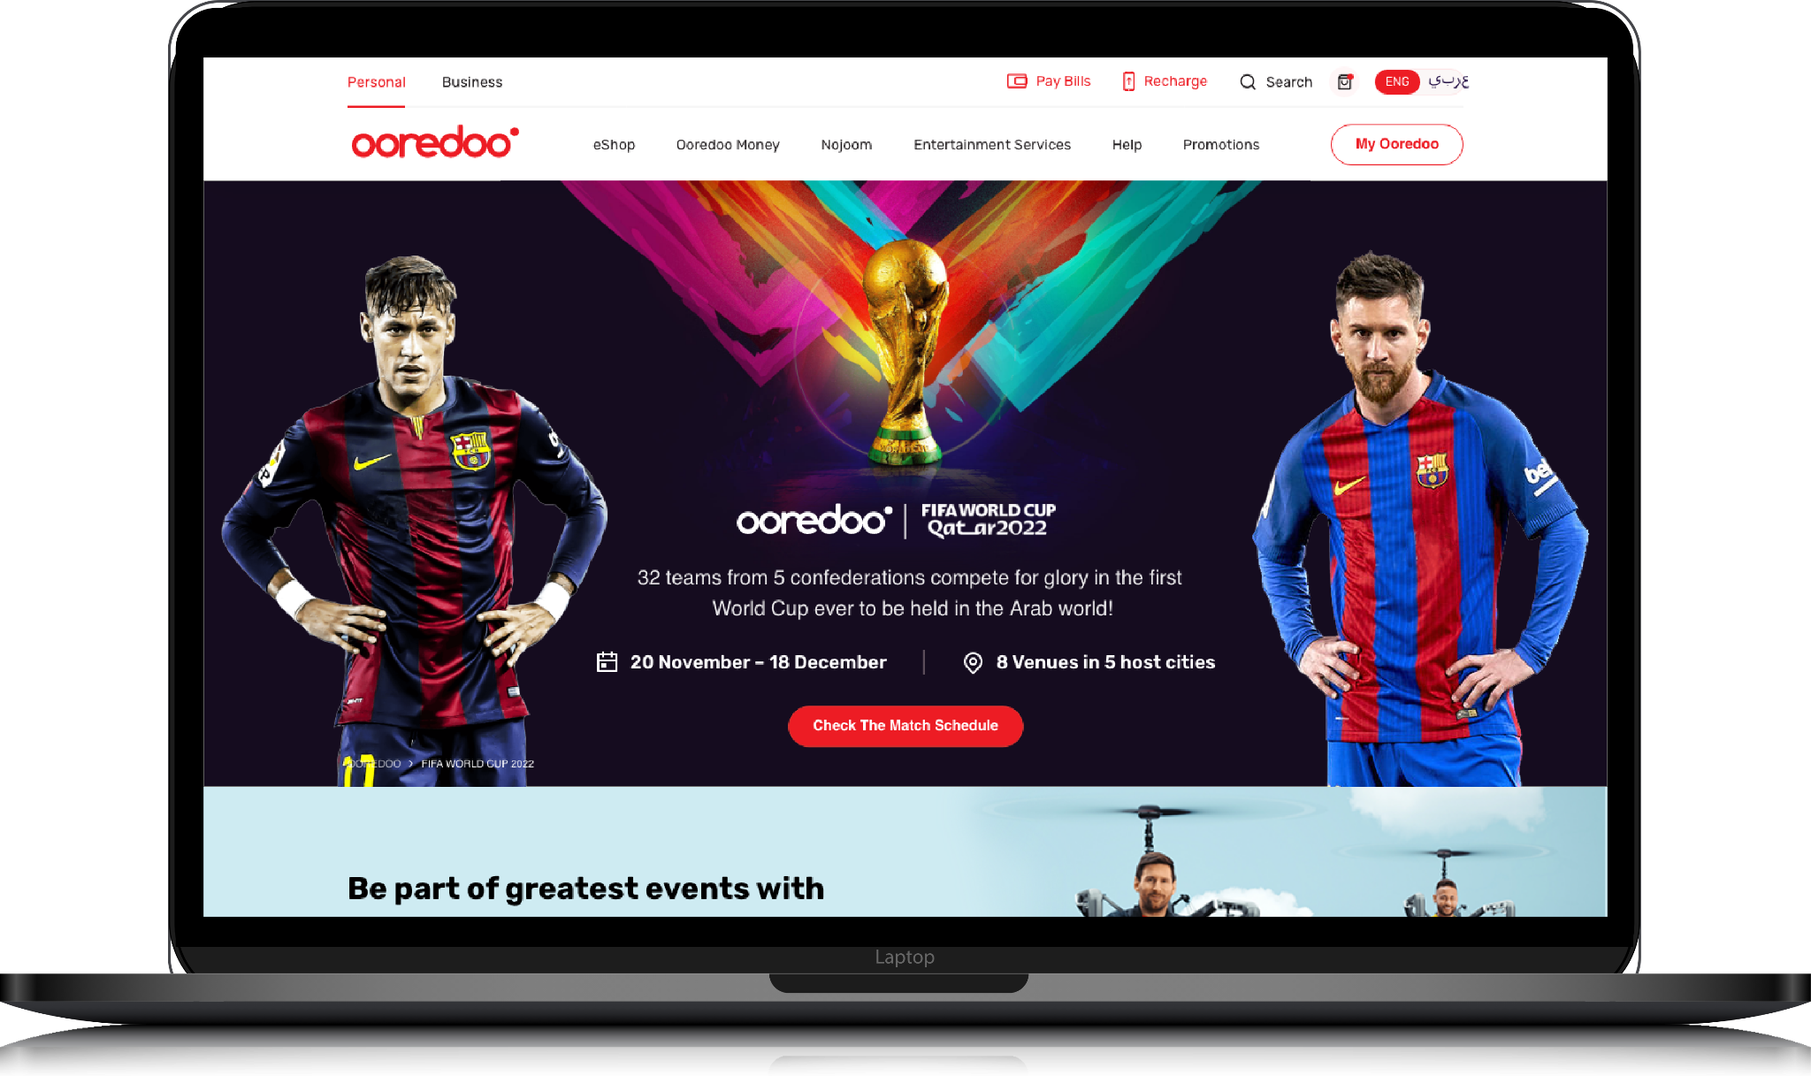


Australia
Since 2018, TTN has been a strategic partner in Tabcorp’s transformation, evolving from supporting its digital arm to over 150 people enabling digital, gaming, data, trackside, retail, and cybersecurity. Together, we have delivered groundbreaking solutions at scale.
From omni-channel innovations like a cross-platform betting app, integrating web and mobile experiences, customer engagement and personalisation through Adobe Target, Analytics, and AEM, to infrastructure modernisation with Infra as Code, AWS Cloud optimisation, and Graviton migration, to reducing manual testing by 45% through automation.
We have enabled compliance adherence through AML/CTF tools for Enhanced Customer Due Diligence and suppression management.
Our work includes cutting-edge betting features like Same Game Multi for sports, Blackbook for racing, and Retail in-play initiatives to boost engagement and custom experiences.
‹#›

Slide 24



Australia
TTN successfully rebuilt the entire Sky Racing Website, optimised for SEO, and implemented a microservices-based architecture that is highly resilient and scalable, hosted on AWS.
In addition to enhancing core digital properties, TTN streamlined content curation through a custom-built CMS, enabling auto and personalised playlists based on user preferences, which significantly improved operational efficiency.
The platform features live race streaming and VOD content, leveraging a comprehensive technology stack that includes Kotlin, Swift, Java, MongoDB, Spring Boot, and more.
‹#›

Slide 25





India
Tata Play partnered with us to reimagine their digital platforms - bringing innovation to both entertainment and customer self-service.
We engineered a secure OTT solution featuring Live TV, VoD, DRM integration, and user-friendly tools like remote recording and rich analytics. In parallel, we developed a React Native-based Self-Care app with a unified Android/iOS codebase, enabling faster releases and seamless CRM/payment gateway integration.
Powered by a microservices architecture, the platforms are scalable, resilient, and experience-driven.
Achieved 70%+ mobile engagement, improved app ratings, higher user adoption, and increased recharge and upsell conversions across digital channels.
‹#›

Slide 26
Quick Recap
The proposed solution aims to deliver a comprehensive and user-friendly website that meets all the mandatory functional and technical requirements outlined in the RFP. The solution will ensure that all pages are developed with the necessary input controls, forms, and content displays as specified. The website will be designed to provide a seamless user experience while maintaining the integrity and functionality required for the platform.

