Slide 1







TTN Proposal for Mobile App Development | Racing Queensland v1.0
Date : 29 May 2025
Proudly recognised by
Notes:
ChatBot Development - Sales & After Sales ( Text to sequel problem)

Slide 2
Agenda
Executive Summary and Our Understanding of Project Requirements
Proposed Technical Solution Approach
Project Plan and Key Deliverables
Commercial Summary
Success Stories

Slide 3
Executive Summary
Following our recent discussions with Racing Queensland Networks (here in after referred to as Racing Queensland) , we are pleased to submit this proposal for the design and development of a custom mobile application tailored to Racing Queensland current and future needs. The application is envisioned to be a comprehensive digital platform that enhances user engagement, delivers real-time racing content, and offers a seamless, intuitive experience to racing enthusiasts and stakeholders alike with following objectives:
Develop a robust admin portal that empowers seamless content management and real-time updates.
Seamlessly embed live race videos and TAB replays with adaptive streaming for smooth playback on all networks.
Enable smart filtering, contextual search, and Blackbook tracking with real-time push alerts for favorite runners and jockeys.
Allow users to access and export steward and sectional data in multiple formats (CSV, PDF, print) directly from the app.
As a strategic technology partner with proven expertise in UX design and end-to-end mobile app development, TO THE NEW (TTN) are well-positioned to bring this vision to life. This proposal outlines our understanding of project requirements , a high level view of technical solution and approach followed by the project plan and commercials.

Slide 4
Why TTN?
Proven UX & Mobile Expertise
We specialize in building intuitive, high-performance mobile applications with seamless user journeys - critical for customer engagement and retention.
Domain-Focused Delivery
Our extensive experience in iGaming with real-time data integration, media streaming, and interactive user features aligns perfectly with your racing platform requirements.
End-to-End Ownership
From design and development to deployment and support, we provide full-cycle mobile app services- ensuring speed, quality, and continuity.
Scalable Architecture
Our solutions are designed to grow with your user base, ensuring performance and reliability under peak traffic conditions

Slide 5
Our Understanding of Requirements
Enable User Access Features such as Registration, Login, and Forgot Password.
Allow User to Race Calendar to support real-time race schedules and results display
Provide View Screens for Track, Jockey/Trainer, Runner Profiles.
Allow users to Search, Filter and View Past and Upcoming race details
List Premiership details.
Allow users to add favorite runners or Jockey/Trainers to their Blackbook
Provide View Screens to support real-time race results.
Integrate live video streaming of races and TAB race replays functionality.
Provide push notifications for race alerts and updates.
Offer betting partner redirection with deep linking.
Admin portal for managing content and updates.
Search and View News Items.
Provide sections for Steward and Sectional Report Data Export via Mobile App (csv, pdf, print).
Provide Business Awareness pages such as Ownership, Career & Training, Infrastructure, Open API details etc.

Slide 6
Key Application Modules
User Access & Account Management
User Registration
User Login
Forgot Password
Show Account Details
Add Jockeys and Trainers to Blackbook
Show Blackbook Activities
Races & Profiles
Search and Filter, Past and Upcoming Races
Search and View Profile Pages for Tracks, Jockeys, Trainers, and Runners
Race Calendar & Planner
View Race Details for Upcoming and Past Races using the Race Calendar
Search, Filter and Export Race Details using Race Planner
Races, Results & Replays
Stream Races and Replay Feeds in-app from Betting Partners.
Redirect to Queensland Non-TAB Racing YouTube channel to Stream Replay Feeds from other sources..
Show Real-Time Race Results.
View and Download Steward and Sectional Reports.
Premiership Details & Reports
List Premiership Rankings and Statistics such as wins, placings, prize money earned and total starts for each participant.
Filter Premiership Details based on for different categories, like Metro, Provincial, and Country Premierships for Trainers, Jockeys, and Apprentices
Search & Download Premiership Reports.
News & Notifications
Search and View Racing News Items
Search and View Business Awareness pages such as Ownership, Career & Training, Infrastructure, Open API details etc.
Get Push Notifications for Race Alerts & Updates.

Slide 7
Non Functional Requirements
Architecture & Code Quality
  A cross-platform mobile application will be developed using a modular architecture approach.
  The codebase will follow modular principles and separation of concerns to support future enhancements and maintain a scalable, loosely coupled architecture.
  Google and Apple recommended architectural guidelines will be followed to ensure the solution is scalable and future-ready.
  The app will be lightweight and built using API-driven development principles to ensure performance and responsiveness.
User Experience & Design
  Development best practices will be implemented to ensure compatibility with screen sizes of 4.5” and above.
  Usability testing will be conducted to ensure a seamless and enriched user experience for any UeX changes.
Security & Compliance
  All personal and sensitive data (e.g., donation information) will be securely stored, both at rest and in transit, using industry-standard encryption practices.
  The application will adhere to the latest Google Play and Apple App Store policies to ensure successful deployment and avoid rejection or delisting.

Slide 8
Non Functional Requirements
Reliability & Monitoring
  The app will be designed to recover gracefully from unexpected errors to maintain a consistent user experience.
  Logging and monitoring tools will be integrated to capture crashes, errors, and app usage analytics for continuous improvement.

Slide 9
Key Assumptions and Dependencies
The app will be built on Cross-Platform tech stack (Flutter or React Native)
Tech Stack will be finalised during the initial 2 weeks of discovery with understanding of current Racing Queensland tech ecosystem to ensure the selected solution is scalable, robust, and resilient for future needs.
All the necessary approvals and access to the critical systems required for this engagement will be provided by the Racing Queensland team.
Availability of SMEs and key stakeholders during Discovery, Designs sign off, Sprint demos, UAT and Go-live from Racing Queensland is required.
Existing backend services from the current web app will be reused, new API development is not considered.
APIs will provide direct playable video links, if low-latency HLS support is required additional third-party player/library will be integrated.
Any necessary regulatory approvals will be secured within 1–2 weeks.
Key user interactions (e.g., clicks, page views) will be tracked via analytics. We have considered 25 events in our scope.
The following sections will load via web views only.(e.g. Animal Welfare, Ownership, Career & Training, Infrastructure, About)
All third-party license costs are not considered in scope.
The app will mirror the current web application, functional changes will require separate effort and approval.
Support for all screen size of 4.5” and above
OS support for iOS - 13.0 and above, and Android - 11 and above.

Slide 10
In Scope and Out of Scope
In Scope
Not Estimated
Project Discovery, Design, Development and Deployment.
  Mobile Application Development
UX and Visual Designs of all the screens
Manual QA Testing for the developed features
CI/CD Implementation
UAT support and deployment
Go-Live Support
Hypercare /Warranty Support(2 Weeks)
Procurement & Maintenance of Infrastructure/ servers.
Marketing and Advertising Campaigns.
Procurement of any 3rd party tools or licenses or services involved during development (any other tools, Hosting cost).
Platform Hosting, VAPT & Automation Testing*
Training sessions will be conducted however preparation of quick start videos are not considered in the scope.*
App distribution licencing cost - Apple Developer account (AUD 149/year) and a Google Play Console registration (AUD 35 one-time).
*TTN has the capability to provide these services and can be offered to Racing Queensland if needed at additional costs.

Slide 11
Agenda
Executive Summary and Our Understanding of Project Requirements
Proposed Technical Solution Approach
Project Plan and Key Deliverables
Commercial Summary
Success Stories

Slide 12
Solutioning Highlights
After a detailed discovery of the platform and user needs, we will evaluate the following key aspects to finalise the most suitable mobile app technology:
Platform: Both Flutter and React Native allow us to build high-performance mobile applications that support live streaming and run seamlessly on both Android and iOS from a single codebase. It will enable us to release new features, updates and fixes across platforms simultaneously.
Streaming and Data Consumption: Assessing how streaming services (such as live video streaming) are currently integrated or intended to be integrated, and how data is consumed or expected to be managed across both platforms.
Technical Considerations: Understanding the performance needs, scalability, and backend integration for streaming content and handling real-time data and the potential for third party libs integration.
Third party support: Since integrations like analytics, ads, and SSO etc are essential. Support and availability for these SDKs will be evaluated to determine the right platform.
Accelerated Development with Generative AI: We will strategically utilise powerful generative AI tools like Cursor AI and GitHub Copilot, significantly improving our coding speed, enhancing efficiency, and enabling our teams to deliver high quality solutions at a faster pace.
Our team has extensive experience and expertise in working with both Flutter and React Native, allowing us to confidently recommend and implement the most suitable solution for your project.

Slide 13


Proposed High Level Architecture
Mobile Application
UI layer Screens
Backend APIs
Business Logic Layer
Data Layer
Mobile
User
Network Service
Local Storage
Firebase
3rd Party
Analytics
Push
Notifications
Crash
Reporting

Slide 14
Architecture Considerations
Component | Key Considerations
Mobile Application Development Platform | Cross-platform technologies like Flutter or React Native to be considered for mobile application development. They will enable us to use a single codebase for both Android and iOS, reducing development time and costs while increasing code reuse and maintainability.
On-the-fly Deployment | On-the-fly deployment enables pushing app updates without app store resubmission-natively supported in React Native via CodePush and achievable in Flutter using Shorebird. This is particularly useful for hot-fixes and minor changes.
Performance Optimisation | Responsive UI and smooth animations, lazy loading of images, pagination and optimised asset management.
API Integration | RESTful API integration using the existing APIs utilised by the Web platform.
Security & Data Protection | Any user data to be securely stored in keychain and encryption if required. Secure communication using HTTPS. Authentication using existing backend architecture.
Analytics & Crash Monitoring | Firebase Analytics(or any other preferred tool) to be utilised for analysing user behavior, page views and clicks. Crash reporting and error monitoring to be dove via Firebase Crashlytics.
Deployment Strategy | App Store and Play store guidelines compliance. CI/CD pipeline for automated deployment for different environments.

Slide 15
Mobile Development Platform - Comparison
Factors | REACT NATIVE | Flutter
Performance/Speed | High | High
OTA Updates (Without going through App Store) | Possible (Using Codepush or Expo) | Possible
Technologies Used | React/ React-Native/ Native Components | Dart
Development Time | Medium | Medium
Debugging | Easy | Easy
Community Support | High | High
Backed By | Facebook/ Open Source | Google/ Open Source
Build Size | Medium | Highest
Code Reuse between Platforms | 70-80% | 70-80%
Support for OS Upgrades | Medium | High
Ability & Support for 3rd party hardware / SDK | Medium | Medium
* Both Flutter and React Native are well-suited to deliver the required functionality. TTN will recommend the most appropriate technology stack after conducting a thorough discovery of the platform and understanding user needs.

Slide 16
Agenda
Executive Summary and Our Understanding of Project Requirements
Proposed Technical Solution Approach
Project Plan and Key Deliverables
Commercial Summary
Success Stories
‹#›

Slide 17





Project Management Approach
Agile Based iterative Development Approach
Continuous Evolution of Working Software
TTN Engineering Team
Engagement
Kick off & Discovery
Iterative
Development
1 2 3 . .
UAT
Go-Live
Hypercare
Support
Project Manager/Business Analyst
Technical lead
DevOps Experts
Key Program Deliverables
Project Charter
RAID Register
Sprint Report
Project Plan
Arch. & Design Document
Test Strategy document & Test Cases
Focused Trainings (where applicable)
Analyse
Ui/UX Expert
Tech & Functional Discovery
Design
Mobility Developer
Test Framework Setup
Repeat
Code
Quality Analyst
Test
Dev & CI Setup
Deploy
Project Setup & Preparation
Iterative & Incremental
Collaboration

Slide 18








Project Governance Model
Steering
Committee
Racing Queensland Executive
Leadership
TTN Executive Leadership and Business Unit Head
Direction & Program Updates
Program
Management
Committee
Monthly Governance Checkpoints (SteerCo)
Product Manager, Racing Queensland
TTN Delivery Director /
Project Manager
Escalate Risks & Issues
Direction & Program Updates
Engagement Highlights
Racing Queensland Stakeholders
TTN Team
Program
Execution
Team
Daily Stand-ups
Month Planning
Project Manager
TTN Engineering
Team
Joint Retrospective
Month Demo

Slide 19


Project Plan
Activities /Timelines | Week 1 | Week 2 | Week 3 | Week 4 | Week 5 | Week 6 | Week 7 | Week 8 | Week 9 | Week 10 | Week 11 | Week 12 | Week 13 | Week 14 | Week 15
Design & Discovery Phase
Agile based Iterative Development and Testing ( end to end features)
UAT and Go Live (2 Weeks)
Hypercare Support ( For 2 Weeks Post Go-Live)
Discovery
Design Phase
Product Increment Review
UAT and Go-Live
*Notes:
2 Weeks of Hypercare support post go-live will be provided at no additional cost.
Project Timelines could be revised after discovery with expected variation upto +/-10%

Slide 20
Agenda
Executive Summary and Our Understanding of Project Requirements
Proposed Technical Solution Approach
Project Plan and Key Deliverables
Commercial Summary
Success Stories
‹#›

Slide 21
Proposed Engagement Model
Project will be executed in Iterative Agile manner for each phase with the following iterations-
  Agile-based Development
  UAT and Go-Live
Any delay in project due to reasons beyond TTN will warrant a change request against the impacted man days
If there are any changes to assumptions or delays caused due to dependencies from Racing Queensland, impact on effort, timelines and cost would need to be assessed and will go through change request process.
Total price for the entire project as per requirements outlined in the proposal would be:
  Price Before dIscount : AUD 80,712.63
  Discount : 5%
  Final Price After discount : AUD 78,727.00
All mentioned prices are exclusive of applicable taxes.
Payment Milestones has been added in the following slide.
All the invoices would be considered accepted by the customer if there is no objection in 5 days.
Payment terms are 30 calendar days from the receipt of the invoice.
Fixed Price Fixed Scope Engagement
Commercial Summary

Slide 22
Agenda
Executive Summary and Our Understanding of Project Requirements
Proposed Technical Solution Approach
Project Plan and Key Deliverables
Commercial Summary
Success Stories
‹#›

Slide 23




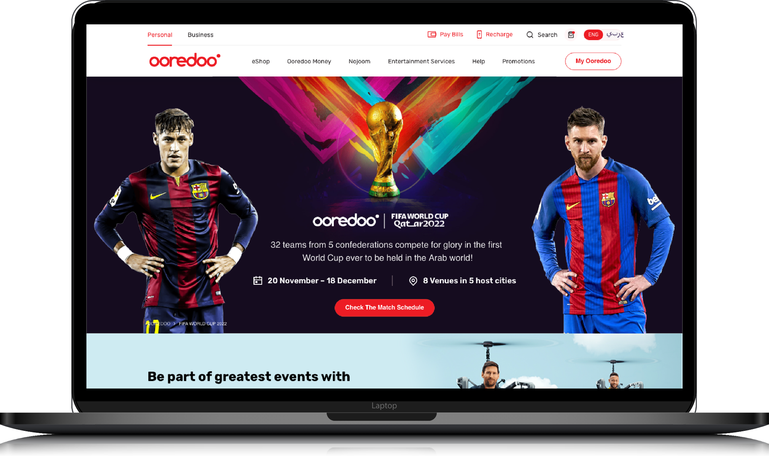


Australia
Since 2018, TTN has been a strategic partner in Tabcorp’s transformation, evolving from supporting its digital arm to over 150 people enabling digital, gaming, data, trackside, retail, and cybersecurity. Together, we have delivered groundbreaking solutions at scale.
From omni-channel innovations like a cross-platform betting app, integrating web and mobile experiences, customer engagement and personalisation through Adobe Target, Analytics, and AEM, to infrastructure modernisation with Infra as Code, AWS Cloud optimisation, and Graviton migration, to reducing manual testing by 45% through automation.
We have enabled compliance adherence through AML/CTF tools for Enhanced Customer Due Diligence and suppression management.
Our work includes cutting-edge betting features like Same Game Multi for sports, Blackbook for racing, and Retail in-play initiatives to boost engagement and custom experiences.
‹#›

Slide 24



Australia
TTN successfully rebuilt the entire Sky Racing Website, optimised for SEO, and implemented a microservices-based architecture that is highly resilient and scalable, hosted on AWS.
In addition to enhancing core digital properties, TTN streamlined content curation through a custom-built CMS, enabling auto and personalised playlists based on user preferences, which significantly improved operational efficiency.
The platform features live race streaming and VOD content, leveraging a comprehensive technology stack that includes Kotlin, Swift, Java, MongoDB, Spring Boot, and more.
‹#›

Slide 25





India
Tata Play partnered with us to reimagine their digital platforms - bringing innovation to both entertainment and customer self-service.
We engineered a secure OTT solution featuring Live TV, VoD, DRM integration, and user-friendly tools like remote recording and rich analytics. In parallel, we developed a React Native-based Self-Care app with a unified Android/iOS codebase, enabling faster releases and seamless CRM/payment gateway integration.
Powered by a microservices architecture, the platforms are scalable, resilient, and experience-driven.
Achieved 70%+ mobile engagement, improved app ratings, higher user adoption, and increased recharge and upsell conversions across digital channels.
‹#›

Slide 26
Quick Recap
TO THE NEW will bring deep domain expertise and strategic alignment across all the chosen focus areas
Continuous investment in innovation and capability building for future readiness for Racing Queensland by leveraging TTN CoE capabilities
Flexible ways of working aligned to Racing Queensland business hours, with maximum overlap in time zones globally.
Proven agility to flex up or down to work seamlessly with small, medium and enterprise customers
One of the lowest attrition in the industry. We are among Top 50 India’s Best Workplaces in IT-BPM as per the recent survey by Great Place to Work® 2024 .
Competitive pricing with focus on high value delivery
Proven Global & Distributed Delivery partner providing right mix of collaboration, cost and scale advantage

