Slide 1
Asp.Net
Asp Basic

Slide 2
ASP.Net Lifecycle
When an ASP.Net application is launched, there are series of steps which are carried out. These series of steps make up the lifecycle of the application.

Slide 3
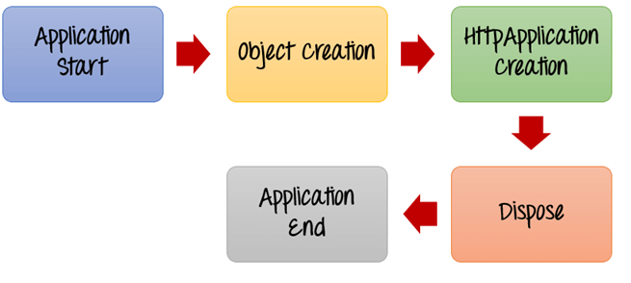

Slide 4
Application Start
The life cycle of an ASP.NET application starts when a request is made by a user. This request is to the Web server for the ASP.Net Application. This happens when the first user normally goes to the home page for the application for the first time. During this time, there is a method called Application_start which is executed by the web server. Usually, in this method, all global variables are set to their default values.

Slide 5
Object creation
The next stage is the creation of the HttpContext, HttpRequest & HttpResponse by the web server. The HttpContext is just the container for the HttpRequest and HttpResponse objects. The HttpRequest object contains information about the current request, including cookies and browser information. The HttpResponse object contains the response that is sent to the client.

Slide 6
HttpApplication creation
This object is created by the web server. It is this object that is used to process each subsequent request sent to the application. For example, let's assume we have 2 web applications. One is a shopping cart application, and the other is a news website. For each application, we would have 2 HttpApplication objects created. Any further requests to each website would be processed by each HttpApplication respectively.

Slide 7
Dispose
This event is called before the application instance is destroyed. During this time, one can use this method to manually release any unmanaged resources.

Slide 8
Application End
This is the final part of the application. In this part, the application is finally unloaded from memory.

Slide 9
Page Life Cycle
When an ASP.Net page is called, it goes through a particular lifecycle. This is done before the response is sent to the user. There are series of steps which are followed for the processing of an ASP.Net page.

Slide 10
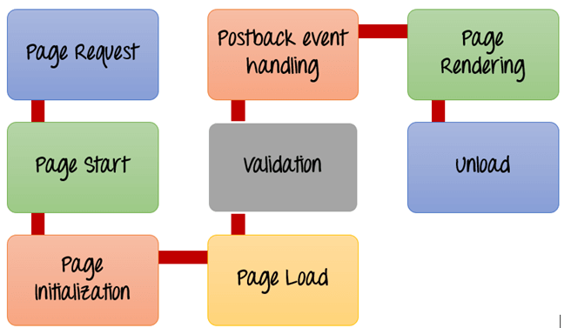

Slide 11
Page Request- This is when the page is first requested from the server. When the page is requested, the server checks if it is requested for the first time. If so, then it needs to compile the page, parse the response and send it across to the user. If it is not the first time the page is requested, the cache is checked to see if the page output exists. If so, that response is sent to the user.

Slide 12
different stages of an ASP.NET page:
Page request
Starting of page life cycle
Page initialization
Page load
Validation
Postback event handling
Page rendering
Unload

Slide 13
Page Start – During this time, 2 objects, known as the Request and Response object are created. The Request object is used to hold all the information which was sent when the page was requested. The Response object is used to hold the information which is sent back to the user.
Page Initialization – During this time, all the controls on a web page is initialized. So if you have any label, textbox or any other controls on the web form, they are all initialized.

Slide 14
Page Load – This is when the page is actually loaded with all the default values. So if a textbox is supposed to have a default value, that value is loaded during the page load time.
Validation – Sometimes there can be some validation set on the form. For example, there can be a validation which says that a list box should have a certain set of values. If the condition is false, then there should be an error in loading the page.

Slide 15
Postback event handling – This event is triggered if the same page is being loaded again. This happens in response to an earlier event. Sometimes there can be a situation that a user clicks on a submit button on the page. In this case, the same page is displayed again. In such a case, the Postback event handler is called.

Slide 16
Page Rendering – This happens just before all the response information is sent to the user. All the information on the form is saved, and the result is sent to the user as a complete web page.
Unload – Once the page output is sent to the user, there is no need to keep the ASP.net web form objects in memory. So the unloading process involves removing all unwanted objects from memory.

Slide 17
Object
The page itself is instantiated as a control object. All web forms are basically instances of the ASP.NET Page class. The page class has the following extremely useful properties that correspond to intrinsic objects:
Session
Application
Cache
Request
Response
Server
User
Trace

Slide 18
Request Object
The request object is an instance of the System.Web.HttpRequest class. It represents the values and properties of the HTTP request that makes the page loading into the browser.
AcceptTypes Gets a string array of client-supported MIME accept types.
ApplicationPath Gets the ASP.NET application's virtual application root path on the server.
Browser Gets or sets information about the requesting client's browser capabilities.

Slide 19
Cookies Gets a collection of cookies sent by the client.
FilePath Gets the virtual path of the current request.
FilesGets the collection of files uploaded by the client, in multipart MIME format.
Form Gets a collection of form variables.
QueryString Gets the collection of HTTP query string variables.

Slide 20
RequestType Gets or sets the HTTP data transfer method (GET or POST) used by the client.
ServerVariables Gets a collection of Web server variables.
TotalBytes Gets the number of bytes in the current input stream.
Url Gets information about the URL of the current request.

Slide 21
Response Object
The Response object represents the server's response to the client request. It is an instance of the System.Web.HttpResponse class.
Cookies
Gets the response cookie collection.
End
Sends all currently buffered output to the client, stops execution of the page, and raises the EndRequest event.

Slide 22
Redirect(String)
Redirects a request to a new URL and specifies the new URL.
Redirect(String, Boolean)
Redirects a client to a new URL. Specifies the new URL and whether execution of the current page should terminate.
SetCookie
Updates an existing cookie in the cookie collection.

Slide 23
Write(Char)
Writes a character to an HTTP response output stream.
Write(Object)
Writes an object to an HTTP response stream.
Write(String)
Writes a string to an HTTP response output stream.

Slide 24
?
?
?
?
?
Questions?
?
?
?
?
?
http://schoolacademy.telerik.com

