Slide 1
Asp.Net

Slide 2
Overview of ASP.NET Controls:
ASP.NET framework includes over 70 controls, which enable you to do everything from displaying a list of database records to displaying a randomly rotating banner advertisement.

Slide 3
These controls can be divided into eight groups:
Standard Controls.
Validation Controls.
Data Controls.
Navigation Controls.
Login Controls.
Web Part Controls
HTML Controls.
Crystal Report Controls

Slide 4
Standard Controls:
This section enable you to render standard form elements such as buttons, input fields, labels, panels, Calendar etc. each of the describe as below.
The ASP.NET Framework includes two controls you can use to display text in a page the Label control and the Literal control.

Slide 5
Label Control:
Label control is used to display the text that can be either static or you can change it programmatically.
By default, a Label control renders its contents in an HTML <span> tag. Whatever value you assign to the Text property is rendered to the browser enclosed in a <span> tag.

Slide 6
As an alternative to assigning text to the Text property, you can place the text between the Label control's opening and closing tags. Any text that you place before the opening and closing tags gets assigned to the Text property
Label control is inherited from this Class (System.Web.UI.WebControls).

Slide 7

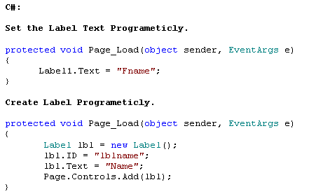

Slide 8
Property | Description
ID | The ID of the Label i.e. lblName etc.
Text | The text of Label either static or Dynamic
AccessKey | The keyboard key for accessing a control
Attributes | The collection of attributes applied to a control
BackColor | The background color of a control
BorderColor | The border color of a control
BorderStyle | The border style of a control
BorderWidth | The border width of a control
CssClass | The CSS class applied to a control
Enabled | A value indicating whether or not control is enabled
Font | The font attributes for the control
EnableTheming | Whether or not themes apply for a control
ForeColor | The foreground color of the control
Height | The height of the control
IsEnabled | A value indicating whether or not control is enabled (Get value only)
SkinID | The skin of the control
Style | The inline CSS style of the control
TabIndex | The tab order of the control
ToolTip | The text that appears when the user rests the mouse pointer over a control
Width | The width of the control
Visible | Possible Value True or False.

Slide 9
Literal

Slide 10
Literal is another standard control which is also used to display text as label work. The Literal control is similar to the Label control. You can use the Literal control to display text or HTML content in a browser. However, unlike the Label control, the Literal control does not render its content inside of a <span> tag.

Slide 11
The Literal control does not support any of the formatting properties supported by the <span> tag. For example, the Literal control does not support either the CssClass or BackColor properties. We can format the literal tag by adding style attribute.

Slide 12
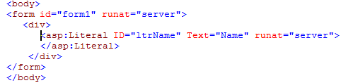

Slide 13
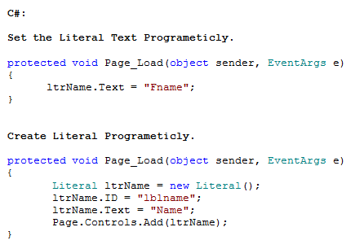

Slide 14
Textbox

Slide 15
TextBox Control is used to get the value from user. Means where user input is require we can use the TextBox.
The TextBox control can be used to display three different types of input fields depending on the value of its TextMode property. The TextMode property accepts the following three values:

Slide 16

SingleLine : Displays a single-line input field
Example:
<asp:TextBox id="txtFname" runat="server" />

Slide 17

MultiLine: Displays a multi-line input field.
Example:
<asp:TextBox id="txtFname" TextMode="multiline" Text="Amit" runat="server" />

Slide 18

Password: Displays a single-line input field in which the text is hidden.
Example:
<asp:TextBox id="txtPwd" TextMode="password" runat="server" />

Slide 19

Take TextBox from toolbox and set the text property declarative

Slide 20
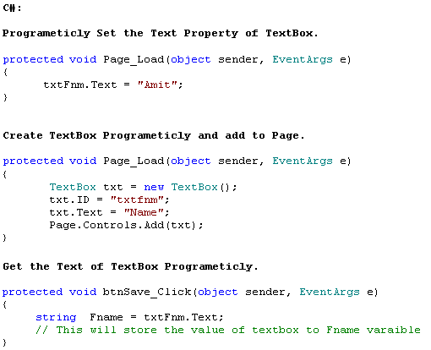

Slide 21
Common Propertis for TextBox :
Property | Description
ID | Set the id of the TextBox
AutoCompleteType | Whether you want to set the TextBox as AutoComplete
AutoPostBack | Specifies whether the control is automatically posted back to the server when the contents change or not. Default value is set as false.
CausesValidation | Specifies if a page is validated when a Postback occurs.
Columns | You can set the width of the TextBox
MaxLength | You can specify maximum number of character allow in textbox
ReadOnly | It will make textbox as readonly means you can not change the value of textbox if readonly property set as true default property is false.
Rows | You can use this property when you have selected textmode as a multiline that will work for the height of the textbox.
Text | Value of the Textbox can be set or get through this property
TextMode | That can be singleline , multiline or password.
ValidationGroup | The group of controls that is validated when a Postback occurs
Wrap | A Boolean value that indicates whether the contents of the textbox should wrap or not
BackColor | The background color of a control
BorderColor | The border color of a control
Visible | Possible Value True or False.

Slide 22
BorderStyle | The border style of a control
BorderWidth | The border width of a control
CssClass | The CSS class applied to a control
Enabled | A value indicating whether or not control is enabled
Font | The font attributes for the control
EnableTheming | Whether or not themes apply for a control
ForeColor | The foreground color of the control
Height | The height of the control
SkinID | The skin of the control
Style | The inline CSS style of the control
TabIndex | The tab order of the control
ToolTip | The text that appears when the user rests the mouse pointer over a control
Width | The width of the control

Slide 23
TextBox control also supports the following method:
Focus: Enables you to set the initial form focus to the text box.
TextBox control supports the following event:
TextChanged : Raised on the server when the contents of the text box are changed.

Slide 24
Button

Slide 25
A button is an object (usually rectangular) the visitor of a web page clicks to initiate a command action. To support buttons on an ASP.NET web site, the .NET Framework provides the Button control that is implemented by the Button class of the System.Web.UI.WebControls namespace of theSystem.Web.dll assembly.

Slide 26

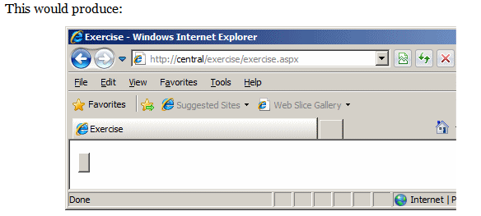

Slide 27
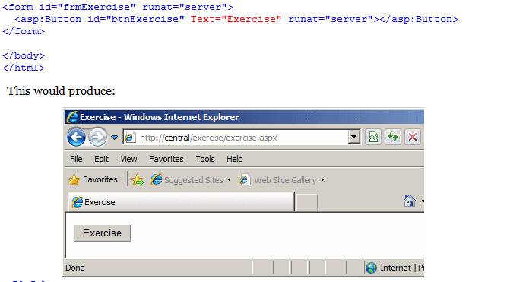

Slide 28
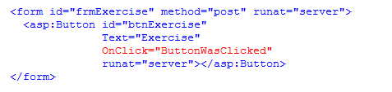

Slide 29
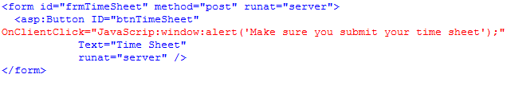
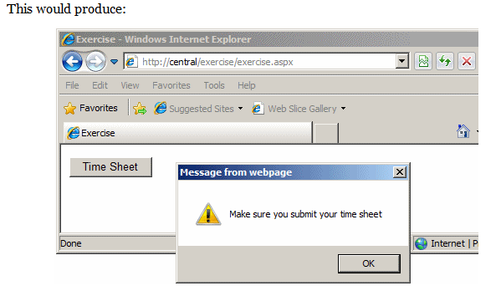

Slide 30
CheckBox

Slide 31
The CheckBox control supports the following properties
(this is not a complete list):
AccessKey : Enables you to specify a key that navigates to
the TextBox control.
AutoPostBack : Enables you to post the form containing
the CheckBox back to the server automatically when the
CheckBox is checked or unchecked.
Checked : Enables you to get or set whether the CheckBox
is checked.

Slide 32
Enabled : Enables you to disable the TextBox.
TabIndex : Enables you to specify the tab order of the check box.
Text : Enables you to provide a label for the check box.
TextAlign : Enables you to align the label for the check box.
Possible values are Left and Right.

Slide 33
The CheckBox control also supports the following method:
Focus : Enables you to set the initial form focus to the check box.
The CheckBox control supports the following event:
CheckedChanged : Raised on the server when the check box is checked or unchecked.

Slide 34
RadioButton
You always use the RadioButton control in a group. Only one radio button in a group of RadioButton controls can be checked at a time.

Slide 35
The RadioButton control supports the following properties (this is not a complete list):
AccessKey Enables you to specify a key that navigates to the RadioButton control.
AutoPostBack Enables you to post the form containing the RadioButton back to the server automatically when the radio button is checked or unchecked.
Checked Enables you to get or set whether the RadioButton control is checked.
Enabled Enables you to disable the RadioButton.
GroupName Enables you to group RadioButton controls.
TabIndex Enables you to specify the tab order of the RadioButton control.
Text Enables you to label the RadioButton control.
TextAlign Enables you to align the RadioButton label. Possible values are Left and Right.

Slide 36
The RadioButton control supports the following method:
Focus Enables you to set the initial form focus to the RadionButton control.
Finally, the RadioButton control supports the following event:
CheckedChanged Raised on the server when the RadioButton is checked or unchecked.

Slide 37
DropDownList

Slide 38
The ListItem control supports the following five properties:
Attributes Enables you to add HTML attributes to a list item.
Enabled Enables you to disable a list item.
Selected Enables you to mark a list item as selected.
Text Enables you to specify the text displayed by the List Item.
Value Enables you to specify a hidden value associated with the List Item.

Slide 39
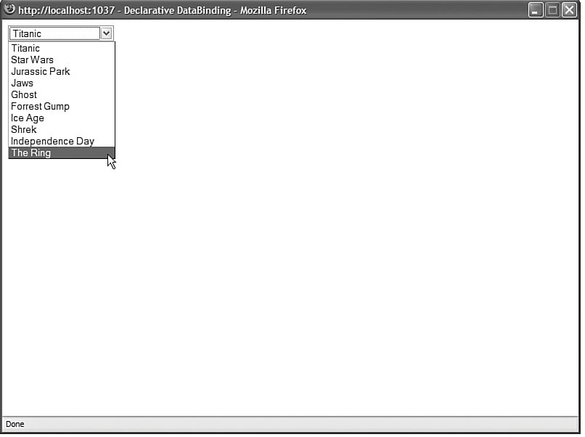

Slide 40
Displaying options with the List controls is all very nice, but at some point you need to be able to determine which option a user has selected. The List controls support three properties that you can use to determine the selected list item:
SelectedIndex Gets or sets the index of the selected list item.
SelectedItem Gets the first selected list item.
SelectedValue Gets or sets the value of the first selected list item.

Slide 41
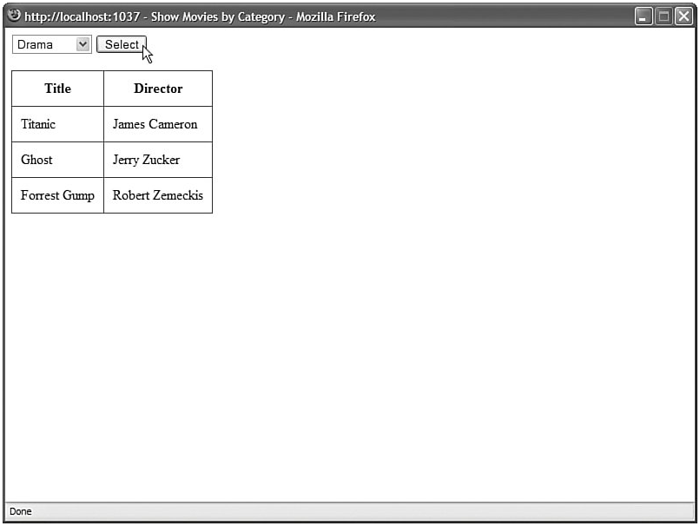

Slide 42
ListBox
The ListBox control is similar to the DropDownList control with two important differences. First, the ListBox control requires more screen real estate because it always displays a certain number of list items. Furthermore, unlike the DropDownList control, the ListBox control enables a user to select multiple items.

Slide 43
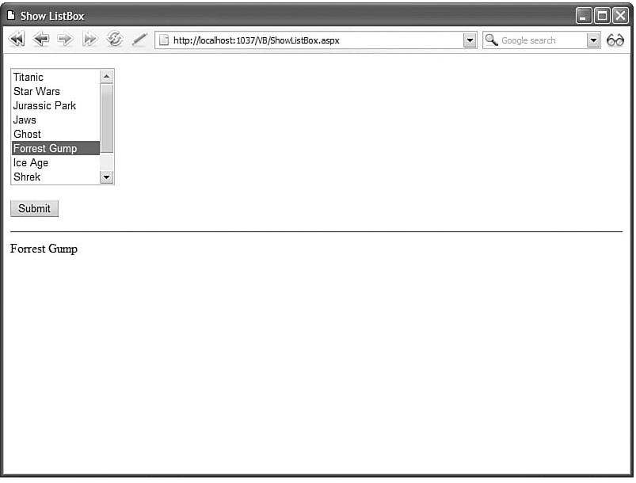

Slide 44
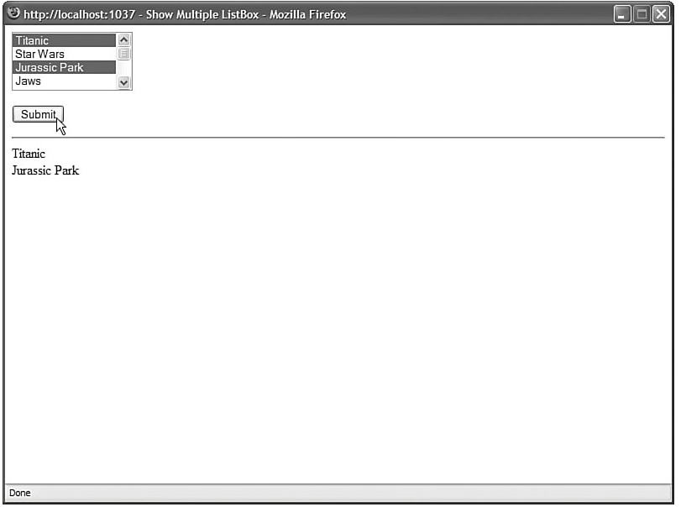

Slide 45
LinkButton

Slide 46
The LinkButton control, like the Button control, enables you to post a form to the server. Unlike a Button control, however, the LinkButton control renders a link instead of a push button.

Slide 47
Behind the scenes, the LinkButton control uses JavaScript to post the form back to the server. The hyperlink rendered by the LinkButton control looks like this:
<a id="lnkSubmit" href="javascript:__doPostBack('lnkSubmit','')">Submit</a>
Clicking the LinkButton invokes the JavaScript __doPostBack() method, which posts the form to the server. When the form is posted, the values of all the other form fields in the page are also posted to the server.

Slide 48
The LinkButton control supports the following properties (this is not a complete list):
AccessKey Enables you to specify a key that navigates to the Button control.
CommandArgument Enables you to specify a command argument that is passed to the Command event.
CommandName Enables you to specify a command name that is passed to the Command event.
Enabled Enables you to disable the LinkButton control.

Slide 49
OnClientClick Enables you to specify a client-side script that executes when the LinkButton is clicked.
PostBackUrl Enables you to post a form to a particular page.
TabIndex Enables you to specify the tab order of the LinkButton control.
Text Enables you to label the LinkButton control.

Slide 50
The LinkButton control also supports the following method:
Focus Enables you to set the initial form focus to the LinkButton control
The LinkButton control also supports the following two events:
Click Raised when the LinkButton control is clicked.
Command Raised when the LinkButton control is clicked. The CommandName and CommandArgument are passed to this event.

Slide 51
ImageButton
The ImageButton control, like the Button and LinkButton controls, enables you to post a form to the server. However, the ImageButton control always displays an image.

Slide 52
ImageUrl contains the path to the image that the ImageButton displays. The AlternateText property is used to provide alternate text for the image used by screen readers and text-only browsers.

Slide 53
You can use the ImageButton control to create a simple image map. For example, the page in ImageButtonTarget.aspx contains an ImageButton that displays an image of a target. If you click the center of the target, then a success message is displayed.

Slide 54
The ImageButton control supports the following properties (this is not a complete list):
AccessKey Enables you to specify a key that
navigates to the ImageButton control.
AlternateText Enables you to provide alternate
text for the image (required for accessibility).
CommandArgument Enables you to specify a
command argument that is passed to the Command event.
CommandName Enables you to specify a
command name that is passed to the Command event.

Slide 55
Enabled Enables you to disable the ImageButton control.
GenerateEmptyAlternateText Enables you to set the Alternate Text property to an empty string.
ImageAlign Enables you to align the image relative to other HTML elements in the page. Possible values are AbsBottom, AbsMiddle, Baseline, Bottom, Left, Middle, NotSet, Right, TextTop, and Top.
ImageUrl Enables you to specify the URL to the image.
OnClientClick Enables you to specify a client-side script that executes when the ImageButton is clicked.
PostBackUrl Enables you to post a form to a particular page.
TabIndex Enables you to specify the tab order of the
ImageButton control.

Slide 56
The ImageButton control also supports the following method:
Focus Enables you to set the initial form focus to the ImageButton control.
The ImageButton control also supports the following two events:
Click Raised when the ImageButton control is clicked.
Command Raised when the ImageButton control is clicked. The CommandName and CommandArgument are passed to this event.

Slide 57
Image

Slide 58
The Image control supports the following properties (this is not a complete list):
AlternateText Enables you to provide alternate text for the image (required for accessibility).
GenerateEmptyAlternateText Enables you to set the AlternateText property to an empty string.
ImageAlign Enables you to align the image relative to other HTML elements in the page. Possible values are AbsBottom, AbsMiddle, Baseline, Bottom, Left, Middle, NotSet, Right, TextTop, and Top.
ImageUrl Enables you to specify the URL to the image.

Slide 59
CheckBoxList
The CheckBoxList control renders a list of check boxes. The check boxes can be rendered horizontally or vertically. Unlike the other List controls, a user always can select multiple items when using a CheckBoxList control.

Slide 60
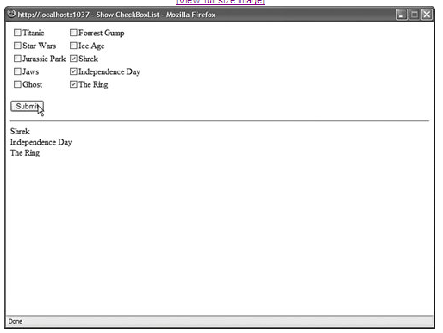

Slide 61
The CheckBoxList control includes three properties that affect its layout:
RepeatColumns The number of columns of check boxes to display.
RepeatDirection The direction in which the check boxes are rendered. Possible values are Horizontal and Vertical.
RepeatLayout Determines whether the check boxes are displayed in an HTML table. Possible values are Table and Flow.
Normally, a CheckBoxList control renders its list items in an HTML table. When the RepeatLayout property is set to the value Flow, the items are not rendered in a table.

Slide 62
RadioButtonList
Working with the RadioButtonList Control
The RadioButtonList control, like the DropDownList control, enables a user to select only one list item at a time. The RadioButttonList control displays a list of radio buttons that can be arranged either horizontally or vertically.

Slide 63
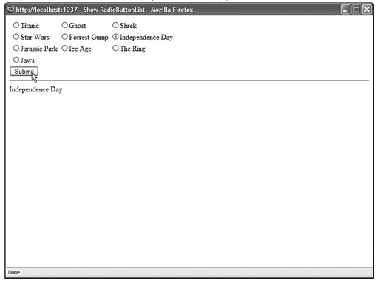

Slide 64
The radio buttons are rendered in a three-column layout. The RadioButtonList control includes three properties that have an effect on its layout:
RepeatColumns The number of columns of radio buttons to display.
RepeatDirection The direction that the radio buttons are repeated. Possible values are Horizontal and Vertical.
RepeatLayout Determines whether the radio buttons are displayed in an HTML table. Possible values are Table and Flow.
By default, the radio buttons rendered by the RadioButtonList control are rendered in an HTML table. If you set the RepeatLayout property to the value Flow, then the radio buttons are not rendered in a table. Even when the RadioButtonList renders its items in Flow layout mode, you can specify multiple columns.

Slide 65
BulletedList
The BulletedList control renders either an unordered (bulleted) or ordered (numbered) list. Each list item can be rendered as plain text, a LinkButton control, or a link to another web page.

Slide 66
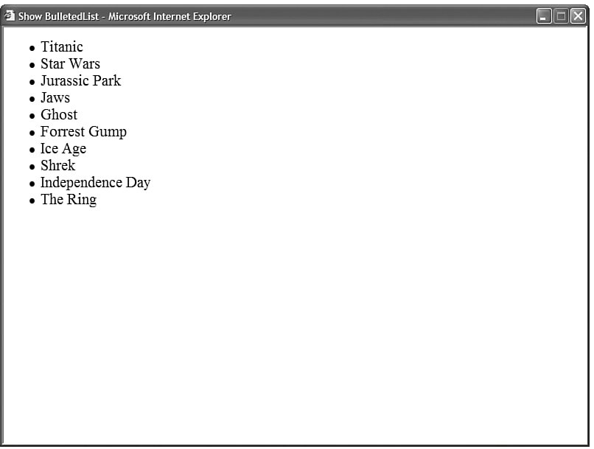

Slide 67
You can control the appearance of the bullets that appear for each list item with the BulletStyle property. This property accepts the following values:
Circle
CustomImage
Disc
LowerAlpha
LowerRoman
NotSet
Numbered
Square
UpperAlpha
UpperRoman

Slide 68
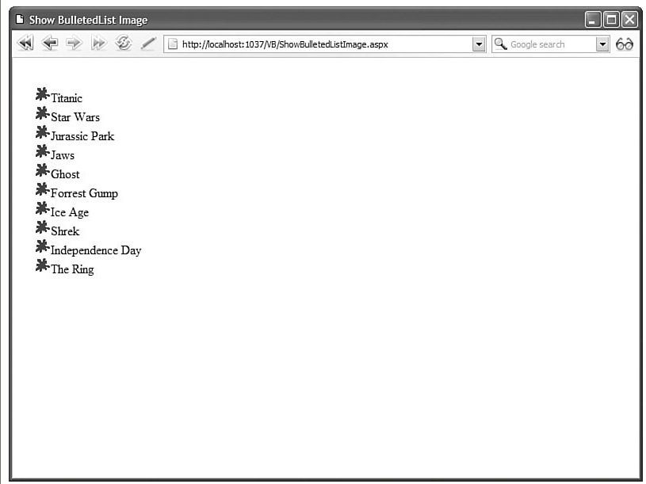

Slide 69
You can modify the appearance of each list item by modifying the value of the DisplayMode property. This property accepts one of the following values from the BulletedListDisplayMode enumeration:
HyperLink Each list item is rendered as a link to another page.
LinkButton Each list item is rendered by a LinkButton control.
Text Each list item is rendered as plain text.

Slide 70
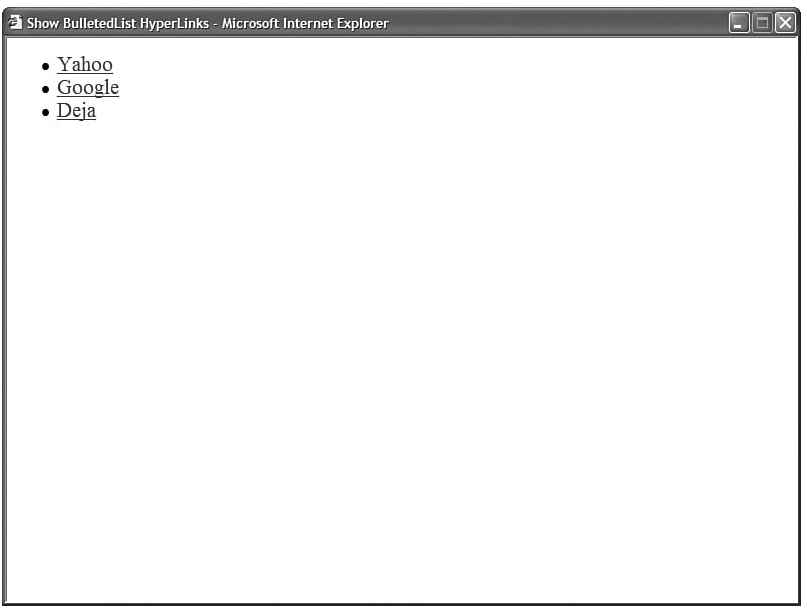

Slide 71
Navigation Controls.
Menu Control
TReeView

Slide 72
The Menu control enables you to create two types of menus. You can use the Menu control to create the left-column menu that appears in many websites. In other words, you can use the Menu control to display a vertical list of links.

Slide 73
You also can use the Menu control to create a menu that more closely resembles the drop-down menus that appear in traditional desktop applications. In this case, the Menu control renders a horizontal list of links.

Slide 74
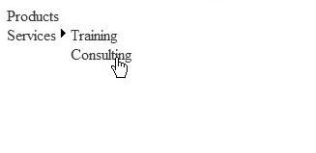

Slide 75
The Menu is created from MenuItem objects. Each menu item in contains a link to another page.
Notice that MenuItem objects can be nested. The second MenuItem objectServicesincludes two child MenuItem objects. When you hover your mouse over a parent menu item, the child menu items are displayed.

Slide 76
Each MenuItem includes a Text and NavigateUrl property. Rather than use a MenuItem to link to a new page, you also can use a MenuItem to link back to the same page. In other words, each MenuItem can act like a Linkbutton control instead of a HyperLink control.

Slide 77
For example, each MenuItem object includes a Text and Value property. When you click a menu item, the same page is reloaded and the value of the selected menu item is displayed.

Slide 78
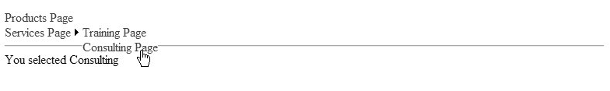

Slide 79
Formatting the Menu Control
The Menu control supports an abundance of properties that can be used to format the appearance of the control. Many of these properties have an effect on static menu items, and many of these properties have an effect on dynamic menu items. Static menu items are menu items that always appear. Dynamic menu items are menu items that appear only when you hover your mouse over another menu item.

Slide 80
DisappearAfter : Enables you to specify the amount of time, in milliseconds, that a dynamic menu item is displayed after a user moves the mouse away from the menu item.
Orientation :Enables you to display a menu horizontally or vertically (the default value is Vertical).

Slide 81
Selectable Enables you to prevent users from selecting (clicking) a menu item.
Selected Enables you to specify whether a menu item is selected.
Target Enables you to specify the name of the window that opens when you click a menu item.

Slide 82
TReeView

Slide 83
The treeView control is very similar to the Menu control. Like the Menu control, you can use the TReeView control to display hierarchical data.
you can use the TReeView control with database data. A treeView is built programmatically from database data.

Slide 84
A treeView control is made up of treeNode objects.
You can build a treeView control by declaring treeNode objects in the treeView control's Items collection

Slide 85
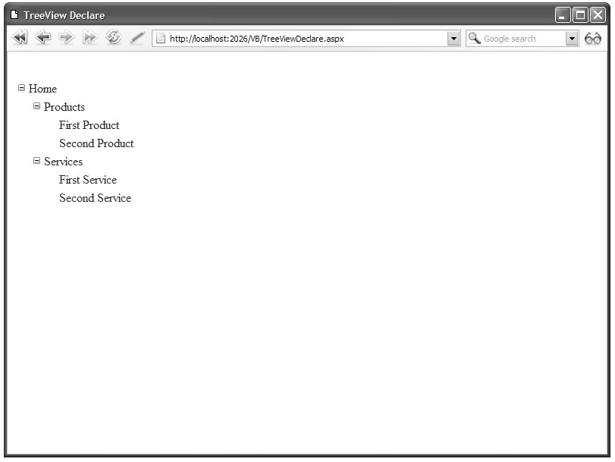

Slide 86
Some of the TReeNodes in above image include a Text property, and some of the TReeNodes include both a Text and NavigateUrl property. You can click the TReeNodes that include a NavigateUrl property to link to a new page.
You also can associate a Value property with a treeNode. This is useful when you want to post back to the same page. For example, if you wnat to display the value of the selected treeNode in a Label control .

Slide 87
Displaying Check Boxes with the treeView Control
You can display check boxes next to each node in a treeView control by assigning a value to the ShowCheckBoxes property. This property accepts the following values:
All
Leaf
None
Parent
Root

Slide 88
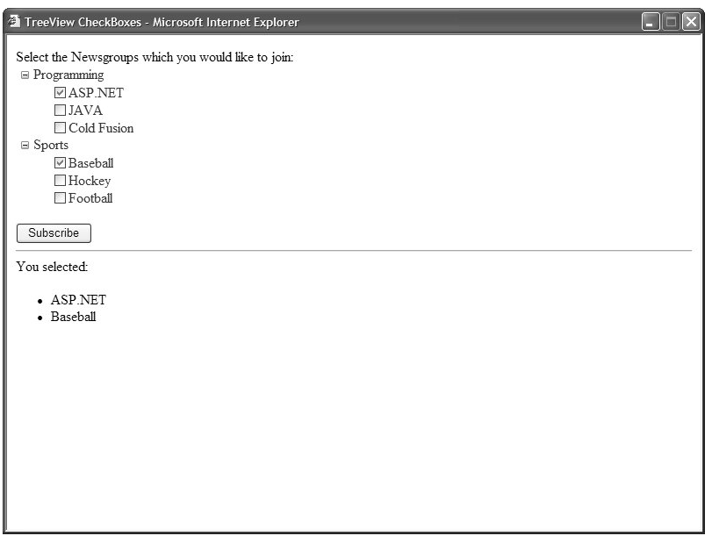

Slide 89
Rich controls
File Uploaded
Ad Rotate

Slide 90
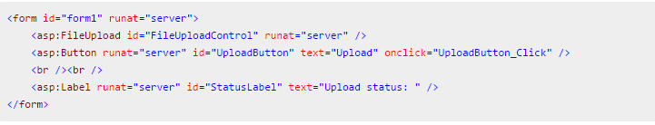
File Uploaded
With ASP.NET, accepting file uploads from users has become extremely easy. With the FileUpload control, it can be done with a small amount of code lines, as you will see in the following example. However, please notice that there are security concerns to to consider when accepting files from users! Here is the markup required:

Slide 91
What is File Uploaded
ASP.Net has two controls that allow the users to upload files to the web server. Once the server receives the posted file data, the application can save it, check it or ignore it. The following controls allow the file uploading:
HtmlInputFile - an HTML server control
FileUpload - and ASP.Net web control

Slide 92
File Upload Cont ….
Both the controls allow file uploading, but the FileUpload control automatically sets the encoding of the form, whereas the HtmlInputFile does not do so.
In this tutorial, we will use the FileUpload control. The FileUpload control allows the user to browse for and select the file to be uploaded, providing a Browse button and a text box for entering the filename.
Once, the user has entered the filename in the text box, by typing the name or browsing, the SaveAs method of the FileUpload control can be called to save the file to the disk.

Slide 93
Basic Syntax
The basic syntax for using the FileUpload is:
<asp:FileUpload ID= "Uploader" runat = "server" />

Slide 94
Properties of File Uploaded
The FileUpload class is derived from the WebControl class, and inherits all its members. A part from those, the FileUpload class has the following read-only properties:
Properties | Description
FileBytes | Returns an array of the bytes in a file to be uploaded..
FileContent | Returns the stream object pointing to the file to be uploaded.
FileName | Returns the name of the file to be uploaded.
HasFile | Specifies whether the control has a file to upload.
PostedFile | Returns a reference to the uploaded file.

Slide 95
Properties of File Uploaded Cont …
The posted file is encapsulated in an object of type HttpPostedFile, which could be accessed through the PostedFile property of the FileUpload class.
The HttpPostedFile class has the following important properties, which are much used:
Properties | Description
ContentLength | Returns the size of the uploaded file in bytes.
ContentType | Returns the MIME type of the uploaded file
FileName | Returns the full filename.
InputStream | Returns a stream object pointing to the uploaded file.

Slide 96
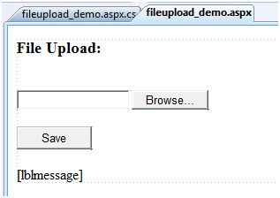
Example of File Uploaded
The following example demonstrates the FileUpload control and its properties. The form has a FileUpload control along with a save button and a label control for displaying the file name, file type and file length.
In the design view, the form looks like:

Slide 97
Ad Rotate
The AdRotator control randomly selects banner graphics from a list, which is specified in an external XML schedule file. This external XML schedule file is called the advertisement file.
The AdRotator control allows you to specify the advertisement file and the type of window that the link should follow in AdvertisementFile and Target property respectively.

Slide 98
Syntax of AdRotator
The basic syntax of adding an AdRotator is as follows:
Before going into details of the AdRotator control and its properties, let us look into the construction of the advertisement file.

Slide 99
The Advertisement File
The advertisement file is an XML file, which contains the information about the advertisements to be displayed.
Extensible Markup Language (XML) is a W3C standard for text document markup. It is a text-based markup language that enables you to store data in a structured format by using meaningful tags. The term 'extensible' implies that you can extend you ability to describe a document by defining meaningful tags for your application.
XML is not a language in itself, like HTML but, a set of rules for creating new markup languages. It is a meta-markup language. It allows developers to create custom tag sets for special uses. It structures, stores and transport information.

Slide 100
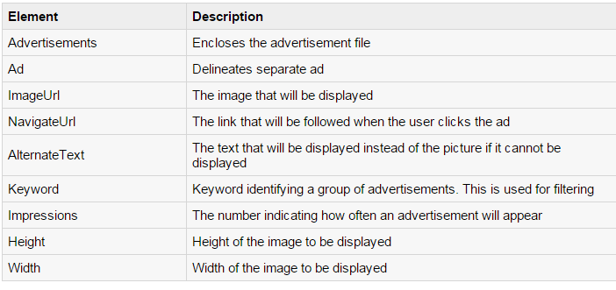
Elements of XML File
Like all XML files, the advertisement file needs to be a structured text file with well-defined tags delineating the data. There are the following standard XML elements that are commonly used in the advertisement file:

Slide 101
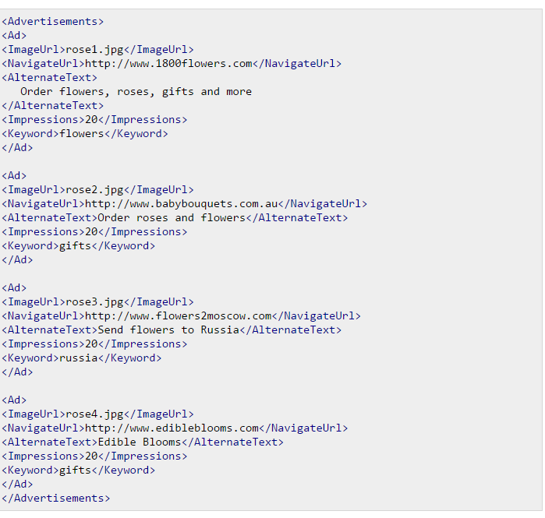
Cont …
Apart from these tags, customs tags with custom attributes could also be included. The following code illustrates an advertisement file ads.xml:

Slide 102
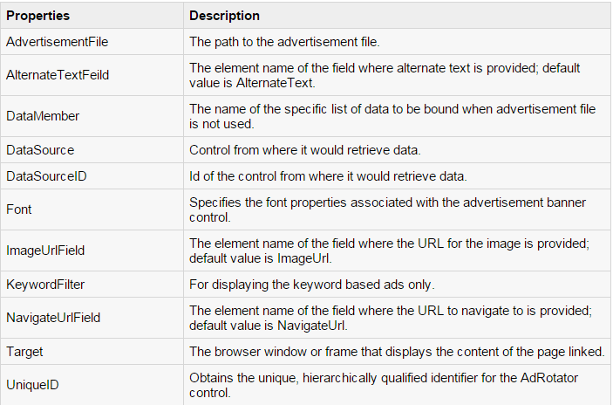
Properties and Events of the AdRotate Class
The AdRotator class is derived from the WebControl class and inherits its properties. Apart from those the AdRotator class has the following properties:

Slide 103
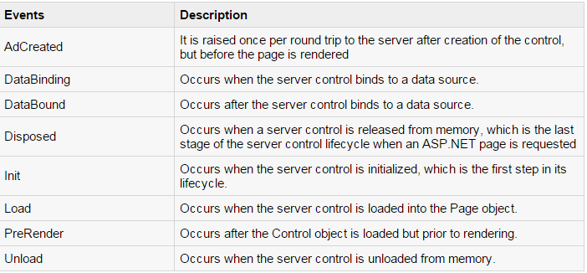
Cont …
Following are the important events of the AdRotator Class:

Slide 104
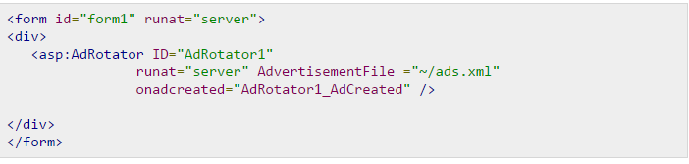
Working with the AdRotator Control
Create a new web page and place an AdRotator control on it
The ads.xml file and the image files should be located in the root directory of the web site.
Try to run the above application an dobserve that each time the page is reloaded, the ad is changed

Slide 105
Calendars
The calendar control is a functionally rich web control, which provides the following capabilities:
Displaying one month at a time
Selecting a day, a week or a month
Selecting a range of days
Moving from month to month
Controlling the display of the days programmatically

Slide 106
<asp:Calender ID = "Calendar1" runat = "server"> </asp:Calender>

Slide 107
Properties
FirstDayOfWeek Gets or sets the day of week to display in the first column.
SelectedDate Gets or sets the selected date.
SelectedDates Gets a collection of DateTime objects representing the selected dates.

Slide 108
SelectionMode
Gets or sets the selection mode that specifies whether the user can select a single day, a week or an entire month.

Slide 109
Events
SelectionChanged
It is raised when a day, a week or an entire month is selected.
DayRenderIt
is raised when each data cell of the calendar control is rendered.
VisibleMonthChanged
It is raised when user changes a month.

Slide 110
MultiView
MultiView and View controls allow you to divide the content of a page into different groups, displaying only one group at a time. Each View control manages one group of content and all the View controls are held together in a MultiView control.

Slide 111
The syntax of MultiView control is:
<asp:MultView ID= "MultiView1" runat= "server"> </asp:MultiView>
The syntax of View control is:
<asp:View ID= "View1" runat= "server"> </asp:View>

Slide 112
Properties
Views Collection of View controls within the MultiView.
ActiveViewIndex A zero based index that denotes the active view. If no view is active, then the index is -1.

Slide 113
Methods
SetActiveview Sets the active view
GetActiveview Retrieves the active view

Slide 114
Events
ActiveViewChanged Raised when a view is changed
Activate Raised by the active view
Deactivate Raised by the inactive view

Slide 115
?
?
?
?
?
Questions?
?
?
?
?
?
http://schoolacademy.telerik.com

