Slide 1
E-Commerce Analytics Project
Dataset : Target Brazil E-Commerce Dataset
Tools: SQL (Google Big Query)

Slide 2
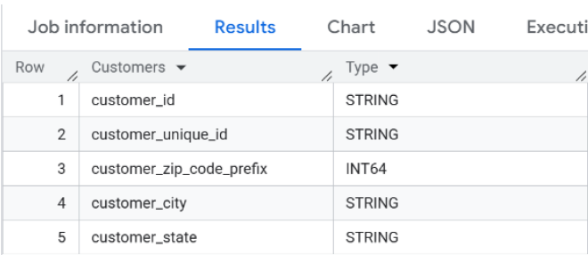
Database Exploration & Data Validation
Column / Data Type Check

Slide 3
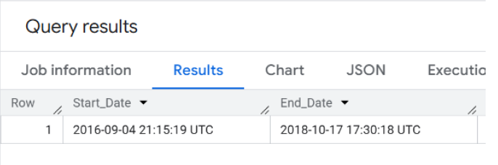
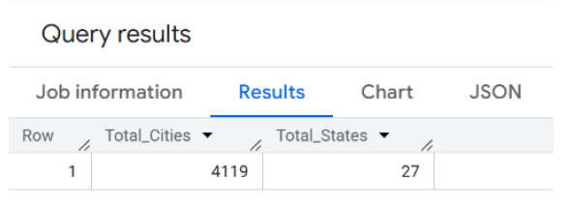
Database Exploration & Data Validation
Order Date Range Check / Distinct Cities & States Count

Slide 4
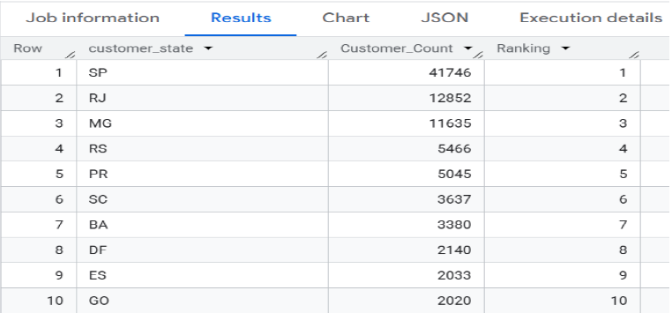
Customer Analysis
Customer Distribution by State

Slide 5
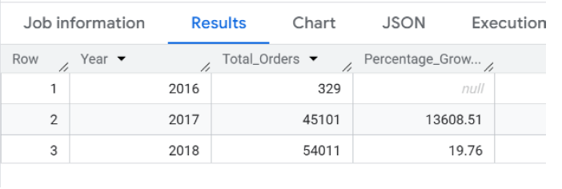
Order Trends & Seasonality Analysis
Analyze yearly order growth trend

Slide 6
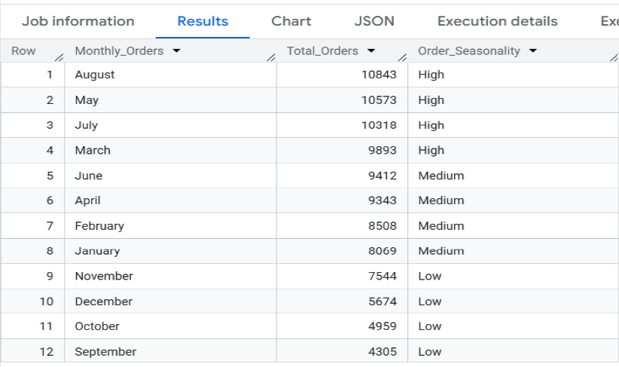
Order Trends & Seasonality Analysis
Analyze monthly order seasonality

Slide 7
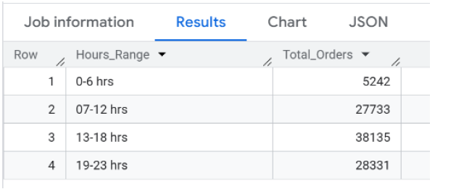
Order Trends & Seasonality Analysis
Analyze peak customer ordering hours

Slide 8
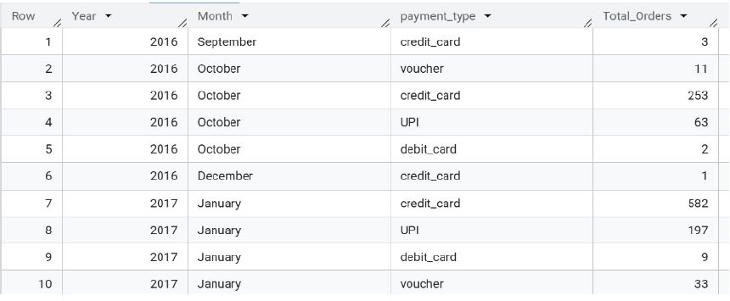
Payment Analysis
Analyze customer payment method preferences

Slide 9
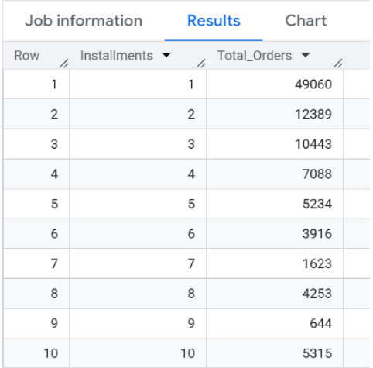
Payment Analysis
Analyze installment payment behavior

Slide 10
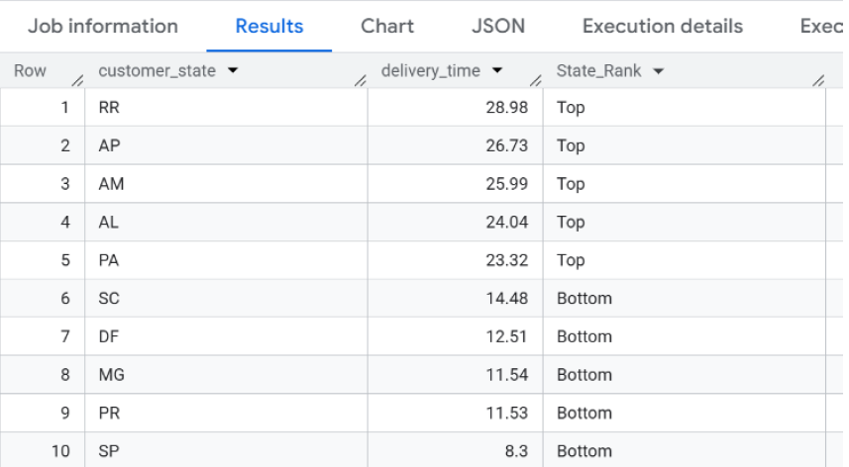
Delivery Performance Analysis
Analyze delivery time performance

Slide 11
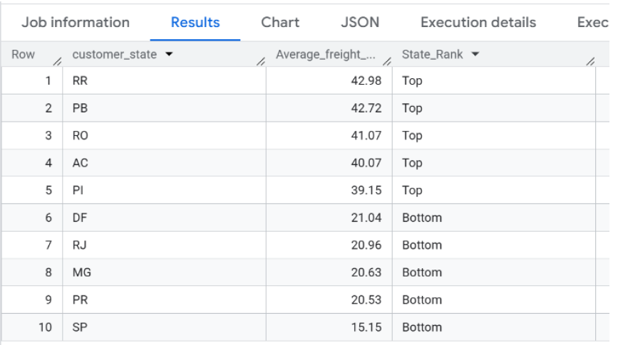
Delivery Performance Analysis
Analyze regional freight cost distribution

Slide 12
Thank you

