Slide 1
Sales Data Insights
Lets create some visualization to understand what the sales data is telling to help business decision with some analysis

Slide 2

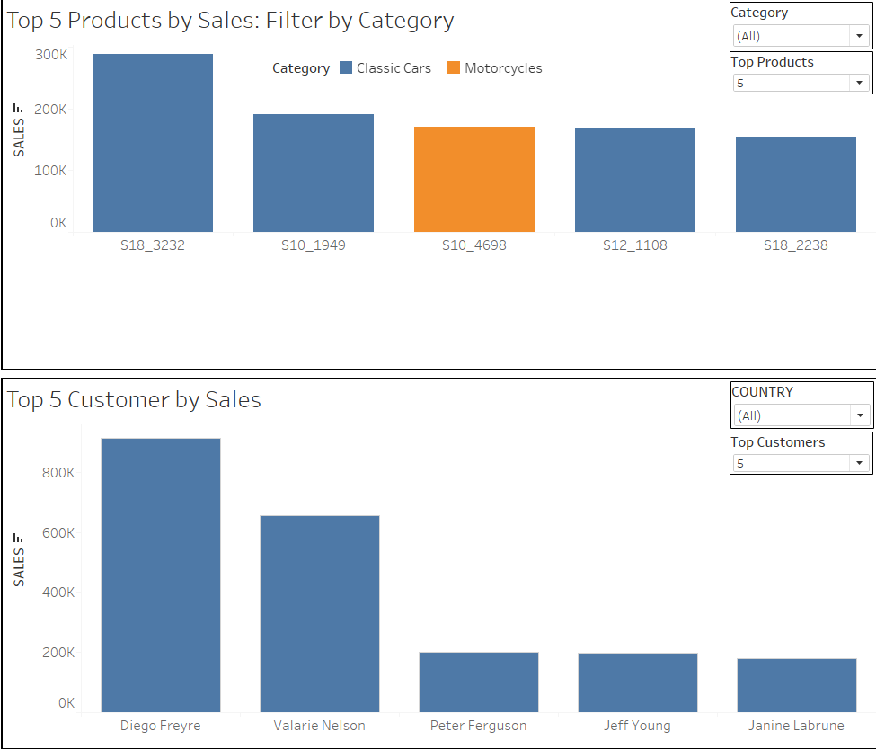
Top Insights
We can see here Top selling products over all categories and locations.
We can even filter out according to the category.
We can see Top consumers and plan premium segment to better server those and plan to improve other section.

Slide 3
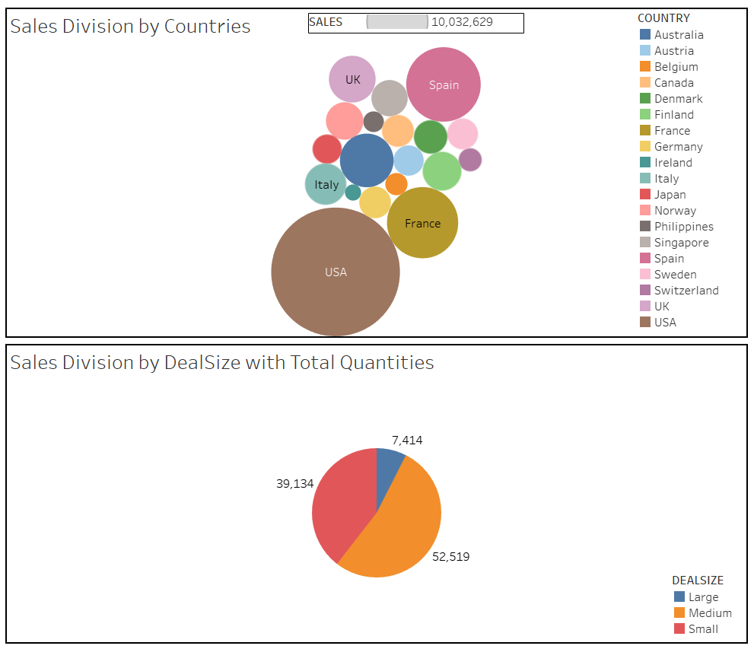
Sales Division
Here we see how sales is performing over different locations and USA, France, Spain are our top 3 consumers.
We can plan marketing strategy and segmentation accordingly.
We have got that our medium deal-size segment is performing best out of all 3 deal-sizes.

Slide 4
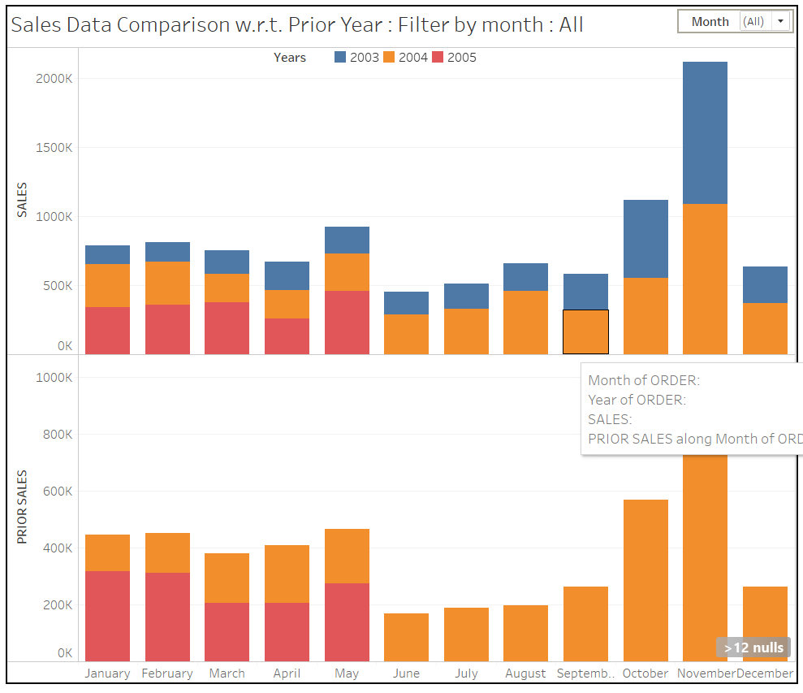
Sales Performance
We have here performance view of sales w.r.t. same month of previous year.
We can easily see that sales is increased every year.
Performance has been improved and can be compared w.r.t. prior year with stacked chart.

Slide 5
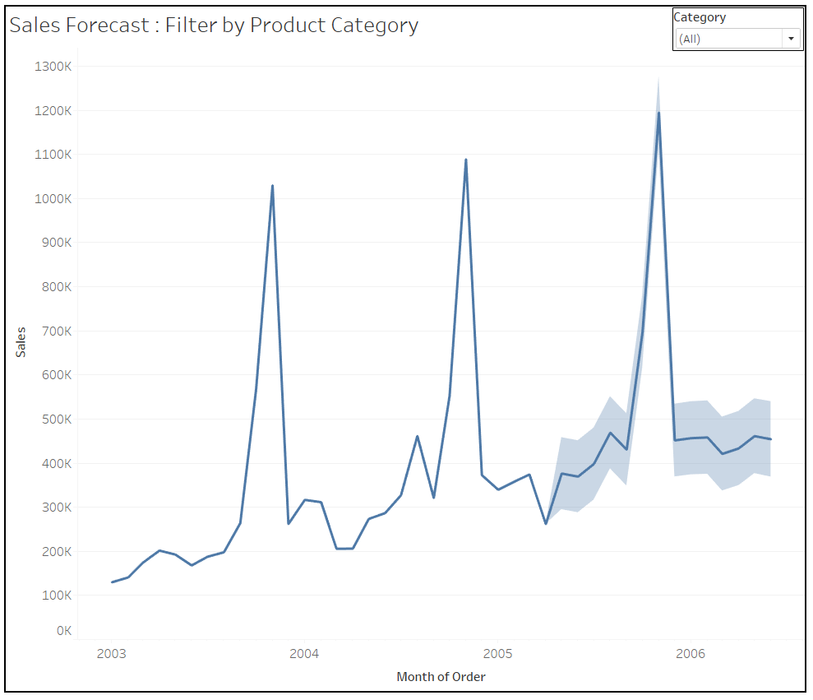
Sales Forecast
We get here sales forecast for one year.
We can easily see that we are going to have more sales target.
Marketing, inventory and promotional budget need to be managed as per projection.
Mgt. can decide next year plan.

Slide 6
Analysis and Observation
We have applied sales data to tableau and created Story board.
We have seen data as how it is performing and distributed.
We get the forecast that we going to perform better than previous and can plan budgets for different section accordingly.

