Slide 1
EDA : “deliveries” Dataset
Lets ANALYSE Team : Royal Challengers Bangalore Performance and Improvements

Slide 2
What we are analyzing
Team : Royal Challengers Bangalore(RCB) has been constantly trying to make the mark in IPL but not performing as expected and this is where our umbrella problem comes.
We are going to use EDA on the IPL deliveries data to find out some important information so as to take out some visible issues to resolve
We will consider both batting and bowling data analysis to improve the same

Slide 3

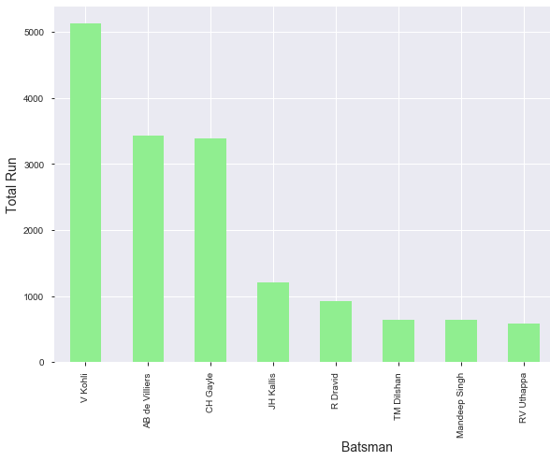
Top Run scorer
This plot presents top 10 scorer for RCB
V Kohli as captain has scored maximum for the team
We see team is lacking here as just 3 key player have made some mark and rest are being unnoticeable

Slide 4
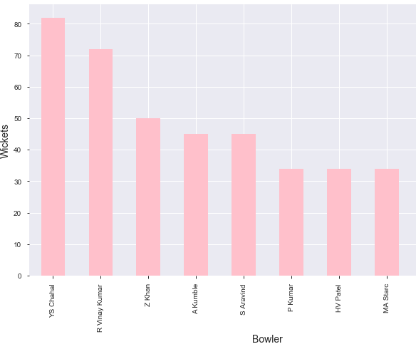
Top Wicket Taker
This plot presents top 10 wicket taker for RCB
YS Chahal is holding the top position in the list
Team has few other noticeable bowlers but those seem to have left and so team is lacking a striking bowler like chahal who can make the bowling line stronger

Slide 5
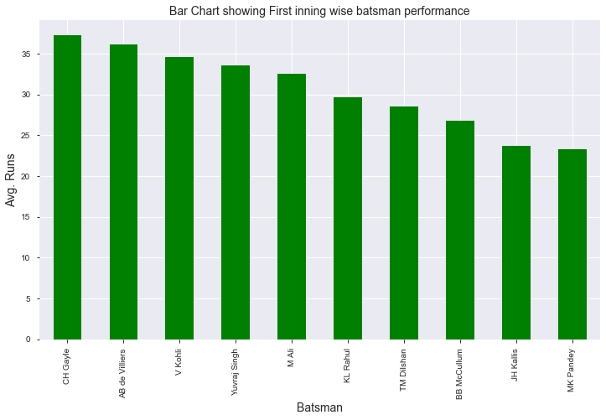
Batting Performance in First Inning
This plot presents top 10 run scorers by their avg. run per match when batted in first inning
Gayle, ABD and Kohli seem to have made the mark here as well but nearly all are up to or above 25 above 25 runs

Slide 6
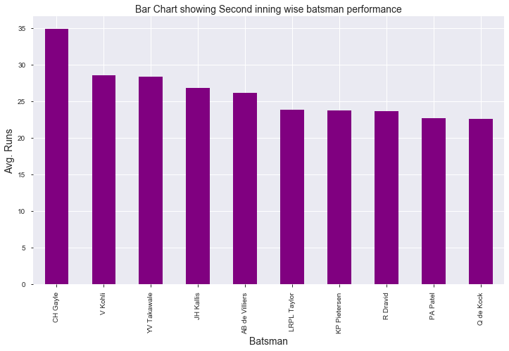
Batting Performance in Second Inning
This plot presents top 10 run scorers by their avg. run per match when batted in second inning
Top 5 batsman seem to have done well here as those are having 25+ run per match

Slide 7
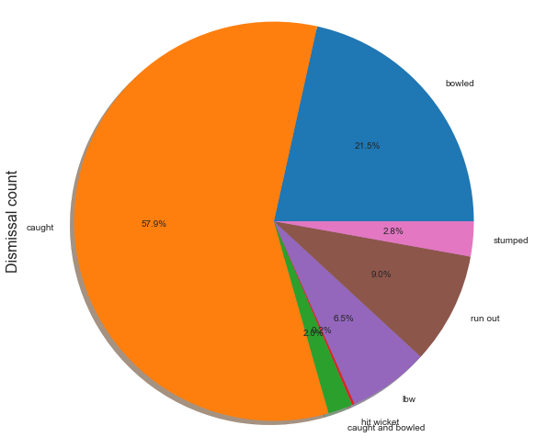
Batsman Dismissal Type Analysis
This plot presents batsman dismissal-type ratio
Majority of batsman are out caught and its 57.9% which is huge
It depicts that in match format like this batsman tries to go big and get out somehow
Dismissal type: caught percentage is so big that need to be analyzed

Slide 8
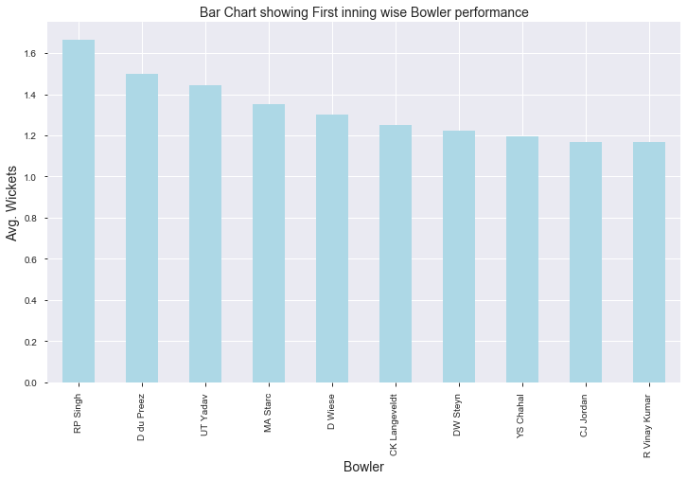
Bowling Performance in First Inning
This plot presents that how RCB bowlers have performed while bowling first
Bowlers have avg. wicket per match is nearly 1.2 and higher up to 1.7

Slide 9
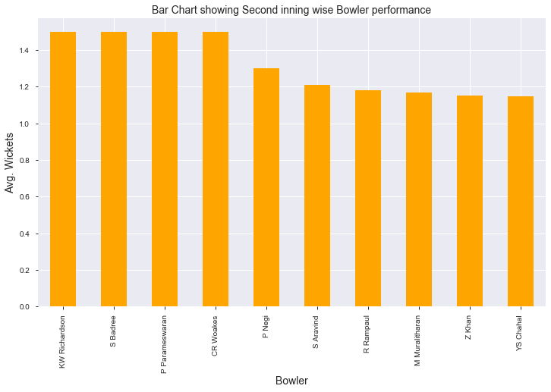
Bowling Performance in Second Inning
This plot presents that how RCB bowlers have performed while bowling second
Bowlers have avg. wicket per match is nearly 1.2 and higher up to 1.5

Slide 10
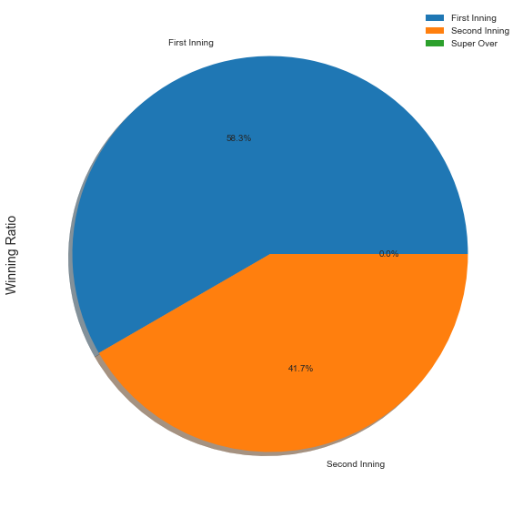
Inning wise winning ratio
This plot present how RCB as a team has performed win while batting in different innings
This clearly depicts that winning ratio while batting first and setting up the total is much higher than while batting second and chasing the target score.

Slide 11
Analysis and Improvements
RCB has to retain many or fill the replacement of it’s top performing players specially bowlers as they either have moved or quit
We have seen that team batting performance while batting second is quite low as compared to batting first so team need to focus on strategies while chasing the target score and playing under pressure.
Player out caught percentage is so high and so team need to think of playing while built the inning gradually and need to choose wisely which ball to hit over the ground.
Bowlers performance while defending the total is low as compared to bowling first but its not that much rather issue is to retain their best bowlers.
Last but not the least team winning percentage is quite high while batting first so choosing batting first should be priority and winning toss is crucial.

