Slide 1



STAKEHOLDER PRESENTATION
REVENUE & CUSTOMER GROWTH STRATEGY
Presented By : Prashant Kumar Sahoo

Slide 2



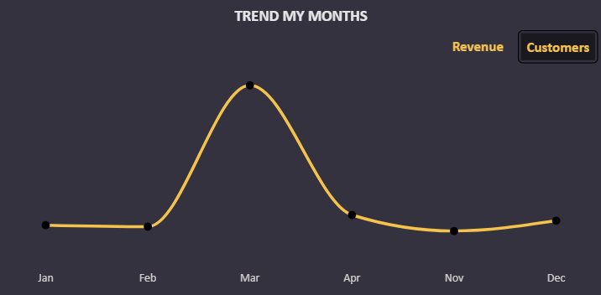
EXECUTIVE OVERVIEW
Revenue peaked in March 2023 : ₹ 263.84M, a massive ⬆️ 85% from Feb
Total Revenue (March)
Sharp Seasonal dip in April : ₹ 153.75M, a ⬇️ 41.7% decrease
₹ 263.84M
85%
vs Feb
Customer Growth mirrored Revenue Trends : March acquisition strong, April acquisition low
Total Revenue (April)
₹ 153.75M
41.7%
vs Mar

Slide 3
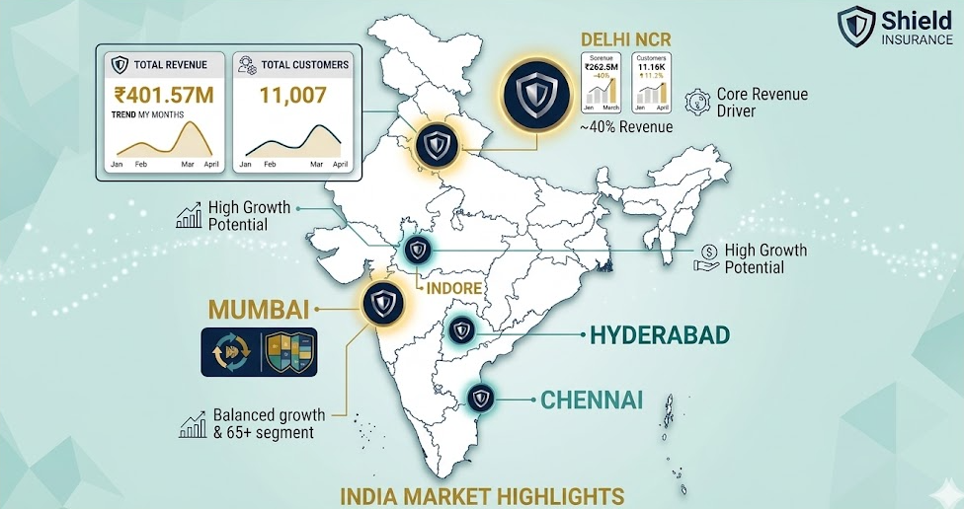
CITY LEVEL INSIGHTS

Slide 4

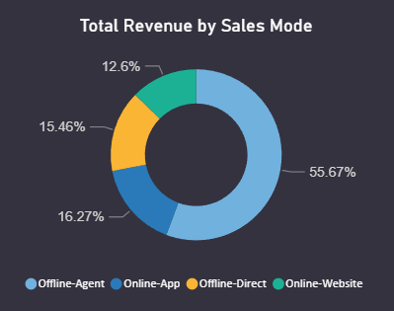




SALES MODE ANALYSIS
Offline-Agent dominates with ~55% of revenue/customers
Online-App & Online-Website together contribute ~29%, showing rising digital adoption.
Offline-Direct remains steady but less scalable.
Online channels growing consistently, especially among younger demographics.

Slide 5

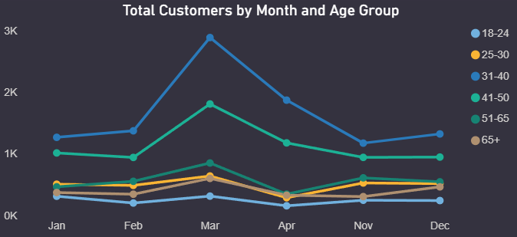



AGE GROUP ANALYSIS
31–40 years : Dominant segment, highest revenue and customer counts.
41–50 years : Strong secondary contributor.
65+ years : Surprisingly high revenue share, especially in Mumbai and Delhi NCR.
18–24 years : Lowest contribution but growing steadily in online channels.

Slide 6




KEY FINDINGS
INSIGHTS SUMMARY
Revenue growth is seasonal, with peaks in March and dips in April.
Delhi NCR and Mumbai are the backbone of Shield Insurance’s revenue.
Digital channels are gaining traction, particularly among younger customers.
Older demographics (65+) are unexpectedly strong contributors.

Slide 7






STRATEGIC RECOMMENDATIONS
Strengthen Digital Channels
Invest in app and website experiences to capture younger demographics
Agent Enablement
Continue training and incentivizing offline agents to sustain effectiveness
Target High-Value Segments
Focus marketing on 31–50 age groups, while designing specialized products for 65+
Seasonality Management
Introduce promotional offers during low-revenue months
Regional Campaigns
Expand presence in Tier-2 cities like Indore and Chennai.

Slide 8

CONCLUSION
Shield Insurance is well‑positioned for growth ( 36.3% revenue)
Balance digital expansion with regional penetration
Serve both younger (18–24) and older (65+) demographics effectively
Secure future through agents + digital platforms

