Slide 1
Selenium
Tutorial on Locators in Selenium

Slide 2
List of Locators
ID Locator:
Name Locator:
Class Name Locator:
Tag Name Locator:
Link Text Locator:
Partial Link Text Locator:
XPath Locator:
CSS Selector Locator:

Slide 3
ID Locator
      Finds an element by its id attribute.
      Syntax:
      driver.findelement(By.ID, "element_id")
      The ID locator in Selenium is one of the most
      commonly used & preferred locators:
          Uniqueness
          Performance
          Simplicity
          Stability/Reliability

Slide 4
Name Locator
      Finds an element by its name attribute.
      Syntax: driver.findelement(By.NAME, "username")
      The NAME locator in Selenium can be
      particularly useful in specific scenarios:
          Form Elements e.g. forms, input fields
          Grouping Elements e.g. group of radio
          buttons or checkboxes with the same

Slide 5
Class Name Locator
      Finds an element by its class attribute.
      Syntax: driver.find_element(By.CLASS_NAME, "element_class")
      This locator can be particularly useful in
      several scenarios:
          When elements do not have unique ID or
          NAME attributes/Locators, the Class
          Name locator can be a good alternative.

Slide 6
      Tag Name Locator
      Finds an element by its HTML tag name.
      Syntax: driver.find_element(By.TAG_NAME, "element_tag")
      The Tag Name locator in Selenium is highly useful for
      interacting with generic element types, working with
      tables, retrieving headings & by using most common
      HTML tags.
      Form Elements: like <input>, <button>, or <select>
      within a form.
      Anchor Tags: All links on a page to validate use Tag
      Name locator e.g. <a> tags.

Slide 7
      Link Text / Partial Link Text Locator
      Finds a hyperlink element by its text.
      Syntax: driver.find_element(By.LINK_TEXT, "link_text")
      The Link Text locator in Selenium is highly effective for interacting with hyperlink elements based on their visible text
      Exact Match Required: The Link Text locator requires an exact match of the link text.
      Finds a hyperlink element by a part of its text.
      Syntax: driver.find_element(By.PARTIAL_LINK_TEXT,
      "partial_link_text")
      Dynamic Link Text: When the text of a link changes
      dynamically but contains a consistent substring,
      Partial Link Text locator can help you find the link reliably.

Slide 8
      XPath Locator
      Finds an element using an XPath expression.
      Syntax: driver.find_element(By.XPATH, "//tagname[@attribute='value']")
      Complex DOM Structures
      Lack of Unique Identifiers
      Dynamic Attributes
      Text Content: XPath is particularly useful when you need to locate
      elements based on their text content, which is not possible with
      other locators like CSS selectors.
      Sibling Relationships: XPath can locate elements based on their
      relationships to sibling elements, which is helpful in cases where
      elements are grouped in a certain way
      Combine XPath with other locators to improve robustness,
      especially in dynamic environments which reduce the likelihood
      of selecting the wrong element, reduce the likelihood of selecting
      the wrong element.

Slide 9
      CSS Selector Locator
      Finds an element using a CSS selector.
      Syntax: driver.find_element(By.CSS_SELECTOR, "css_selector")
      They are particularly useful in scenarios where you
      need a precise, fast, and flexible method to find
      elements.
      Speed and Performance
      Element Styling
      Complex Matching
      Simple Hierarchies
      Class and ID Attributes
      Partial Matches

Slide 10
      Steps To Add SelectorHub Tool
Open Google Chrome.
    Go to the Chrome Web Store by typing chrome://extensions/ in the address
    bar and pressing
    Enter, then click on the "Chrome Web Store" link, or directly visit the
    Chrome Web Store.
    Search for SelectorHub: Search bar on the top left of the Chrome Web
    Store, type "SelectorHub" and press Enter >> Select SelectorHub Extension
                OR
Directly open this link to Add Selectorhub extension to Chrome browser:
https://chromewebstore.google.com/detail/selectorshub/ndgimibanhlabgdgjcpbbndiehljcpfh?hl=en-US&utm_source=ext_sidebar
From the search results, locate the SelectorHub extension. >> Add to Chrome:
Click on the "Add to Chrome" button next to the SelectorHub extension >> Confirm Installation:
A dialog box will appear asking for confirmation to add the extension. Click on "Add extension" to confirm.

Slide 11
      SelectorHub Tool Pinning
Refer to next slide image to know how to Pin/Add “Installed Extension” to the Chrome Browser Quick Menu options.
Refer slide: “Pin SelectorsHub”

Slide 12
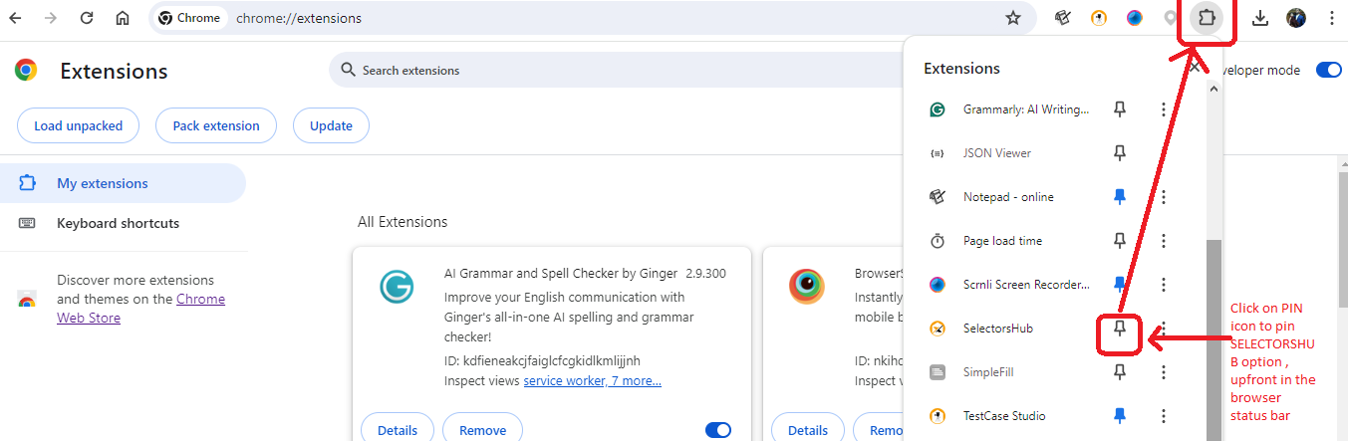
Pin SelectorsHub

Slide 13
      Steps to Use SelectorsHub
Refer to How to Activate SelectorsHub to identify Locators.
Refer slide: “Activate Selectorshub”.
      Open any website e.g. justdial.com (Refer no.1)
      Click on the SeletorsHub icon in the Browser Pin menu option
      (Refer no.2)
      SelectorsHub form will be seen.
      Click on Inspect Element (Refer no.3) & select the element for
      which Locator is required.
      You will get all types of Locator options in SelectorHub console
      Panel (Refer no.4)
      Selected Locator will be seen populated in xpath searchbox
      (Refer no.5)
      Copy the Locator & Use it in the Selenium.
      Note: Before using this Locator always validate in the
      DOM-Element console.

Slide 14
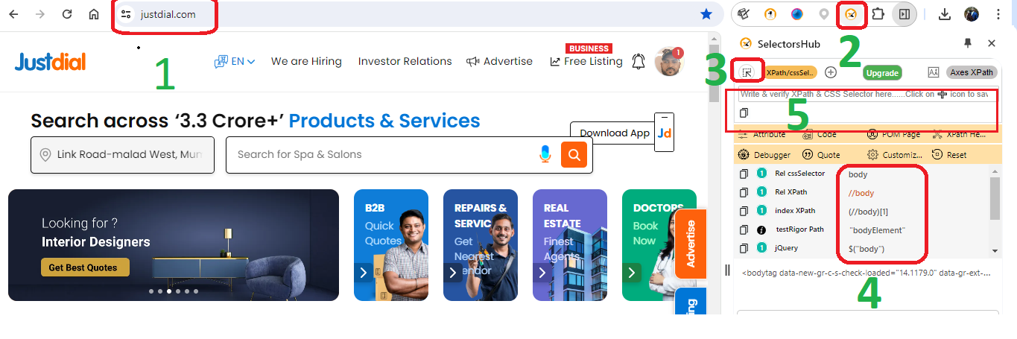
Activate SelectorsHubs

Slide 15
Activate SelectorsHubs

Slide 16
Selenium Locators Session End
Thank You!!!

