Slide 1
Selenium Automation
Presentation for Selenium Automation
-Prashant Shetty

Slide 2
Selenium Introduction
Why do we need to learn Selenium Automation?
How to begin / Pre-Requisite?

Slide 3
Q. Why do we need to learn Selenium Automation?
Basic pointers:
Efficiency: Speeds up repetitive testing tasks.
Accuracy: Reduces human error in testing.
Cross-Browser Testing: Ensures functionality testing on different browsers.
Reduces Efforts: Reduces our manual efforts for the daily basic and we can focus more on productive works.
Regression Testing: Ensures new code changes don’t break existing functionality
Career Growth: In-demand skill for software testers.

Slide 4
Q. How to begin Learning Selenium?
Learn Programming Basics: Choose a language like Java & start practicing by solving small logical problems.
Web Technologies: Learn Basics of HTML & Web Browsers.
Platform Set up: Install Java.
IDE Setup: Install Eclipse.
Install Selenium WebDriver: Download and set up Selenium WebDriver.
Testing Concepts: Understand test cases and automation basics.
Read Documentation: Go through the official Selenium documentation.
Start with Tutorials: Follow beginner tutorials and online courses.
Practice: Write simple test scripts and gradually increase complexity.
Google the error / problems faced & try to find a relevant solution.

Slide 5
Installation & Setup
Set Up Programming Environment
  For Java:
  Install the Java Development Kit (JDK) from the official Oracle website.
  Set the JAVA_HOME environment variable.
      Copy the Java jdk path until/bin folder e.g. C:\Program Files\Java\jdk1.8.0_144\bin.
      Open Control Panel -> System -> Advanced System Settings -> Environmental Variables -> Click New.
      Variable Name: JAVA_HOME & Variable Value: Paste the Java jdk Copied Path and Click on OK.
      Note: For Office system Kindly Contact IT Team and ask to install Java & setup environment Variable.
  Install: Eclipse

Slide 6
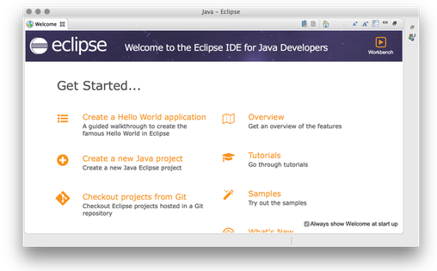
Eclipse Homescreen

Slide 7
Setup Selenium Webdriver
Open Eclipse and go to File > New > Other
  Select Maven Project and click Next.
  Select Create a simple project (skip archetype selection) and click Next.
  Enter GroupId (e.g., com.justdial) and ArtifactId (e.g., SeleniumTest1).
  Click Finish.
Add Selenium Dependency to pom.xml
  Click on SeleniumTes1 (folder) on the Left panel - Open the pom.xml file in your Maven project.
  Add the dependency for Selenium: Open this link and 1st Delete all the
  default codes and then copy paste this entire code starting with “<project” in pom/xml file
  https://github.com/prashant-shetty27/JD/blob/main/selenium%20maven%20project%20setup.txt
  Note: Change the GroupID / Artifactid as per the name used while creating Maven project.
  Update your Maven project:
  Eclipse: Right-click on the project, select Maven, then Update Project.

Slide 8
Selenium 1st Project Creation
In your Maven project, Right click on the src/test/java > New > Package (always start with Lowercase) > e.g. com.B2B.tests.
Create a new Java class(always start with uppercase) e.g.B2BHome.java in this package.
Write a simple Selenium test: Refer below url:
  https://github.com/prashant-shetty27/JD/blob/main/samplecode.txt
  Right-click the java class and select Run As -Java Application.

Slide 9
Programming Tasks
Beginners to attempt following:
Q. Print Hello World
Q. Sum of Two Numbers
Q. Find Vowels: "Umbrella"
Q. Find Largest of Three Numbers
Members having programming knowledge:
Q. Check Even or Odd: 1, 3, 2, 44, 100, 10, 0, 7
Q. String Palindrome e.g. Madam & Java
Q. Enter any 3 numbers to validate the type of Triangle e.g. Right, Obtuse, Acute & no triangle
Q. Reverse a string: "Java" & "Just Dial"
Q. Concat strings to form a sentence:
String a = Hello!, String b = Just, String c=Dial;
Q. The Prime Number Check: 1, 3, 2, 44, 100, 17, 0, 7
Q. Count the number of letters in a string with & without using existing function: "Java" & "Just Dial"

Slide 10
Selenium Automation
Presentation Completed
Thank You!!!

