Slide 1

Object Oriented Language
Subject Code- CS3CO23
Student Data Record
Made By :-
Prashant Patil.
Prashant Chaurasiya.
Prashant Ranjan Singh.
Guided By :-
Prof. Arpit Deo

Slide 2



Purpose of the project:
The main purpose is to build a student database system which is easy to access student record
Its purposed to reduce time spend on administrative task.
The project is also intended to provide better and meaningful services to the user.
It promotes efficiency by converting paper process to electronic form.

Slide 3
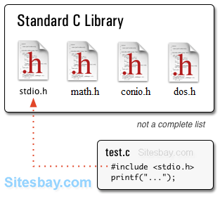
Header files
Header files are text files included in a source file during compilation, By including a header file we can use its contents in our program.
In this program we included 5 header file:-
#include <stdio.h>
#include <iostream>
#include <fstream>
#include <iomanip>
Stdio.h
iostream.h
fstream.h
iomanip.h

Slide 4
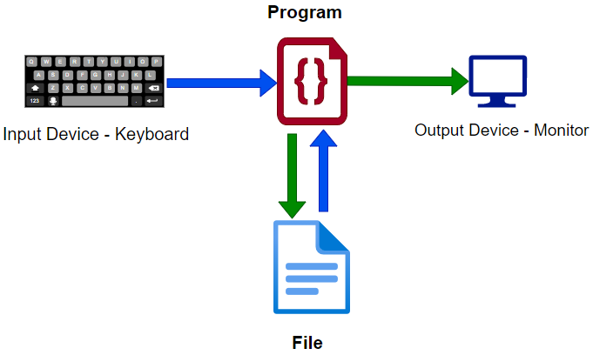
File handling
What is file handling?
File handling in C++ is a mechanism to store the output of a program in a file and help perform various operations on it. Files help store these data permanently on a storage device.
File handling provides us various feature to work with file
Create a file
Open a file
Read from a file
Write to a file
Close a file

Slide 5
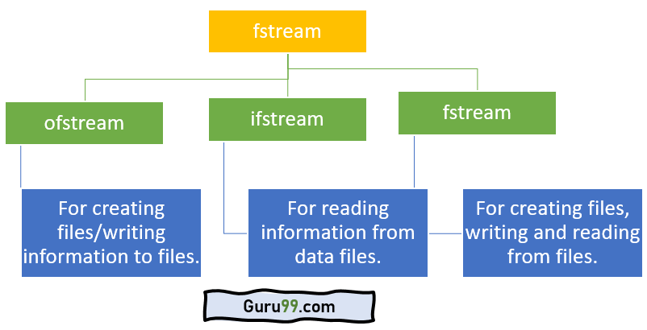
File handling
Fstream library
In C++, Fstream library is used to handle files, and it is dealt with the help of three classes.
Ofstream: This class helps create and write the data to the file obtained from the program’s output. It is also known as the input stream.
Ifstream: We use this class to read data from files and also known as the input stream.
Fstream: This class is the combination of both ofstream and ifstream. It provides the capability of creating, writing and reading a file.

Slide 6
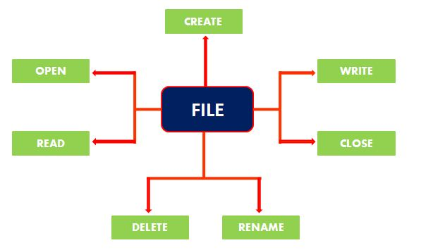
File handling
File Operations in C++
In this project we have use four different operations for file handling. They are :-
open(): This is used to create a file in cpp program.
read(): This is used to read the data from the file in cpp program.
write(): This is used to write new data to file in cpp program.
close(): This is used to close the file in cpp program.

Slide 7
File handling
Opening a file in C++
To read or enter data to a file, we need to open it first. This can be performed with the help of ‘ifstream’ for reading and ‘fstream’ or ‘ofstream’ for writing or appending to the file.
All these three classes have open() function pre-built in them.
Syntax: file.open(file name, mode).
Mode | Description
iso::in | File opened in reading mode
iso::out | File opened in write mode
iso::app | File opened in append mode

Slide 8
File handling
Reading and writing class object
Creating the object of fstream :-
fstream.file;
Reading from the file :-
file.read((char *)&obj, sizeof(obj));
Here data present in class object obj is read from file datafile.txt by calling read function.
(char*)&obj is used to point at the start of an object and sizeof(obj) calculates the number of bytes read from the file.
Opening a file :-
file.open(“datafile.txt”,ios::in|ios::app);
Writing to the file :-
file.write((char *)&obj,sizeof(obj))
Here data present in class object obj is written to file datafile.txt by calling write function.
(char*)&obj is used to point at the start of an object and sizeof(obj) calculates the number of bytes copied in file.

Slide 9

File handling
Positioning file pointer
Function to move the file pointer :-
seekg(): Get pointer, while reading from the file
seekp(): Put pointer, while writing to the file.
Example:-
seekp(5,ios::beg)
seekp(-5,ios::end)
seekp(5,ios::cur)

Slide 10

Functions of our program
This program has Following function :-
Create student report card record.
Read all students report card record.
Read specific student’s report card record.
Display all students’ grade report.
Modify student’s report card record.
Delete student record

Slide 11

1) Create student report card.
This feature creates a new student record containing his marks.
For this the information to be provided which are :-
Roll Number of new student.
Name of the new student.
Marks obtained in all 5 subject :-
Physics
Chemistry
Math's
English
Computer Science.

Slide 12

2) Read all students report card.
The void display_all() function in this student report card system has been used for this feature.
This feature displays:-
Roll Number of new student.
Name of the new student.
Grade.
Marks obtained in all 5 subject :-
1) Physics 2) Chemistry
3) Math's 4) English
5) Computer Science.

Slide 13


3) Read specific student’s report
4) Display all students grade
This feature enlists all the students’ record saved in file. The grade report is displayed in a tabular form with roll no. and name of the students, marks achieved in the five subjects, and the grade and percentage obtained by them.
This feature is same as the one explained above, except it shows the progress report and relevant data related to a particular student.

Slide 14


5)Delete student report card
6) Modify student
report card
This feature is used to edit the report card record of a particular student. Upon successful modification, the program displays the message “Record Updated”. If no record of student is found in file, it displays the message “Record not found”.
This feature deletes the report card record of a particular student, for this it will first of all asks for the name and roll number of the student whose record you want to deleted.

Slide 15
Block Diagram
Int main()
Intro
Main Menu
Result Menu
Exit
Entry / Edit
All student Result
Search student result
Display all student result
Back to main menu
Create student record
Modify student record
Delete
record
Back to main menu
All Student Result (tabular)
Return Roll number
Display Data
Return Roll number
Input Data
Display Data

Slide 16

Limitations
Few Limitations are :-
Project does not involve the use of GUI.
Project can work error free on Linux, but not as like that of windows.
Project could have some more features like :-
Sorting students data.
Keep record of students fees.
Keeping record of student attendance.

Slide 17


