Slide 1
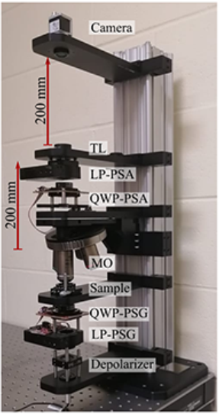
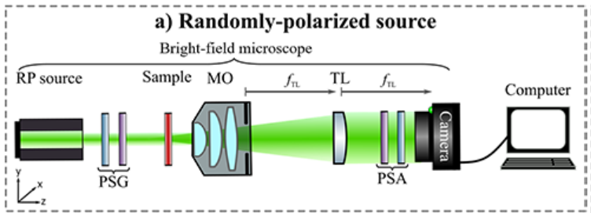
Bright field microscopy based method to recover mueller matrix
This is the experimental way to find the Mueller matrix of the sample.
It consist of PSA and PSG which is placed before and after the sample.
PSA always consist of QWP and LP, while PSG depends upon illuminating source polarization state.
Sofia Obando-Vasquez, Ana Doblas, Carlos Trujillo; Apparatus and method to recover the Mueller matrix in bright-field microscopy. American Journal of Physics 1 September 2022; 90 (9): 702–714. https://doi.org/10.1119/5.0081673

Slide 2
WORKING PROCEDURE: (1) Apparatus setup
A sample is imaged using an infinity corrected microscope objective lens which produces the image of the sample at infinity.
To produce the real sample of the image Tube lens is used.
Microscope image plane is located at the back the focal plane of the TL lens.
The CCD is also located to the back focal plane of the TL.
PSG and PSA is place before the sample and after the TL.
The PSA is always composed of the QWP followed by the Linear polarizer.
The PSG system depend upon the polarization state of the illuminating Source.
Randomly PL | Linear polarizer | QWP
Linearly PL | HWP | QWP
EPL | Linear Polarizer + HWP | QWP
Randomly PL | Linear polarizer | QWP
Linearly PL | HWP | QWP
EPL | Linear Polarizer + HWP | QWP
We can use the depolarizer also instead of the Linear polarizer if we are using EPL, because it convert the EPL into the randomly polarized light.

Slide 3
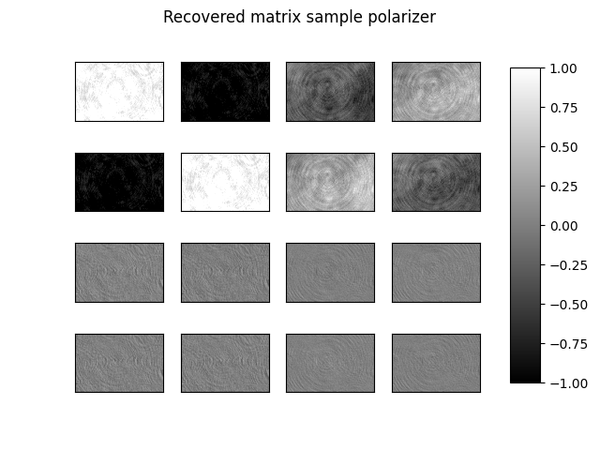

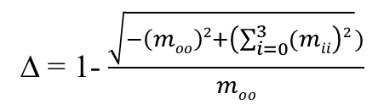

Relation between Mueller matrix element and different linear combination of intensities
[m₀₀ = (HH + HV + VH + VV)]; [m₀₁ = (HH + HV –VH –VV)]; [m₀₂ = (PH + PV – MH – MV)]; [m₀₃ = (RH – RV – LH - LV)]
[m₁₀= (HH – HV + VH – VV)]; [m₁₁= (HH – HV – VH + VV)]; [m₁₂= (PH – PV – MH + MV)]; [m₁₃ = (RH – RV – LH + LV)]
[m₂₀= (HP – HM + VP - VM)]; [m₂₁= (HP – HM – VP + VM)]; [m₂₂= (PP – PM – MP + MM)]; [m₂₃ = (RP – RM – LP + LM)]
[m₃₀ = (HR – HL + VR - VL)]; [m₃₁ = (HR – HL –VR + VL)]; [m₃₂ = (PR – PL – MR + ML) ]; [m₃₃ = (LL – RL – LR + RR)]
M_{sample} =
$D= \frac{\sqrt{\left(moo\right)2+\left(mo3\right)2+\left(mo2\right)2 }}{moo}$
$P= \frac{\sqrt{\left(m10\right)2+\left(m20\right)2+\left(m30\right)2 }}{moo}$
∆ = 1- $\frac{\sqrt{−\left(moo\right)2+\left(\sum_{i=0}^{3}{(mii}\right)2 })}{moo}$
Sofia Obando-Vasquez, Ana Doblas, Carlos Trujillo; Apparatus and method to recover the Mueller matrix in bright-field microscopy. American Journal of Physics 1 September 2022; 90 (9): 702–714. https://doi.org/10.1119/5.0081673

Slide 4
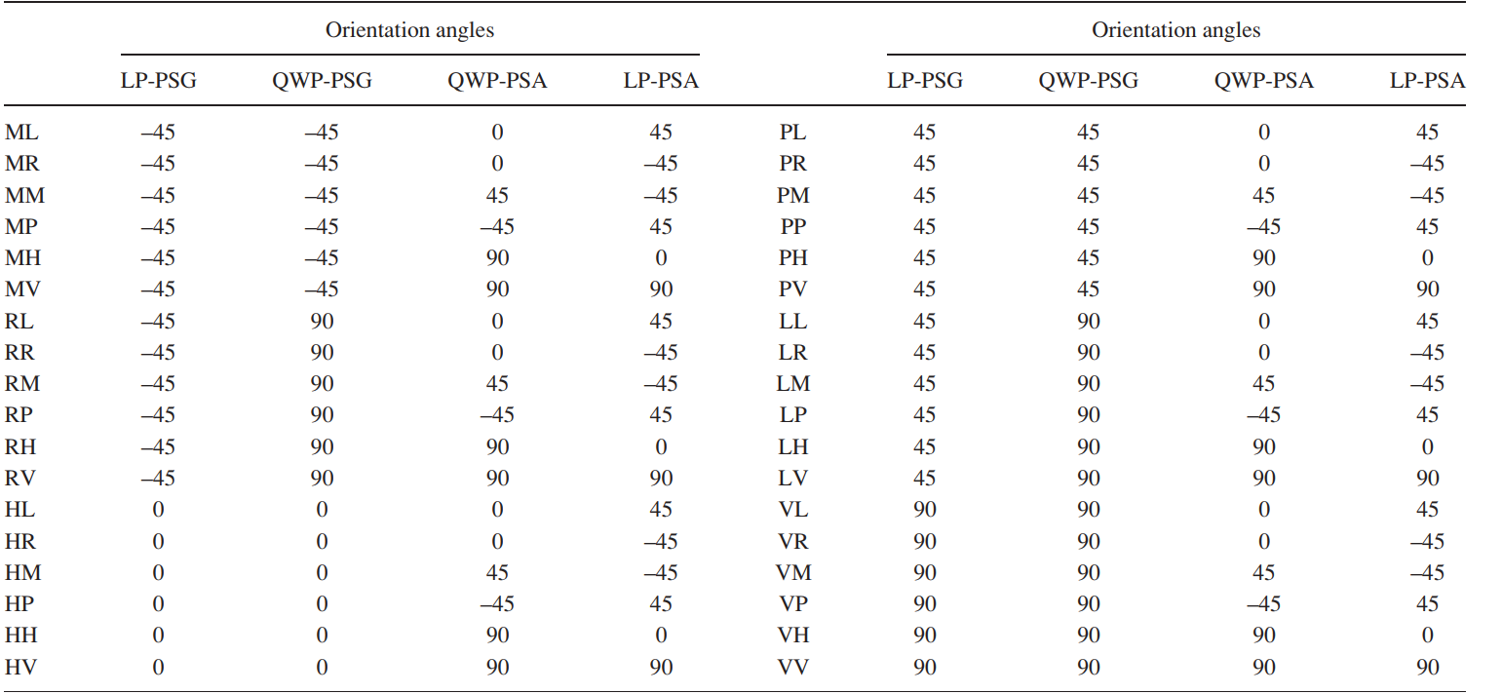
(3) Recording of the images
Once the system is aligned the images are taken with following configuration of the PSG and PSA
In this method,
polarization states in both PSG and PSA systems must be generated: vertical polarization, i.e., 90º (V), horizontal polarization, i.e., 0º (H), linear polarization at 45º (P), linear polarization at 45º (M), righthanded circular polarization (R), and left-handed circular polarization (L).
Refrences: Sofia Obando-Vasquez, Ana Doblas, Carlos Trujillo; Apparatus and method to recover the Mueller matrix in bright-field microscopy. American Journal of Physics 1 September 2022; 90 (9): 702–714. https://doi.org/10.1119/5.0081673

