Slide 1
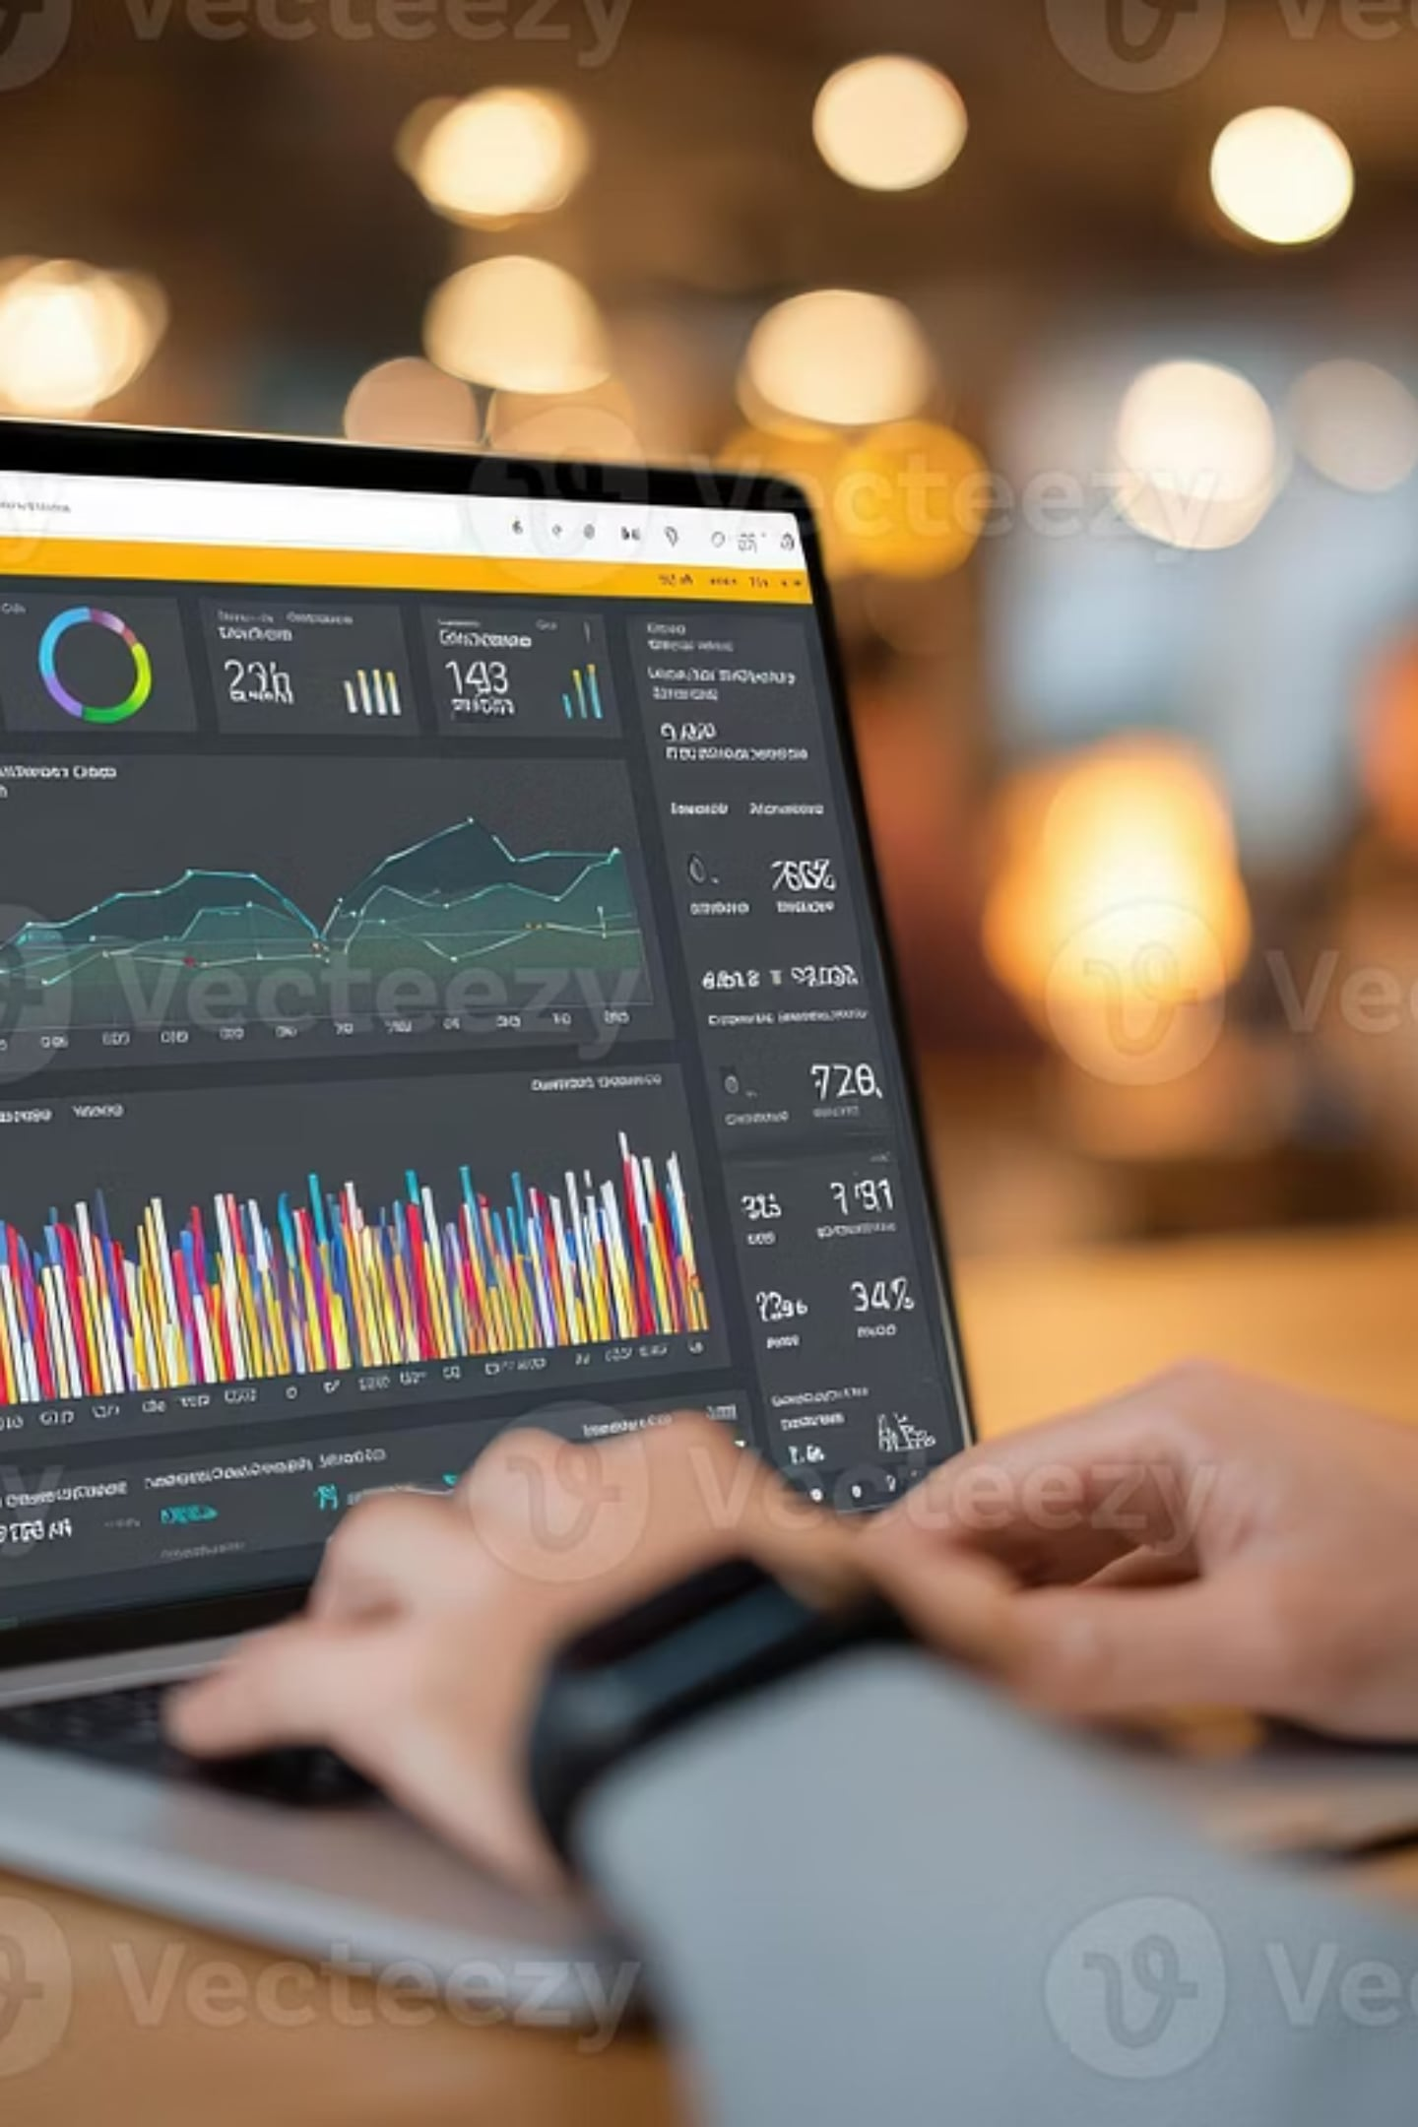
Task 4: Data Storytelling & Insights Presentation
Superstore Sales Analysis
Internship: ApexPlanet Software Pvt. Ltd.
Prepared by: Prashant Kumar
Turning retail sales data into actionable business insights using analysis, visualization, and storytelling.

Slide 2
Project Objective & Dataset Overview
Objective
Dataset Overview
Analyze the Superstore sales dataset to understand business performance across sales, profit, customers, product categories, regions, shipping patterns, and discounts, and convert findings into actionable business recommendations.
Dataset: Sample Superstore
Domain: Retail / Sales / Business Analytics
Key fields used:
Order Date
Sales
Profit
Discount
Category
Segment
Region
State
Product Name
Customer Name
Ship Mode

Slide 3
Business Questions Explored
1
Which product category contributes the highest sales?
2
Which region generates the highest profit?
3
How have sales changed over time?
4
Which customer segment contributes the most revenue?
5
Which customers and products drive the most sales?
6
Which states are the most profitable?
7
How do discounts vary across categories?
8
Which shipping mode is most commonly used?

Slide 4
Overall Business Performance
2.30M
286.40K
Total Sales
Total Profit
5.009K
793
Total Orders
Total Customers
Interpretation
The business generated strong sales with a healthy profit and a broad customer base. This provides a strong foundation for identifying high-performing categories, regions, and customer groups.

Slide 5

Category & Regional Performance
Sales by Category
Profit by Region
Technology generated the highest sales.
Furniture ranked second.
Office Supplies followed closely behind.
West region generated the highest profit.
East was the second most profitable region.
South and Central delivered comparatively lower profit.
Business Insight: Technology is the strongest sales driver, while the West region is the most profitable market. The company should strengthen technology-focused strategies and study the West region's performance model for replication in weaker regions.

Slide 6



Monthly Sales Trend (2014–2017)
Key Observations
Sales vary month to month, indicating seasonal or demand-based changes.
Multiple high peaks are visible in the later years.
Sales performance appears stronger closer to 2017.
Business Insight: The business is showing long-term growth. Understanding peak sales periods can help in planning inventory, promotions, and seasonal campaigns more effectively.

Slide 7
Segment & Customer Analysis
Sales by Segment
Top Customers by Sales
Consumer segment contributes the highest share of sales.
Corporate is the second-largest contributor.
Home Office contributes the least.
Some of the top customers include:
Sean Miller
Tamara Chand
Raymond Buch
Tom Ashbrook
Business Insight: The Consumer segment is the core revenue driver, and a small group of high-value customers contributes heavily to sales. This creates an opportunity for customer retention programs, loyalty benefits, and personalized marketing campaigns.

Slide 8
Product & State Performance
Top Products by Sales
Top States by Profit
Top-performing products include:
California generated the highest profit.
New York ranked second.
Other profitable states include Washington, Michigan, and Virginia.
Canon imageCLASS products
Fellowes office equipment
Cisco TelePresence systems
HP and GBC office products
Business Insight: A small set of premium products and a few profitable states contribute significantly to overall business performance. The company should prioritize top-performing products and expand strategies in highly profitable states.

Slide 9
Shipping & Discount Analysis
Shipping Mode Analysis
Discount by Category
Standard Class is the most frequently used shipping mode.
Second Class and First Class follow.
Same Day is used the least.
Furniture receives the highest average discount.
Office Supplies receives a moderate discount.
Technology receives the lowest discount.
Business Insight: The company depends heavily on Standard Class shipping, so improving its efficiency can directly improve customer experience. Heavy discounting in Furniture should also be reviewed to ensure it is not reducing profitability.

Slide 10








Key Business Insights
Major Findings from the Analysis
Technology Leads Sales
West: Profit Hub
The Technology category is the highest revenue generator.
The West region yields the highest overall profit.
Consistent Sales Growth
Consumer Segment Dominant
Sales show a strong upward trend from 2014 to 2017.
The Consumer segment drives the largest share of revenue.
Top Performers Drive Value
CA & NY: Profit Centers
A core group of customers and products account for significant sales.
California and New York are the most profitable states.
Standard Class Shipping
Furniture Discount Impact
Standard Class is the most frequently utilised shipping method.
High discounts on Furniture may be affecting profit margins.

Slide 11
Business Recommendations
1
Focus on Technology Category
Technology generates the highest sales and lowest discounts, making it the most profitable category. Increase marketing and inventory focus on technology products.
2
Strengthen West Region Strategy
The West region is the most profitable. Study its customer behavior and replicate successful strategies in South and Central regions.
3
Improve Shipping Efficiency
Since most orders use Standard Class, improving delivery speed and reliability can enhance customer satisfaction without increasing costs significantly.
4
Optimize Discount Strategy
Furniture receives high discounts but contributes lower profit. Review discount levels to maintain sales volume while improving margins.
5
Customer Retention Programs
Top customers contribute significantly to revenue. Implement loyalty programs, personalized offers, and targeted campaigns to retain high-value customers.
6
Expand in High-Profit States
Focus expansion efforts on California, New York, Washington, and other high-performing states to maximize profitability.

Slide 12
Conclusion
This project demonstrates how business data can be transformed into meaningful insights using data analysis, dashboarding, and storytelling. By analyzing sales, profit, customers, categories, regions, shipping, and discounts, the project identifies practical opportunities to improve revenue generation, regional profitability, customer retention, shipping efficiency, and discount strategy.
The project highlights the value of data-driven decision-making in retail business performance analysis.

