Slide 1
WUForex
The modern solution to trade and compare
Team Name - GAPS
College - Pune Institute Of Computer Technology
Team Members:
Prashant Agrawal
Gaurav Palkhade
Ashutosh Harkare
Shubham Loya

Slide 2
Problem Statement
Implement a foreign exchange aggregator that interfaces with multiple forex providers to provide the user with the current rates that are available in the market. The user should be able to enter the currencies to be exchanged, search for options available, sorting based on multiple parameters (like best rates, time duration) etc.
Minimum Features Expected
A simple to use responsive Web UI with working prototype
Display best and worst Forex rates for given day and week of month
Multi currency conversion support (for ex. USD-INR, EUR-INR, USD-JPY, USD-EUR etc)

Slide 3
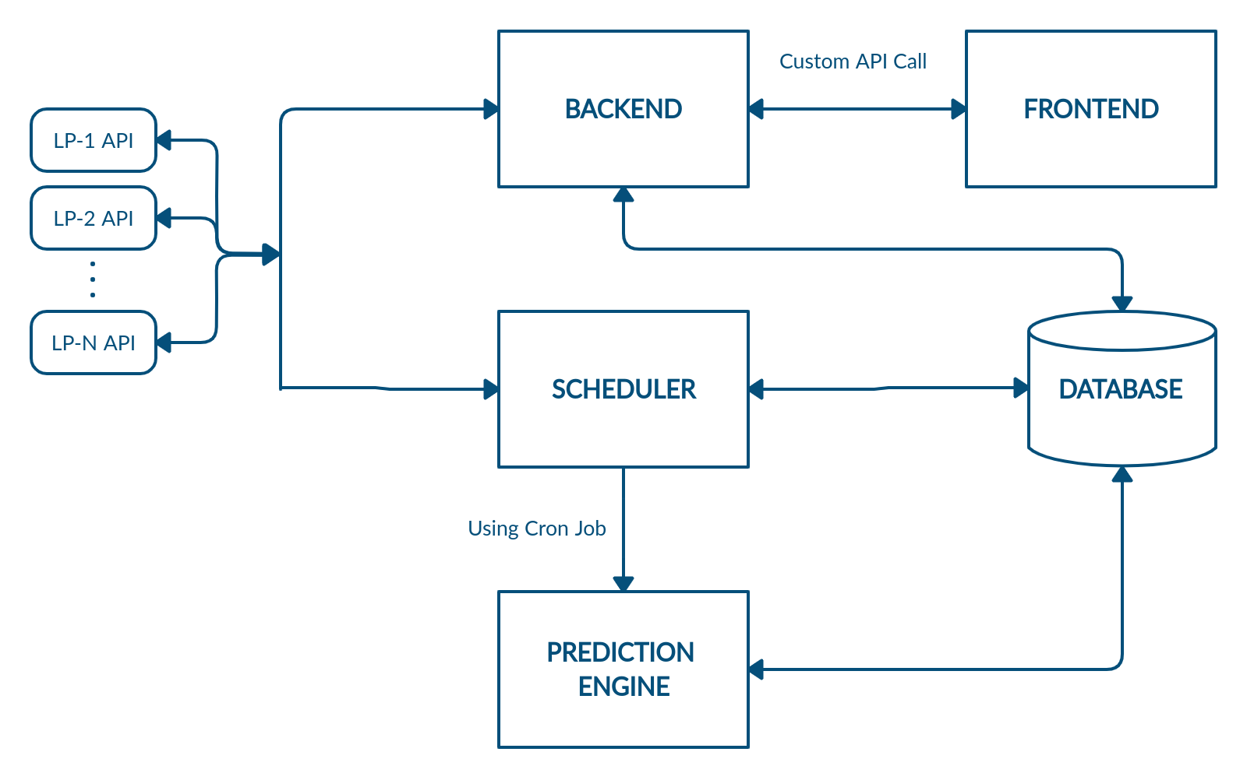
Bird Eye’s View

Slide 4
Frontend
Backend
Scheduler
Database
Recommending the best LP for selected currency pair.
Using concept of polling to display the changing rates.
Displaying graphs for visualization
To connect Frontend with database providing data for different graph.
Massaging the data from LP’s API and providing it to Frontend.
The Scheduler will make use of cron-job to achieve three main roles :
To call and store ohlc data every hour.
Call prediction engine every hour by running its script.
Calculation daily and weekly high and low prices.
MongoDB database will having following role:
Storing of historical Forex rate for every currency pair for every LP.
To store the result of Prediction Engine which will be used in graphs.

Slide 5








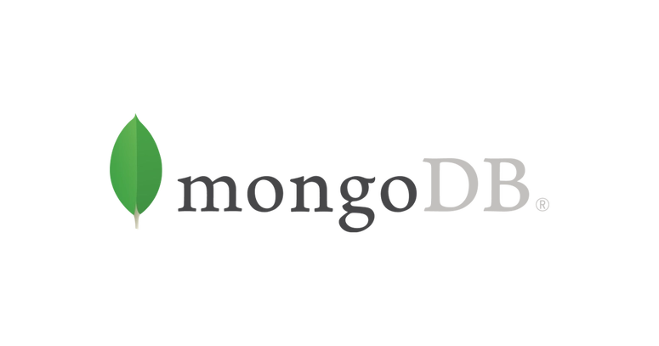

Technology Stack
 | Asynchronous, for ensuring better multiple processing. Vast community support. Reusable code
 | Easy to work and reuse components. Quick rendering and high scalability Compatible with CanvasJs
 | For better data visualization Faster development and processing Compatible with various frameworks
 | NoSql to store data from different LP’s API. Easily scalable
Other Libraries

Slide 6
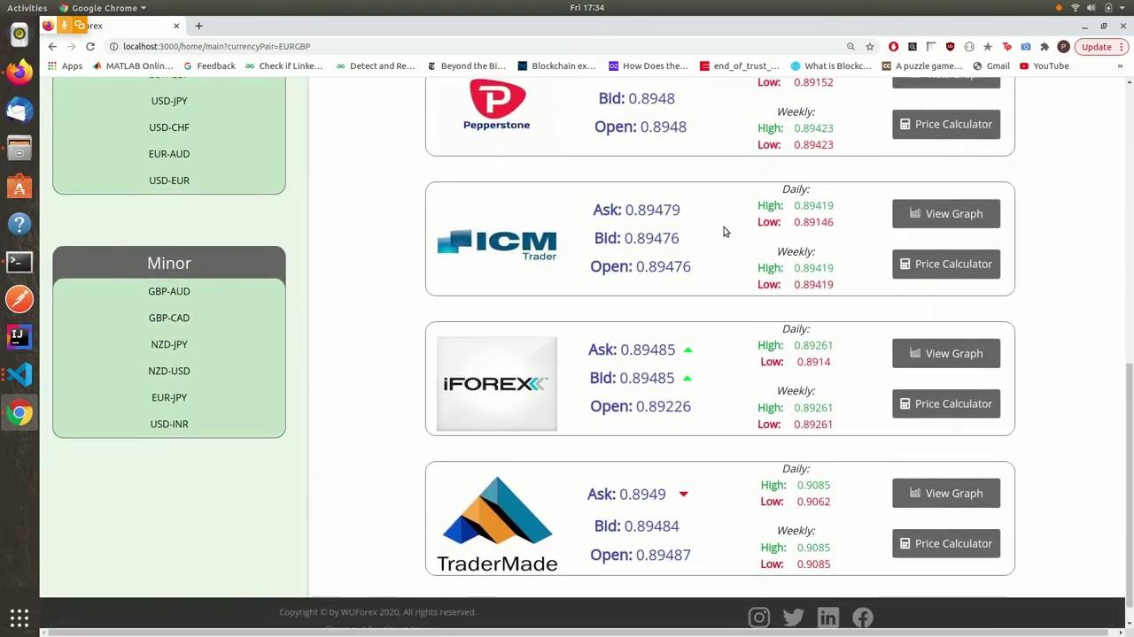

Slide 7
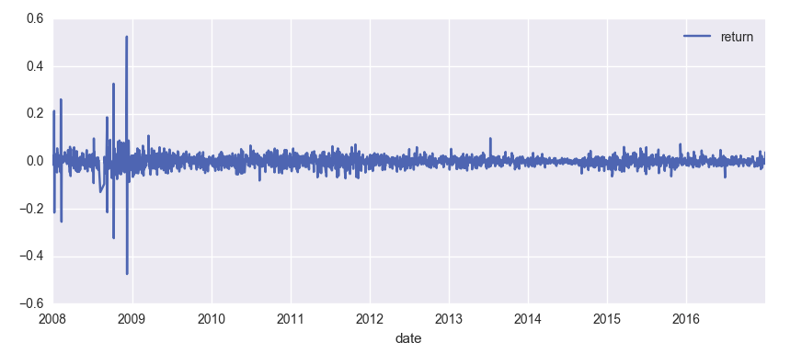
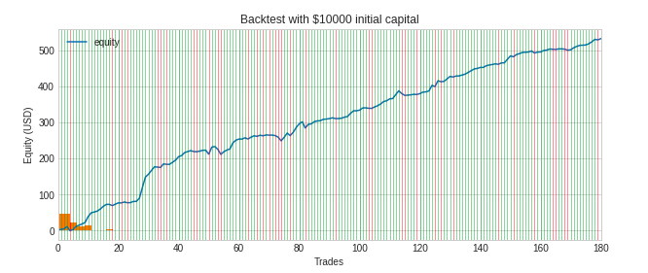
Prediction Engine
Pymongo and other basic ML libraries
Idea:
Mongodb to dataframe
OHLC
Return
Label (Loss or Profit)
ML model(KNN)
Accuracy
Profit factor and other features
Recommendation count

Slide 8
Future Scope
As of now we have 10 currency pairs available, but we are aiming to expand and include more currency exchange pairs.
We can also reduce the data storage and retrieval time interval and simultaneously improve the polling time for rendering real time ask and bid rates.
Prediction of the best currency pair in the market. As of now we are focusing only on the best LP for a particular currency pair.
Predicting rates for a particular period in future, based on historical data.

