Slide 1

Code
ing
CS307 -System Practicum

Slide 2
OUR TEAM
Prashant Kumar (B19101)
Shubham Saurav (B19222)
Saloni Patidar (B19111)
Ravi Kumar (B19191)
Gaurav Sahitya (B19083)
Sagar Tarafdar (B19110)

Slide 3
ABOUT CODEWING
CodeWing is a collaborative editor that allows several people to edit, view, compile a programming code simultaneously over a computer network. Users can edit the same code, run the code, can chat through the text box in real time.

Slide 4
Features
Collaborative Coding
Video + Audio Calling
RealTIme WhiteBoard
RealTime Chatting
Code Download

Slide 5
COLLABORATIVE CODING
Everyone on the meeting can edit and run the code
Implemented using Realtime Firebase

Slide 6
Video + Audio Calling
People can see each other and talk to each other
Implemented using Node.js and Peer.js
Server hosted on Heroku

Slide 7
Real-Time WhiteBoard
Everyone on the meeting can scribble on the whiteboard using mouse
Implemented using Socket.io
Server hosted on Heroku

Slide 8
Real-Time Chatting
People in the meeting can text with each other
Implemented using Socket.io
Server hosted on Heroku

Slide 9
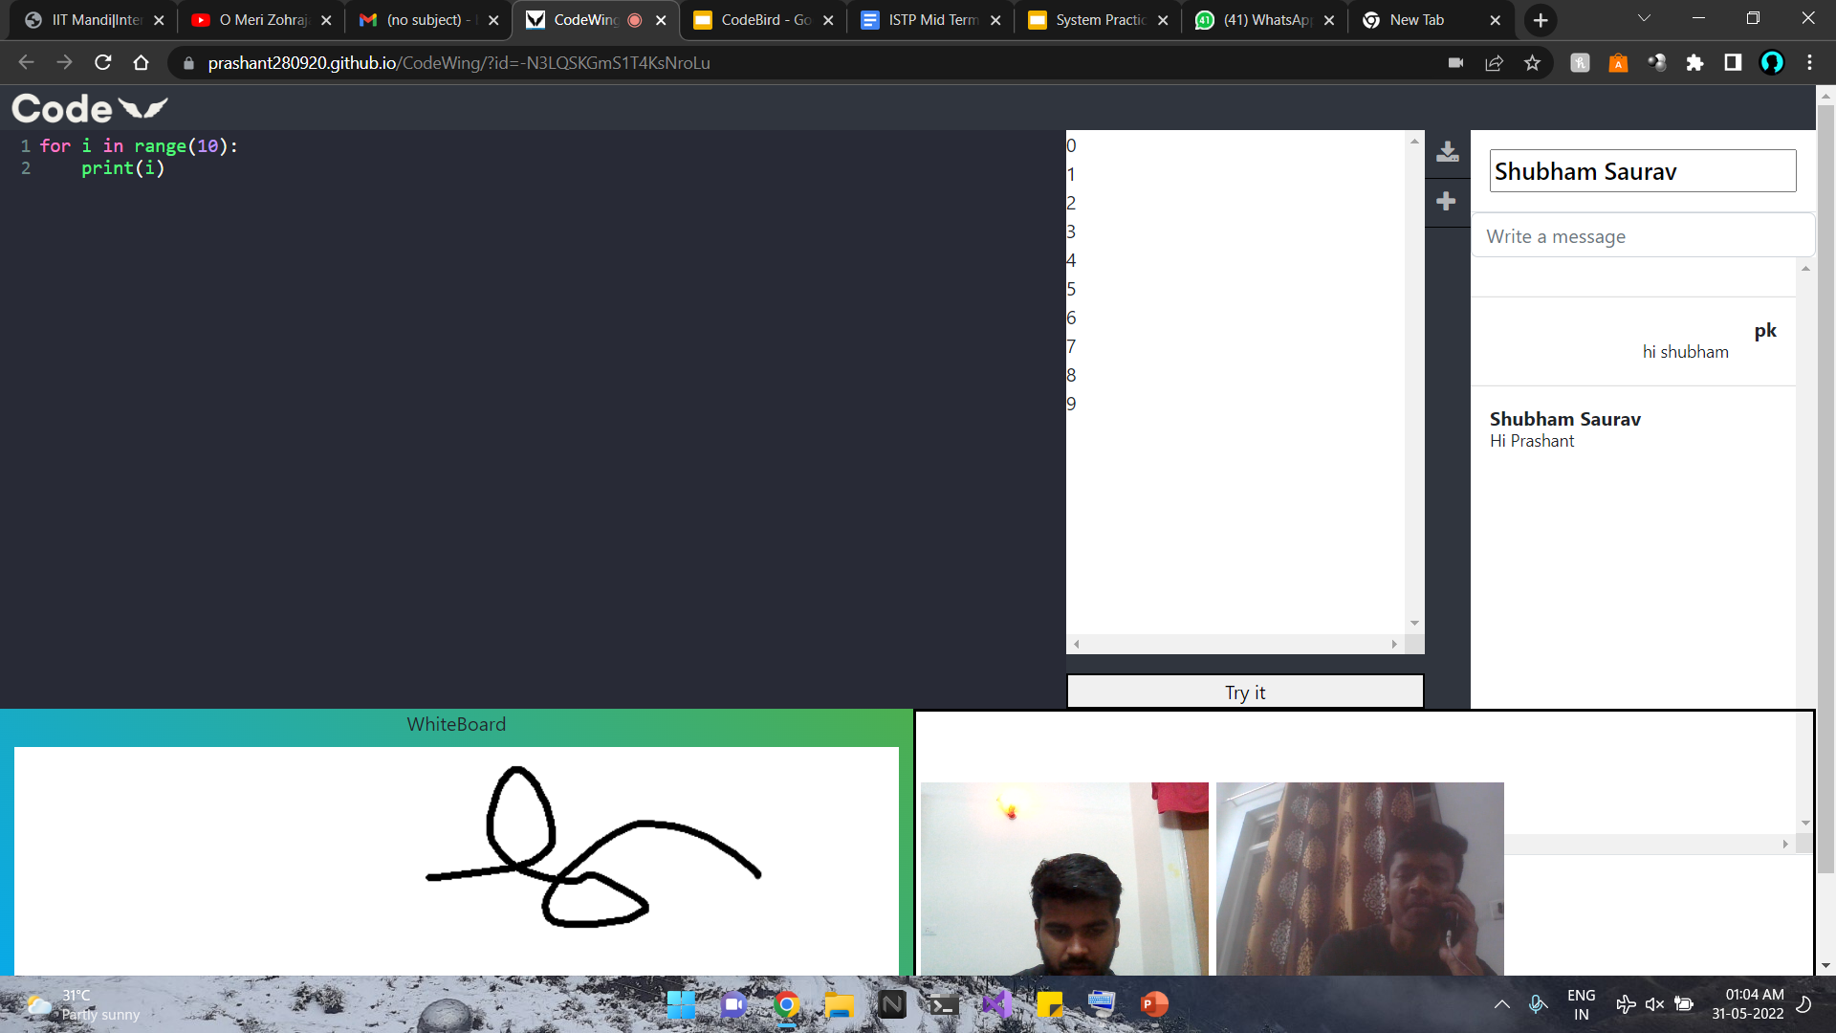
Application
This image shows our working application
Hosted on Github
Made using Svelte.js

Slide 10
DEMO

Slide 11
Benefits
In the times of pandemic, we realised that working from different locations on a same project is difficult. Hence, CodeWing can prove to be a life saver.
Can be used for personal code writing, scribbling, etc.
Can be used for video/audio calling by group of people.
Can be used by professors to explain the code to the students easily.
Can be used by professionals to take interviews.

Slide 12
Challenges Faced
While implementing whiteboard, the board components were not getting updated parameters.
While fetching the server, data was not getting send to the server in svelte.js .
While implementing video-feature, socket was not able to directly connect to video-server.
Python shell and Require module was not importing in svelte.js while compiler API.

Slide 13
Conclusion
User friendly
Can be used by anyone and everyone for projects and coding purposes.
Use of several frameworks to make it more efficient and effective.
We can commercialize it by adding more features.

Slide 14
References
https://stackoverflow.com/questions/23450534/how-to-call-a-python-function-from-node-js
https://firebase.google.com/docs/database
https://www.youtube.com/watch?v=DvlyzDZDEq4
https://github.com/chithakumar13/Share-Code
https://socket.io/

Slide 15
THANKS!

