Slide 1
Online Adaptive Early Warning System Under Concept Drift
BTech Project Presentation | March 2026

Slide 2
Agenda
Problem and motivation
Theory: critical transitions and drift
System architecture and methods
Validation and current results
Limitations and next roadmap

Slide 3
Problem Statement
Goal: detect approaching critical transitions in streaming time series
Challenge: data distribution changes over time (concept drift)
Key ambiguity: drift signatures can resemble true collapse signatures
Research objective: robust, adaptive, and measurable early warning framework

Slide 4
Why This Matters
Real systems are nonstationary: climate, ecology, infrastructure, finance
False alarms are costly; missed collapse warnings are dangerous
Static models fail under shift; adaptive systems risk overreacting
We need benchmarked methods with clear uncertainty and failure modes

Slide 5
Theoretical Foundations
Critical transitions occur near bifurcation points
Critical slowing down causes rising variance and lag-1 autocorrelation
Classical EWS uses these indicators as collapse precursors
Concept drift can also change variance/autocorrelation, causing confounding

Slide 6
Synthetic Dynamical Systems
Fold bifurcation: dx/dt = r - x^2 - gamma*x^4 + noise
Saddle-node style: dx/dt = r + x - x^3 + noise
Hopf bifurcation: coupled 2D system with oscillatory transition
Three phases per trajectory: stable, approaching, post-transition

Slide 7
Labeling and Learning Target
Regime labels: 0 (stable), 1 (approaching), 2 (post-transition)
Model target mapping: 0->0.0, 1->0.5, 2->1.0
Output is a continuous warning score in [0,1]
Important: labels are phase labels, not exact tipping instant labels

Slide 8
Controlled Drift Injection
Shared ramp(t) controls gradual drift progression from 0 to 1
Mean drift: additive shift scaled by magnitude
Variance drift: amplitude scaling around reference mean
Noise drift, autocorrelation drift, and control-parameter drift also supported

Slide 9
Drift Injection Mathematics
Mean: x_t' = x_t + ramp(t) * (magnitude * Delta_mu)
Variance: x_t' = mu + s(t) * (x_t - mu)
Noise: x_t' = x_t + epsilon_t, epsilon_t ~ N(0, sigma(t)^2)
Autocorr: x_t' = (1-rho(t))*x_t + rho(t)*x_{t-1}; Control: r_t' = r_t + ramp(t)*Delta_r

Slide 10
Approach 1: Classical EWS Baseline
Rolling variance and rolling lag-1 autocorrelation
Normalized and combined with equal weighting
Pros: interpretable, theory-aligned
Cons: weak under complex nonlinearity and drift confounding

Slide 11
Approach 2: Offline CNN-LSTM
Conv1D layers extract local temporal features
LSTM captures temporal dependencies in windows
Trained once on stationary synthetic data
Limitation: no mechanism to adapt under distribution drift

Slide 12
Approach 3: Online Adaptive CNN-LSTM
Initialized from offline model and run in streaming mode
Buffer recent windows and fine-tune when drift is detected
Stability controls: cooldown, small LR, limited epochs
Trade-off: adaptivity vs. false adaptation and forgetting risk

Slide 13
Pluggable Drift Detector Interface
Unified detector API: update(value), reset(), reset_baseline(), get_state()
Implemented detectors: Variance, ADWIN, CUSUM, Page-Hinkley
Any detector can be plugged into the online model without changing core adaptation logic
Enables controlled detector comparison experiments

Slide 14
Detector Algorithm Intuition
ADWIN: adaptive window split test with significance bound
CUSUM: cumulative evidence for persistent mean shift with thresholds
Page-Hinkley: cumulative deviation from running mean
Variance detector: variance spike relative to baseline window

Slide 15
Drift Quantification Metrics
Wasserstein distance: transport cost between distributions
KL divergence: information mismatch D_KL(P||Q)
MMD: kernel two-sample distance for higher-order differences
Moment shifts: absolute mean shift and variance shift

Slide 16
EWS Performance Metrics
Lead Time: collapse_time - first pre-collapse persistent alarm
False Alarm Rate: alarm density in pre-warning region
Regime Separation: standardized mean difference between stable and pre-collapse windows
Batch evaluator supports per-series and aggregate reporting

Slide 17
Validation Framework
Validation scripts now clean, reproducible, and Windows-safe
Outputs include fresh logs and figures in validation/outputs
Validated: generators, drift metrics, detectors, and EWS metrics
Removed stale/duplicate output files

Slide 18
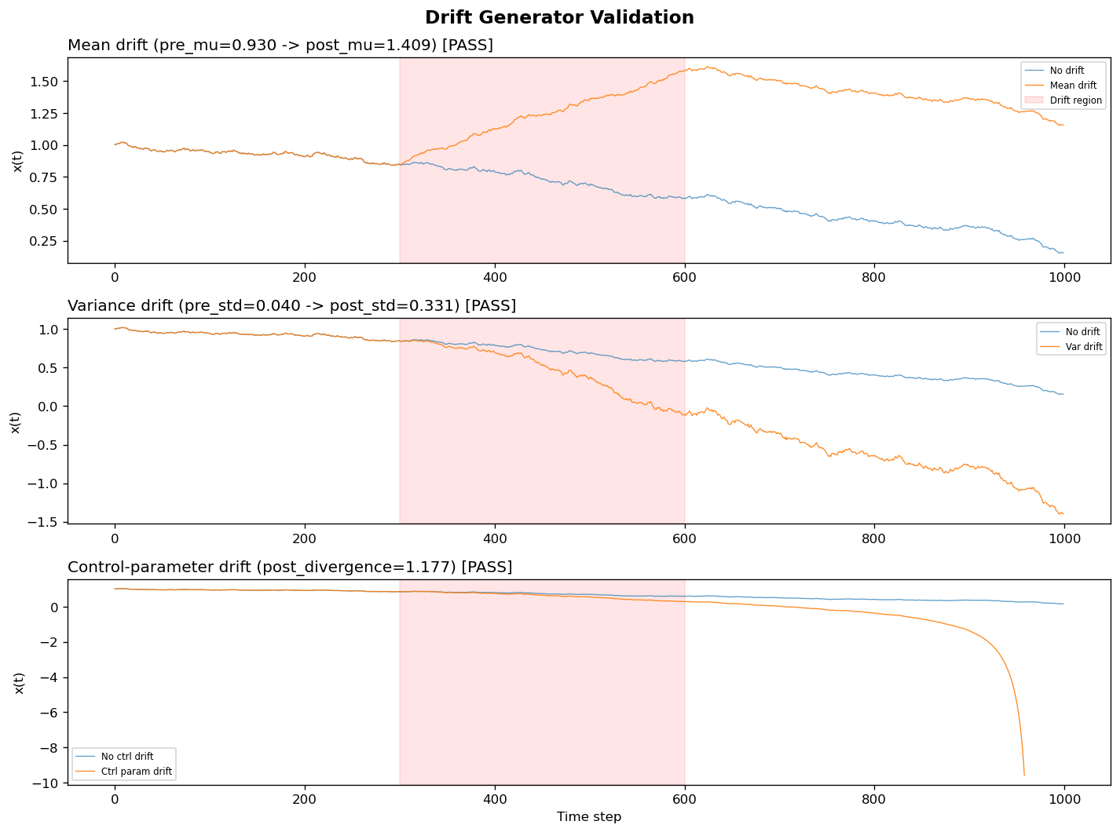
Validation Result: Drift Generators
All generator checks passed: mean drift, variance drift, and control-parameter drift behave as expected.

Slide 19
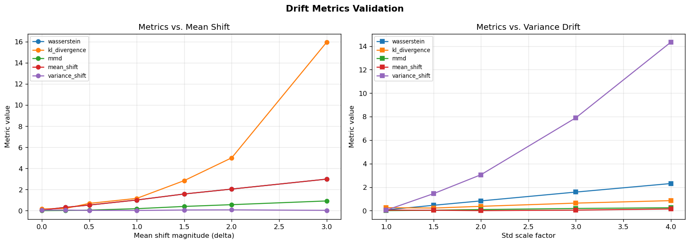
Validation Result: Drift Metrics
All checks passed: near-zero on identical distributions and monotonic trend with drift severity.

Slide 20
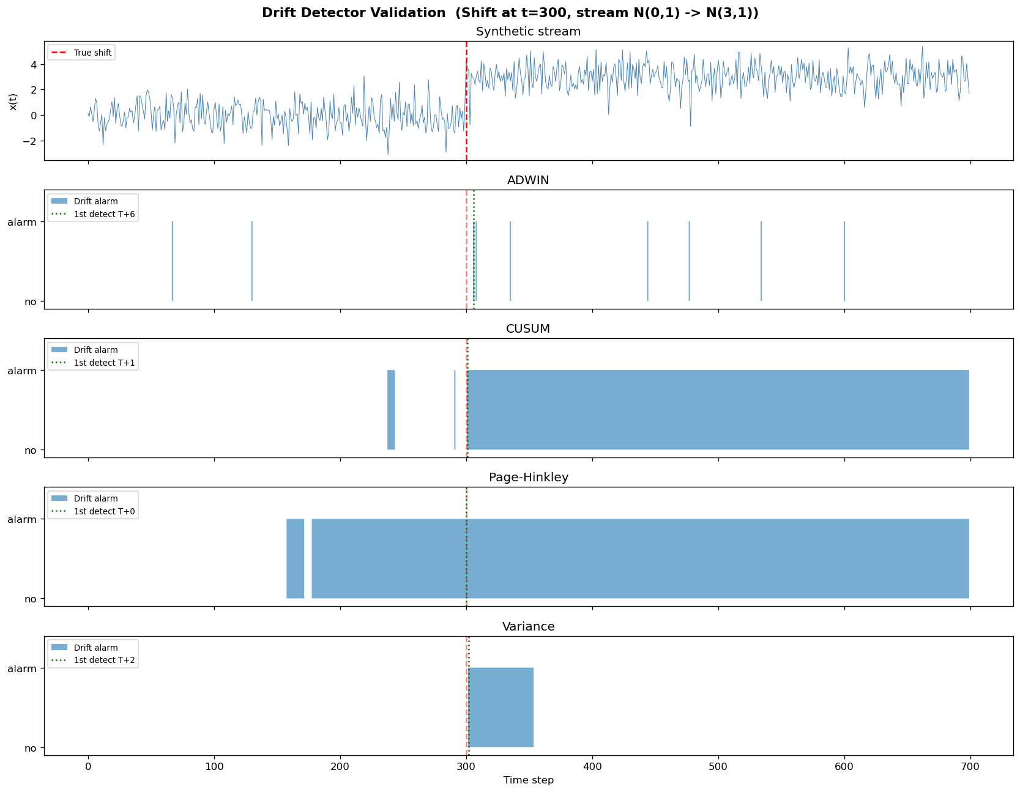
Validation Result: Drift Detectors
All detectors detected shift in time; false alarm behavior differs by detector and parameter settings.

Slide 21
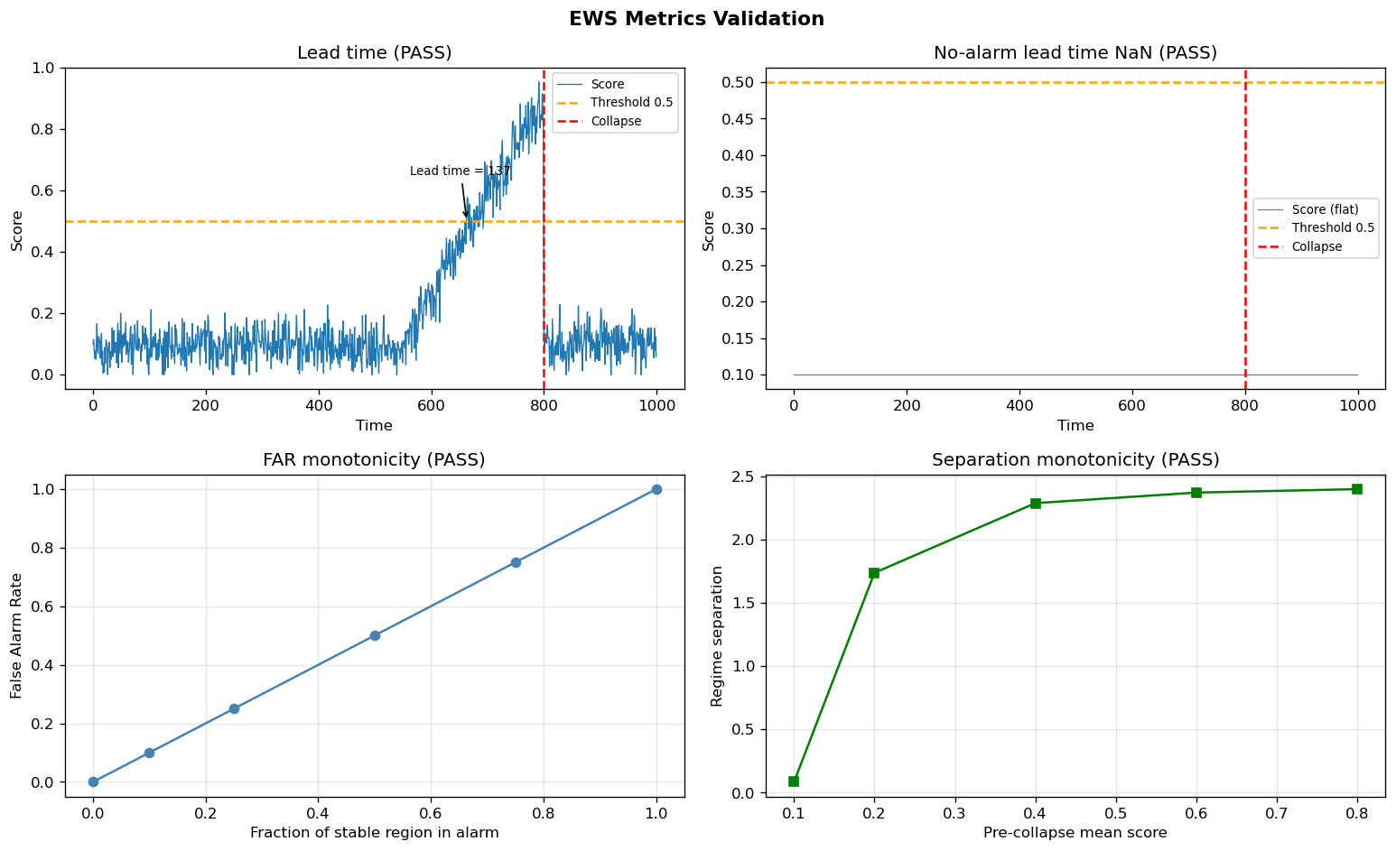
Validation Result: EWS Metrics
All checks passed: lead-time behavior, FAR monotonicity, and regime-separation monotonicity.

Slide 22
Current Research Insight
Offline models degrade significantly under drift
Online adaptation improves robustness but does not fully resolve drift-vs-collapse ambiguity
Detector tuning strongly affects false alarm behavior
Main challenge is separability between distributional shift and genuine critical transition

Slide 23
Limitations (Honest Assessment)
Current synthetic benchmark still limited in drift realism combinations
Detector thresholds are not globally optimized
Real-world validation currently narrow (Delhi 2015 track)
Need stronger uncertainty estimation and confidence calibration

Slide 24
Next Phase Roadmap
Build full benchmark grid: drift type x drift magnitude x model x detector
Quantify drift severity and correlate with EWS failure modes
Develop failure taxonomy: false collapse alarms vs missed true transitions
Propose drift-aware warning logic and evaluate on broader real datasets

Slide 25
Key Contributions So Far
End-to-end pipeline: synthetic dynamics -> model -> adaptation -> evaluation
Controlled drift injection framework with modular drift operators
Pluggable drift detector architecture
Reusable drift and EWS metric modules with validated diagnostics

Slide 26
Thank You
Questions and discussion
Focus points: methodology rigor, detector behavior, and next benchmark experiments
Project path: from prototype to systematic research framework

