Slide 1

KIDNEY AND KIDNEY TUMOR SEGMENTATION
SUBMITTED BY-
ALANKRIT KADIAN (2021CSB1065)
PRASHANT SINGH (2021CSB1124)
SAHIL (2021CSB1128)

Slide 2
Problem Statement
The accurate segmentation of kidney tumors and cysts is a critical task in medical image analysis. Traditional manual segmentation methods are time-consuming, subjective, and prone to inter-observer variability. Therefore, developing an automatic semantic segmentation system for kidney tumors is highly desirable, which can improve the efficiency and accuracy of clinical decision-making.

Slide 3
Motivation
Kidney cancer is diagnosed in more than 430,000 individuals each year, accounting for roughly 180,000 deaths. Kidney tumors are found in an even greater number each year, and in most circumstances, it's not currently possible to radiographically determine whether a given tumor is malignant or benign. Even among tumors presumed to be malignant, many appear to be slow-growing and indolent in nature, which has given rise to "active surveillance" as an increasingly popular management strategy for small renal masses . Hence, an automatic semantic segmentation for kidney tumors and cysts can be very helpful in solving the above issue.

Slide 4
Architectures Explored
2D-UNET | 3D-UNET | SCUNET
Lower number of layers, fewer parameters than 3D UNet | More layers and parameters than 2D UNet, but less than SCUNet | More complex than 3D UNet with additional skip connections and attention mechanisms
Good segmentation accuracy, but not as accurate as 3D UNet | Better segmentation accuracy than 2D UNet, but not as accurate as SCUNet | Best segmentation accuracy due to skip connections and attention mechanisms, outperforming others

Slide 5
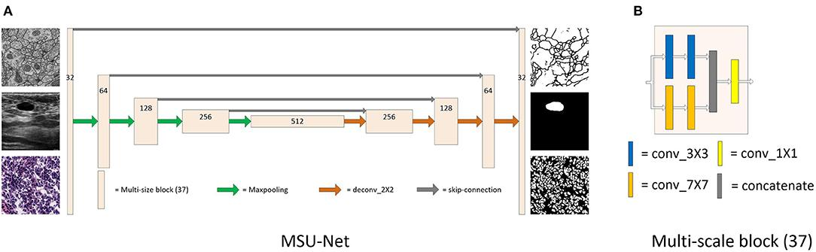
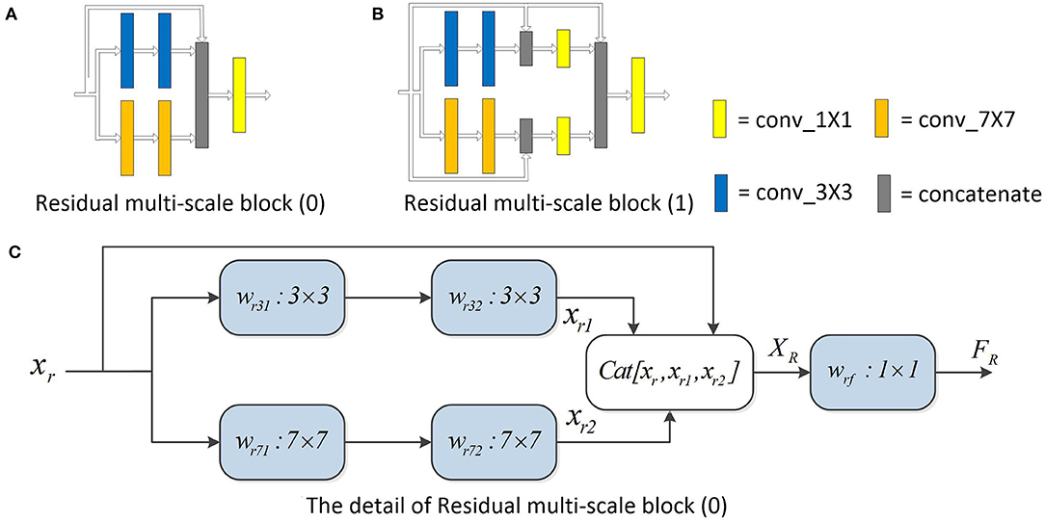
MSU
2D-UNET
The proposed framework incorporates the implementation of a 2D UNet model for kidney tumor and cysts segmentation with the objective of creating an expert system for predicting tumors at an early stage.
The proposed segmentation and classification models are empirically evaluated using various evaluation metrics such as precision, recall, F score, dice similarity coefficient, and support.

Slide 6
Segmentation Model
2D UNet is a type of neural network architecture that is commonly used for image segmentation tasks. In the encoder stage, the input image is progressively downsampled by convolutional layers, which reduce the spatial dimensionality while increasing the number of channels.The resulting feature maps are then passed through the decoder stage. The skip connections between the encoder and decoder stages allow the network to retain more detailed information about the input image, which helps to improve the accuracy of the segmentation.
2D-UNET can be used for 3D image segmentation by slicing the 3D volume into a series of 2D images, then apply the 2D-UNET to each slice separately. The resulting 2D segmentation maps can then be combined into a 3D volume to obtain the final segmentation.

Slide 7
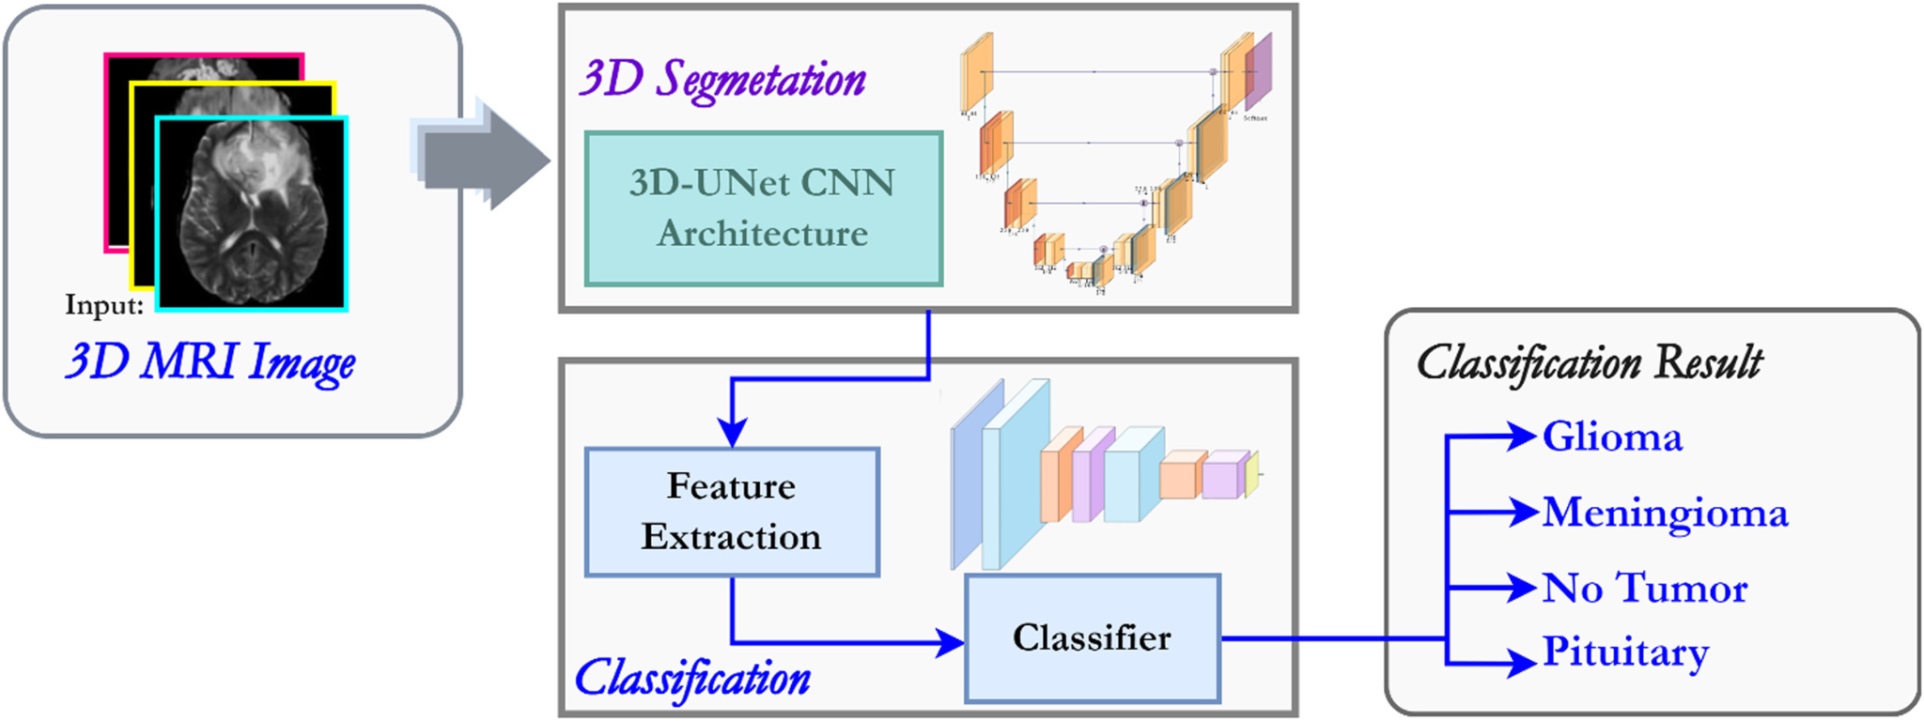
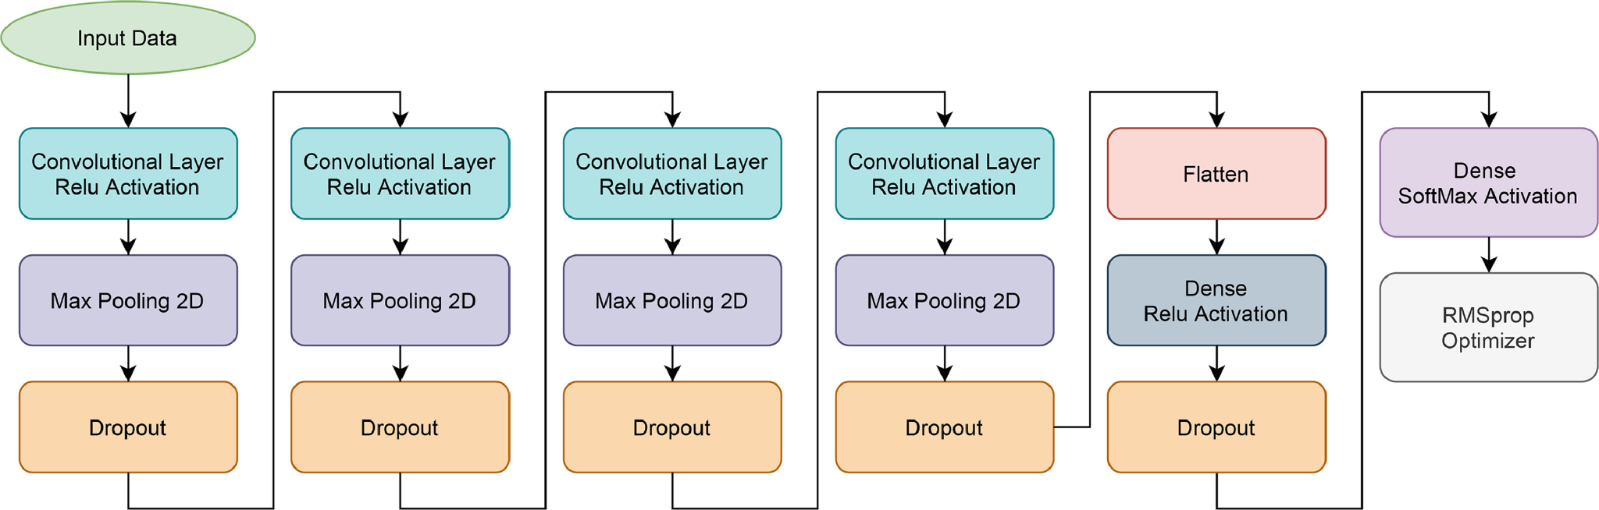
3D-UNET
The proposed framework incorporated the implementation of an advanced 3D U-Net model for volumetric segmentation and updated CNN for the classification of the MRI images, with the objective of creating an expert system for predicting brain tumors at an early stage.
The proposed segmentation and classification models are empirically evaluated using various evaluation metrics such as precision, recall, F score, dice similarity coefficient, and support.

Slide 8
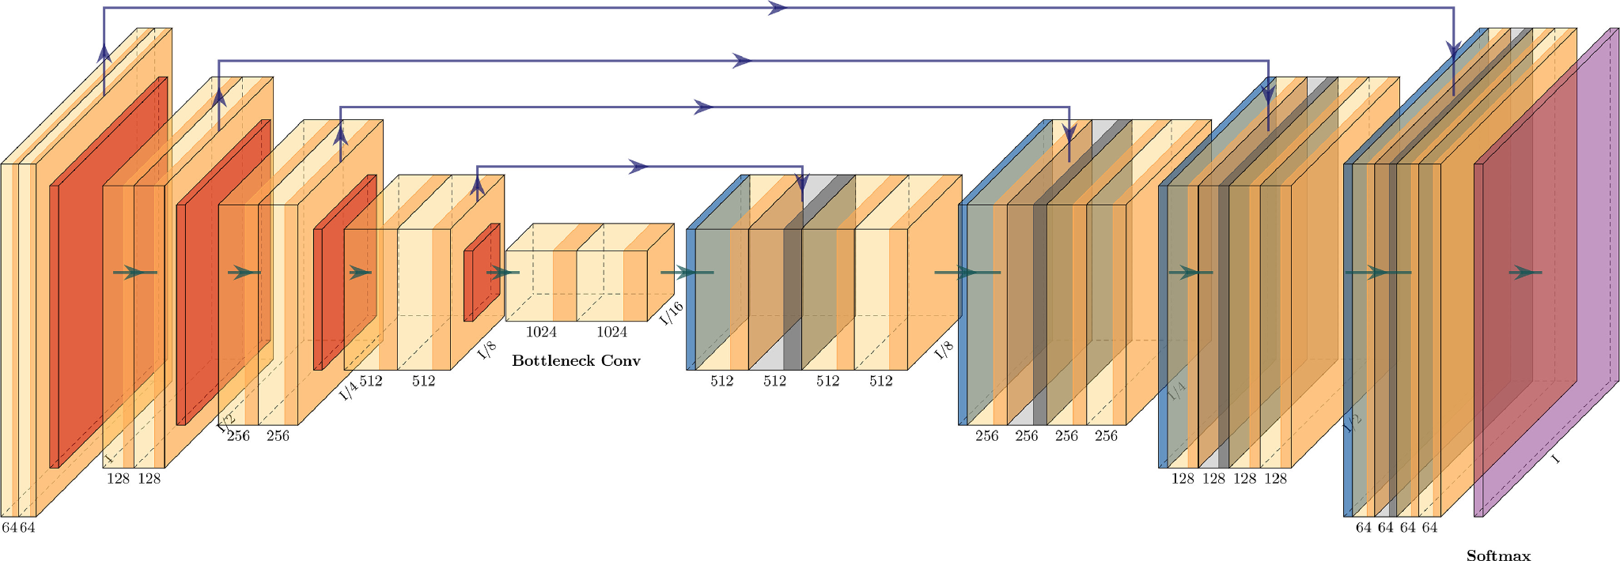
Segmentation Model
The 3D U-Net model is the model introduced in this paper. The models that make up the full tumor detection platform are an image registry model, a 3D U-Net model, and soft dice failure. The first step was to combine 3D image slices from an MRI scan into a single 3D model. Image registration is used to solve misalignment issues during combination. Following the formation of the 3D model, the 3D model is divided into subsections, each of which is coded in the appendix. The subsections are then fed into the U-Net model, which produces the segmented model after all of the down and up convolution cycles. The subsections are then merged once more to create a segmented 3D model. The next move is to calculate the damage.

Slide 9
Classification Model
Neural network architecture is inspired by the biological human brain. Neural networks are primarily used to quantify vectors, approximate data, cluster data, align patterns, optimize, and classify functions. Based on their links, the neural network is categorized into three groups, viz., (a) feedback, (b) feedforward, and (c) recurrent networks. Further, a neural network can be classified as a single-layer network or a multilayer neural network.

Slide 10
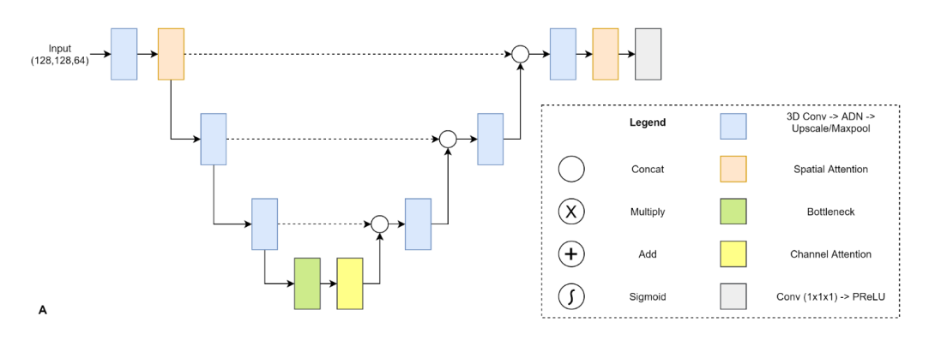
Spatial and Channel attention enhanced U-Net
This model enhance the basic U-Net by including visual attention with 3D convolutions. Attention blocks help the model train more effectively by refining the features with the help of a global attention map.

Slide 11
The components of this model are:-
Data Preprocessing
The number of slices for each volume sample is different and the number of slices can also be high enough to consume all available resources during training. To avoid such a scenario, we resample the data to 2x1.62x1.62 mm to have the same voxel spacing across the patient image volumes. The lower spacing along the z-axis increases the number of training slices per patient and thus helps generalizability. The final cropped data is further divided in chunks of 64x128x128 volumes for training and evaluation.
Data Augmentation
In order to make the model generalizable, we introduce variance in data using data augmentation techniques. To introduce spatial variance, we use 3D Elastic deformation with a probability of 0.5. The parameters for 3D elastic deformation are: sigma (smoothness factor) = (5,8); magnitude = (50,150); translate = (10,10,5) in pixels; rotate = (5,5,180) in degrees, scale = (0.1, 0.1, 0.1) in proportion of image size. This augmentation introduces variation in shape of structures while maintaining spatial information.

Slide 12
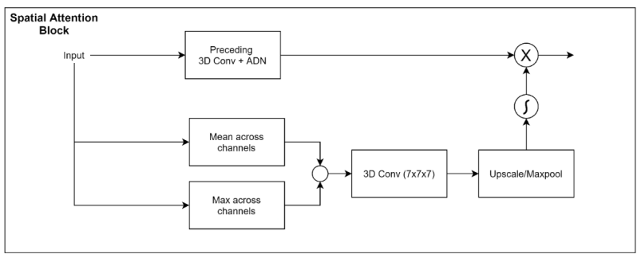
Spatial Attention block:
The spatial attention block is responsible for identifying where the useful information is present in the image, by utilizing the inter-spatial relationships of the image features. The spatial attention block uses mean and max operations along channel dimension followed by 3D conv (7x7x7) to identify region of interest and multiply the attention map with output of preceding 3D Conv + ADN (Attention+Dropout+Normalization) block to filter out location of important features.

Slide 13
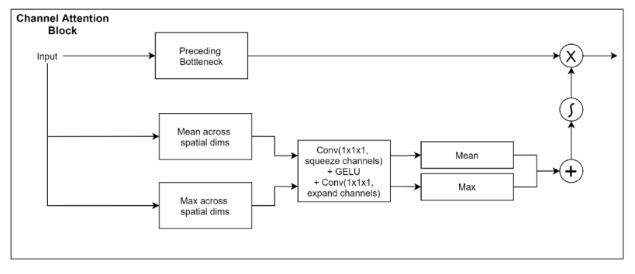
Channel Attention block:
Instead of focusing on where the important feature is, the channel attention block identifies what is useful in a given image. This figure describes the channel attention block used in our approach. The channel attention block uses mean and max values across spatial dimensions followed by a conv block to identify what is important in a given volume.

Slide 14
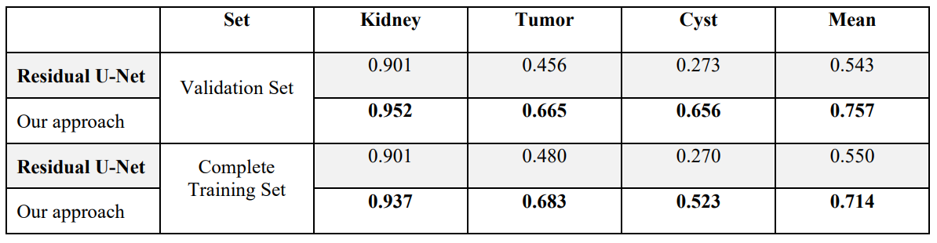
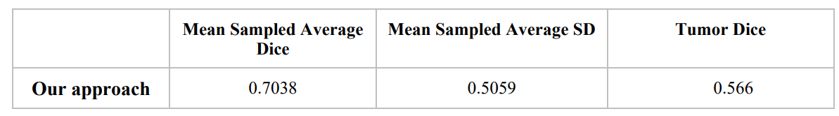
Results

Slide 15
Steps used in Code:-
Step 1 - Defined channel Attention, Spatial Attention and Conv Block Codes for the Architecture
Step 2 - Write the code for the Unet model (SCU-Net is used)
Step 3 - Data - Preprocessing
Step 4 - Creating Data Loaders
Step 5 - Training the Model on batches from the data Loaders

Slide 16
Dataset:-
We used the Kits23 dataset given on the official site of Kits Challenge 2023.
The dataset is in the following format:-
dataset
├── case_00000
│ ├── imaging.nii.gz
│ ├── segmentation.nii.gz
├── case_00001
│ ├── imaging.nii.gz
│ ├──segmentation.nii.gz
…

Slide 17
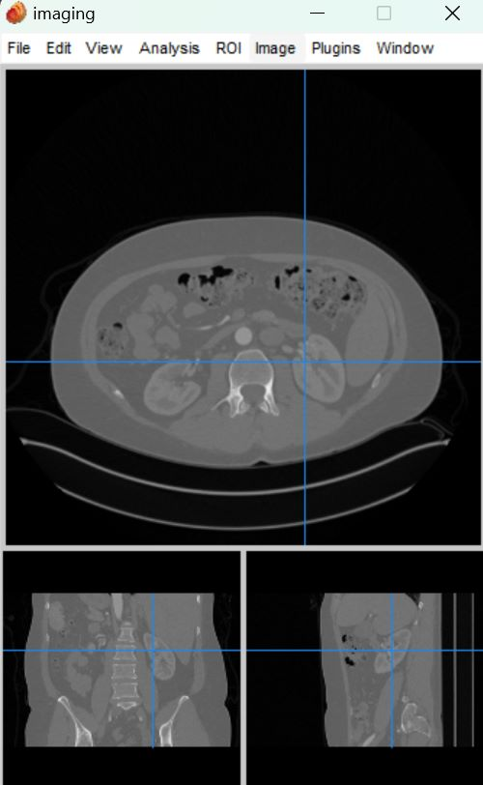
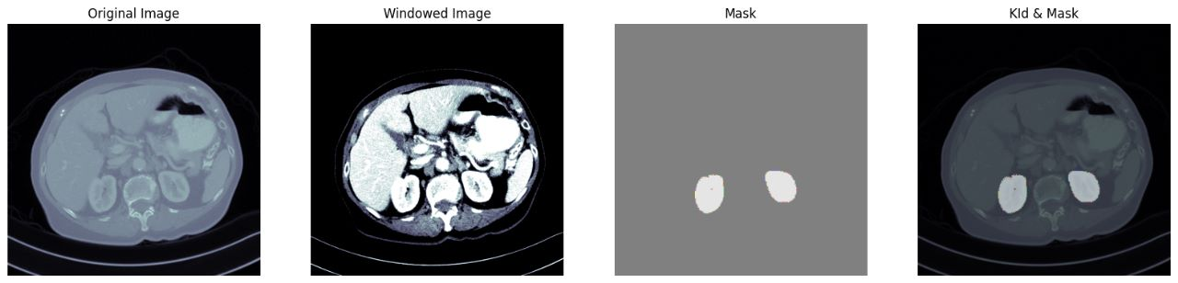
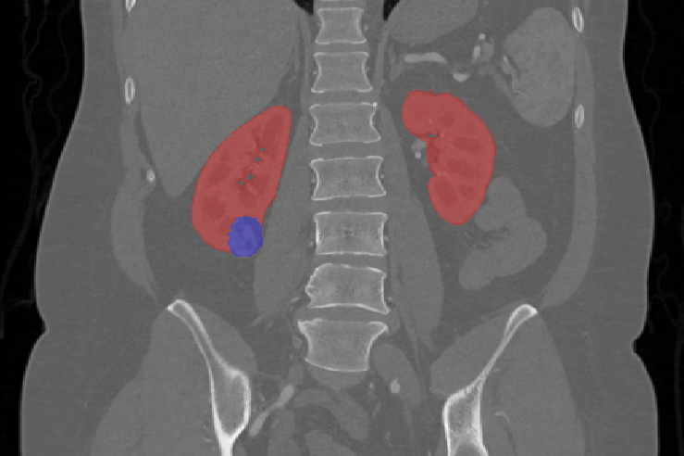

Slide 18
Data Pre-Processing
We used MonAI library in python to compose a pipeline of transforms in the data loader. We used the following transformations on the train and validation sets
LoadImaged: Loads images from file. It expects the file paths to be provided as a dictionary with keys "image" and "label".
EnsureChannelFirstd: Transposes the axes of the input data to ensure that the channel axis is the first axis.
Spacingd: Resamples the input images to have a new voxel spacing. It takes the pixel dimension, mode of interpolation, and the keys of the input data to resample.
Orientationd: Reorients the input images to a standard orientation using the RAS (right, anterior, superior) convention.
ScaleIntensityRanged: Rescales the pixel values of the input images to a new range. This transform takes the minimum and maximum values of the input data and rescales them to a new range.

Slide 19
Data Pre-Processing
CropForegroundd: Crops the input images to remove any empty space around the edges.
SpatialPadd: Pads the input images to a fixed size.
RandCropByPosNegLabeld: Randomly crops the input images based on the presence of positive and negative labels. It takes the spatial size of the cropped images, the number of positive and negative samples, and a threshold to determine whether a label is positive or negative.
Rand3DElasticd: Applies a random elastic deformation to the input images. It takes the keys of the input data, the mode of interpolation, the probability of applying the transform, and the parameters of the elastic deformation.
RandShiftIntensityd: Applies a random shift to the intensity values of the input images.
RandGaussianNoised: Adds Gaussian noise to the input images.
CastToTyped: Casts the label data to an unsigned integer type.
EnsureTyped: Casts the input data to the expected data type.

Slide 20
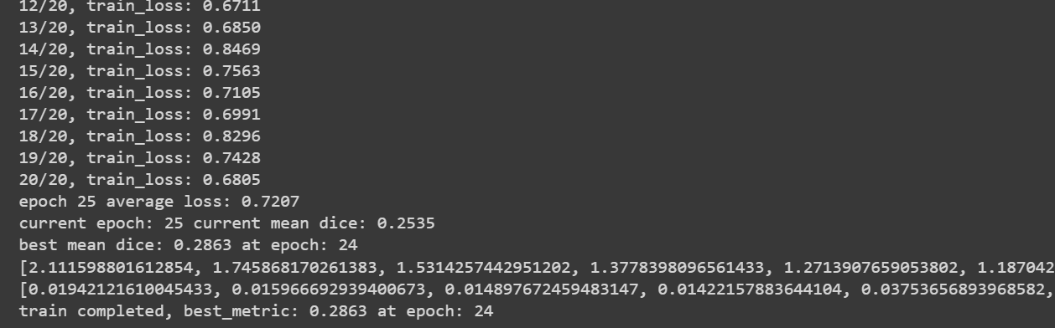
Training and Testing
We Split our data loaders into train and validation in the ratio of 0.8:0.2 then
We trained our model for 25 epochs with only 0.1% cache due to time and gpu constraints.
Each epoch takes ~10 minutes and the whole model completes 25 epochs in ~4 hours.

Slide 21
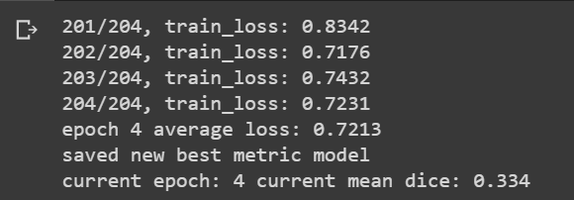
Training and Testing
The results for 1 epoch over the full dataset:

Slide 22
Learnings from the Project
During the project of 3D segmentation of kidney tumors and cysts, we have learned several important concepts and techniques related to medical image analysis and segmentation.
We learnt the segmentation of 3D images. Compared to 2D segmentation, which processes images slice by slice, 3D segmentation takes into account the full volume of the image and can provide more accurate and comprehensive results.
Preprocessing techniques are often required to enhance the quality of medical images and improve segmentation accuracy.
Evaluation metrics are essential to quantify the accuracy and performance of segmentation algorithms.
The use of machine learning techniques, such as deep learning, is becoming increasingly popular in medical image segmentation and can improve segmentation accuracy and efficiency.
Overall, the project of kidney tumor and cysts 3D segmentation highlights the potential of deep learning models in improving medical image analysis and facilitating early diagnosis and treatment of pathologies.

Slide 23
Individual Contributions
Alankrit Kadian - Execution and training of SCU-Net
Prashant Singh - Comparison of SCU-Net with 3-D Net
Sahil Mangla - Data Preparation and preprocessing with comparisons with 2D-Net

