Slide 1
GLOBAL MOBILIZATION · STRATEGY & IMPACT
Climate Activism: Mobilizing for a Living Planet
Voices, frontline tactics, and the systemic pressure reshaping global governance.
EXECUTIVE BRIEFING · CLIMATE ACTION ANALYSIS
GLOBAL CLIMATE STRIKE ASSEMBLY · WORLDWIDE COALITION

Slide 2
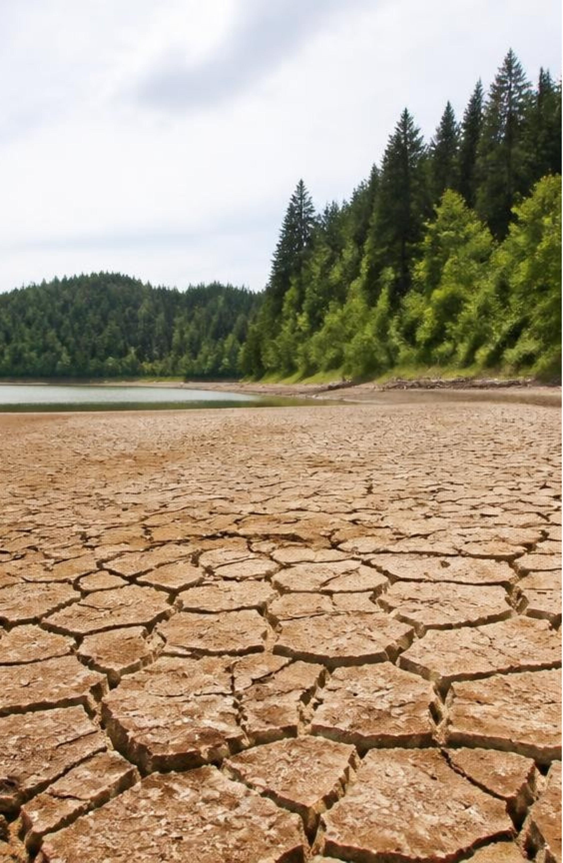
PLANETARY BASELINE · THE COST OF INACTION
Why We Mobilize: The Planetary Reality
1
1.5°C threshold: a critical boundary for cascading climate risk.
2
Record extremes: weather volatility is accelerating across continents.
3
Unequal burden: frontline communities absorb a disproportionate share of damages.
FRONTLINE MONITORING STATION · ECOLOGICAL SURVEY

Slide 3

HISTORICAL TRANSITION FROM NEGOTIATION TO DISRUPTIVE ACTION
STRATEGIC EVOLUTION · FIFTY YEARS OF MOBILIZATION
From Conservation to Direct Action
1970s–1990s
2018–Present
Conservation Era: institutional awareness, international treaties, and wildlife protection reserves.
Mass Disruption: youth-led school strikes, coordinated civil disobedience, and nonviolent disruption.
2000s–2018
NGO & Divestment: grassroots campus fossil fuel divestment, carbon footprinting, and global NGO lobbying.

Slide 4
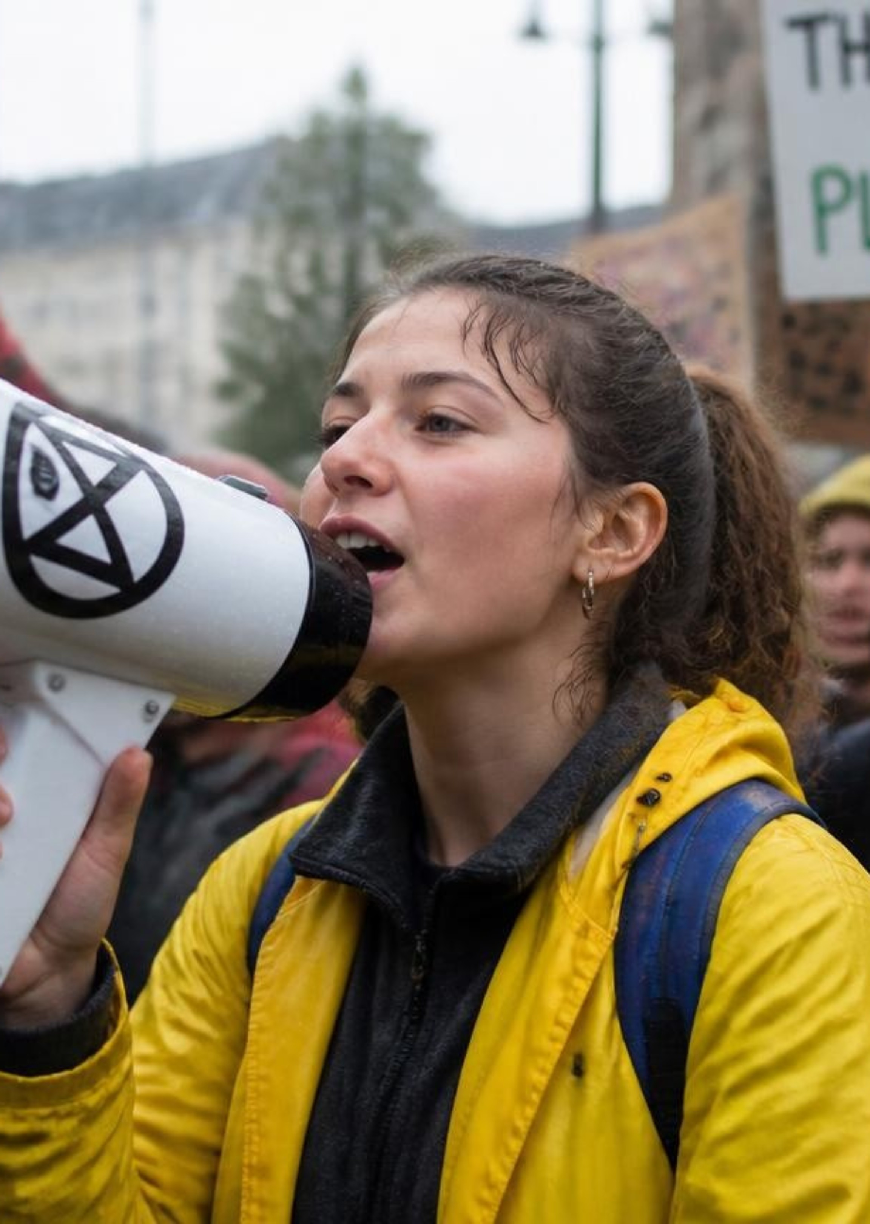
The Youth Vanguard
1
Fridays for Future: millions mobilizing across more than 150 nations
2
Sunrise Movement: bringing the Green New Deal into mainstream politics
3
Indigenous youth: leading land-defense and water-protection frontlines

Slide 5
A Multi-Pronged Toolkit
1
Policy advocacy
2
Legal action
Lobbying, citizen assemblies, ballot measures.
Suing governments and fossil fuel corporations.
3
Strategic divestment
4
Nonviolent civil disobedience
Pulling capital from fossil assets.
Disruption that compels attention.

Slide 6
80%
Guardians of Global Biodiversity
Indigenous sovereignty is a powerful conservation tool
Rights of Nature legal frameworks are gaining traction
Land defense confronts deforestation, pipelines, and extractive mining

Slide 7

GLOBAL DIVESTMENT DATABASE · FINANCIAL DISCLOSURE PROJECT
FINANCIAL LEVERAGE · BOARDROOMS & CAPITAL MARKETS
Shifting Capital: Divestment & Shareholder Activism
1,600+
Proxy Battles
Stop-Funding
Institutions divested: sovereign funds, endowments, and pensions stripping fossil assets.
Boardroom votes: activist slates securing board seats and mandating scope-3 transition plans.
Bank campaigns: targeting debt underwriting and cutting off project finance lines.

Slide 8
CIVIC SPACE EROSION · LEGAL PERSECUTION
The Cost of Confrontation: Protecting Frontline Defense
As ecological breakdown accelerates, state statutes and corporate litigation are engineered to criminalize civil society.
CRITICAL THREAT 01
CRITICAL THREAT 02
COUNTER-STRATEGY 03
Anti-Protest Statutes
SLAPP Intimidation
Legal Defense Funds
Critical infrastructure laws elevate nonviolent trespassing near pipelines and rail yards to felony sabotage, imposing decade-long prison penalties.
Extractive conglomerates deploy Strategic Lawsuits Against Public Participation to freeze movement capital, seize communications, and bankrupt grassroots NGOs.
Philanthropy must treat rapid-response bail funds, countersuits, and pro-bono defense networks as foundational movement infrastructure, not afterthoughts.

Slide 9

JUDICIAL PRECEDENTS · STRATEGIC LEGAL ACTION
Taking Governments and Polluters to Court
Case / Forum | Jurisdiction | Core Legal Precedent & Outcome
Held v. Montana | State Supreme Court | Enforced youth constitutional rights to a clean, healthful environment; invalidated fossil fuel exemption statutes.
Urgenda v. Netherlands | Dutch Supreme Court | Established legally binding national emission reduction mandates under European human rights law.
Corporate Liability | Global Courts | Demands civil damages and financial accountability for historical carbon emissions and deceptive lobbying.
SABIN CENTER FOR CLIMATE CHANGE LAW · COMPARATIVE LITIGATION REVIEW
HELENA COURTHOUSE · CLIMATE DOCKET

Slide 10
STRATEGIC DIALECTIC · DEBATE WITHIN THE MOVEMENT
Friction Points Within Modern Activism
The movement navigates continuous internal tension between tactical urgency and strategic coalition building.
TENSION 01 · TACTICAL SPEED
TENSION 02 · LOCUS OF CHANGE
Disruptive Direct Action
Individual Lifestyle Change
High-profile disruptions force immediate news cycles and crisis visibility, but risk alienating broader mainstream public coalitions.
Consumer choices, plant-based diets, and travel reduction cultivate personal moral buy-in, yet leave foundational infrastructure intact.
COUNTER-PERSPECTIVE
COUNTER-PERSPECTIVE
Mass Coalition Building
Structural Policy Reform
Focuses on patient, broad-based labor and municipal alliances to secure durable voting majorities.
Concentrates pressure on regulatory mandates, grid modernization, and dismantling fossil fuel subsidies.

Slide 11
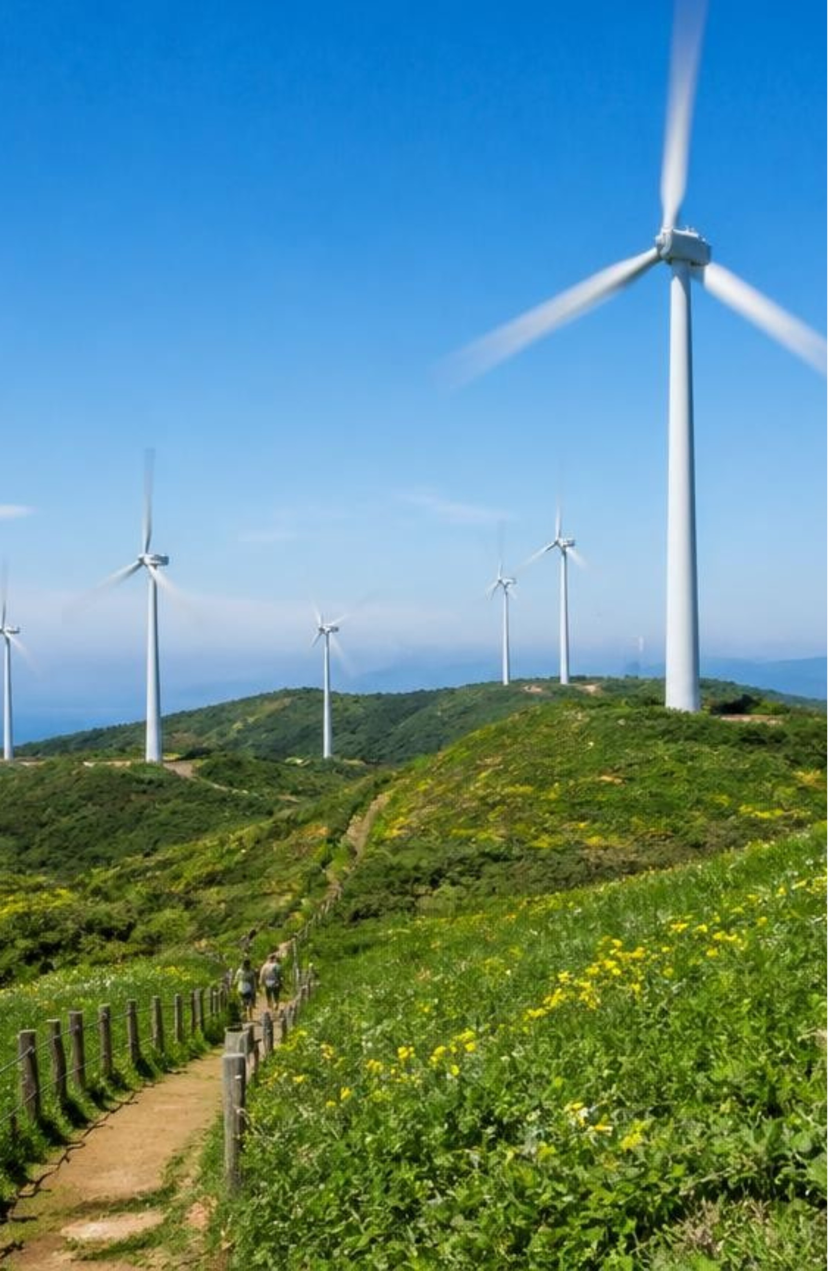
MEASURABLE OUTCOMES · THE ACTIVISM DIVIDEND
Real Impact: What Activism Has Achieved
1
Fossil infrastructure projects halted or cancelled
2
Net-zero commitments codified across major economies
3
Climate elevated to a top-tier voter priority

Slide 12

STRATEGIC COALITIONS · SOLIDARITY ECONOMICS
Bridges Across the Divide: Labor & Climate
Connecting organized worker power directly to the physical velocity of the energy transition.
BlueGreen Alliances
Align industrial trade unions with grassroots climate advocates to unlock legislative leverage.
Guaranteed Wage & Benefit Parity
Protect legacy fossil-fuel workers with guaranteed wage floors, portable pensions, and retraining covenants.
Unionized Clean Energy Supply Chains
Enforce project labor agreements across renewable manufacturing to make decarbonization politically irreversible.

Slide 13
AGROECOLOGY · BIODIVERSITY RESISTANCE
Defending Soil, Seed, and Forest
Ecological defense integrates food sovereignty, biological heritage, and carbon stewardship.
01
02
03
Resist Enclosure
Seed Sovereignty
Canopy Agroforestry
Halt industrial monoculture land-grabs and synthetic fertilizer runoff through collective communal land tenure and legal boundary defense.
Establish indigenous-governed seed banks to preserve heritage varietals resistant to severe drought without patented chemical dependency.
Scale perennial polycultures that sequester durable soil organic carbon while sustaining local economic yields and wildlife corridors.

Slide 14
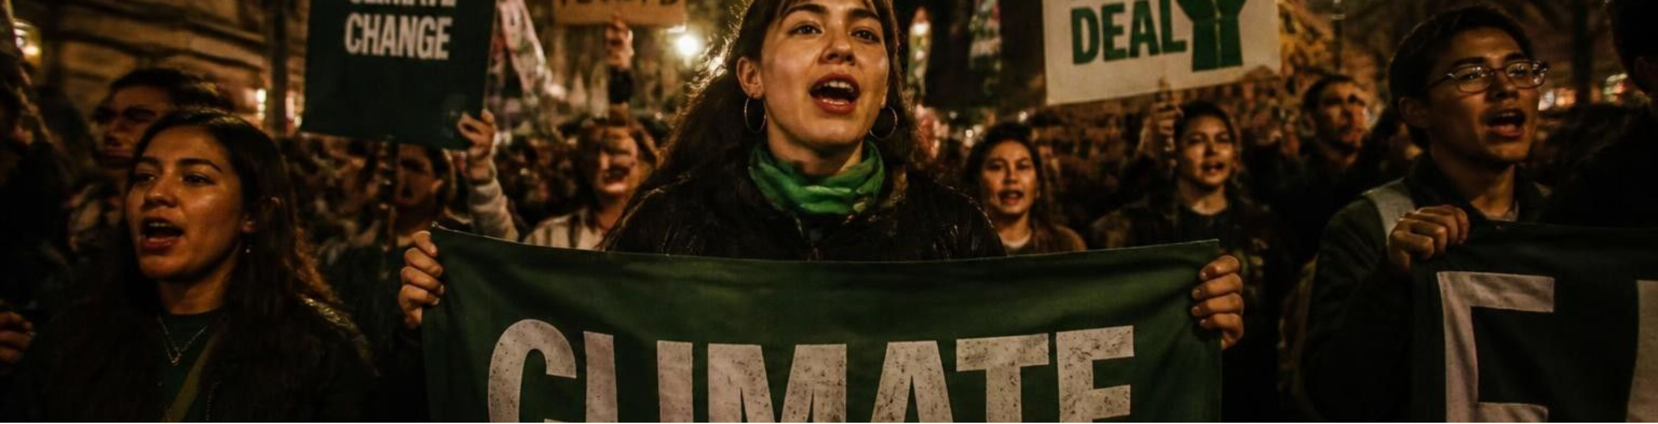
NARRATIVE HEGEMONY · CULTURAL MOBILIZATION
Winning the Battle for Attention
Defeating PR Hegemony
Targeted Accountability
Digital Virality to Power
Challenge multi-billion-dollar greenwashing campaigns and sports sponsorships by demanding total tobacco-style advertising bans on fossil fuels.
Replace disempowering doomer narratives with visible, named corporate perpetrators, linking executive bonuses to ecological degradation.
Harness youth-led meme culture and decentralized digital streaming to convert passive viral impressions into sustained offline blockades.

Slide 15
CLIMATE JUSTICE · MULTILATERAL REDISTRIBUTION
Frontline Sovereignty: The Global South
Nations that contributed least to historic emissions require binding financial justice, not exploitative emergency loans.
Mechanism | Current Hurdle | Frontline Sovereignty Imperative
Loss & Damage Fund | Voluntary pledges, World Bank fees, and bureaucratic delays | Establish mandatory annual capital injections governed directly by affected Global South communities.
Debt-for-Climate Swaps | High transaction costs and conditional structural adjustments | Comprehensive debt cancellation tied to sovereign adaptation budgets to restore domestic fiscal headroom.
Reparations Architecture | Framed as charitable foreign aid rather than legal liability | Codify historic carbon debt obligations as non-repayable grant transfers led by Indigenous and island states.

Slide 16
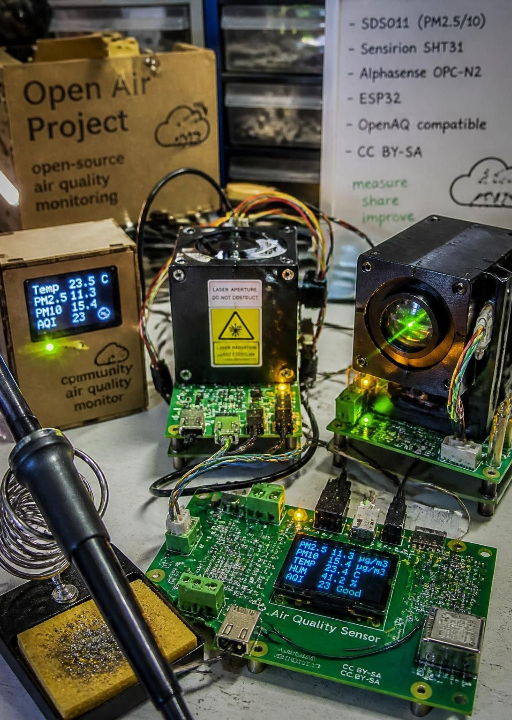
CIVIC INTELLIGENCE · DECENTRALIZED VERIFICATION
High-Tech Accountability
Grassroots coalitions deploy advanced technological infrastructure to pierce industrial opacity.
Satellite Methane Tracking
Independent microsatellite constellations expose unreported super-emitter leaks in real time, bypassing state and corporate monitoring blackouts.
Citizen Sensor Mesh
Low-cost particulate monitors in fence-line neighborhoods aggregate ground-truth pollution logs, delivering legally admissible evidence to regional courts.
Encrypted Coordination
Zero-knowledge identity protocols and decentralized communication stacks protect movement organizers against unlawful digital surveillance.

Slide 17
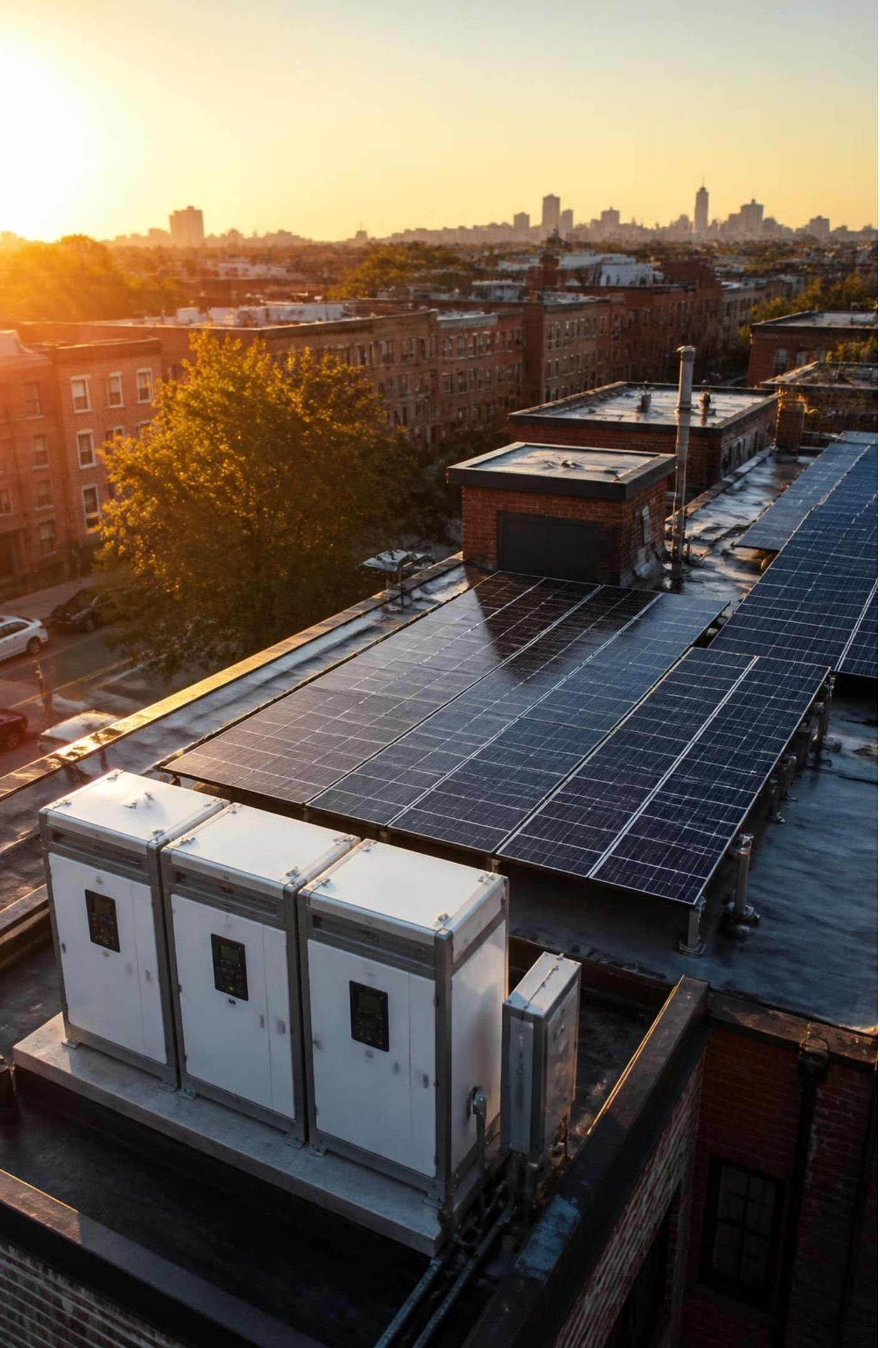
CIVIC INFRASTRUCTURE · COMMUNITY ADAPTATION
Resilience from the Ground Up
While macro-policy stalls, local communities are engineering immediate survival systems.
Solar Microgrids
Community-owned rooftop solar paired with battery storage powers life-critical clinics and cooling hubs during centralized grid collapses.
Rapid Mutual Aid
Decentralized neighborhood networks distribute potable water, food, and emergency medical kits days before bureaucratic disaster agencies mobilize.
Urban Thermal Refugia
Community shade canopies, reflective roof coatings, and pocket wetlands reduce local heat-island exposure by up to 6°C across redlined districts.

Slide 18
MARKET INTEGRITY · CORPORATE DISCLOSURE
Dismantling Corporate Illusion
Targeting accounting loopholes, fraudulent offsets, and unscientific net-zero PR strategies.
AUDIT 01
AUDIT 02
AUDIT 03
Phantom Offsets
2030 Interim Roadmaps
Regulatory Sanctions
Voluntary carbon registries routinely credit non-additional forests. Activist investigations push exchanges to delist junk credits and enforce real abatement.
Reject aspirational 2050 targets detached from immediate capex budgets. Mandatory 2030 milestones expose whether corporations are investing or stalling.
Compel securities commissions and consumer protection bureaus to treat misleading climate advertising as securities fraud and unlawful market distortion.

Slide 19


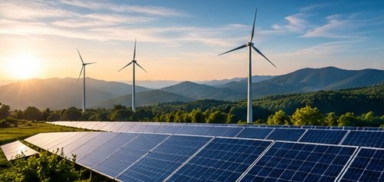



STRATEGIC HORIZON · CRITICAL PATHWAYS
The Critical Decade Ahead
2026
2028
2030
Litigation triggers and civic-defense capacity.
Subsidy repeal and coalition pressure.
Grid decarbonization thresholds and accountability.

Slide 20
SYSTEMIC ALIGNMENT · THE CHARTER FOR ACTION
Aligning Strategy, Capital, and People
The transition demands total convergence across frontline resistance, institutional capital, and political power.
PILLAR 01
PILLAR 02
PILLAR 03
Defund Extraction
Codify Human Rights
Scale Distributed Power
Sever private bank underwriting, eliminate state exploration subsidies, and enforce fiduciary duty standards that penalize carbon-heavy balance sheets.
Enshrine the constitutional right to a safe climate, defend frontline environmental protectors from state retaliation, and uphold Indigenous land sovereignty.
Direct philanthropic and public capital toward community-owned solar microgrids and democratic energy co-ops that build irreversible public wealth.

Slide 21
THE FUTURE IS IN OUR HANDS
Climate change is not a problem for tomorrow — it is a challenge we face today.
Every action matters. Every voice counts.
Let’s protect our planet, inspire change, and build a sustainable future together.
🌱 Act. Speak. Inspire. Change.
Thank You

