Slide 1

GITHUB
Presented by : Prashant Soni ‘Asst. Professor, UCER‘
Notes:
Are your classroom colors different than what you see in this template? That’s OK! Click on Design -> Variants (the down arrow) -> Pick the color scheme that works for you!
Feel free to change any “You will…” and “I will…” statements to ensure they align with your classroom procedures and rules!

Slide 2
Content
After completing this session, you should be able to understand the following:
The need for GITHUB
What is GITHUB
Getting started with GITHUB
Creating Repository
Create a branch
Make a commit
Open and merge pull request
GITHUB case study.

Slide 3

01- The need for GITHUB
Developers need a web/cloud based code hosting platform
Useful for version control
Enable Effective collaboration
Download project and files in one go
Easy evaluation of each other’s work.

Slide 4


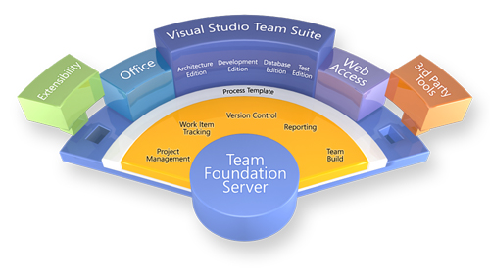

Competitor of GITHUB

Slide 5


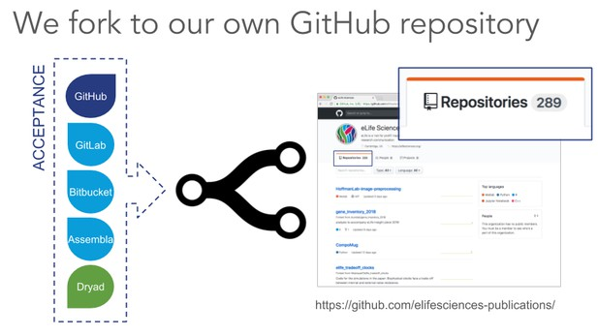


The need for GITHUB
Immensely powerful community
The largest shared repository
Easy version control
Secure cloud storage
But what makes GitHub so Popular?

Slide 6

02-what is GITHUB?
Web Based Git repository hosting Service
Easy Management Code
Open source software for Version Control
Effective collaboration
Bug tracker

Slide 7
What is git and GitHub
git
GitHub
Git is a revision Control system, a tool to manage your source code history.
Installed and maintained your local system.
Git is tool
GitHub is a hosting service for Git repositories
Exclusively cloud-based
GitHub is the Service for projects that use Git

Slide 8
03
GETTING STARTED With GitHub

Slide 9
04
CREATING A REPOSITORY

Slide 10
What is REPOSITORY
Storage space for your project
GitHub is a very popular central repository that allows you to share your files
Push your local repository into GitHub and share it with other collaborators via the central repository.

Slide 11
05
CREATING A BRANCH

Slide 12
What Branches Are?
Branches allow you to work on copied file.
They can be included with the main line of your project
The main branch – the one where all changes eventually get merged back into, and is called master.

Slide 13
06
MAKE A COMMIT

Slide 14
What are COMMIT?
Record changes to one or more files in your branch
Git assign each commit a unique ID, called a hash, that identifies : The specific changes.

Slide 15
07
OPEN & MERGE PULL REQUEST

Slide 16
What are PULL REQUEST?
Notifies developers about changes you have pushed to a branch in a repository.
Acknowledge and review changes

