Slide 1
SparkFaces
Phase 1- pages, flow and design

Slide 2
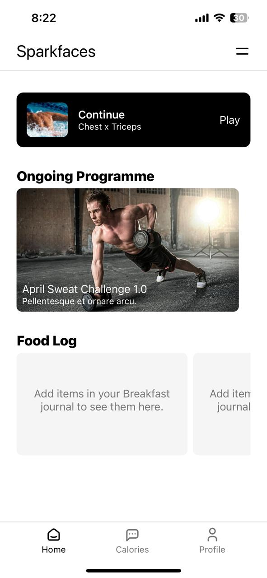
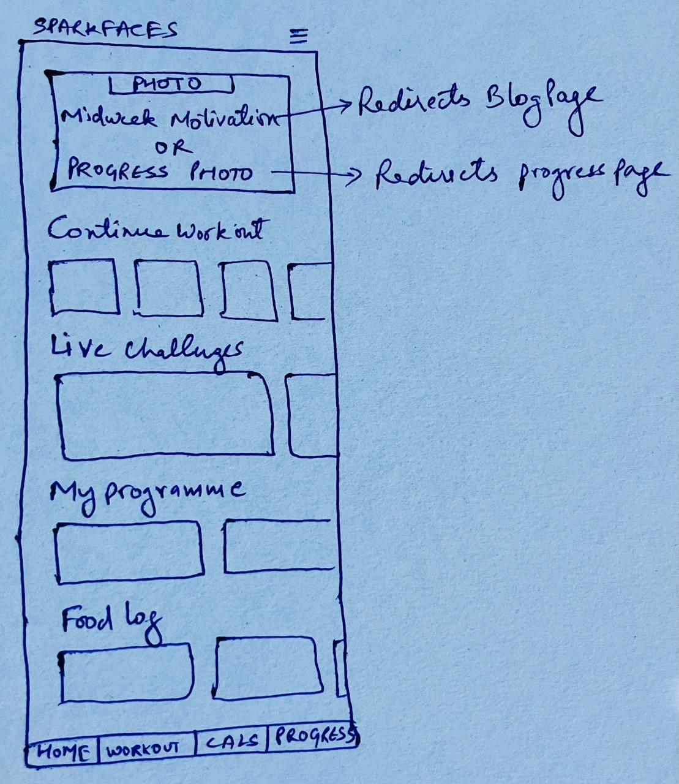
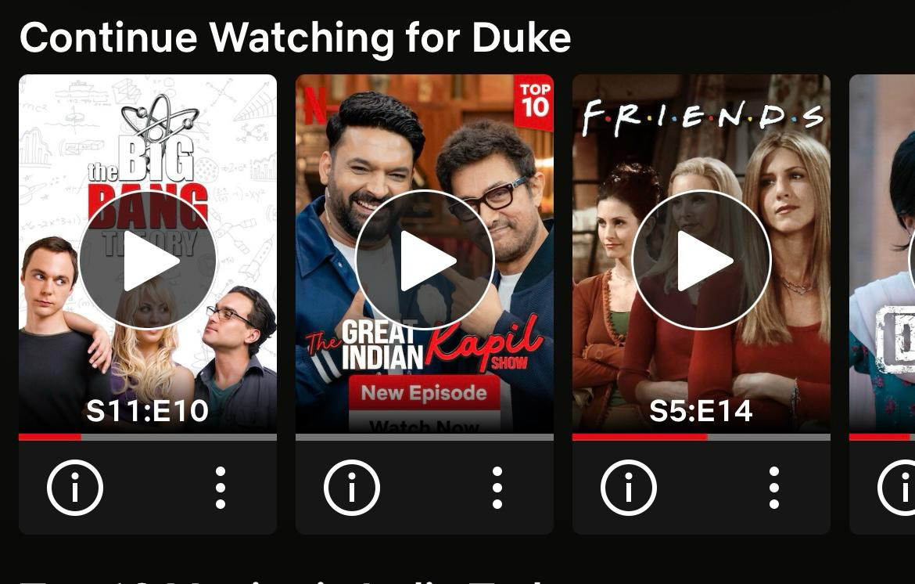
Home Page
Live Videos
(LIVE CHALLENGE PAGE)
Reference for continue workout
Recorded sessions
(MY PROGRAMME PAGE)
Live Challenges is same as My programmes.
Just instead of recorded session its live video
Current
Proposed

Slide 3
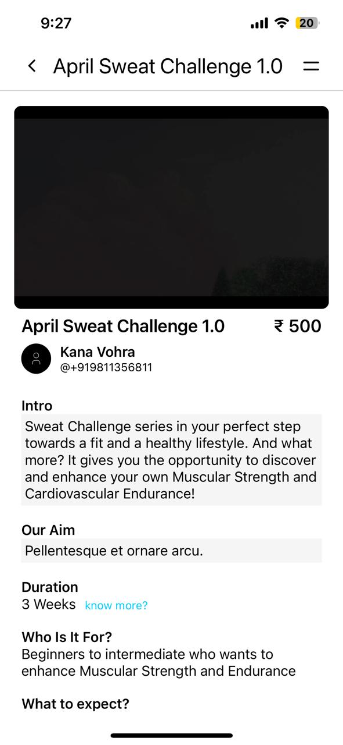
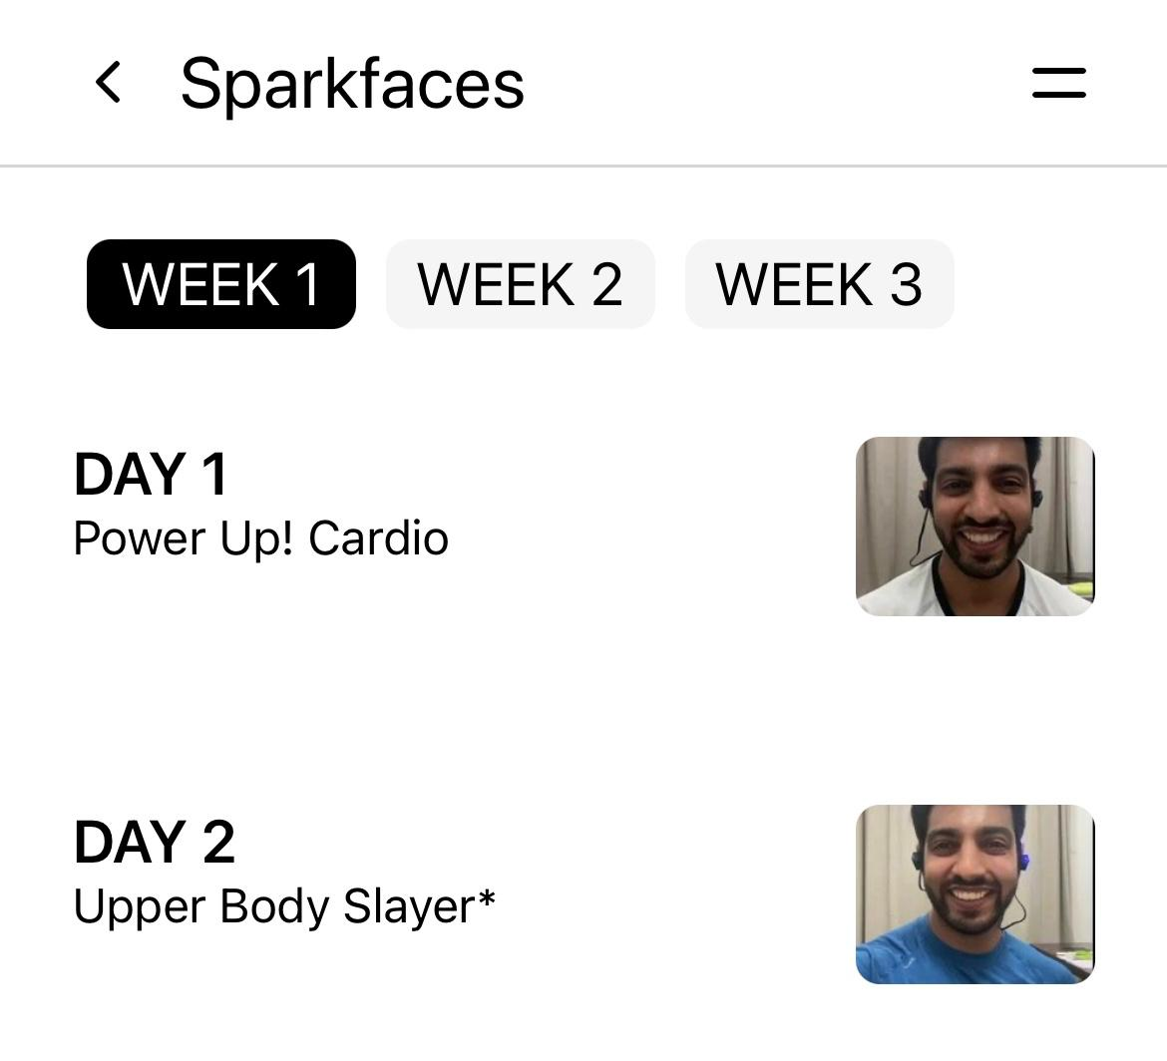
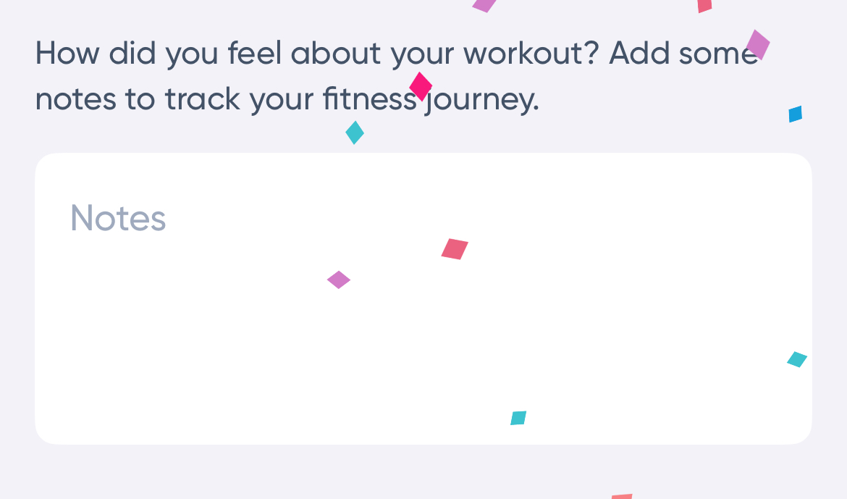
My Programme Page
Option/Button for Start, Resume & Completed.
Next day video is available once previous day video is completed
Programme Image
On Click
On Click
After video ends -> Pop Up/screen like this
Starts Video
Redirect to Video page

Slide 4
Live Challenge Page
(Design is same as My Programme Page)
Live video preview
After Live video ends -> Pop Up like this with thumbs up/down button
Redirect to Weekly Details page
On Click Video Page

Slide 5
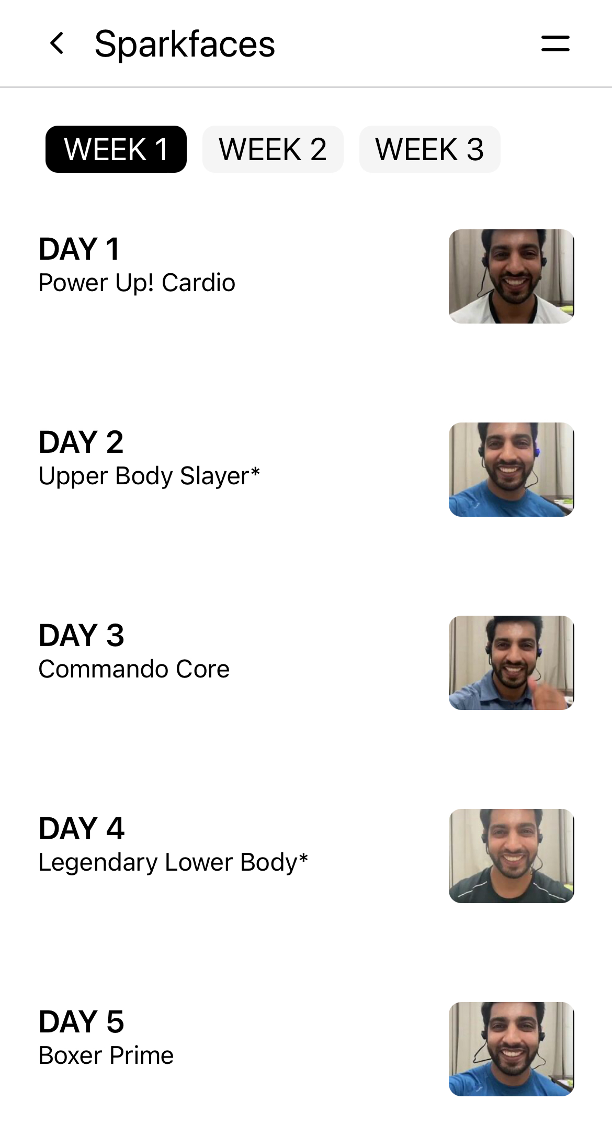
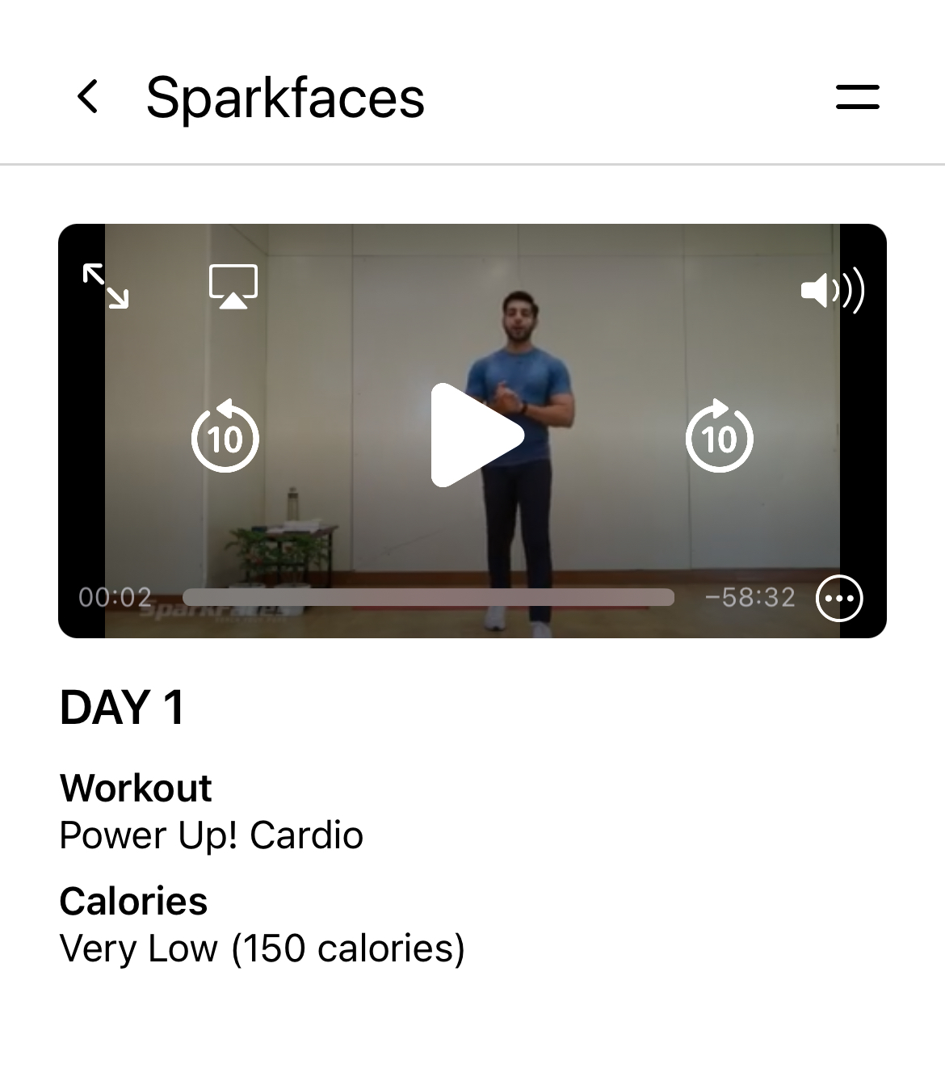
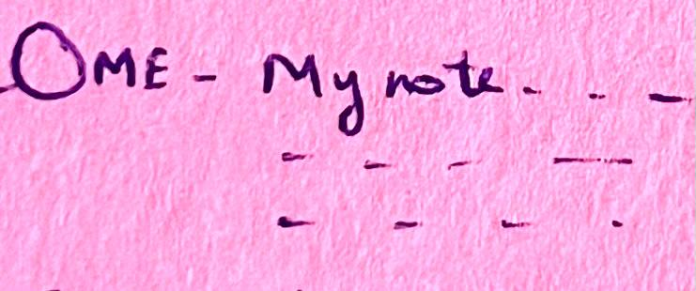
Weekly Details & Video Page
Redirect Video Page
Display total thumbs up and thumbs down with icons
My Note to be added like this with profile picture and name.
Contact Trainer for more info and add link to trainer’s whatsapp with whatsapp button
Weekly Details Page

Slide 6
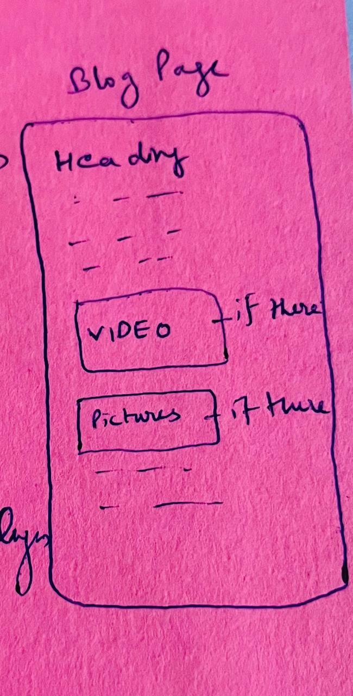
Blog Page
Basic Blog Page where videos and pictures can be added if there

Slide 7
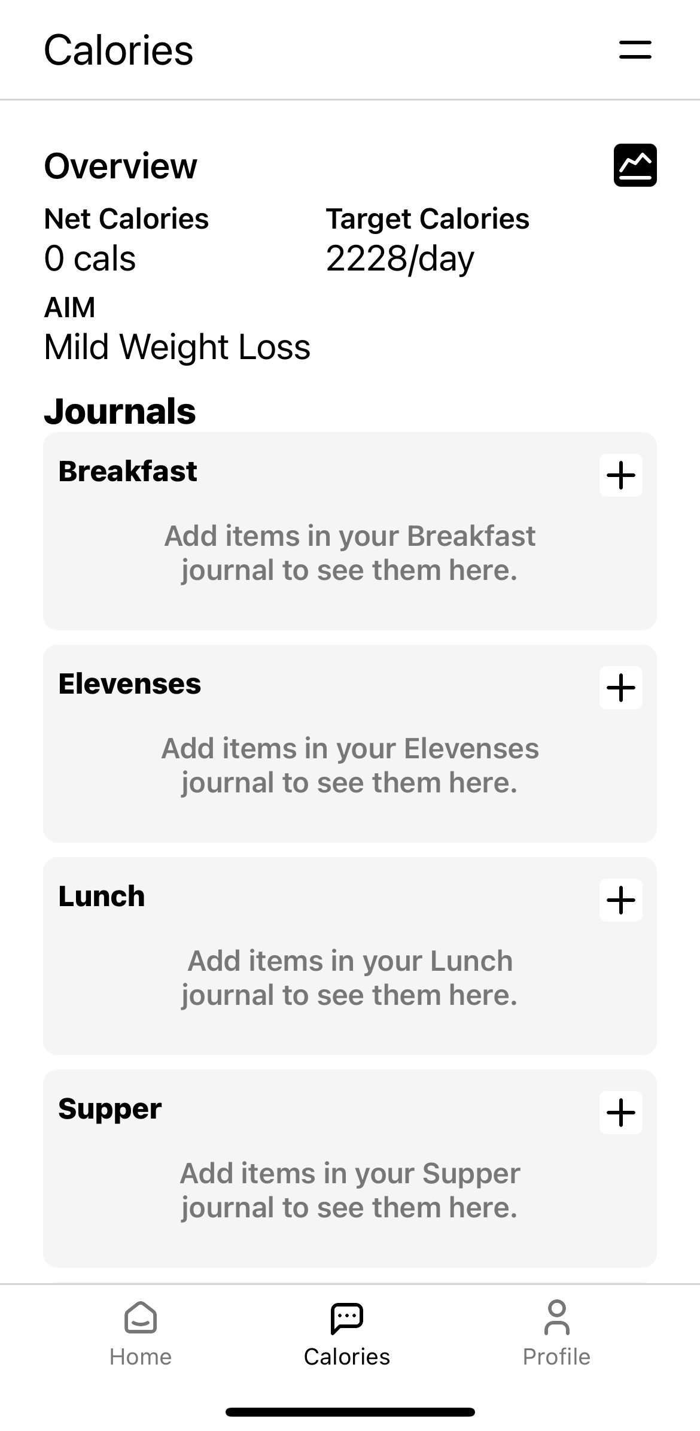
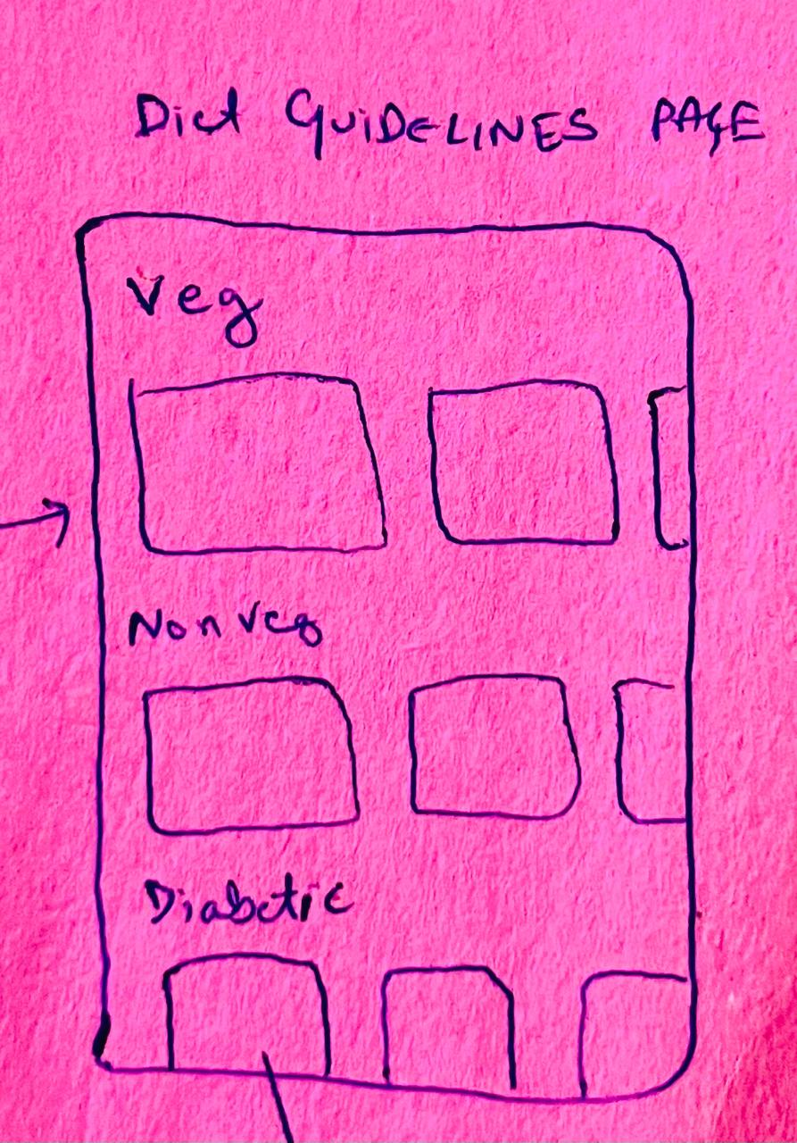
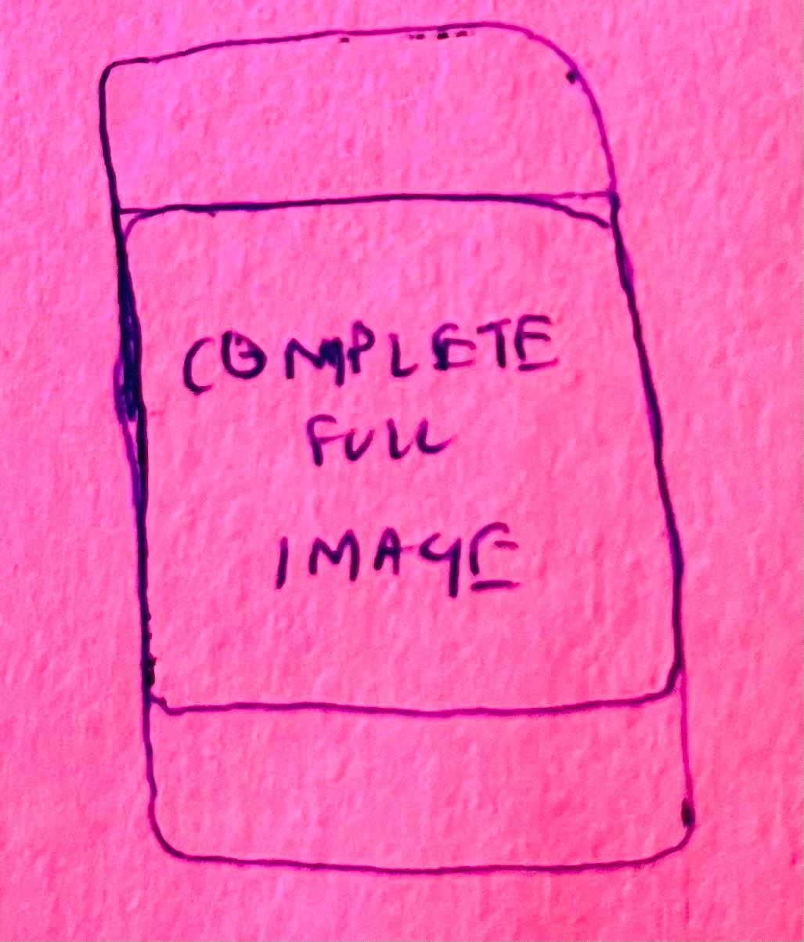
Calories and Diet Guidelines Page
Redirects to
Diet Guidelines *
Add Text
On Click Redirects to
current

