Slide 1

Prediction Of Store Sales

Slide 2
Business Perspective
Building a Model to Forecast Sales.
Distinguishing different parameters to improve sales.

Slide 3
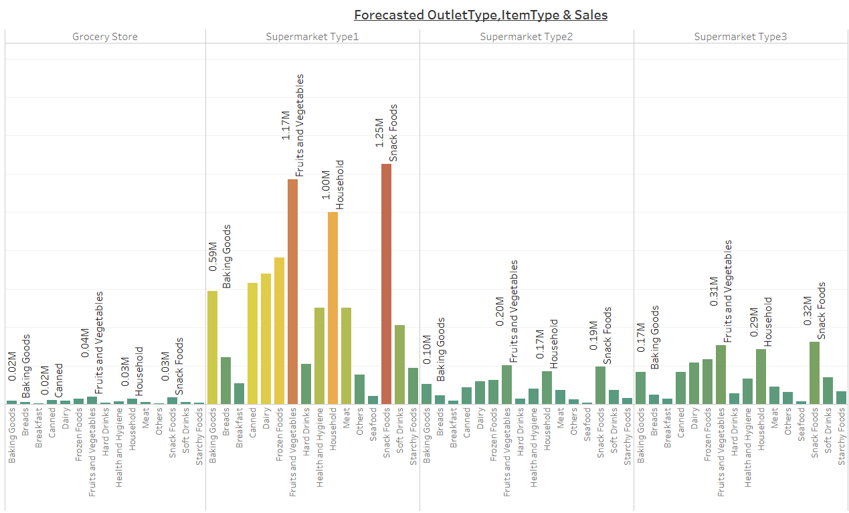
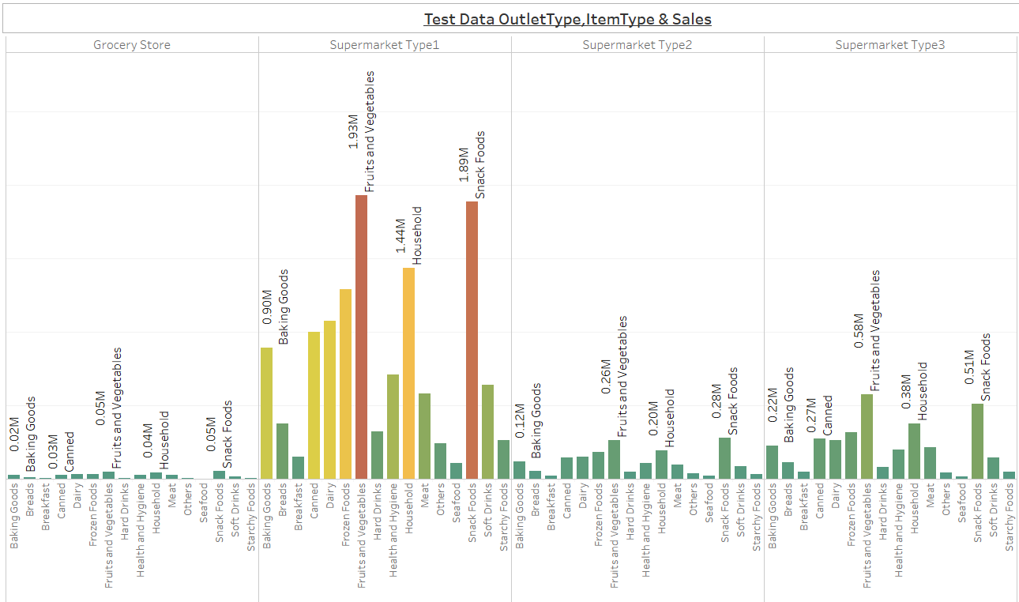
People seek experience…
Sales is high in Supermarket Type 1 and FMCG products are high in sales.
Forecasted data show the similar pattern.

Slide 4
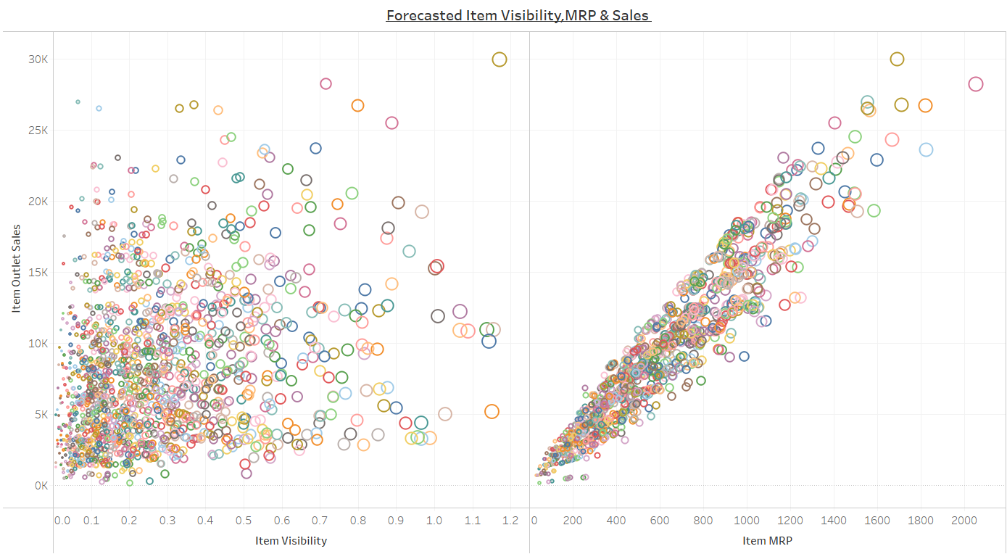
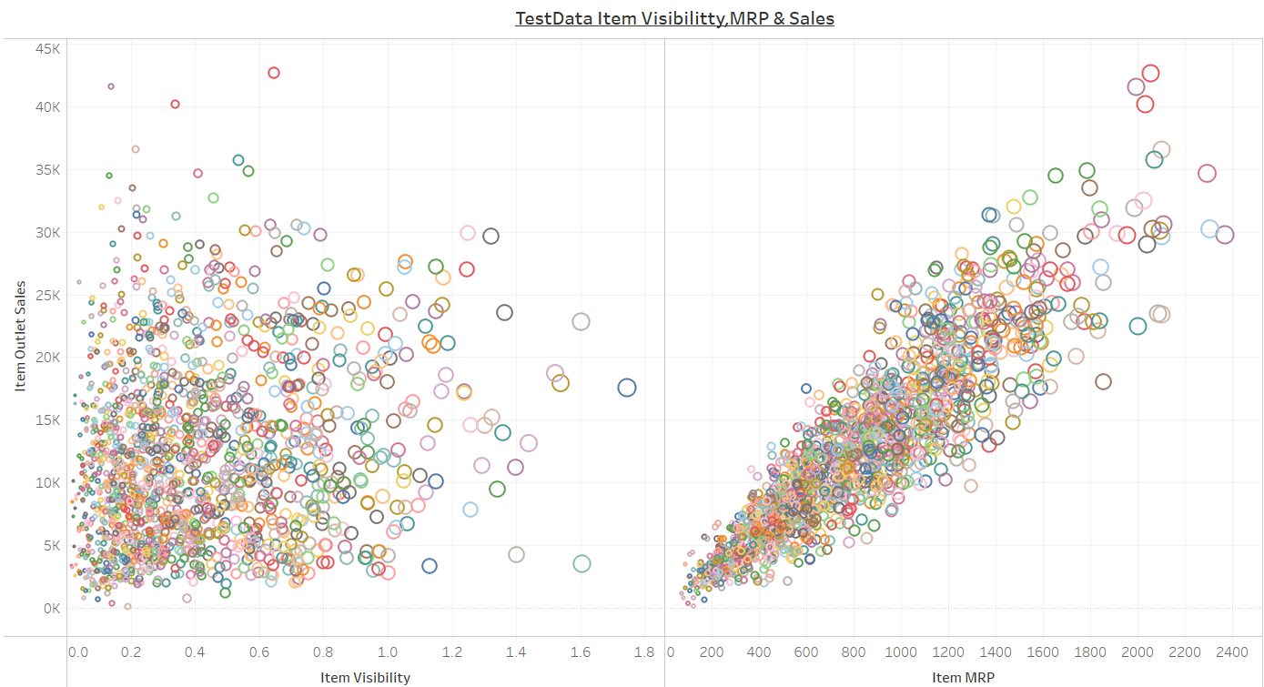
FMCG Products are the key…
Sales of Items Smaller in size and low end cost is high.

Slide 5
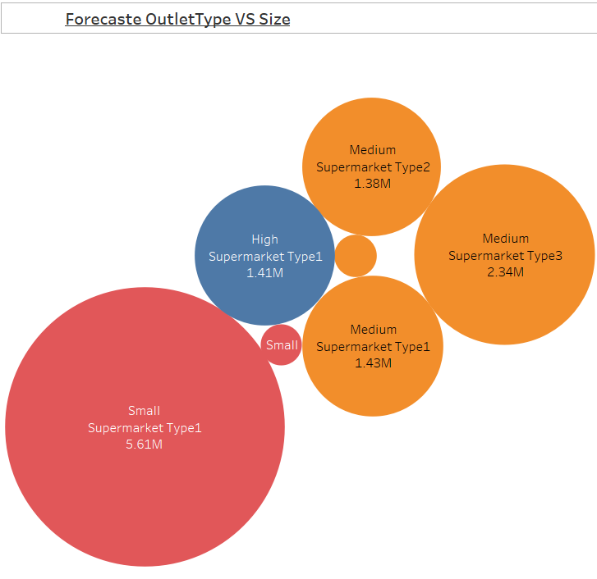
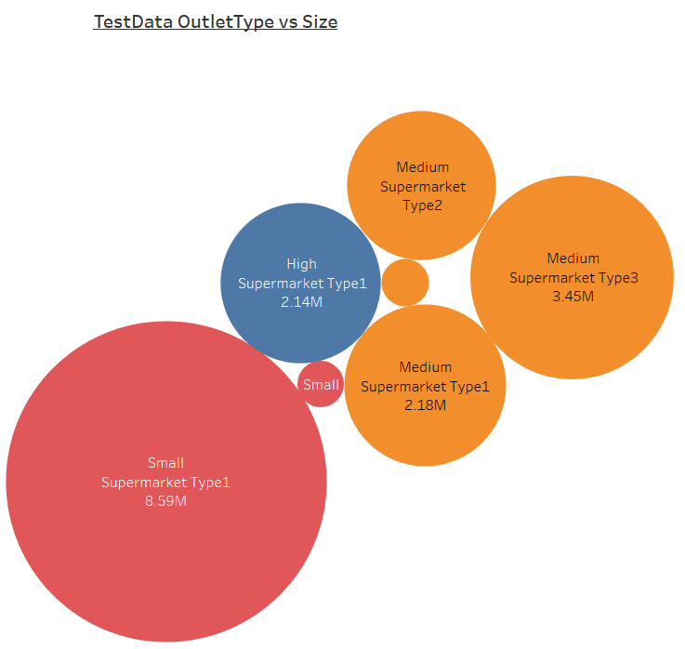
Sales is all about psychology..
Small and Medium Size Outlets have the highest sales.

Slide 6
The Story…
Buying is no more just an necessity but its has become an EXPERIENCE.
Analysis tells that Sales is high for mostly FMCG products.
These are the daily consumer goods that can easily be bought at a grocery store.
The Sales is particularly high for Supermarkets.
Customers seeks comfort like ACs, Music and Vending Machines.
Labelled shelfs give customer comfort.
The freedom to buy different item types at one place is intriguing.
People tend to only to shop but also socialize there.
No matter if they want a pack of chips, one gets explore high end things like electronics.
Psychology plays a vital role, its all about perception.
Small and medium store sizes provide balance between level of exploration and stimulating the senses.
Small and Medium Size Supermarkets let the human mind consume more in a lesser space.
Hence Concepts like BIGBAZAAR,24/7 are success.

Slide 7
Technical Details Ahead..

Slide 8
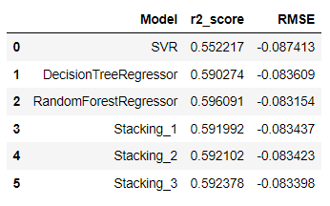
Technical Details
4 Models, 2weak learner and 2 strong learners where chosen.
SVR being capable of handling non-linear relationships as well.
Decision Tree Regressor not affected by the outliers and also able to build relationship between variables easily.
RandomForestRegressor being a powerful ensemble model having features of DTR included counters biasing.
Stacking helps combine the features of different heterogenous models.
Different set of Stacking models were tested after finding the best parameters.
RandomForestRegressor outperformed every model.

Slide 9
Thank You

