Slide 1
Linear Algebra
Module 2:

Slide 2
Basics of Linear Algebra: Vectors, Matrices, and Scalars
Vectors
Ordered arrays of numbers that represent a point in space.
Matrices
Two-dimensional arrays of numbers used for linear transformations.
Scalars
Single numbers that can scale vectors and matrices.

Slide 3
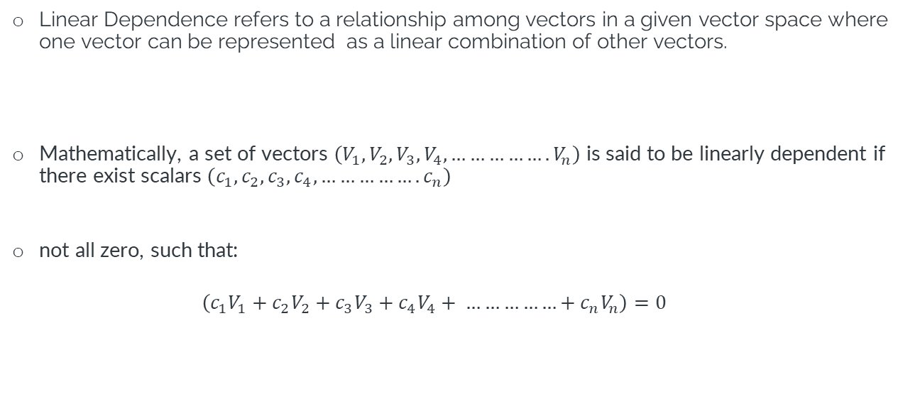
What is Linear Dependence?
Linear Dependence refers to a relationship among vectors in a given vector space where one vector can be represented as a linear combination of other vectors.
Mathematically, a set of vectors $\left(V_{1},V_{2},V_{3},V_{4}, …………….V_{n}\right)$ is said to be linearly dependent if there exist scalars $\left(c_{1},c_{2},c_{3},c_{4}, …………….c_{n}\right)$
not all zero, such that:
$$\left(c_{1}V_{1}+c_{2}V_{2}+c_{3}V_{3}+c_{4}V_{4}+ ……………+c_{n}V_{n}\right)=0$$

Slide 4

Examples to Understand Linear Dependence
Let's consider a simple example with three vectors
$$V_{1}= \left[1, 2\right], { V}_{2}= \left[2, 3\right] and V_{3}= \left[3, 5\right]$$
Here, $V_{3}$ can be represented as a linear combination of $V_{1}$ and $V_{2}$,
i.e., $V_{3}=V_{1}+V_{2}$.
This indicates that these vectors are linearly dependent.

Slide 5
Case Study: Reducing Dimensions in a Marketing Dataset
Background
Suppose an e-commerce company has collected a dataset containing various features like user age, click-through rates,
time spent on site, etc.
Problem: The dataset has high dimensionality, making it difficult to analyze and visualize.
Challenges
Computational overhead due to high dimensionality.
Risk of overfitting the model.
Solution
By identifying linearly dependent features, the dimensionality of the dataset can be reduced.
Impact
Improved model performance.
Simplified data visualization.

Slide 6
Real-world Use Cases of Linear Dependence in Data Science
Linear dependence is not just a mathematical abstraction; it has several real-world applications in data science:
Feature Selection
Identifying redundant features that can be removed to simplify the model.
Dimensionality Reduction
Reducing the number of dimensions without significant loss of information.
Eigenvalues and Eigenvectors
Used in Principal Component Analysis (PCA) for dimensionality reduction.

Slide 7
Basis and Dimension in Vector spaces
Vector Space: A set of vectors that is closed under vector addition and scalar multiplication.
Basis: A set of linearly independent vectors that span the vector space.
Dimension: The number of vectors in a basis for the vector space.

Slide 8
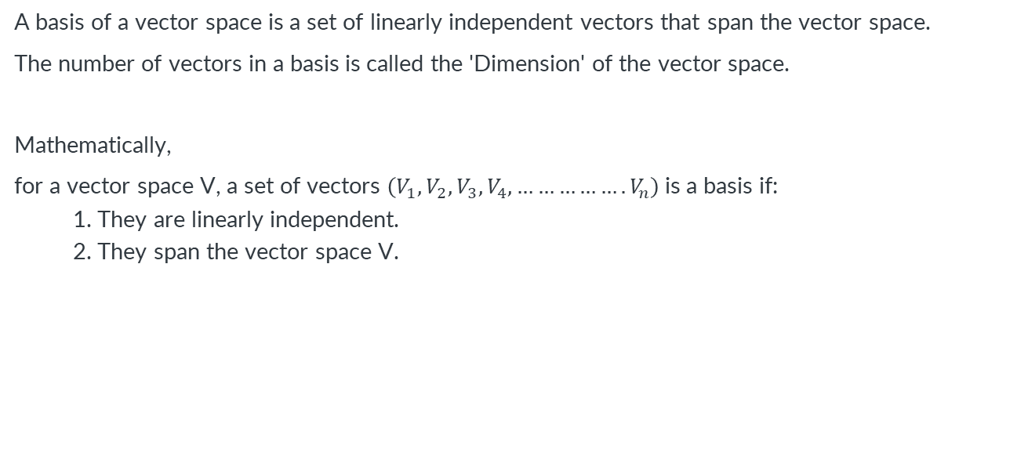
Basis and Dimension in Vector spaces
A basis of a vector space is a set of linearly independent vectors that span the vector space.
The number of vectors in a basis is called the 'Dimension' of the vector space.
Mathematically,
for a vector space V, a set of vectors $\left(V_{1},V_{2},V_{3},V_{4}, …………….V_{n}\right)$is a basis if:
1. They are linearly independent.
2. They span the vector space V.

Slide 9
Types of matrix spaces
For an m x n matrix A, the following matrix spaces are commonly discussed:
Row Space: The span of the rows of A, denoted as Row(A).
Column Space: The span of the columns of A, denoted as Col(A).
Null Space: The set of all vectors x such that Ax=0, denoted as Null(A).

Slide 10
Dimension of Matrix Spaces
Matrix spaces, also known as matrix algebras or linear spaces of matrices, are vector spaces consisting of matrices.
The dimension of a matrix space is given by the number of entries in the matrices that make up the space.
Dimension of Row Space: The maximum number of linearly independent rows in A. It is the same as the rank of the matrix A, denoted as Rank(A).
Dimension of Column Space: Also equal to the rank of the matrix A.
Dimension of Null Space: Given by n−Rank(A), where n is the number of columns in A.

Slide 11
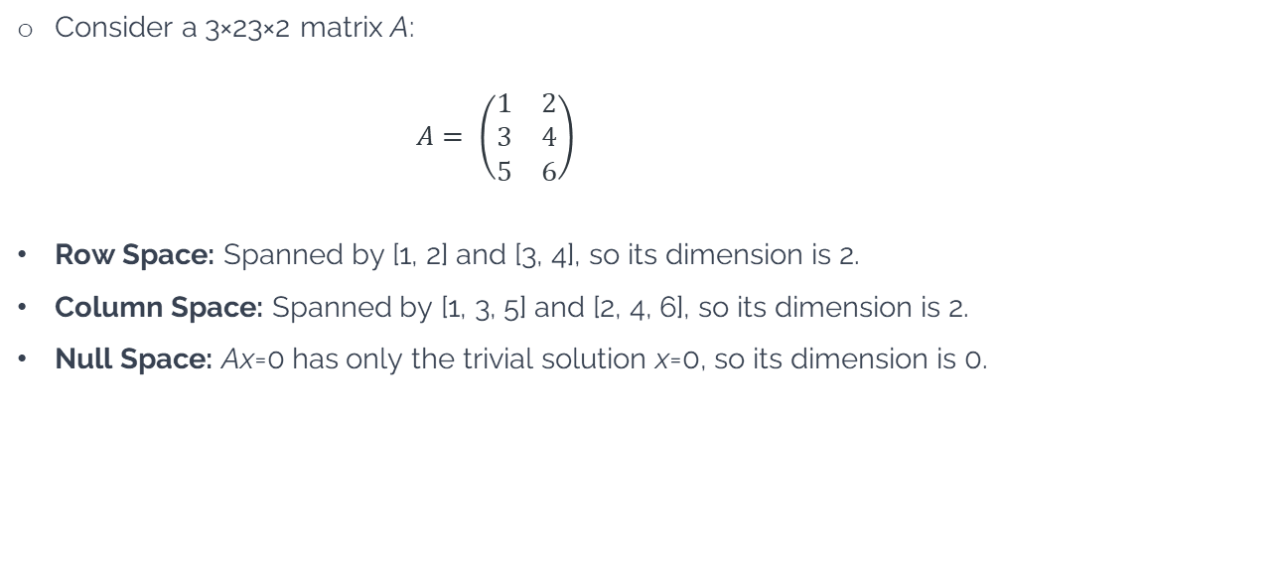
Example
Consider a 3×23×2 matrix A:
$$A= \left(\begin{matrix}1 & 2 \\ 3 & 4 \\ 5 & 6\end{matrix}\right)$$
Row Space: Spanned by [1, 2] and [3, 4], so its dimension is 2.
Column Space: Spanned by [1, 3, 5] and [2, 4, 6], so its dimension is 2.
Null Space: Ax=0 has only the trivial solution x=0, so its dimension is 0.

Slide 12
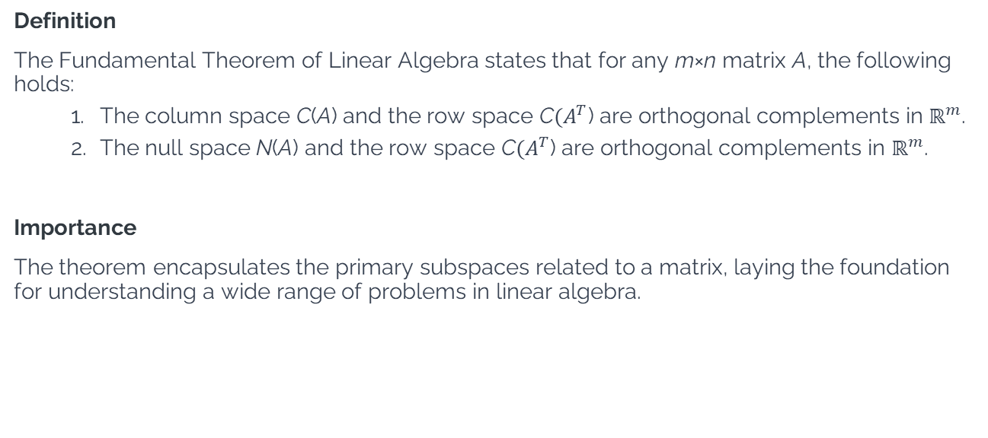
What Is the Fundamental Theorem of Linear Algebra?
Definition
The Fundamental Theorem of Linear Algebra states that for any m×n matrix A, the following holds:
The column space C(A) and the row space C$(A^{T}$) are orthogonal complements in $ℝ^{m}$.
The null space N(A) and the row space C$(A^{T}$) are orthogonal complements in $ℝ^{m}$.
Importance
The theorem encapsulates the primary subspaces related to a matrix, laying the foundation for understanding a wide range of problems in linear algebra.

Slide 13

Example: Fundamental Theorem of LA
Consider a 2x2 matrix A:
$$A= \left(\begin{matrix}1 & 2 \\ 3 & 4\end{matrix}\right)$$
We will examine how the Fundamental Theorem applies to this matrix by identifying its column space, row space, and null space.

Slide 14
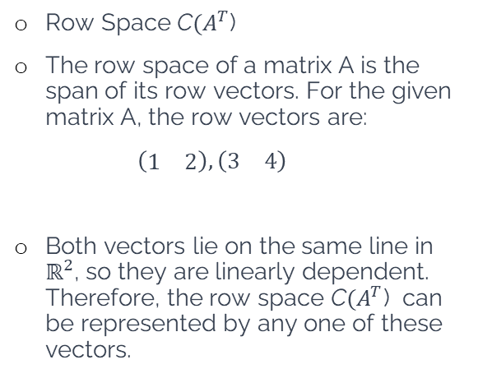
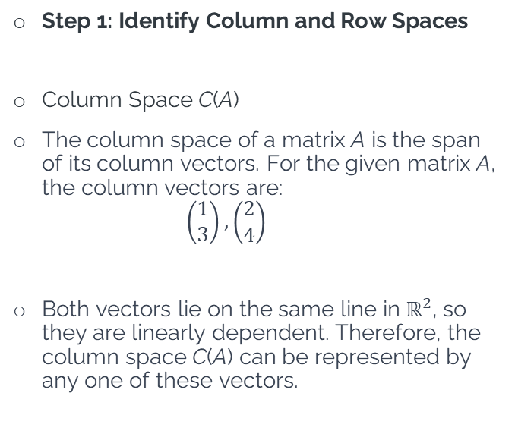
Example: Fundamental Theorem of LA
Step 1: Identify Column and Row Spaces
Column Space C(A)
The column space of a matrix A is the span of its column vectors. For the given matrix A, the column vectors are:
$$\left(\begin{matrix}1 \\ 3\end{matrix}\right),\left(\begin{matrix}2 \\ 4\end{matrix}\right)$$
Both vectors lie on the same line in $ℝ^{2}$, so they are linearly dependent. Therefore, the column space C(A) can be represented by any one of these vectors.
Row Space C$(A^{T}$)
The row space of a matrix A is the span of its row vectors. For the given matrix A, the row vectors are:
$\left(\begin{matrix}1 & 2\end{matrix}\right), \left(\begin{matrix}3 & 4\end{matrix}\right)$
Both vectors lie on the same line in $ℝ^{2}$, so they are linearly dependent. Therefore, the row space C$(A^{T}$) can be represented by any one of these vectors.

Slide 15
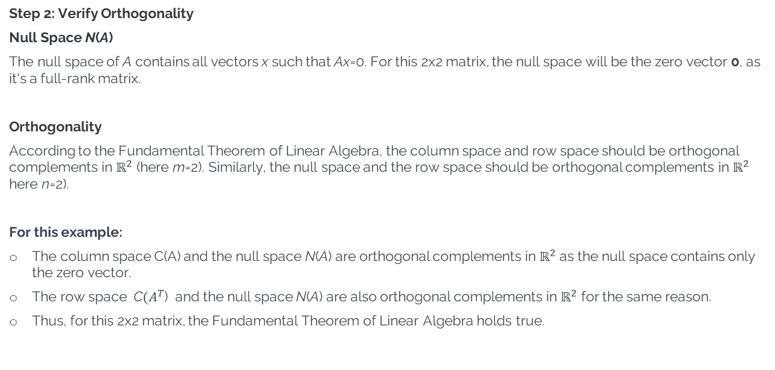
Example: Fundamental Theorem of LA
Step 2: Verify Orthogonality
Null Space N(A)
The null space of A contains all vectors x such that Ax=0. For this 2x2 matrix, the null space will be the zero vector 0, as it's a full-rank matrix.
Orthogonality
According to the Fundamental Theorem of Linear Algebra, the column space and row space should be orthogonal complements in $ℝ^{2}$ (here m=2). Similarly, the null space and the row space should be orthogonal complements in $ℝ^{2}$ here n=2).
For this example:
The column space C(A) and the null space N(A) are orthogonal complements in $ℝ^{2}$as the null space contains only the zero vector.
The row space C$(A^{T}$) and the null space N(A) are also orthogonal complements in $ℝ^{2}$ for the same reason.
Thus, for this 2x2 matrix, the Fundamental Theorem of Linear Algebra holds true.

Slide 16
Real world Case Study
Background of Problem| Suppose you are a data analyst in a healthcare company. You are given a dataset containing patient information and their medical records. The aim is to identify patterns or clusters within the data for better healthcare outcomes.
Problem: Apply dimensionality reduction techniques on the dataset to identify key variables affecting patient health.
Dataset
Columns: Patient_ID, Age, Blood Pressure, Cholesterol, Glucose Levels
Rows: Data for each patient
Solution
Import the dataset into MS Excel.
Calculate the covariance matrix of the dataset.
Apply the Fundamental Theorem to identify the significant subspaces of the covariance matrix.
Reconstruct the reduced dataset based on these subspaces.

Slide 17
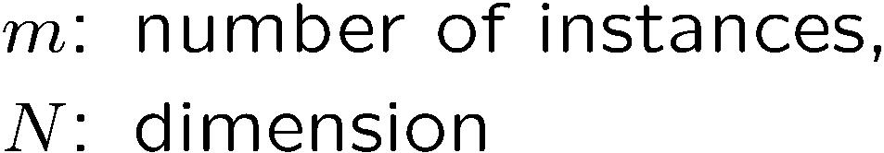
Singular Value Decomposition
Singular Value Decomposition of the centered data matrix X.
X_{features × samples} = USV^{T}
X
=
U
S
V^{T}
sig.
significant
noise
noise
significant
noise
samples

Slide 18
Singular Value Decomposition
Columns of U
the principal vectors, { u⁽¹⁾, …, u^{(k)} }
orthogonal and has unit norm – so U^{T}U = I
Can reconstruct the data using linear combinations of { u⁽¹⁾, …, u^{(k)} }
Matrix S
Diagonal
Shows importance of each eigenvector
Columns of V^{T}
The coefficients for reconstructing the samples

Slide 19
Singular Value Decomposition
Ureduce= U(:,1:k);
Z=Ureduce*X
Z is the final matrix with reduced dimension.

Slide 20
Thank You
Happy Learning!

