Slide 1
Wellness Companion
"Harnessing AI’s Power for a Healthier Mind & Brighter Tomorrow!" ✨💙

Slide 2
Feature & Tech stack
MVP1 Features :
Speech to text
Accessibility : Visually challenged users responsive
Multilingual chat support
Responsive cross platform
Plug and play bot interface with iFrame
Tech Stack
ReactJS (Front end)
Node JS (Backend )
Python (AI service code)
Cosmos DB (No SQL)
Terraform(unauthorized to creating resources )
Docker (Containerisation)
ACR (Container registry)
Kubernetes(Deployment environment with Rolling update for resiliency)
Azure pipelines (CI/CD)
Nginx Ingress (Load Balancing)
Azure ML studio : (High billing -stopped)
Azure Synapse (ETL)
Power BI (Data Visualisation)
MVP 2 Features :
Intuitive UI with Integration : in progress.
To be done:
Testing and Gate Check -
SonarQube and Test coverage
GitLeaks and Linting

Slide 3
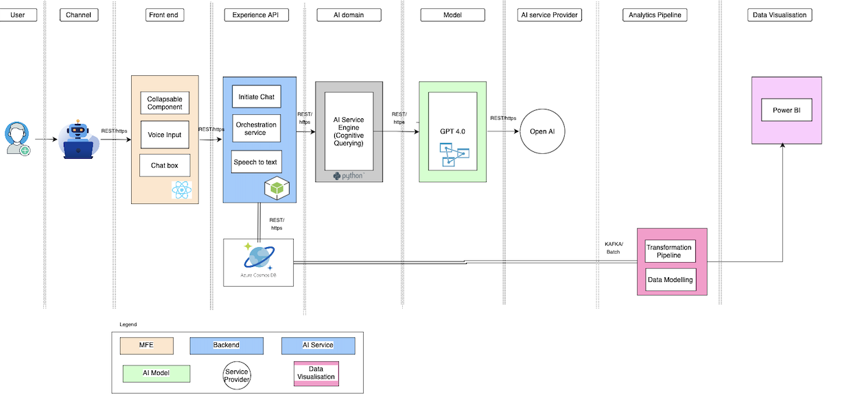
Application Architecture

Slide 4
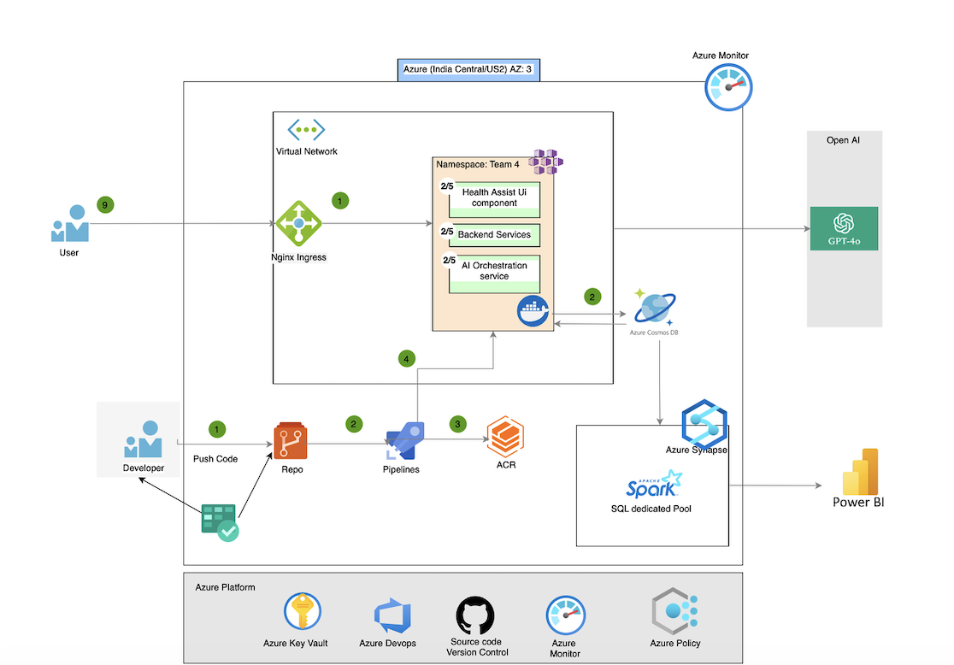
Deployment Architecture

Slide 5
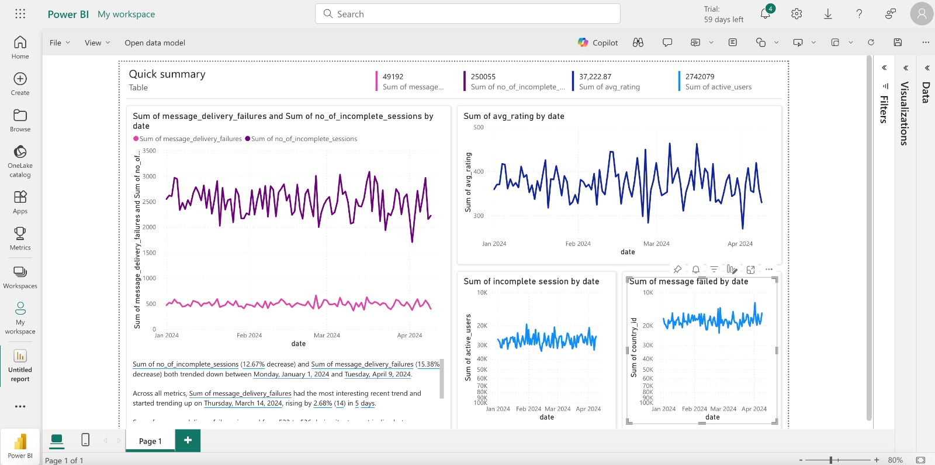
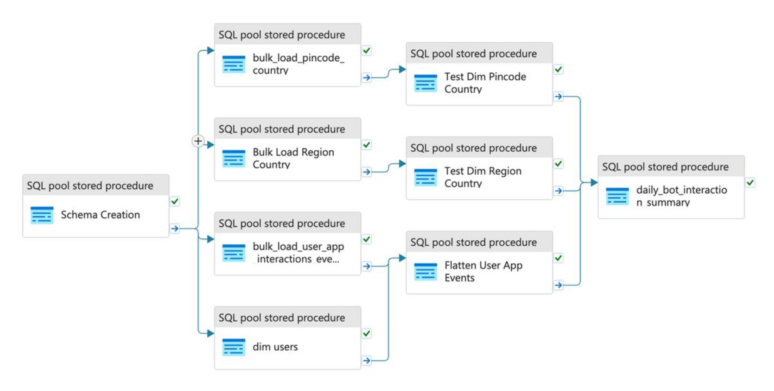
Application Insights : Power BI & SQL Pool

Slide 6
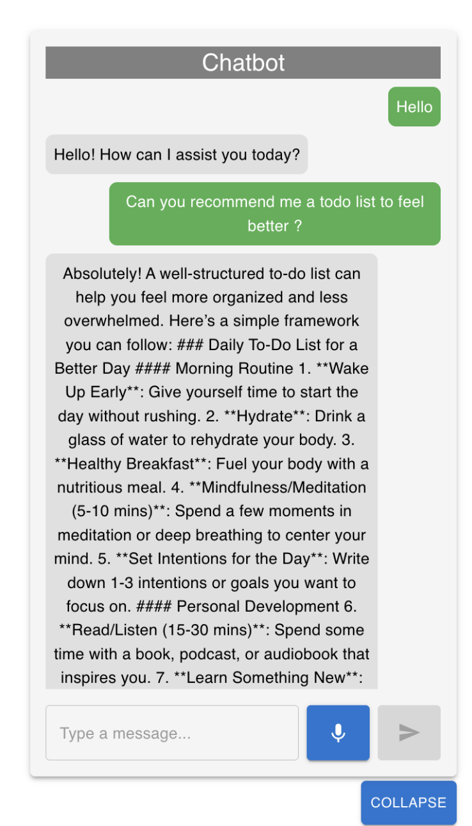
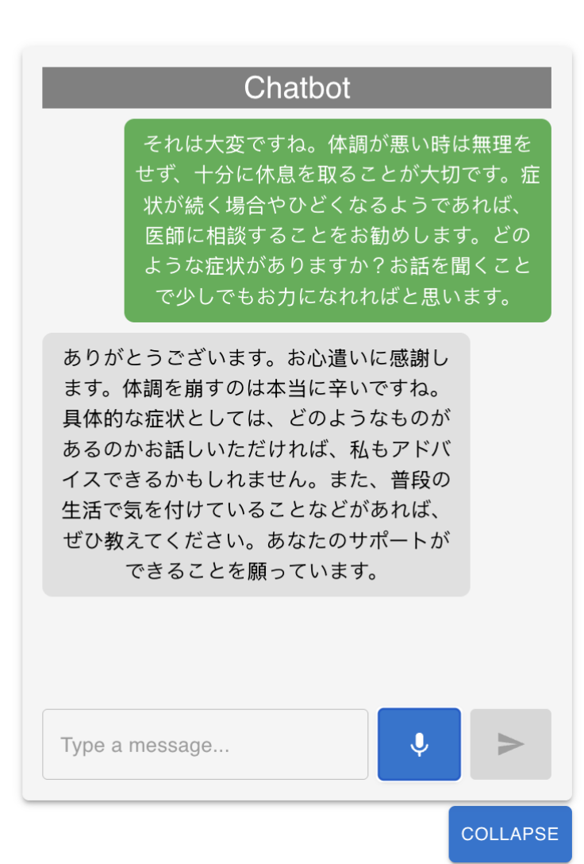
MVP1 : Demo

Slide 7
Azure Kubernetes Service (AKS)
Use multi-zone clusters, multiple node pools, and auto-scaling for resilience.
Ensure pod HA with replicasets, anti-affinity rules, and health probes.
Use Azure Load Balancer, Ingress, and Application Gateway(TBD) for traffic distribution.
Azure Cosmos DB
Enable multi-region writes and automatic failover for redundancy.
Optimize partitioning and autoscale throughput (RU/s) for performance.
Secure data with geo-redundant backups and private endpoints.
Docker Services
Deployed with Load Balancer.
Use restart policies, health checks, and persistent storage (Azure Files/Blob Storage).
Monitor services with Azure Monitor & Application Insights. (TBD)
For critical applications, integrate AKS + Cosmos DB + Docker with multi-region failover & automated recovery. Regularly test disaster recovery plans to minimize downtime.

Slide 8
Performance & Latency
Response Time:
95% of chatbot responses should be within 1–2 seconds.
P99 response time should not exceed 3 seconds under normal load.
Database Latency:
Read latency: <10ms (for single-region Cosmos DB queries).
Write latency: <15ms (assuming optimal Request Units (RUs) allocation).
Network Latency Considerations:
Since AKS and Cosmos DB are in different regions, network latency should not exceed 200ms.
Consider enabling Cosmos DB multi-region read replicas to reduce latency.
Throughput:
Should handle 100 concurrent users with an average of 5 requests per second per user → 500 RPS total.
Cosmos DB should be provisioned with autoscaling Request Units (RU/s) based on peak traffic.
2. Scalability
AKS Auto-Scaling:
Horizontal Pod Autoscaler (HPA) should scale API pods based on CPU (60-70% threshold) and memory usage.
Cluster Autoscaler should add nodes when necessary.
Cosmos DB Autoscaling:
Enable autoscale throughput with a minimum of 10,000 RU/s and scale up as needed.
WebSocket/Long Polling Consideration:
If the chatbot uses WebSockets, AKS should be optimized for long-lived connections.

Slide 9
3. Security & Compliance
Data Protection:
Use Azure Private Link to secure Cosmos DB connections.
Enable VNET integration for AKS to ensure no public exposure.
Encryption:
All API traffic must be secured using TLS 1.2+.
Data at rest must be encrypted with AES-256 in Cosmos DB.
Authentication & Authorization:
Use Azure AD for authentication and enforce RBAC for Cosmos DB and AKS.
API access should be protected using OAuth2.0 & JWT-based authentication.
4. Availability & Reliability
Uptime SLA:
AKS: 99.9% availability
Cosmos DB: 99.999% availability
Failover Strategy:
Use Cosmos DB multi-region replication (e.g., a read replica in a closer region).
AKS should support rolling updates with zero downtime.
Disaster Recovery:
RPO (Recovery Point Objective) ≤ 15 min (backup snapshots for Cosmos DB).
RTO (Recovery Time Objective) ≤ 30 min (redeploy AKS with automation if needed).

