Slide 1

HTML
Hyper Text Mark-up Language

Slide 2

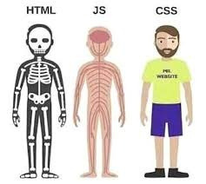
WHAT IS A WEBPAGE?
A webpage is a single document or page that can be displayed in a web browser
A web page is made up of three main components. HTML, CSS and JavaScript.
HTML is like a skeleton of a human body. It gives structure.
JavaScript(JS) is the brain and muscles, it controls the activities in a web-page.
CSS is the decorative clothes, it beautifies the webpage.

Slide 3
WHAT IS HTML?
HTML, or Hyper Text Mark-up Language is language used to make websites. It is a skeleton of a webpage.

Slide 4
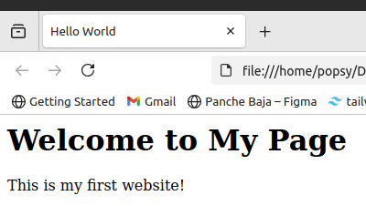
EXAMPLE CODE
<html>
<head>
<title>Hello World</title>
</head>
<body>
<h1>Welcome to My Page</h1>
<p>This is my first website!</p>
</body>
</html>

Slide 5
HTML TAGS
HTML tags are the building blocks of HTML.
They always are in between < and >
<p>
This is a paragraph.
</p>
<h1>
This is a heading.
</h1>

Slide 6
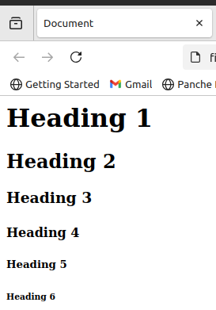
HEADING TAGS
Headings are html tags that are used to define headings. It go from h1, the biggest text to h6, the smallest text.
<h1>This is a heading1. </h1>
<h2> This is heading2. </h2>
<h3> This is heading 3. </h3>
.........
<h6> This is heading 6</h6>

Slide 7

ADDING IMAGES TO YOUR WEB-PAGE
<img src=” PATH_TO_YOUR_IMAGE_FILE ” alt=”ALT_TEXT” >
The ‘img’ tag in html displays an image in your website. Notice how we don’t have a </img> tag.
<img src="cute-bag.png" alt="cute-bag">

Slide 8
LISTS IN HTML
There are two types of lists: Ordered list and Un-ordered lists

Slide 9
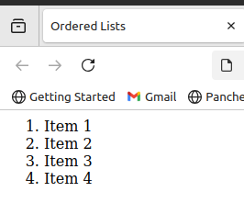
ORDERED LISTS
If the lists are in an order, they’re ordered list. It is denoted by the ol tag. Inside ‘ol’ tag, There is another tag, “li” used to show list items
<ol>
<li> Item 1 </li>
<li> Item 2 </li>
<li> Item 3 </li>
<li> Item 4 </li>
</ol>

Slide 10
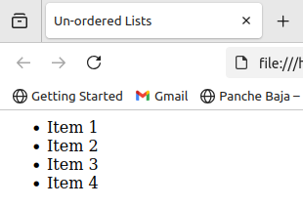
UN-ORDERED LISTS
If the lists are not in an order, they’re nu-ordered list. It is denoted by the “ul” tag. Inside which there is another tag, “li” used to show list items
<ul>
<li> Item 1 </li>
<li> Item 2 </li>
<li> Item 3 </li>
<li> Item 4 </li>
</ul>

Slide 11
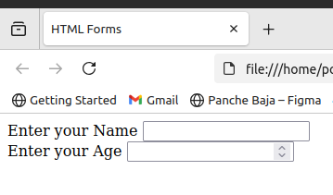
FORM TAG
Forms in HTML collect information from users. Form tag has other tags inside of it, which takes data from users.
<form>
<label for="name"> Enter your Name </label>
<input type="text" id="name">
<br>
<label for="age"> Enter your Age </label>
<input type="number" id="age">
</form>

Slide 12
LABEL AND INPUT TAGS
The label tag is used to, tell users what each input field is for.
The input tag is used to let the user type something or to select an option.
They are both usually used inside the <form> tag.
<form>
<label for=”username >Username: </label>
<input type=”text” id=”username”>
</form>

Slide 13
TODAY’S TASK
MAKE A PERSONAL PORTFOLIO WEBSITE
LET’S CODE TOGETHER

