Slide 1
Smart Web Crawler for Semantic Search Engine
Guided by :-
Mr. S Ganesh Kumar
Submitted by :
Prashant Bana – RA1411003010766
Saurabh Baishnab - RA1411003010757

Slide 2
Overview
Abstract
Introduction
Innovative Idea of the Project
Purpose of the Project
Scope of the Project
Present System
Proposed System
Hardware and Software Requirements
References

Slide 3
1. Abstract
There is a concept of Semantic Web that is an extended version of the existing Web. The main added value of such an extended web is standardization of a way of expressing the relationships which allows computers to understand the information and process it in a way commensurate to its meaning.
The primary standards for Semantic Web are RDF (Resource Description Framework), OWL (Ontology Web Language) and SPARQL (SPARQL Protocol and RDF Query Language).

Slide 4
2. Introduction
Semantic Web amalgamates the classes and the relationships thus making the search results more precise to the users need .
Using Semantic Web technology we aim to make a search engine particularly for restaurants. With the help of Web Ontology language the relations can be described to a particular search in a much more precise manner .

Slide 5
Introduction ..
Furthermore we would like to extend the search engines capability to a more generalized area of search .

Slide 6
3. Idea of the Project
Existing System of Semantic Search Engine requires a web crawler that goes around the internet collecting and storing data in a database for further analysis and arrangement. The process of web crawling involves gathering pages from the web and arranging them in such a way that the search engine can retrieve then efficiently. .
One of the main drawbacks in Semantic Search Engines is that of Intelligent Content Scraping.

Slide 7
4. Purpose of the Project
We aim to make an efficient and smart web crawler which will provide data to the Inference Engine of the Search Engine .
The primary purpose of the project is to make a crawler that can provide text files to the Semantic Search Engine. The text files are meant to be the input for the Search engine which will try to analyze the data and extract meaningful concepts from the data and store it in a database.

Slide 8
5 .Present System
System Architecture
  A crawler program collects the web pages on the Internet with its semantic mark (RDF label) and the corresponding ontology which is described in an OWL document in the Internet.
  The collected web pages are transported to a web page database to be stored for the use of future retrieving URLs and corresponding web pages.

Slide 9
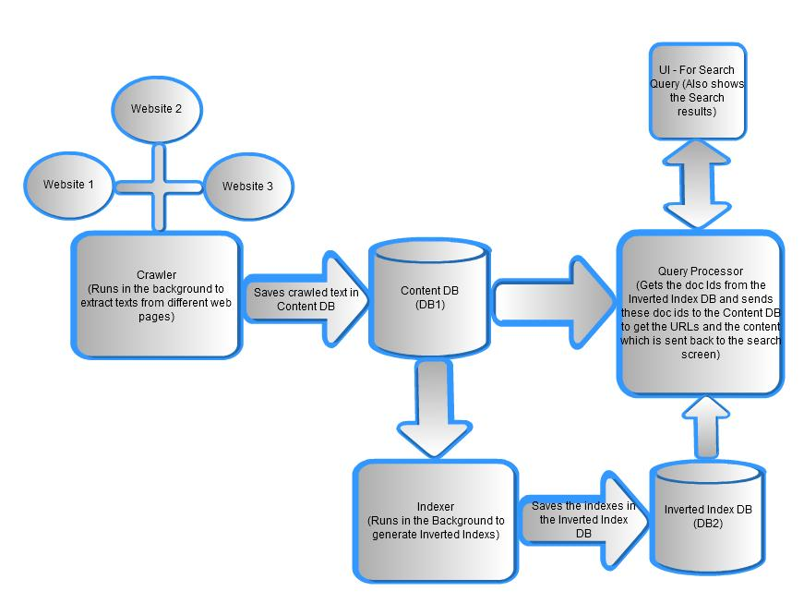
Continued ..

Slide 10
6. Proposed System
Crawler: Required if data needs to be found and accessed in a domain specific way before it can be integrated. Implements automatic discovery and retrieval of data. 35% implement a crawler.
Natural language processing or expression matching to parse search results or other web pages can be employed. The crawler can be active once if data is assumed to be static or continuous (76%) if new data needs to be discovered.

Slide 11
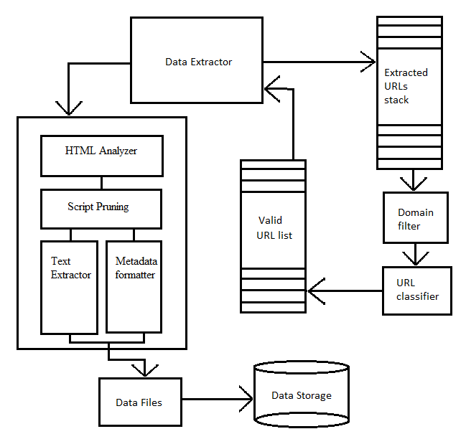
6.1 System Architecture of Smart Web Crawler

Slide 12
Components of Proposed System
Data Extractor
  The data extractor is the component of the crawler that in the first iteration gets the URL from the user and uses the URL to access the remote server on which the URL is hosted.
Extracted URL Stack
  The Extracted URL Stack stores the URLs that the Data Extractor finds on the pages that it extracts. The URL stack is actually a queue data structure. So it has a first in first out (FIFO) mechanism.

Slide 13
Continued...
Domain Filter
  Domain Filter checks whether the URL it gets from the URL stack belongs to the given domain or not. This is necessary to restrict the crawler to the specified domain
URL Classifier
  The URL Classifier is the component that checks whether the URL is a useful URL or not. The URLs that the extractor extracts will contain all kinds of files like jpeg, css, img, js, etc. These files are useless to crawl as they will not contain any text data.

Slide 14
Continued...
Valid URL List
  The Data Analyzer is the component that is responsible for processing the data extracted by the data extractor. This Data Analyzer gets raw data from the extractor and processes it to get some meaningful text information. This has four important sub components The HTML tag Analyzer, the Java Script pruner, the Text Extractor and the Metadata Formatter .

Slide 15
Continued...
HTML Tag Analyzer
  An HTML page contains a lot of HTML tags which contain information that is necessary to format the HTML page and makes it render properly on the browser. But all those tags contain information that are unnecessary for the data analyze
JavaScript Pruning
  The Java Script that is left over in the data after all the tags are removed is filtered from the data in this component. This component scans the script elements from the data and removes them. The residual data sent to the Text Extractor.

Slide 16
Continued...
Text Extractor
  This component extracts important text data from the body part of the HTML page. We internally parse the data to a parse tree using the BeautifulSoup python module. From this parse tree we extract all the paragraph tags that are in the body of the HTML page. We filter texts from all the remaining tags that contain texts.
Metadata Formatter
  This component also utilizes the parse tree of the html tags and tries to convert the HTML page into a fixed format which is a requirement of the project. It re-formats the contents of the HTML page. This component will create a separate text file for each URL .

Slide 17
Continued...
Text Files
  The text files contain data from each URL from the text extractor. These text files serve as input to the Concept Based Semantic Search Engine. They are stored on the hard disk at a location known to the Semantic Search Engine.

Slide 18
9. References
A Smart Web Crawler for a Concept Based Semantic Search Engine by Vinay Kancherla.
A Relation-Based Search Engine in Semantic Web by Yufei Li , Xiaotao Huang , Yuan Wang.
Bootstrapping Ontologies for Web Services by Aviv Segev and Quan Z.Sheng.

Slide 19
CONCLUSION
THANK YOU

